Slide 1
Intro Slide Title 1
Are we nearly there yet?
Liz Marr
26th April 2023

Slide 3
“HE systems in the UK today are loaded against students from the lowest socio-economic groups and [that ] the policies designed to redress the bias are themselves biased, reflecting predominantly middle class values.”
“Real educational opportunity can only be achieved by …a completely different stance…that values all contributions equally, respecting the insights that different backgrounds and experiences offer, rather than trying to make us all middle class.”
(Hayter and Paczuska, 2002)

Slide 4
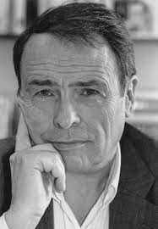
Pierre Bourdieu

Slide 5
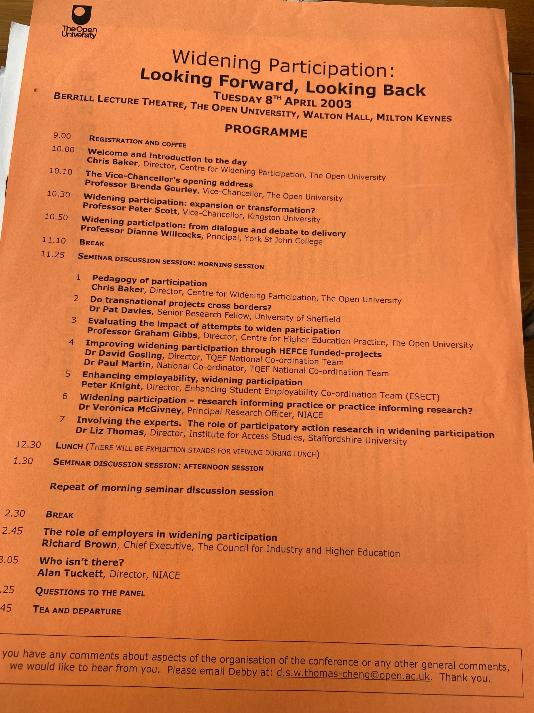

Slide 6
2010
“It is obvious that the current policy to increase participation in higher education has led to too many students attending who are not suited to studying at university level. And, as a consequence, standards fall.
The crisis in university funding could be solved overnight by reducing participation to 20 per cent (from the current level of 43 per cent). Standards would rise, staff morale would rocket, and engaged students would get the education they deserve.”

Slide 7
What is the University?
It is an asylum – or what do they call them now? – a rest home for the infirm, the aged, the discontent and the otherwise incompetent. Look at the three of us - we are the University.
From ‘Stoner’ (Williams 2012)

Slide 8
This Photo by Unknown Author is licensed under CC BY-SA-NC

Slide 9
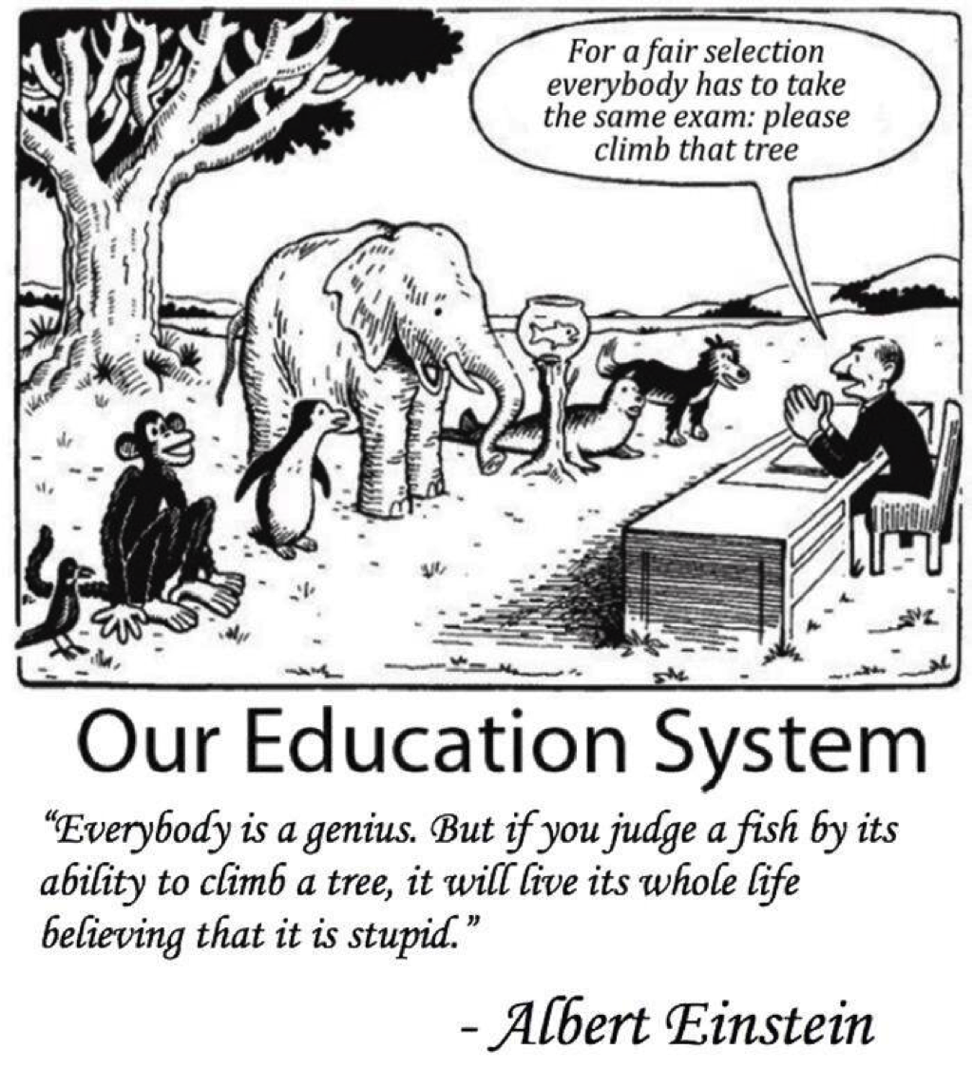

Slide 10
How it was
Lectures
Seminars/Tutorials
Essays / assessments
Exams
Reading
Labs/studios
This Photo by Unknown Author is licensed under CC BY-NC-ND

Slide 11
Creative Destruction? How it is now
Access to HE Diplomas
Foundation Years/Programmes
Foundation Degrees
Distance Learning
MOOCs
Microcredentials
Stackable quals
Students as partners
Inclusive curriculum
Mentoring

Slide 12
The real market in higher education
The cost of entry:
Fees/Funding
Prior qualifications
Social/cultural capital
The value on exit:
Credentials
Enhanced capitals

Slide 13
Paradigm shift? How it could be
An educational system should provide all who want to learn with access to available resources at any time in their lives; empower all who want to share what they know to find those who want to learn from them; and finally furnish all who want to present an issue to the public with the opportunity to make their challenge known.
Illich (1975)

Slide 14
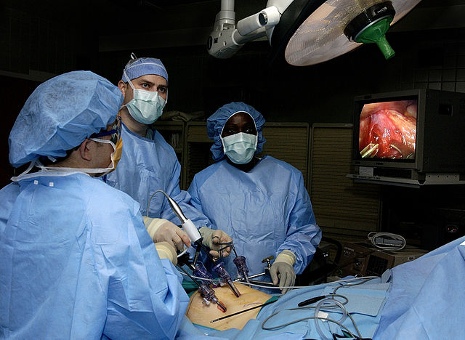
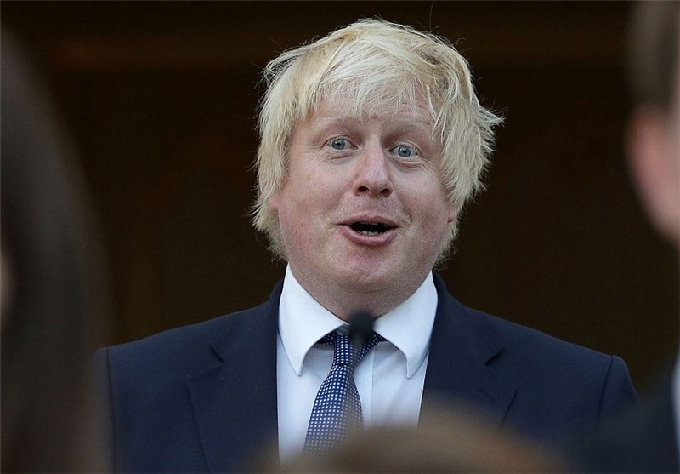
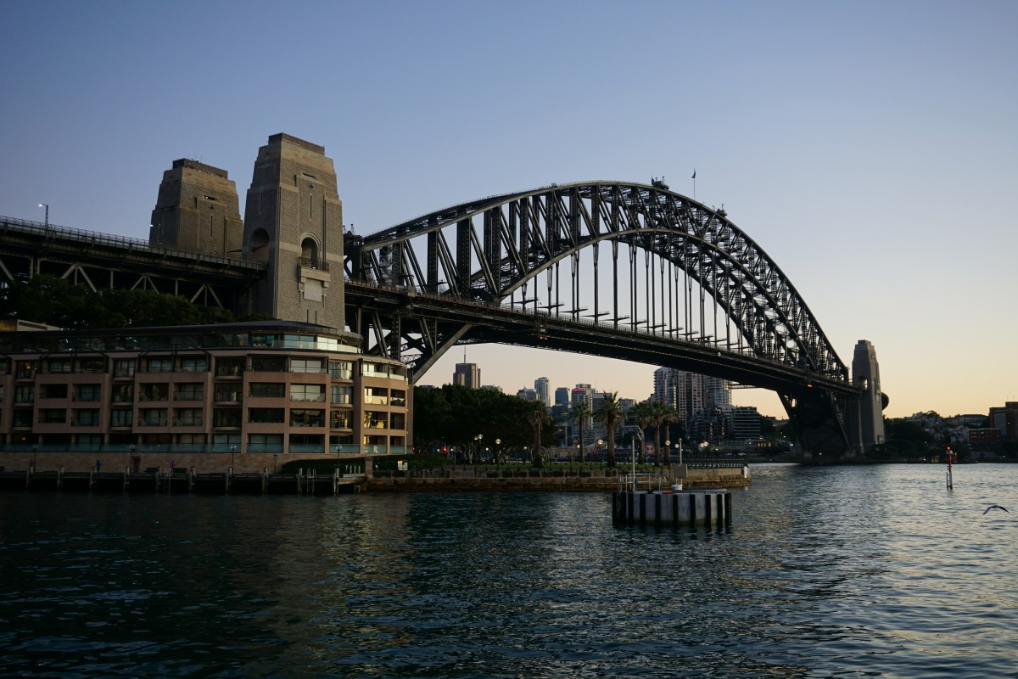

Slide 15
This most reactionary of British institutions may yet be forced to waken from the sleep of ages.
Simon Jenkins, The Guardian, 25/04/23

Slide 16
Slide Title 30
Thank you

Slide 17
Slide Title 31

