Slide 1
Inclusive Curricula and Professional, Statutory and Regulatory Bodies
Morag Duffin – Head of Access and Student Success

Slide 2
Contents
Challenges of working with PSRBs
Challenges of professional Law programmes
Addressing inequalities within the professions
What can we do?

Slide 3
PSRBs (Professional, Statutory and Regularity Bodies)
Solicitors Regulation Authority
Bar Standards Board
General Medical Council
British Psychological Society
Institution of Mechanical Engineers
etc

Slide 4
What are the challenges you’ve faced when working with PRSBs? https://padlet.com/moragduffin/challenges-of-working-with-psrbs-hahk7zu9pqemgt0l

Slide 5
Challenges
Content stipulated by PSRB through accreditation
Applied as opposed to theoretical so less opportunity for discussion
Assessment stipulated by PSRB and/or directly carried out by PSRB

Slide 6
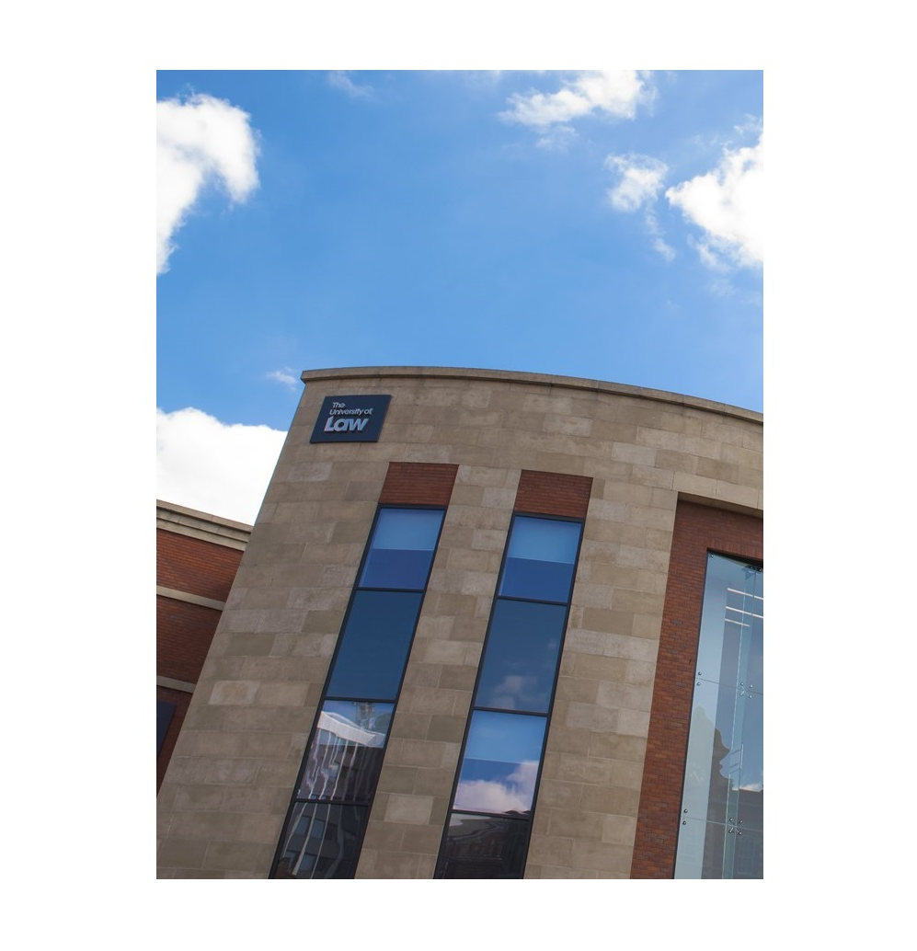
Law as a case study
Specified content
Sheer amount of content
Specified assessment format (e.g. MCQs)
External assessment (unknown results and awarding gaps)

Slide 7
Inequalities within the professions
Underrepresentation generally and/or in senior roles within the profession
Law and legal system built on historical precedent
Preparation for the workplace: traditions and practices (challenge vs support)
CSCS project – complications around negative portrayals

Slide 8
What can we do? https://padlet.com/moragduffin/what-can-we-do-ohj4wrqoa0m3zq2u

Slide 9
What can we do?
Universal design for inclusive learning
Delivery of teaching
Monitoring of provision and encouraging feedback
Allowing space for theoretical discussion within prescribed content
Developing theoretical understanding outside of the curriculum
Co-creation with students
Collaboration with other HEIs
Engagement with PRSBs

Slide 10
Any questions?

