Slide 1

Towards Accessibility in Digital Electronics for the Visually Impaired
A b-learning experience
Jorge Pérez-Martín
Alejandro Rodriguez-Ascaso
Félix de la Paz

Slide 2
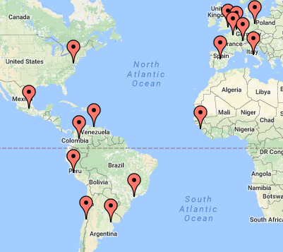

UNED: Universidad Nacional de Educación a Distancia
Among the biggest campus in Europe
230,000+ students (150,000 HE students)
28 Undergraduate programs
75 Master programs
20 PhD. programs
1,400 lecturers
7,000 tutors
600,000+ personalized exams a year
60 study centres, + 15 abroad

Slide 3




UNIDIS
Disabled Students Unit at UNED
Offering assistance to +7,000 students
  Support during registration
  Adapted exams: in collaboration with external stakeholders, e.g. ONCE
  Day-to-day assistance to access the university services

Slide 4
Fundamentals of Digital Systems: learning objectives
Foundations of digital information: binary representation and Bool algebra
Analysis and synthesis of:
  Combinational circuits
  Sequential circuits
Foundations of computer memories

Slide 5
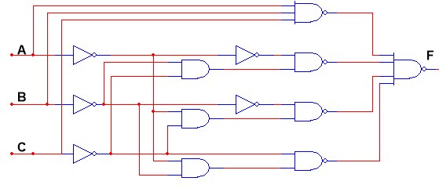
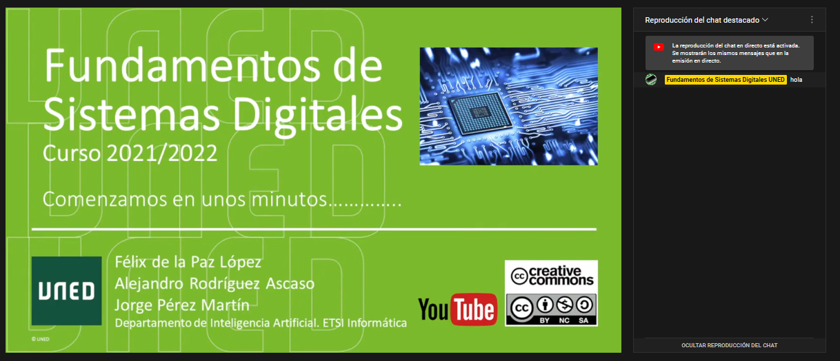

Fundamentals of Digital Systems: materials
Mathematical content with complex graphical representations
$\overline{\overline{\left(\overline{B}+\overline{C}+D\right)+}\overline{\left(\overline{A}+\overline{C}+D\right)}}$
Schematics
Live YouTube sessions
Circuit simulator

Slide 6
Accessibility challenges for the visually impaired
Perceiving and exploring complex, bidimensional information
Producing Maths expressions, schematics, diagrams
Operating circuit simulation software
Understanding & Learning: So far, mostly based on visual learning style

Slide 7





Enablers, partners and resources
UNIDIS
ONCE Centre for Educational Resources (CRE)
WCAG 2.1 W3C
Other standards like MathML
(and MathJax for Chrome support)
Commitment from the teaching staff

Slide 8
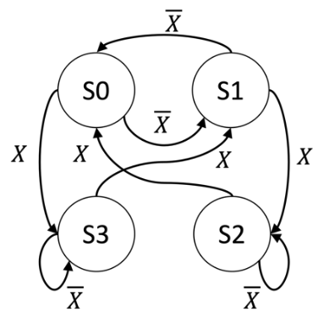
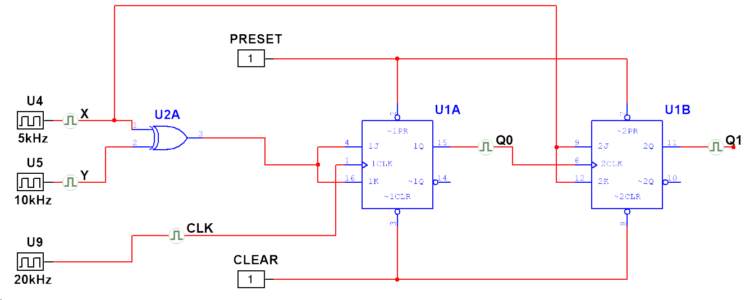
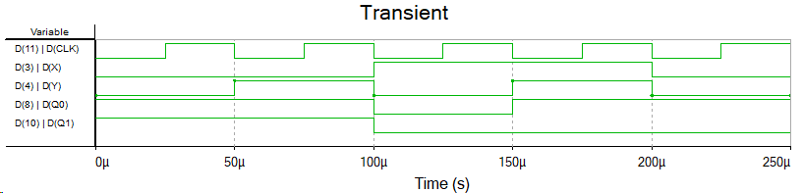
Materials and adaptations of the VLE and resources
Assignments and exam materials (34 exams)
  W3C guidelines to provide accessible HTML contents (with JavaScript)
Mathematical content using MathML
Images of signals, schematics, and state transition diagrams
Is alternative text a suitable learning accommodation for complex images?

Slide 9
Image adaptations process (from digital to tactile)
Select the most representative contents and exercises
Remove non-essential information for optimising tactile perception
ONCE expert redesigns the image and produces the digital version for the tactile design, including text in Braille
Revision of the final design by the teaching staff
  If any problems are detected in the design, go back to step 2
ONCE produces the tactile materials and send them to the student by post mail

Slide 10
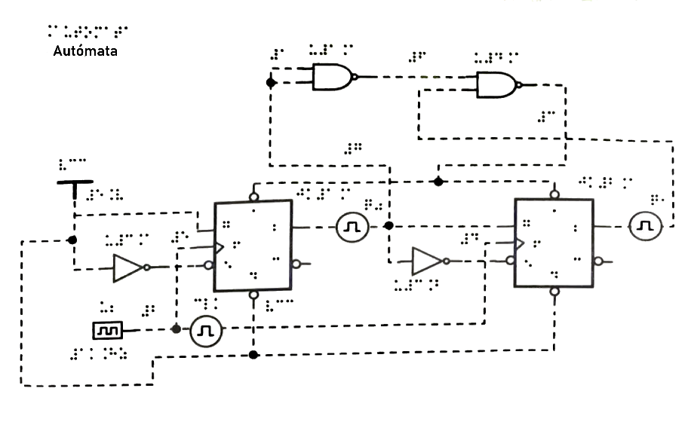
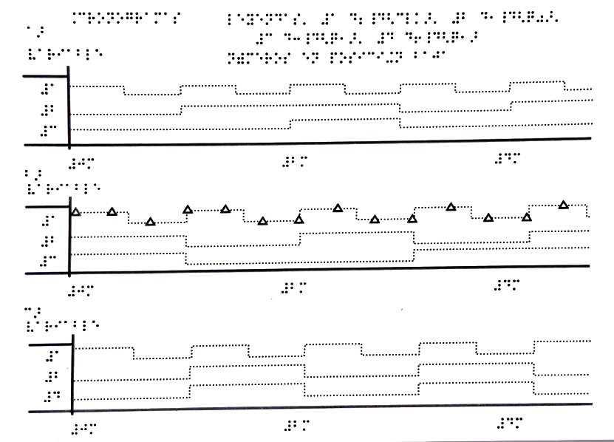
Student’s perspective
She receives the materials:
  Assignment, as an accessible digital document in MSWord or HTML
  Tactile schematics and diagrams
She makes an attempt to
  Read & understand the assignment and
  Draft her response, including mathematical expressions, tables, etc.
She meets the teaching staff in a one-to-one Teams session

Slide 11

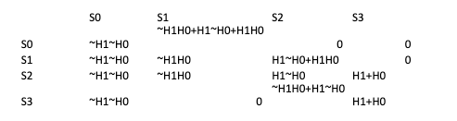
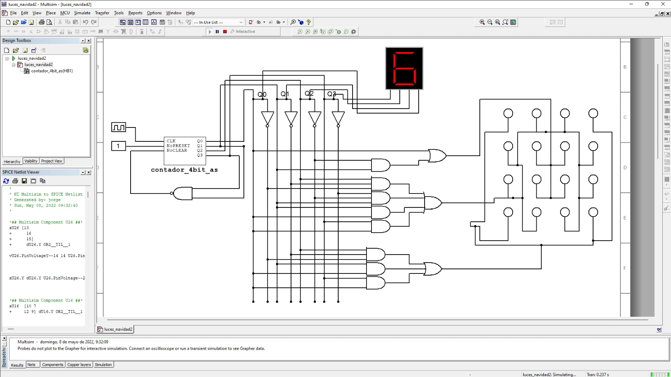
Working with the student
Meetings through Microsoft Teams
  Solve student’s doubts
  Understand student’s (unique) approach to produce the response, and her personal needs and preferences
Once the student has finished the assignment work
  Help her to understand how her work would run in the circuit simulator
  Ask her to reflect on that, and to include her reflections in the assignment report

Slide 12


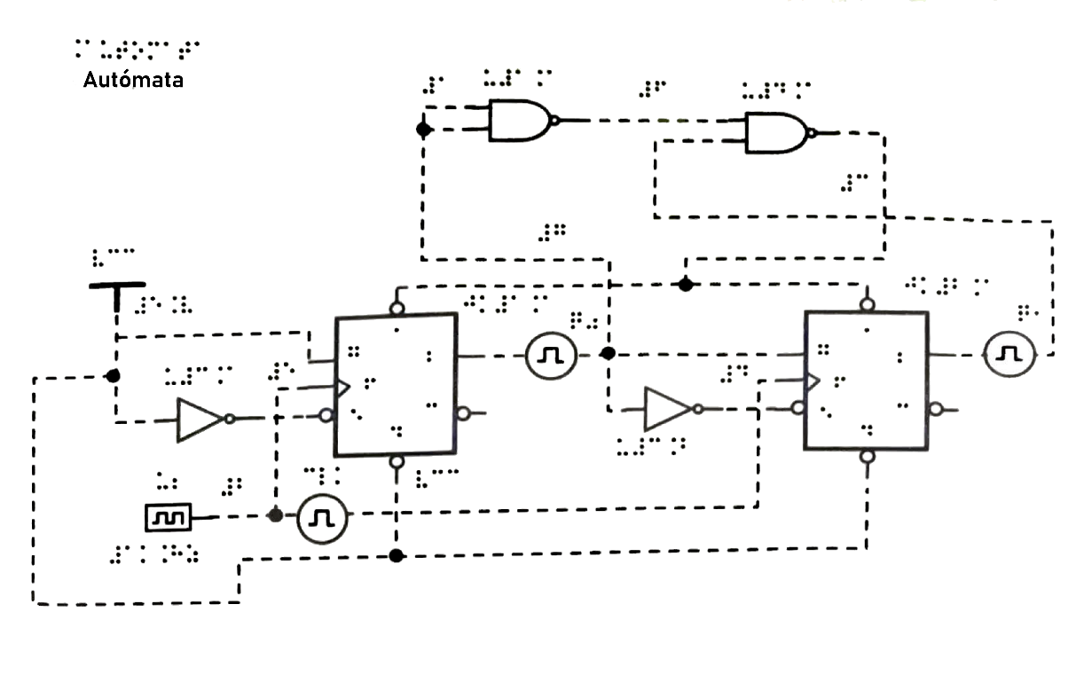


The exam
UNIDIS – Exam adaptations
New adaptation based on digital materials and tactile sheets
  Accessible Word document (statement, maths, etc.)
  Tactile sheets produced in collaboration with ONCE

Slide 13





Remaining challenges (1/2)
Adapt all the textbook images
Improve the accessibility of the video material through
audio description and detailed scripts
Check the accessibility of YouTube live stream chat
Find an accessible circuit simulator
Ensure the accessibility of communication channels (Microsoft Teams)

Slide 14

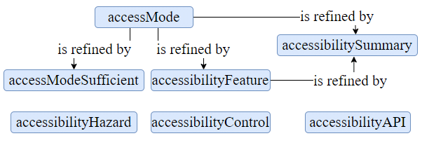
Remaining challenges (2/2)
Establish communication processes with the student since the very beginning of the module
Ensure that the exam equipment has the setup and support products suiting student’s needs
Formally defining accessibility barriers of the subject and their solutions
(by using standards like Schema.org)

Slide 15

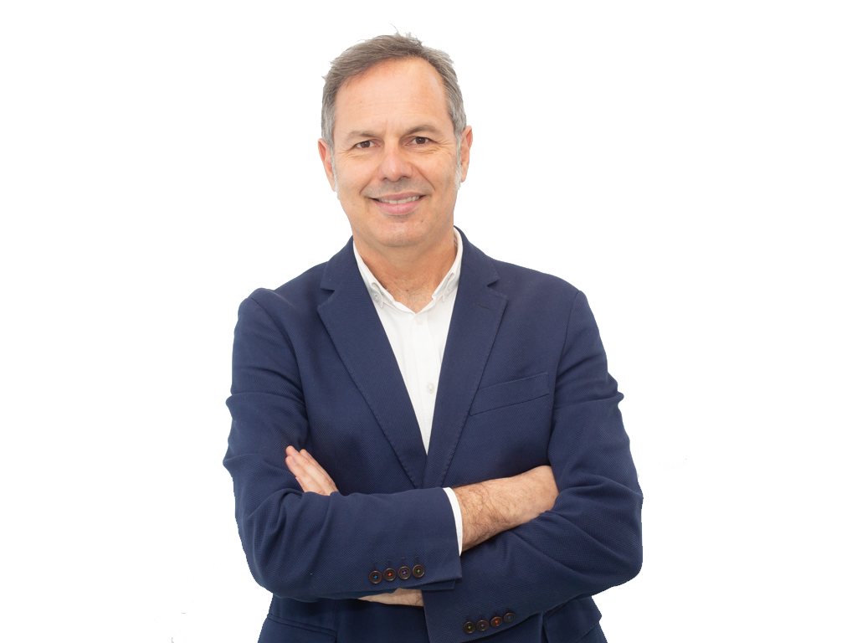
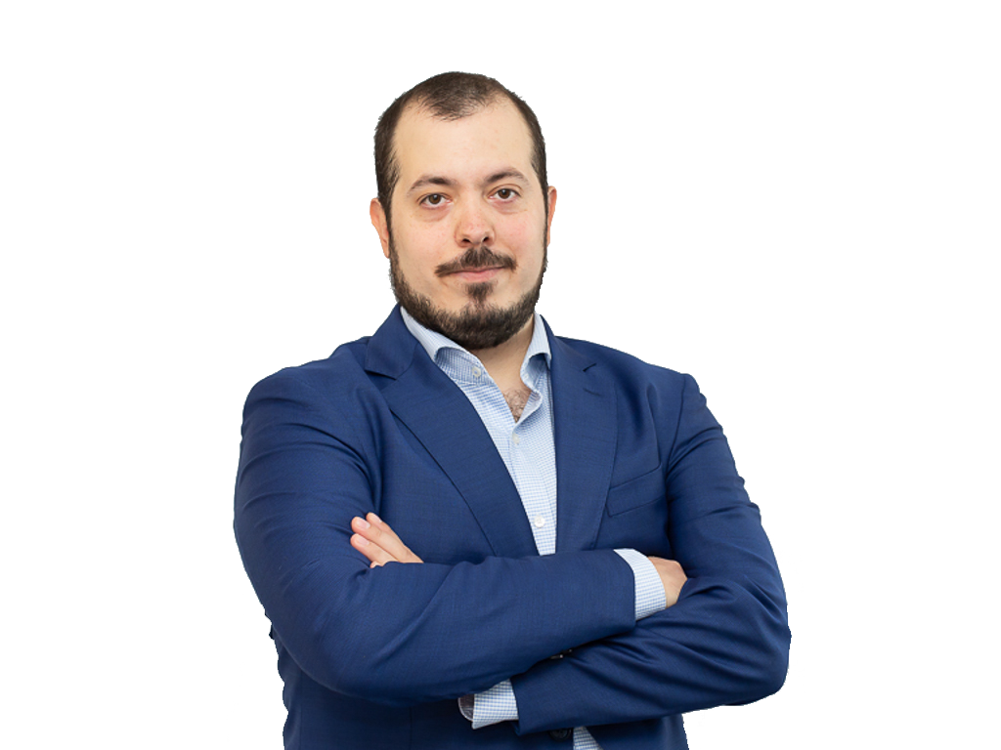
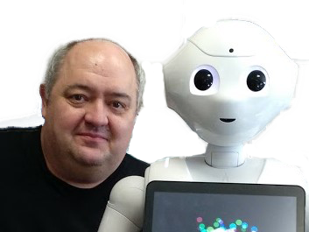
Thanks for your attention

