Slide 1
Shaping the OU Websites and systems of the future with student research.
APS 7th International Biennial Conference
Jade Matos Carew, Kirsty Baker & Paul Hambidge
Accessibility and Usability Evaluation (AUE)
26th April 2023

Slide 2
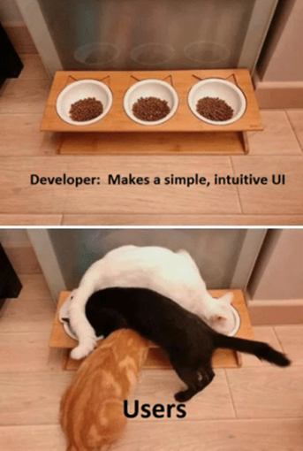
Why do we need a panel?
The AUE team is responsible for looking after the digital accessibility and usability of our centralised, student-facing websites and systems.
User-centered design and the student voice is at the heart of everything we do.
The panel allows us to test new features, components, and designs, and observe and analyse real student behaviour rather than make assumptions.
We can then feed this research into an iterative design process and evidence the decisions we make when developing and designing.
Image credited from: https://www.reddit.com/r/ProgrammerHumor/comments/dyb3l1/every_time_we_have_users_test_new_features/

Slide 3
AUE Student Panel
The AUE student panel is our pool of students for user-testing. When we recruit for projects, we recruit from there.
Established in September 2022.
246 student panel members.
68% have declared a disability or condition.
Non-panel recruitment = 3-4% of students contacted replied.
Recruitment from student panel invites= 33%* of students replied (*disclaimer)

Slide 4
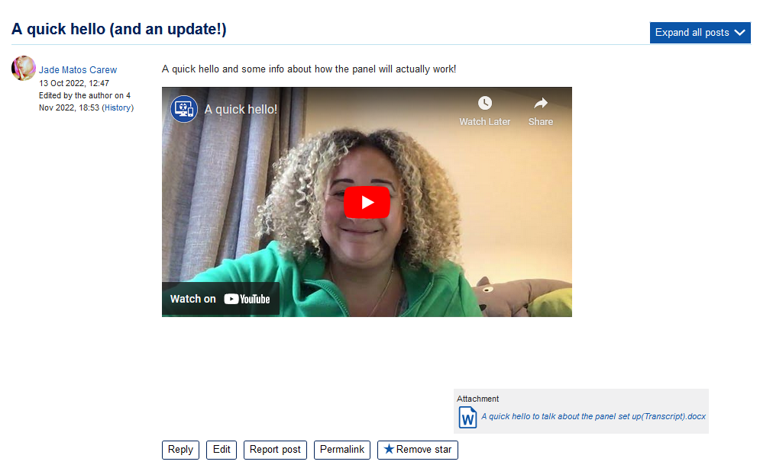
Looking after our student panel members
A hands-on approach to communication and interaction

Slide 5
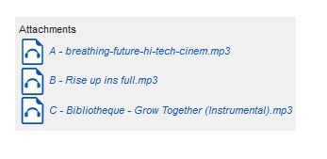
Quick, bite-sized research
Quick activities such as polls, short questions, surveys, allow us to gather opinions in an informal and relaxed atmosphere.
This can provide rich data and allow for interaction with us and communication between panel members.
The activities are enjoyable and also offer an opportunity for our students to learn and feel connected to one another.

Slide 6
Creating tasks
Task writing for 1:1 moderated user testing can be tricky because you don’t want to influence the participants behaviour. They might do things completely differently – a tool or setting may not even occur to them.
You could ask “Can you find the accessibility settings?”
Instead we asked “Imagine you are in a tutorial and need to adjust the font size within Adobe Connect to see the words better. Can you show me how to do this?”
This way we determine:
How they approach the task (keyboard shortcuts/zoom/full screen/settings).
Whether they know it would be in the settings.
If they can find the settings.
How clear the process is.

Slide 7
Creating tasks - considerations
Most tasks we write are scenario based in some way around a likely situation. This comes with risks such as participants understanding of the scenario, the participants mental load and tongue twisters for the facilitators .
Understandably a time-consuming process to write the tasks.
We had a diverse range of abilities and experience so our task lists consist of subtly different routes (more follow-up questions, questions and tasks we could drop etc.).
Sometimes a set-up question is needed for clarity.

Slide 8
Inclusive design
The diverse nature of the OU student body and our student panel means that inclusive design of processes and tasks is crucial.
When recruiting we never book on a first come first served basis and we always ask about any adjustments the participants may need.
We offer flexible test slots when we can, such as evening sessions so people who are busy during the day can still participate.
We post any significant task or question in the chat for the participant to refer back to.
We use plain English.
We give the participant enough time to complete the task and explore.

Slide 9
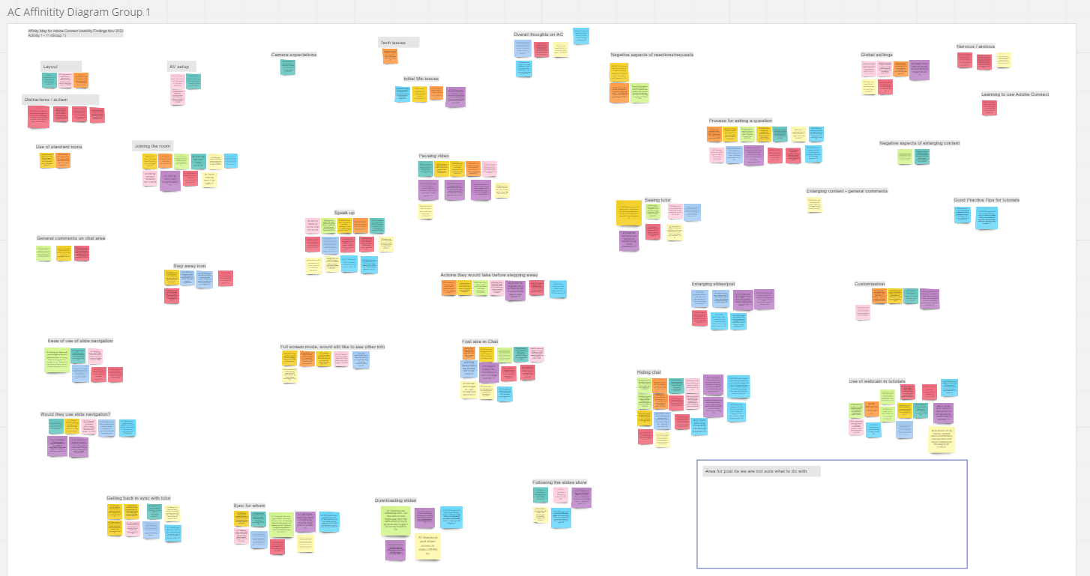
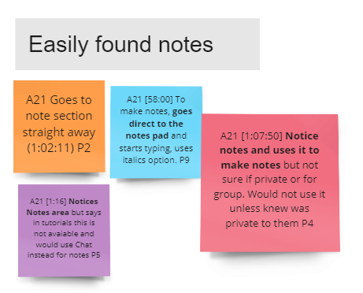
Analysis of results

Slide 10
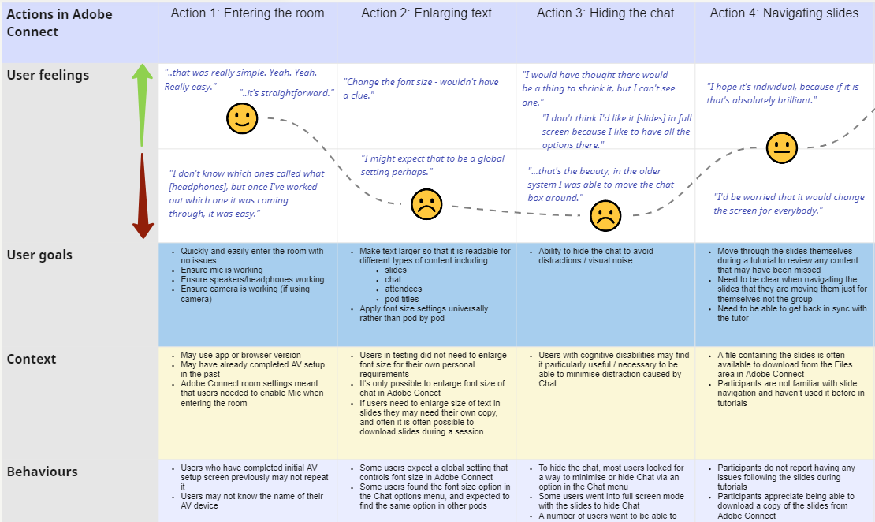
Write up of results

Slide 11
Impact of our research
Image credited from: https://www.pexels.com/photo/water-drop-photo-220213/

Slide 12
Improvements to our websites and systems
Short Term Impacts
Adobe connect guidance & templates
Longer Term Impacts
Recommendations to Adobe
Image credited from: https://www.pexels.com/photo/cheerful-surprised-woman-sitting-with-laptop-3762940/

Slide 13
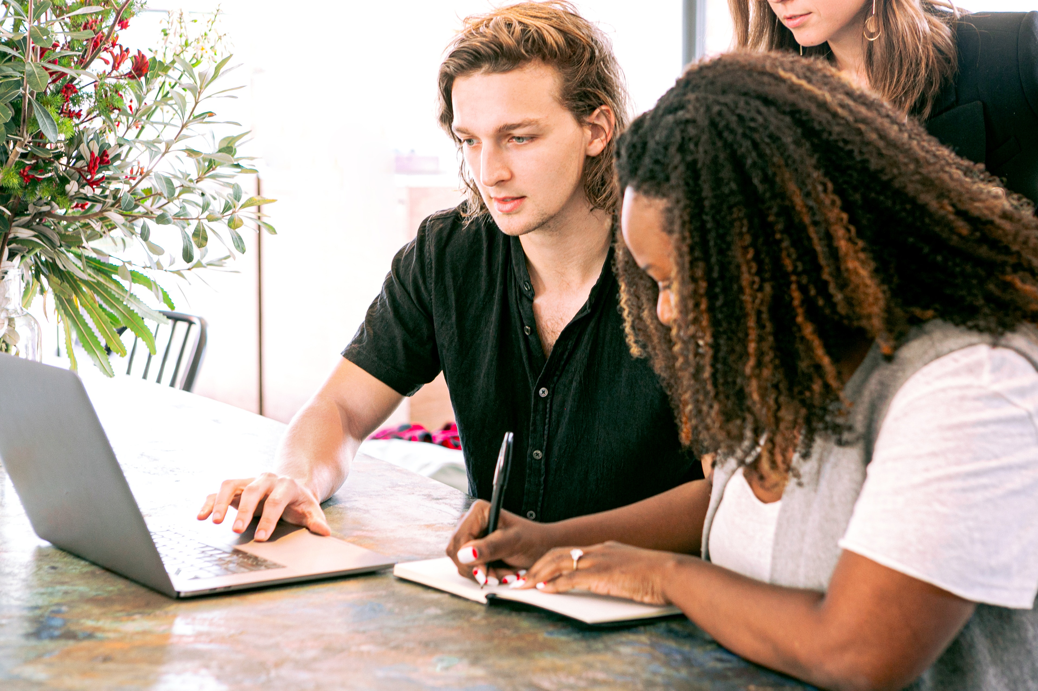
Opportunities for staff to hear directly from students
Image credited from: https://www.pexels.com/photo/man-working-on-laptop-while-woman-takes-notes-3153199/

Slide 14
Positive impacts for students who get involved
“Having this open forum to get feedback on things…you do feel that you can contribute and make a difference. It is a nice feeling. So thank you.”
Image credited from: https://www.pexels.com/photo/woman-sitting-on-concrete-surface-2167673/

Slide 15
Thank you
aue-user-testing@open.ac.uk

