Slide 1
Employability and Student Success:
Virtual Internships for Underrepresented Students
Trinity Western, Flavia Ranzolin, Virtual Interns
Kristen Reid, Catherine Comfort, Faculty of Business and Law
Andrew Potter, Diane Butler, Faculty of Science, Technology, Engineering and Mathematics
26 April 2023

Slide 2
Aims of the seminar
Introductions
Explanation of virtual internships scheme
Experiences of interns
Experiences of supervisors
Findings
Implications for student success, Equality, Diversity and Inclusion (EDI)

Slide 3
Explanation of the Virtual Internship Scheme
Programme Overview/1
Aims to improve and support the progression of underrepresented students and disadvantaged groups into further study or graduate-level employment through virtual work experience
A small-scale pilot of virtual internships supported through ringfenced funding via the university's Access and Participation Plan
Virtual internships were offered to students in underrepresented groups covered by the Plan.

Slide 4
Explanation of the Virtual Internship Scheme
Programme Overview/2
Joint project of the Faculty of Business and Law (FBL) and the Science, Technology, Engineering and Mathematics Faculty (STEM) with the university's Careers and Employability Service (Placements Team)
Initial cohort offered 17 virtual internships, primarily 'university-based', i.e., working within the university setting on a wide variety of faculty projects, which were supervised by university staff
Varying lengths of internships offered over a 4-month period, usually part-time, and paid at the UK's 'living wage
Highly flexible format

Slide 5
Evaluation Study of the Virtual Internship Scheme
Study Overview
Data collected via focus groups and semi-structured interviews
Examined how a 'virtual' internship works for interns and supervisors
Offering flexibility that traditional internships are less likely to have
Building confidence in work and in applying for work
Developing skills in independent working and teamworking
Allows tailoring of experience to meet intern developmental wishes
Particularly important to the intern's success is the coaching/mentoring role of their supervisors

Slide 6
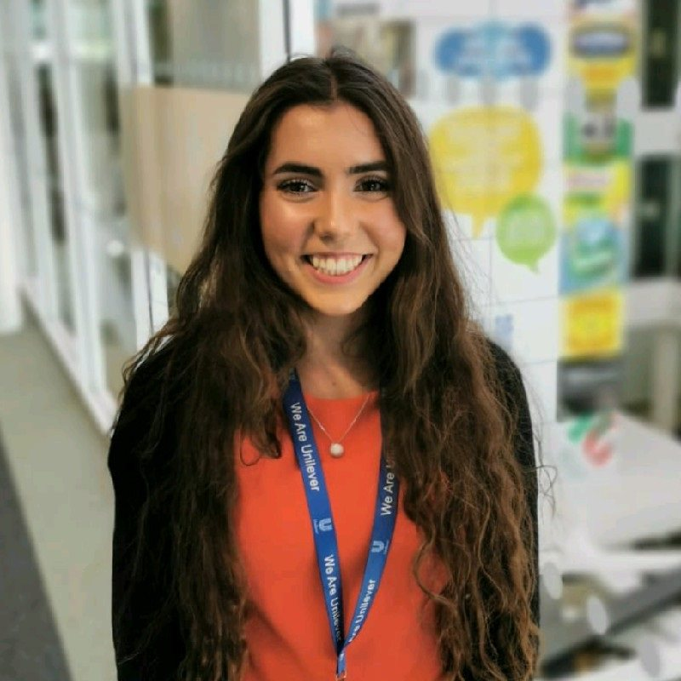
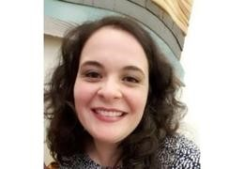
Views of interns
The appeal of the virtual internship scheme
What we did
What we gained from virtual internship

Slide 7
The supervision experience
Student lived experience is valued and valuable
Student experience of studying with OU is very helpful e.g., to suggest how to reach students with information more effectively
Work can be done that otherwise would not be done – ‘real work’
More effort expended, greater the rewards
Linking to professional resources and networks
Reflection on employability skills
Supervisors gain line management skills
Extremely rewarding to see students develop in the areas they wish e.g. confidence, public speaking, survey design.

Slide 8
The Supervision experience
Feedback from interns
The importance of supervisory relationship
How relationship was built/negotiated
Communication
Tips for building virtual relationships

Slide 9
Conclusions and Next Steps
Facilitates participation of students with protected characteristics such as disability or neurodiversity in authentic work
Accessibility and personal circumstances can be taken into account.
Builds confidence to apply for future courses/graduate employment
Enables co-collaboration on projects where student participation (particularly diverse student participation) is hard to get
Proof of concept that internships can be offered successfully within the institution to benefit several agendas
Need to scale up for 2023/4.

Slide 10
Thank you

