Slide 1

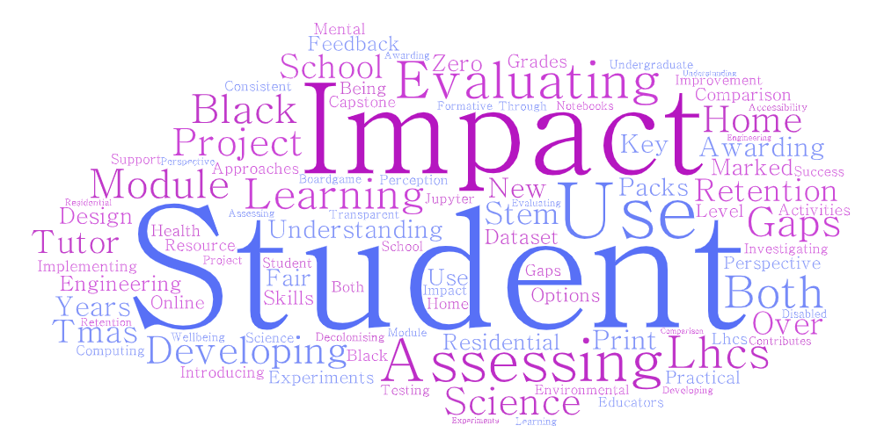

Celebrating the Impact of Scholarship in STEM
Shailey Minocha and Trevor Collins
http://www.open.ac.uk/esteem
@OU_eSTEeM
esteem@open.ac.uk
Notes:
The Scholarship of Teaching and Learning (SoTL) challenges us to critically engage with educational research, systematically investigate our teaching and learning practices, and share our findings for others to review and build upon. In this closing workshop, we will encourage you to consider how scholarship has impacted your teaching and learning, and reflect on the processes you instigated to enrich your practice. We will introduce an impact evaluation framework that we developed for SoTL and share a selection of inspiring impact stories to demonstrate how eSTEeM scholarship projects have enhanced the student experience, improved retention and progression, influenced discipline-based teaching, and facilitated the professional development of project team members. Reflecting on these examples, we will identify some of the environmental and cultural factors that can be barriers and enablers for impact. Through celebrating the ways that scholarship has informed teaching and learning in STEM, we hope this workshop will help identify potential pathways to impact for your scholarship.

Slide 2
Overview
Polls (anonymous aggregated results)
  Experience of scholarship
  Motivation for scholarship
Scholarship of Teaching and Learning (SoTL)
  Role of SoTL for the University
  Role of SoTL for educators
SoTL Impact
  Impact Evaluation Framework for SoTL
  Examples from eSTEeM projects
Barriers and Strategies to facilitate SoTL impact
Notes:
Polls…
1. What experiences do you have of scholarship [select all that apply]
- Scholarship informs my teaching
- I have participated in a scholarship study
- I have participated in scholarship community events
- I have been a member of a scholarship project team
- I have mentored a scholarship project
2. What is your strongest motivation for engaging with scholarship? [select one only]
- To improve the student experience
- To improve student retention and progression
- To improve teaching in my discipline
- As a route to get some publications
- As a route for personal and professional development
- Recognition through promotion or HEA fellowship

Slide 3
Scholarship of Teaching and Learning (SoTL)
Defining scholarship as the Scholarship of Teaching and Learning (SoTL)
  “systematic and ethically reasoned investigation of aspects of teaching and student learning by applying disciplinary knowledge, resulting in reflections and outcomes that are publicly shared for peer-review and for others to build upon” (SoTL BOC – Minocha and Butler, 2021)
Teaching
Scholarly Teaching
Scholarship of Teaching and Learning
Evidence-informed teaching
Evidence-informed teaching made public and open to peer-review
Research
Discipline-Based Educational Research

Slide 4
Role of SoTL for the University
SoTL supports the evidence-informed development of learning and teaching
SoTL enables everyone involved in teaching and learning at the University to understand what works and what doesn't work so well for our students
SoTL provides the opportunity to improve academic practice and to make evidence-based improvements
  For example: Curriculum design and assessment, learning design, student journey, student-informed adjustments to teaching and learning, and institutional-level policies of student support
Without SoTL, policymakers will make decisions without a firm grounding in the classroom-based practicalities and insights of educators and students
(Felten and Chick, 2018)

Slide 5
Role of SoTL for educators
SoTL enables educators to generate research from teaching initiatives
SoTL provides intellectual nourishment for educators and affirms their professional identity
SoTL activity creates synergies between research and teaching, and enables educators to move outside of traditional silos and into new communities that SoTL helps create
Although maintaining both a SoTL and discipline-specific research agenda for educators can be demanding, the rewards could be transformative as SoTL can strengthen the teaching and learning in their disciplines

Slide 6
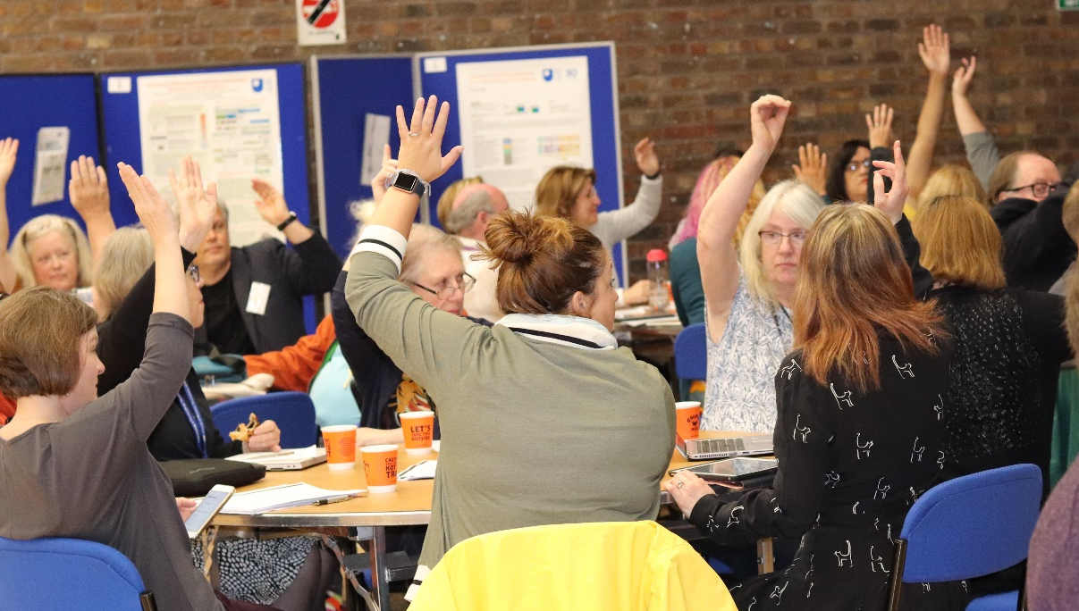
SoTL Impact
Impact implies demonstrable benefits that are directly attributable to that project
  How significant are the benefits of the SoTL project and for whom?
  How far-reaching are the outcomes of the SoTL project?
Evaluation for impact will involve finding out who has benefited from SoTL and how (i.e., collecting evidence of significance and reach)

Slide 7
Impact: Evaluate, integrate and transfer
Maths & Statistics Subject Site
Qualification or Subject Sites in STEM
Diagnostic quizzes
Early start on M140
Early start on S294 + Diagnostic quizzes
Early start on K118 (WELS)
Pilot of OJCs
Online journal clubs (OJCs)
SiSE, S112, S294, SXE390

Slide 8

SoTL Impact Evaluation Framework (IEF)
IEF has 12 impact criteria
  Student experience
  Student retention and progression
  Excellence in teaching
  Discipline-based teaching, research and practice
  Dissemination of project outcomes
  Adoption of project outcomes
  Mutual stakeholder understanding
  Personal and professional development
  Recognition and rewards
  Fostering of SoTL culture
  Financial implications
  Funding opportunities
Example case study: Early start on Introducing Statistics (M140)
Impact criteria | Attributes | Description
1: Student experience | Student engagement with the course content Student satisfaction | Students have identified the benefits in terms of reduction in stress, better time management and a better understanding of how study at the OU is organised.
2: Student retention and progression | Student registrations Student retention rate | Student retention has improved by 2‐3 percentage points between registration and module start. 40 more students passed M140 than would have been expected compared with registration numbers in 2015 and 2016.
3: Evidence-based excellence in teaching | Inform policy development internally at the level of the sub-unit, faculty or University | The project has established that a substantial number of students are keen to take part in an opportunity to start M140 on a more flexible basis prior to the October module start.
Notes:
The IEF is licensed under a Creative Commons Attribution-NonCommercial-NoDerivatives 4.0 International License.

Slide 9
SoTL IEF: Guiding evaluation for impact
Learning and teaching
  What has been the impact on student experience?
  What has been the impact on student retention and progression?
  Is there evidence of excellence in teaching?
Transfer to others
  Has there been an influence on discipline-based teaching, research and practice?
  Have you disseminated the project’s outcomes?
  Have the outcomes of the project been adopted by other educators?
Stakeholder benefits
  Has the project enhanced mutual stakeholder understanding?
  Has the project facilitated the personal and professional development of project team and associated stakeholders?
  Has the project led to the recognition of project team members and other stakeholders?
Cultural and economic benefits
  Has the project helped to foster SoTL culture?
  Has the project had any financial implications?
  Has the project led to funding opportunities?

Slide 10
Learning and teaching
What has been the impact on student experience?
  Student pre-registration; student induction; student engagement with course content (Case study example: Diagnostics Quizzes)
What has been the impact on student retention and progression?
  Student retention rate; student progression (Early Start on M140)
Is there evidence of excellence in teaching?
  Inform policy development internally at the level of the sub-unit, faculty or University (Qualification Study Sites)
Diagnostics Quizzes: The diagnostic quiz guides students about their readiness for a module. The quiz and the personal contact by the tutor/SST team facilitates the induction to OU’s processes. Since, the quiz is tailored to the MST124 content, it provides an early introduction.
Early Start on M140: A greater readiness for study through an early start; reducing registrations on modules where students are not prepared (helps retention and progression).
Qualification Study Sites: SoTL evaluation of subject sites in STEM, produced evidence-based recommendations for improved design and visibility of subject sites in STEM for student retention, employability and engagement with resources.

Slide 11
Transfer to others
Has there been an influence on discipline-based teaching, research and practice?
  Change in the ways in which subject concepts are taught (Maths and Statistics Subject Site)
Have you disseminated the project’s outcomes?
  Number of publications; sharing of novel research methods/strategies for conducting SoTL (Online Journal Clubs - OJCs)
Have the outcomes of the project been adopted by other educators?
  adoption of outcomes internally to improve assessment, curriculum design in the same discipline (Assessment Analytics on S217)
Maths and Statistics Subject Site: Consolidates outcomes of several SoTL projects. The content relates to studying mathematics and statistics effectively, problem solving, and on writing mathematics and statistics.
Online Journal Clubs: Workshops in the LHCS, STEM Faculty’s newsletters, Quality Monitoring and Enhancement Report as ‘best practice’ example, eSTEeM and Advance HE Conferences. OJC user pack giving advice and guidance.
Assessment Analytics on S217: The assessment strategy of a new module, Astronomy (S284) in 2021 has been driven by the experiences gained by Andrew Norton and colleagues on their SoTL inquiry related to quizzes in 2015-2016.

Slide 12
Stakeholder benefits
Has the project enhanced mutual stakeholder understanding?
  Understanding among students and staff
  (Student Co-design of Quizzes)
Has the project facilitated the personal and professional development of project team and associated stakeholders?
  Improved practice or personal knowledge
  (Online Journal Clubs – OJCs)
Has the project led to the recognition of project team members and other stakeholders?
  Career trajectory attributed to SoTL such as promotions; fellowships or membership of professional associations (Several case studies)
Student Co-design of Quizzes: Students reported better understanding of how SoTL leads to evidence-based and research-informed teaching.
Online Journal Clubs: The tutors valued OJC experience for their own development. Feedback suggested experience was transformative for tutoring practice, resulting in tuition becoming more facilitative and student centred (rather than tutor-led).
“I included the findings of my SoTL project in an SFHEA application and promotion to senior lecturer, both of which were successful.” SoTL Project Lead

Slide 13
Cultural and economic benefits
Has the project helped to foster SoTL culture?
  Inspiring others to conduct SoTL
  (Diagnostic Quizzes)
Has the project had any financial implications?
  Effect on costs of modules/programmes
  (Early Start on M140)
Has the project led to funding opportunities?
  Funding for follow-on/new projects based on SoTL project’s success (3D Virtual Field Trips)
Diagnostic Quizzes: Since this project (last 5-6 years) School of Maths and Statistics developed a strong SoTL culture. Outcomes of several SoTL projects have contributed to the design of Maths and Stats subject site to students throughout their journey.
Early Start on M140: Costs involved: programme manager’s time to set up (early start) web site, project leader to develop and administer the programme, and tutor appointments. Administrative effort reduced over time and ongoing costs offset against improved retention (e.g., additional 30 students in 2018).
3D Virtual Field Trips: Virtual Skiddaw led to Google Virtual Reality Research Award (~£100K).

Slide 14
SoTL IEF: Guiding evaluation for impact
Learning and teaching
  What has been the impact on student experience?
  What has been the impact on student retention and progression?
  Is there evidence of excellence in teaching?
Transfer to others
  Has there been an influence on discipline-based teaching, research and practice?
  Have you disseminated the project’s outcomes?
  Have the outcomes of the project been adopted by other educators?
Stakeholder benefits
  Has the project enhanced mutual stakeholder understanding?
  Has the project facilitated the personal and professional development of project team and associated stakeholders?
  Has the project led to the recognition of project team members and other stakeholders?
Cultural and economic benefits
  Has the project helped to foster SoTL culture?
  Has the project had any financial implications?
  Has the project led to funding opportunities?

Slide 15
Barriers to SoTL impact
Narrow focus
Time constraints
Lack of continuity of funding or resources
Change in situation
Delay in dissemination
Not being able to operationalise the outcomes or recommendations
Notes:
Trevor – Introduce and explain each of the barriers before bring up the poll
Discuss the responses in the poll results – implications for eSTEeM / STEM Deanery
Poll…
3. Which barrier to impact do you feel is the most problematic? [select one only]

Slide 16
Strategies to facilitate SoTL impact
Plan for impact from the beginning
Record reflections throughout the SoTL project
Share emerging findings
Share findings strategically
Make research accessible to stakeholders
Be realistic and specific
Keep an open mind about changing established processes and policies
Notes:
Introduce the strategies first then bring up the first poll
Polls…
4. Which strategies have worked for you? [select all that apply]
5. Which strategies would you use in the future? [select all that apply]

Slide 17
Celebrating the Impact of Scholarship in STEM
Shailey Minocha and Trevor Collins
http://www.open.ac.uk/esteem
@OU_eSTEeM
esteem@open.ac.uk
Notes:
The Scholarship of Teaching and Learning (SoTL) challenges us to critically engage with educational research, systematically investigate our teaching and learning practices, and share our findings for others to review and build upon. In this closing workshop, we will encourage you to consider how scholarship has impacted your teaching and learning, and reflect on the processes you instigated to enrich your practice. We will introduce an impact evaluation framework that we developed for SoTL and share a selection of inspiring impact stories to demonstrate how eSTEeM scholarship projects have enhanced the student experience, improved retention and progression, influenced discipline-based teaching, and facilitated the professional development of project team members. Reflecting on these examples, we will identify some of the environmental and cultural factors that can be barriers and enablers for impact. Through celebrating the ways that scholarship has informed teaching and learning in STEM, we hope this workshop will help identify potential pathways to impact for your scholarship.

Slide 18
Case Study References
(Diagnostic Quizzes) Calvert, C., Hilliam, R. and Coleman, J. (2016) Improving retention for all students, studying mathematics as part of their chosen qualification, by using a voluntary diagnostic quiz. MSOR Connections, vol. 14, no. 3, pp. 32-38. Available at https://journals.gre.ac.uk/index.php/msor/article/
view/312 (Accessed 25 June 2021).
(Early Start on M140) A flexible start to M140, https://www.open.ac.uk/about/teaching-and-learning/esteem/projects/themes/supporting-students/flexible-start-m140 (Accessed 25 June 2021)
(Qualification Study Sites) Qualification Study websites: uptake and practice, http://www.open.ac.uk/about/teaching-and-learning/esteem/projects/themes/supporting-students/
qualification-study-websites-uptake-and-practice (Accessed 25 June 2021)
(Maths and Statistics Subject Site) The Mathematics and Statistics Community of Learners, https://www.open.ac.uk/about/teaching-and-learning/esteem/projects/themes/supporting-students/
the-mathematics-and-statistics-community-learners (Accessed 25 June 2021)

Slide 19
Case Study References
(Online Journal Clubs – OJCs) Online journal clubs in distance higher education: an opportunity to develop skills and community?, https://www.open.ac.uk/about/teaching-and-learning/esteem/projects/themes/
onlineonscreen-stem-practice/online-journal-clubs-distance-higher-education (Accessed 25 June 2021)
(Assessment Analytics on S217) Assessment analytics of student engagement with, and performance on, S217 online quizzes, https://www.open.ac.uk/about/teaching-and-learning/esteem/projects/themes/
innovative-assessment/assessment-analytics-student-engagement-and-performance-s217 (Accessed 25 June 2021)
(Student Co-design of Quizzes) Student co-design of confidence-building formative assessment for Level 1 Computing & IT students, https://www.open.ac.uk/about/teaching-and-learning/esteem/projects/themes/
innovative-assessment/student-co-design-confidence-building-formative-assessment (Accessed 25 June 2021)
(3D Virtual Field Trips) Evaluation of The OpenScience Lab’s 3D Virtual Skiddaw application, https://www.open.ac.uk/about/teaching-and-learning/esteem/projects/themes/teaching-laboratory-practice-online/evaluation-the-openscience-lab%E2%80%99s-3d-virtual (Accessed 25 June 2021)

