Slide 1

Getting started with scholarship
Diane Butler, eSTEeM Director
With grateful thanks to Laura Hills
10th December 2019

Slide 2
This session will cover
Definitions of scholarship (of teaching and learning)
Interrelationships with teaching and research
Stages of SoTL
Thinking about your own project
SoTL books and websites

Slide 3
Activity
Defining scholarship
How would define scholarship?
Are there any other terms you would associate with scholarship?

Slide 4
Definitions of scholarship
Scholarship (of teaching and learning) …
  is focused on improving and supporting student learning through teaching practices;
  includes reflection on our own teaching and the resultant learning of our students, … and the implementation of subsequent interventions and improvements that better support student learning;
  requires considerable familiarity with the publically disseminated knowledge both about the discipline-specific area that is being taught, and about learning and teaching, and the latter should inform actual teaching practice (i.e. it requires the scholar to engage with the literature); and,
  involves dissemination of teaching practices for public/peer scrutiny
  And at the OU…
  Scholarship is a term used … to cover activities that lead to evidence-informed development of our learning and teaching
Other terms
  Action research; Educational inquiry; Pedagogic research

Slide 5
Definitions of scholarship
Interrelationships
OU view of scholarship
TEACHING
SCHOLARLY TEACHING
(Evidence-informed teaching)
SCHOLARSHIP OF TEACHING & LEARNING
Evidence-informed teaching made public and open to critique)
RESEARCH
.

Slide 6
Activity
What is SoTL for?
What is your impetus for being interested in SoTL?
What does SoTL offer?

Slide 7
What is SoTL for?
What SoTL can do
  Offer space to understand issues around teaching and learning
  Provide evidence to identify and address issues in module design and delivery
  Provide a basis for determining whether an intervention or change in practice is successful
What SoTL can’t do
  Provide a silver bullet to overcome issues of retention and attainment
  Provide absolute evidence of cause and effect

Slide 8
Stages of research
Starting from what you know
Thinking about your own discipline areas, what are the stages of research?
How might they compare to the steps for pedagogic research/ SoTL?

Slide 9
Steps in SoTL
7 steps to pedagogic research (PEDRIO)
Identify a research question
Consider theoretical underpinnings
Formulate a research methodology
Obtain ethical approval
Analyse data appropriately
Disseminate your findings
Collaborate
Standards associated with SoTL
(University of Glasgow)
Clear goals – clear articulation of purpose
Adequate preparation – grounded in the literature
Appropriate methods – aligned with goals
Significant results – evidence to address goals
Reflective critique – implications for future practice
Effective dissemination – open to peer review and to influence others

Slide 10
BUT
Before you get started you need to take a step back – what stage of the research are you at?
Stage 1: Identifying an issue
  Clear goals – clear articulation of purpose
  Adequate preparation – grounded in the literature
  Appropriate methods – aligned with goals
Stage 2: Changing practice
  Making changes to resolve the issue identified
  Based on issues identified
Stage 3: Evaluating change
  Significant results – evidence to address goals
  Reflective critique – implications for future practice
  Effective dissemination – open to peer review and to influence others

Slide 11
AND
Plan
Carry out (Act)
Analyse (Observe)
Reflect

Slide 12
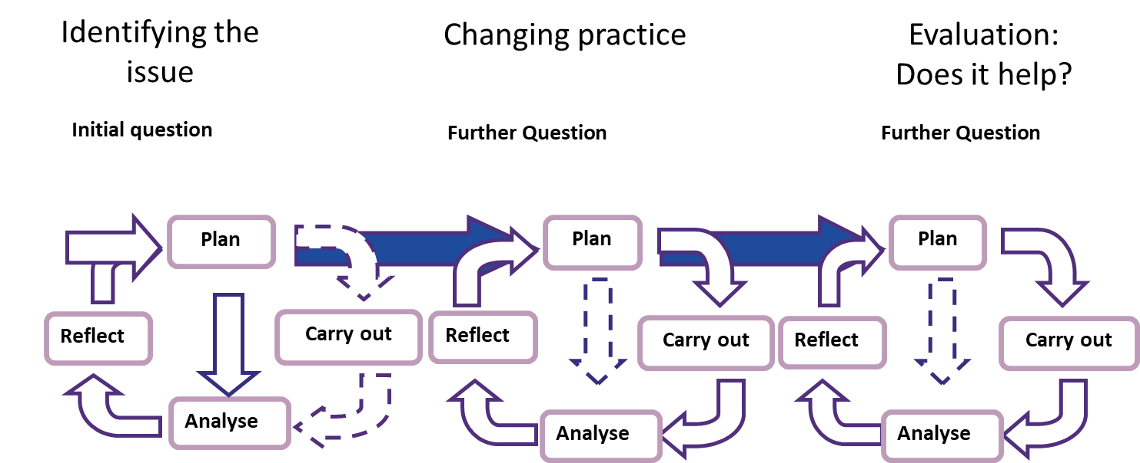



Stages of a scholarship project

Slide 13
Activity : Goals and preparation
Think about a potential project you are interested in
What are the goals of your project?
What initiated your interest in this project?
What is already known about the topic
  From existing evidence
  From shared practice
  From the research literature
  Leads to identifying a research question …
What would be your question(s) at this stage of the research?

Slide 14
Other factors to consider
What are the intended outcomes of the project?
  To inform module development
  For dissemination amongst colleagues
  For external publication
How many people will be involved?
How much time do you have?

Slide 15
Practical considerations
Researching OU students
Research with OU students requires permission from the Student Research Project Panel (SRPP). The panel also offers guidance on research process and can put you into contact with similar projects.
  https://openuniv.sharepoint.com/sites/mi/data-and-student-analytics/SitePages/SRPP.aspx
You need to be aware of ethics in relation to students and any other participants. The OU Research Ethics website has an ethics checklist for your project and guidance on ethical procedures.
  http://www.open.ac.uk/research/governance/ethics/human/review-process
  BERA (British Educational Research Association) ethical guidelines
    http://www.bera.ac.uk/researchers-resources/publications/ethical-guidelines-for-educational-research-2011

Slide 16
Identifying the issue
Now that you have a research question and clear goals…
What data already exists?
What do you still need to know?
What methods might be appropriate?

Slide 17
Finding and interpreting institutional data
OU student data
  https://openuniv.sharepoint.com/sites/mi/data-and-student-analytics
Learning analytics
  Analytics 4 Action active presentation toolkit
    https://learn3.open.ac.uk/course/view.php?id=300833
  Analytics Evidence Hub
    https://intranet9.open.ac.uk/collaboration/Scholarship-Exchange/Wiki/Affiliation.aspx?Affiliation=Analytics%20Evidence%20Hub
  OU Analyse
    https://analyse.kmi.open.ac.uk

Slide 18
Finding OU knowledge
Assessment Hub
  https://learn3.open.ac.uk/course/view.php?id=300224
Learning design
  http://intranet6.open.ac.uk/teaching/learning-design/
ORO (intersects with externally published literature)
  http://oro.open.ac.uk/
Scholarship Exchange
  https://openuniv.sharepoint.com/sites/units/lds/scholarship-exchange/SitePages/Home.aspx

Slide 19
HE research, policy and practice
Equality Challenge Unit
  http://www.ecu.ac.uk
Higher Education Statistics Agency
  https://www.hesa.ac.uk
Higher Education Funding Councils
  http://www.hefce.ac.uk (England)
  https://www.hefcw.ac.uk (Wales)
  http://www.sfc.ac.uk (Scotland)
Higher Education Academy
  https://www.heacademy.ac.uk
Jisc
  https://www.jisc.ac.uk
Office for Fair Access
  https://www.offa.org.uk
Quality Assurance Agency for Higher Education (QAA)
  http://www.qaa.ac.uk

Slide 20
Choosing research methods
Depends on the purpose of the stage of the research
  To identify the issue
  To evaluate change
and on the scope and scale of the research
  Needs to be manageable by one person or team of people
  Has to be appropriate to the time frame you have available

Slide 21
Choosing research methods
What the methods can be used for, and when
Interviews/ focus groups
  Useful for gathering in-depth data, including feelings and attitudes. Can be used at any point in the research cycle. Generates a lot of data to analyse
Questionnaires
  Useful for getting snapshots in time, getting quantifiable data, identifying the situation before and after a change. Not so good for identifying feelings and attitudes
Observations (face to face and online)
  Useful for understanding what students actually do, rather than what they say they do in activities, although can never be truly naturalistic

Slide 22
Choosing research methods cont.
Documentary evidence (teaching and assessment materials, student assignments, policy documents)
  Useful for identifying the current state of play and whether any changes have occurred after making changes
Learning analytics
  Provides data on student activity. Can be used at any time in the research cycle.
Research diaries by students
  Useful for providing longitudinal data over time and gives some control to the student
Research diaries by researcher
  Useful for providing longitudinal data over time and provide a basis for analytical notes

Slide 23
Activity : identifying the issue
Over to you …
For your chosen area of interest
What data already exists?
What do you still need to know?
What methods might be appropriate?

Slide 24
Needs analysis
What skills do you feel you already have in relation to
  Planning your scholarship project
  Identifying and reviewing the literature
  Selecting appropriate methods
What skills do you need to acquire or improve?

Slide 25
Next steps
After identifying the issue …
Changing practice
Evaluating change

Slide 26
Dissemination
OU events
School or faculty seminars
E learning events
eSTEeM conference and workshops
External Conferences
HEA STEM
Horizons in STEM
Publications

Slide 27
Books on SoTL
OU - Available physically or online from OU Library
Nitty gritty guides
  Bishop-Clark, C. and Dietz-Uhler, B. (2012), Engaging in the Scholarship of Teaching and Learning: A Guide to the Process, and How to Develop a Project from Start to Finish. Sterling, VA, Stylus Publishing. (OU)
  Cleaver, E., Lintern, M. and McLinden, M. (2014), Teaching and Learning in Higher Education. London/ Thousand Oaks/ Nee Delhi/ Singapore, Sage.
  Cousin, G. (2009), Researching Learning in Higher Education: An Introduction to Contemporary Methods and Approaches. London & New York, Routledge. (OU)
  Norton, L. (2009), Action research in teaching and learning: A Practical Guide to Conducting Pedagogical Research in Universities. London & New York, Routledge. (OU)
Nature and relevance of SoTL
  McInney, K. (Ed), The Scholarship of Teaching and Learning In and Across the Disciplines. Bloomington and Indianapolis, Indiana University Press. On OU library online.
  Murray, R. (2008), The Scholarship of Teaching and Learning in Higher Education (Helping Students Learn). Maidenhead & New York, Open University Press.

Slide 28
Websites on SoTL - OU
SHARE (Scholarship Help Area for Regional Scholars)
  https://learn3.open.ac.uk/course/view.php?id=300463
Open University Scholarship Exchange
  https://openuniv.sharepoint.com/sites/units/lds/scholarship-exchange/SitePages/Home.aspx
eSTEeM
  http://www.open.ac.uk/esteem
MyLearningCentre
  https://thelearningcentre.learningpool.com/course/index.php?categoryid=49

Slide 29
Websites on SoTL - external
Getting Started in Pedagogic Research within the STEM Disciplines
  https://www.heacademy.ac.uk/system/files/pedagogic_research_guide_final_version_0.pdf
University of Edinburgh Scholarship of Teaching and Learning
  https://www.ed.ac.uk/institute-academic-development/learning-teaching/staff/sotl
University of Glasgow 5 Stages of SoTL
  https://www.gla.ac.uk/myglasgow/leads/staff/sotl/fivestagestoengagewithsotl/#d.en.87898
Plymouth University Pedagogic Research Institute and Observatory
  https://www.plymouth.ac.uk/research/institutes/pedagogic
SoTL Canada
  https://sotlcanada.stlhe.ca/sotl-resources/
University of Central Florida Guide to SoTL
  http://www.fctl.ucf.edu/researchandscholarship/sotl/
Vanderbilt University Guide to SoTL
  https://my.vanderbilt.edu/sotl/

Slide 30
Teaching and Learning journals – some examples
Assessment and Evaluation in Higher Education
Distance Education
Higher Education Quarterly
Innovations in Education and Teaching International
International Journal for the Scholarship of Teaching & Learning
International Journal of Teaching and Learning in Higher Education
Journal of Further and Higher Education
Open Learning: The Journal of Open, Distance and eLearning
Practice and Evidence of Scholarship of Teaching and Learning in Higher Education
Studies in Higher Education
Teaching in Higher Education
ALSO Subject teaching and learning journals

