Slide 1

Intro Slide Title 1
Finding and evaluating scholarship literature
Nicola Dowson
Senior Library Manager (Research Support)
November 2023

Slide 2
Session overview
Will cover
  Library resources and how to effectively search them
  Tools for keeping up-to-date with scholarship in your area
  How to access material that is not held by the library
  Literature searching strategies and techniques
  How to evaluate what you find
Will also briefly cover:
  Reference management tools
  Where to get help

Slide 3

Finding information

Slide 4
Slide Title 10
Places to search
Library Search – on home page of library website:
  a single search box to search across library resources
  Can search for article titles and access the full-text
  Signing in allows you to use the ‘My Favourites’ feature to save search results
  Can help with identifying relevant journals and databases to search
Subject specific databases:
  listed on the database A-Z list and
  under selected resources for your study
Multi-disciplinary databases:
  Scopus, Web of Science

Slide 5
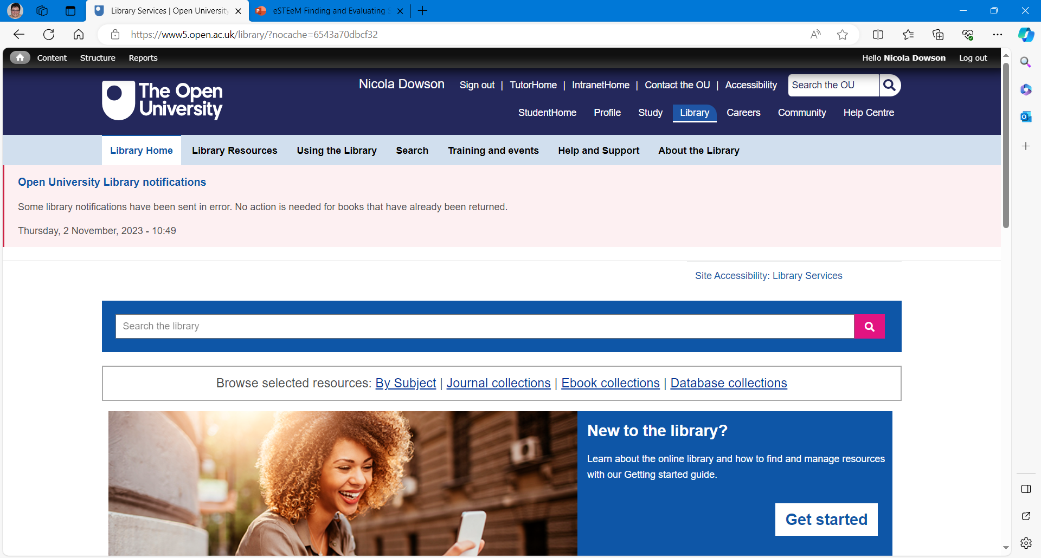

Slide 6
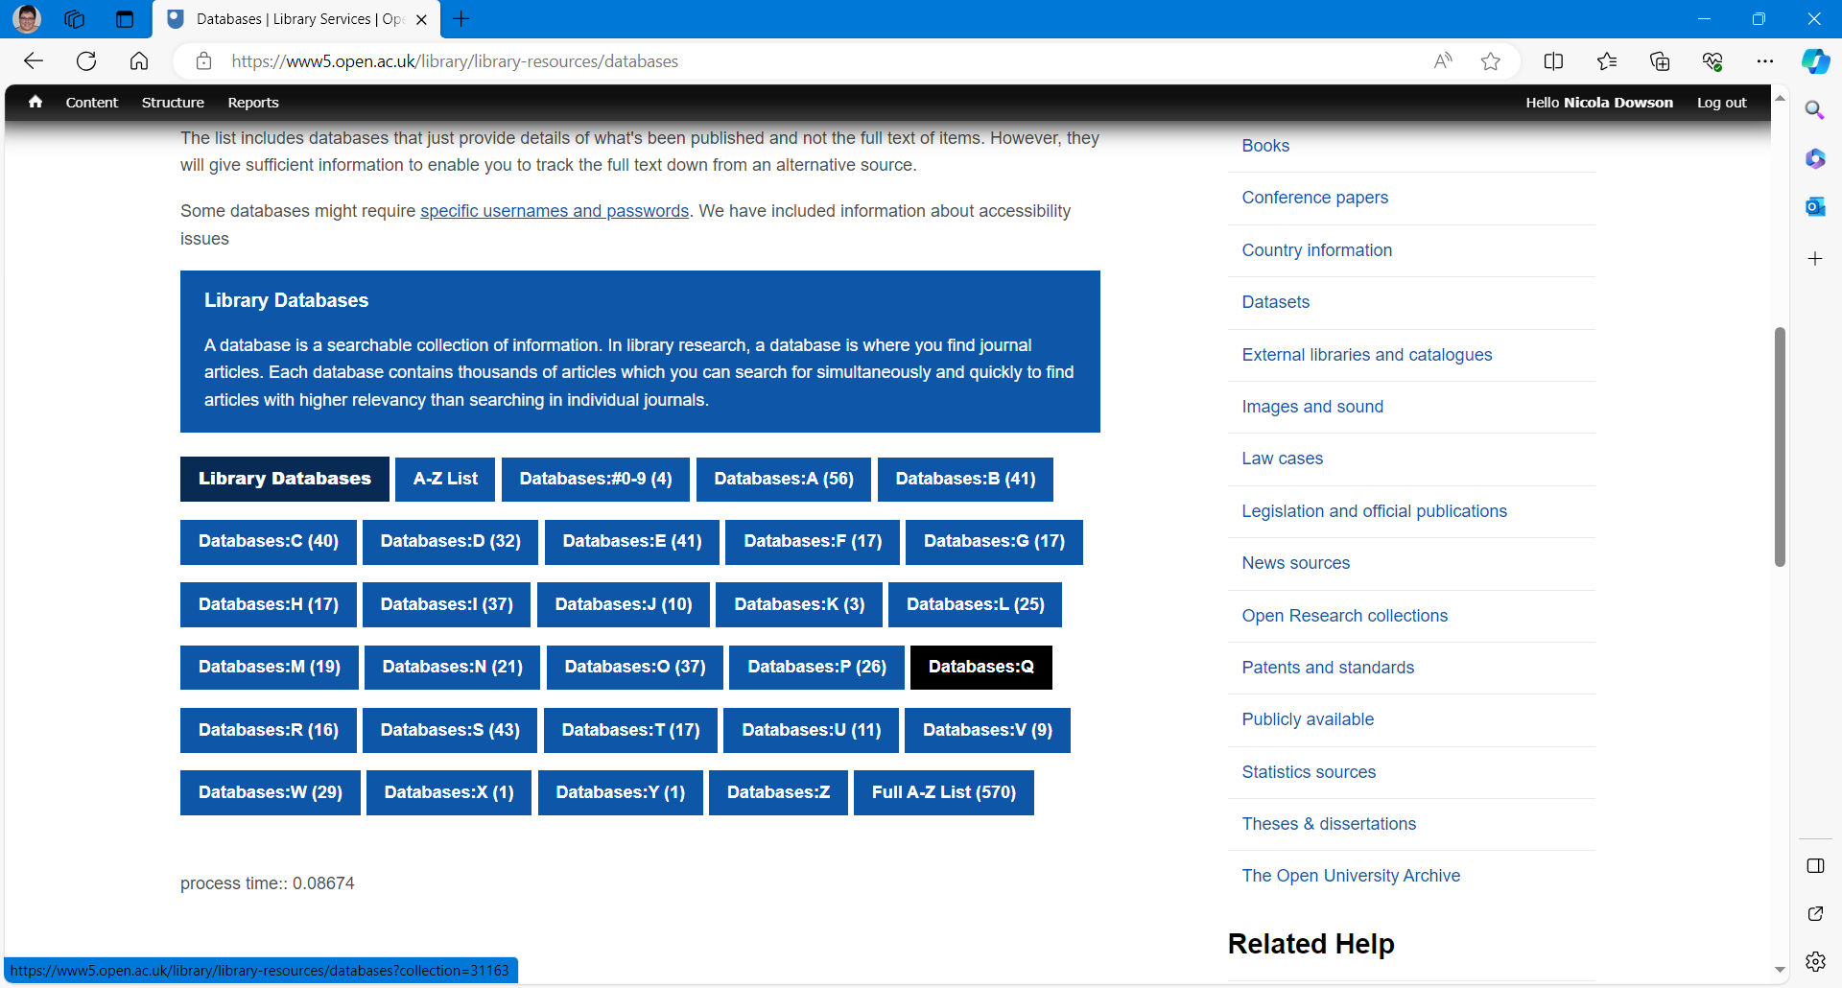

Slide 7
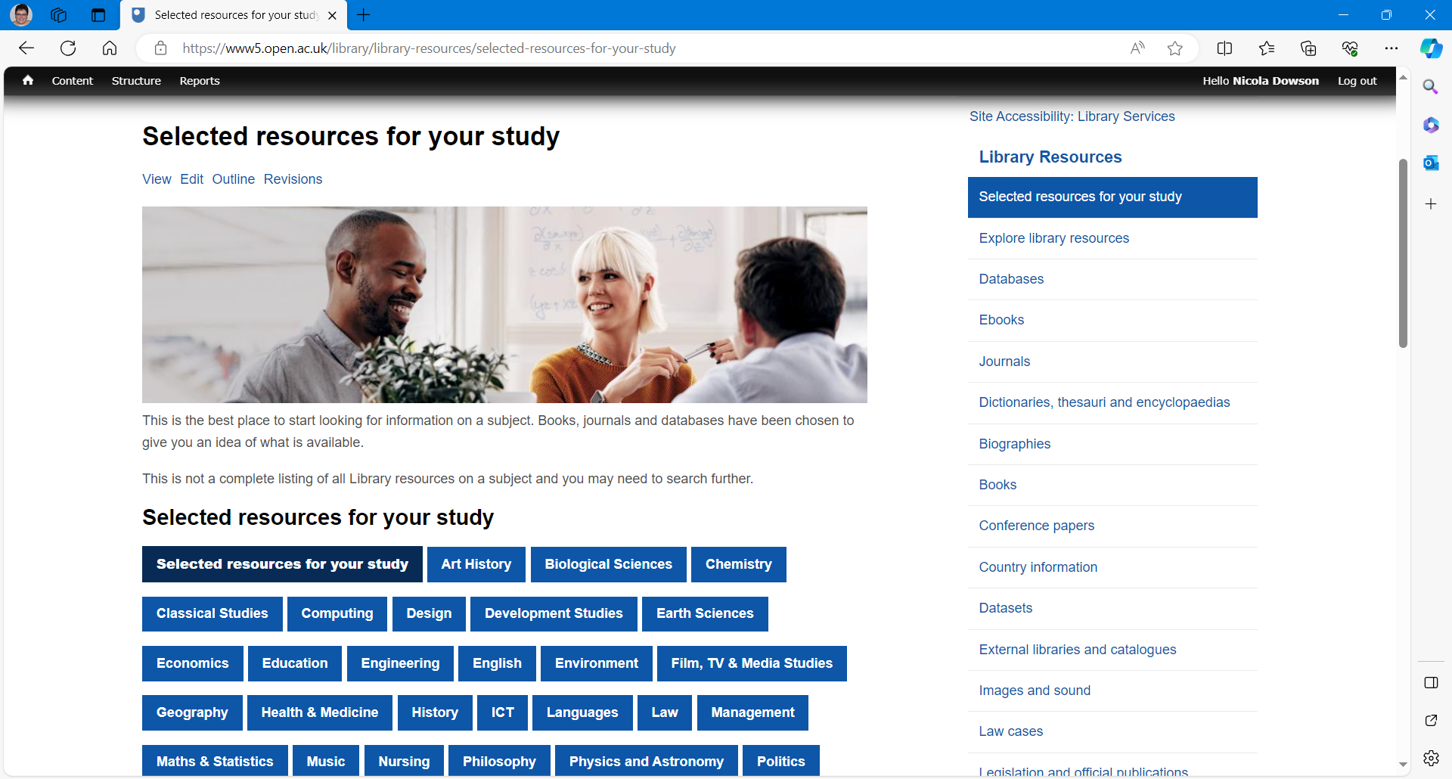

Slide 8
Slide Title 10
Selecting a database to search
Things to consider:
Subject coverage – read the description – titles may not reflect the content.
Is the database a full-text one or does it only contain bibliographic information? If bibliographic only will need to source the full-text.
What types of research outputs does it cover – articles, books, conference papers, grey literature. What type of research output is most important in your discipline?
Date range database covers.
Notes:
What databases do you find useful and why?

Slide 9
Tips for searching databases
Familiarise yourself with the layout – are there simple and advanced search options?
Some databases are provided through the same supplier so give the opportunity to search multiple databases at once e.g. EBSCO covers many of the major education databases.
Look at options to restrict results e.g. by when published, full-text, peer-reviewed, publication type.
Many have options to save searches and set up alerts which can save you time. But beware don’t set up so many you have no time to look at them.
Many have options to export results to reference management tools e.g. EndNote, Mendeley.
Look at the help pages – they give tips on how to search functionality and how to search effectively.

Slide 10
Research Methods resources
Sage Research Methods Online – books, reference works, journal articles and instructional videos by world leading academics
Sage Research Methods: Cases – case studies of actual research projects from many different disciplines to show methods are applied.
Find both via Library Search or the Database A-Z list

Slide 11
Slide Title 10
Ebooks
Ebooks | Library Services | Open University – collections of ebooks.
Library Search – search for individual titles.
Although multiple readers can access many of the ebooks in our collections, some titles might only admit one reader at a time.
Many ebooks are only available online. There is often no facility to download a title in a format that is compatible with ebook readers.
Some ebooks are limited to a certain number of users at one time.

Slide 12
Search tools
Library access extension browser – notifies you if you are on a website that the library has a subscription to enabling access the content directly from the website.
BrowZine - allows you to browse, read and follow scholarly journals in a visual display designed for your smartphone or tablet.
Google Scholar – connect the OU Library to access subscribed resources using ‘The Find it at the OU’ link.

Slide 13


Slide 14
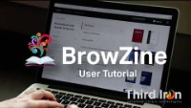

Slide 15
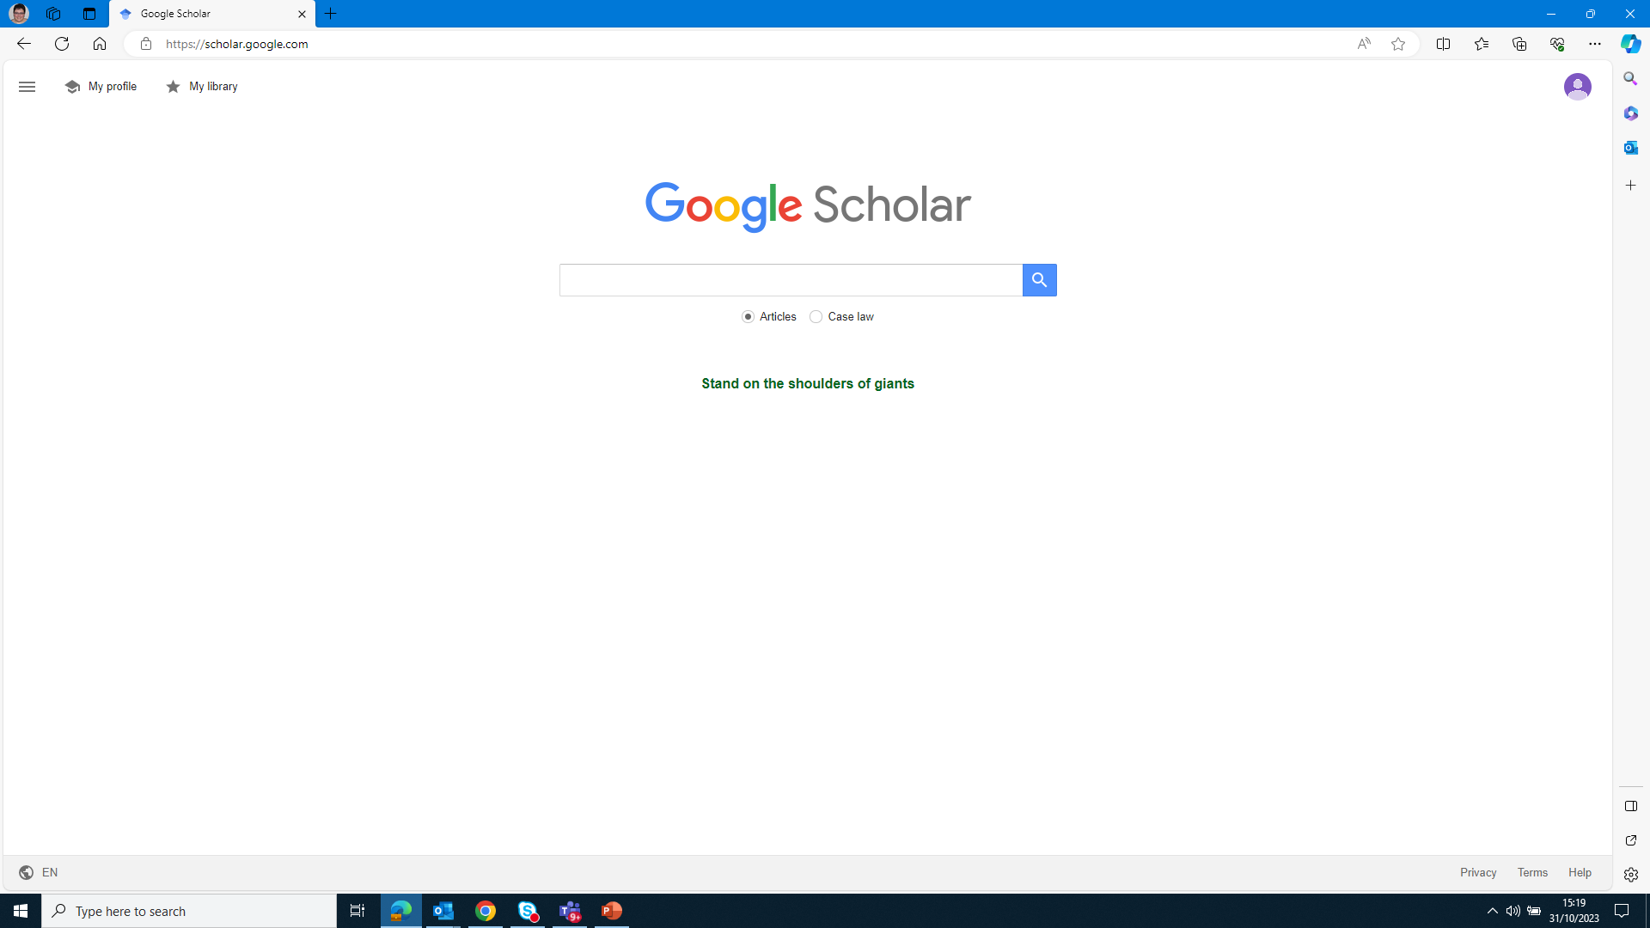

Slide 16
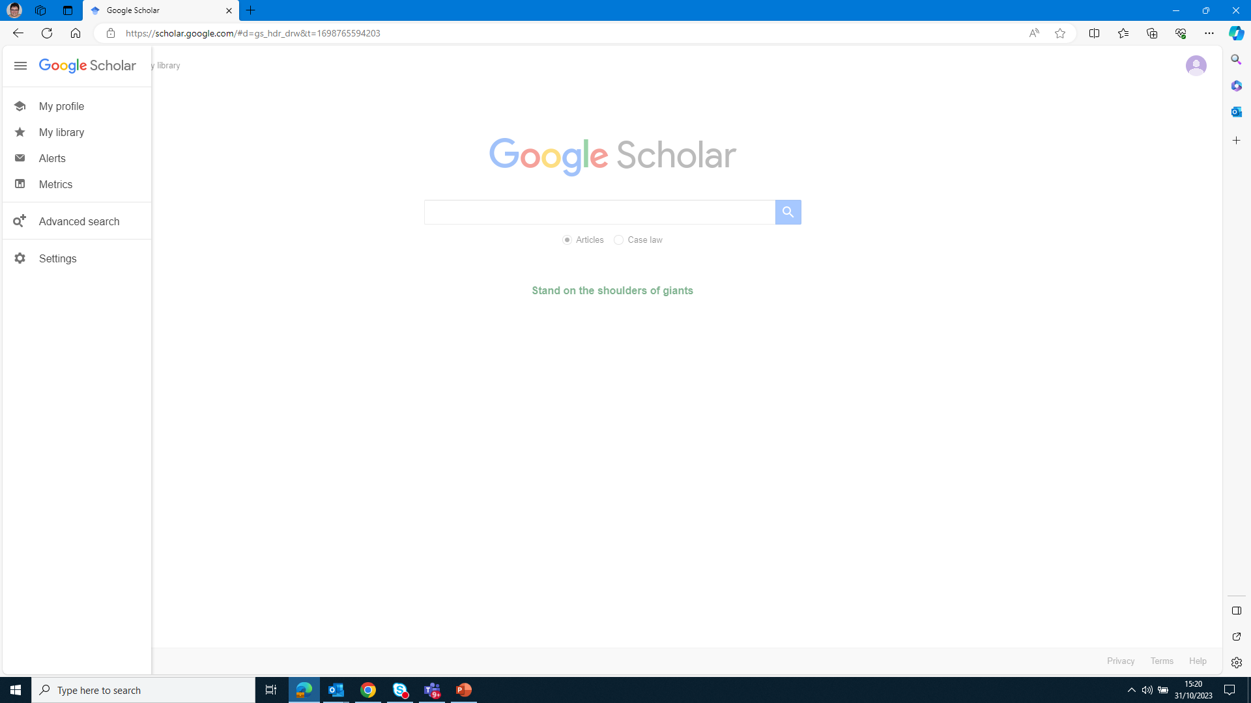

Slide 17
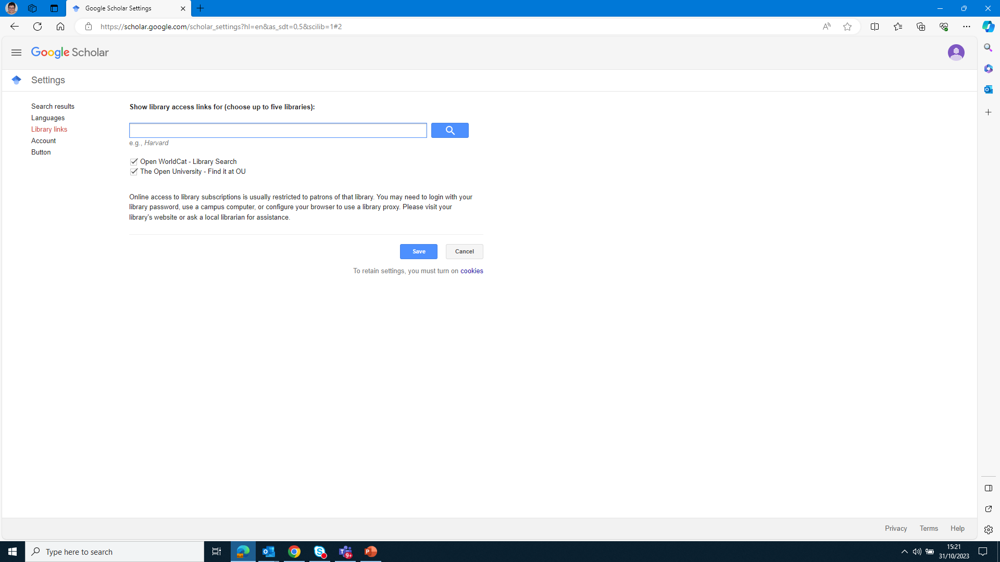

Slide 18
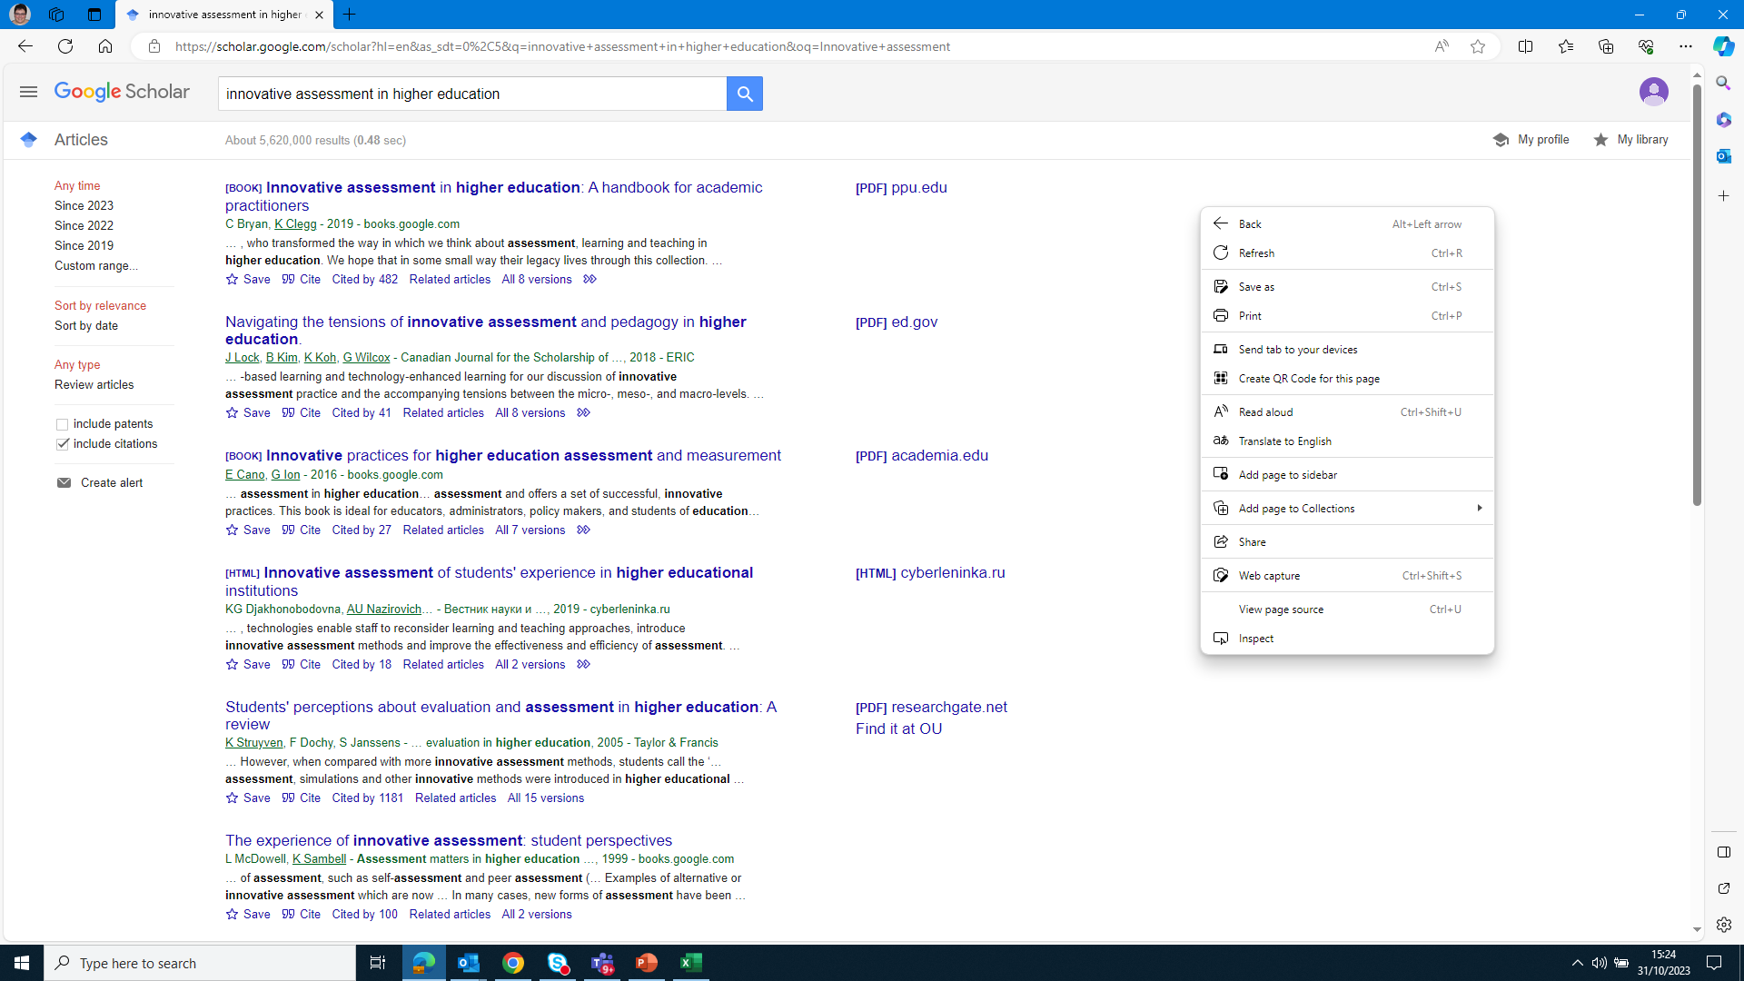

Slide 19

Slide Title 4
Accessing materials the Library doesn’t hold

Slide 20
Obtaining material the Library doesn’t hold
SCONUL Access – access to other University libraries to study and borrow books. Can use more than one University Library. Some have computer access – check before you visit.
Document delivery and interlibrary loan:
  you need to be registered with the Library
  journal articles are delivered electronically directly to your inbox
  loans of books etc. from other University Libraries can take time
  check we don’t have access to an item before requesting
Request a new item for purchase

Slide 21
Slide Title 4
Literature Searching

Slide 22
Scholarship
Question
Re-focus
Focus
e.g.
Choosing keywords
Choosing databases/search engines
Choosing filters
Choosing search operators (AND, OR, NOT etc.)
Search
Strategy
Reflect and revise
Search
Results
Recording searches
Update
Evaluation of
Literature

Slide 23
Things to consider
Are you looking for information :
in a particular context e.g. HE, private sector
in a particular country or geographic region
in a particular timeframe
that include other factors such as the age or gender of the people included in your study
that is introductory or reference material – how well do you know your topic already?
Of a particular type e.g. policy documents (Overton database on the database A-Z list), peer reviewed journal articles

Slide 24
Choosing Keywords
Identify the key concepts:
Assess the role of active learning in improving the engagement of international students during online learning.

Slide 25
Choosing Keywords
Identify the key concepts:
Assess the role of active learning in improving the engagement of international students during online learning.
Remove instructional/process words:
Assess the role of active learning in improving the engagement of international students during online learning.

Slide 26
Choosing Keywords
Think about synonyms
Online learning:
E-learning
Online teaching
Online tuition
and related terms:
Active learning:​
​Student-based learning ​
Problem solving ​
Paired discussion

Slide 27
Searching techniques
Phrase searching –usually put in quotations e.g. “active learning”.
AND – narrows your search as will find all the words.
NOT – narrows your search by excluding words.
OR – broadens your search, will find one of the search terms or all of them.
Truncation – useful if want to search for the singular or plural of the word or words with the same stem e.g. skill* would retrieve skill, skills, skilled.
Wildcard – finds variations of spellings of a word e.g. organi?ation will find organisation and organization.
Check database help pages to see the options.
Advanced search techniques | Library Services | Open University

Slide 28
Citation searching
Allows you to see outputs that have cited an output that you have found.
Look for cited by links in search results in databases.

Slide 29
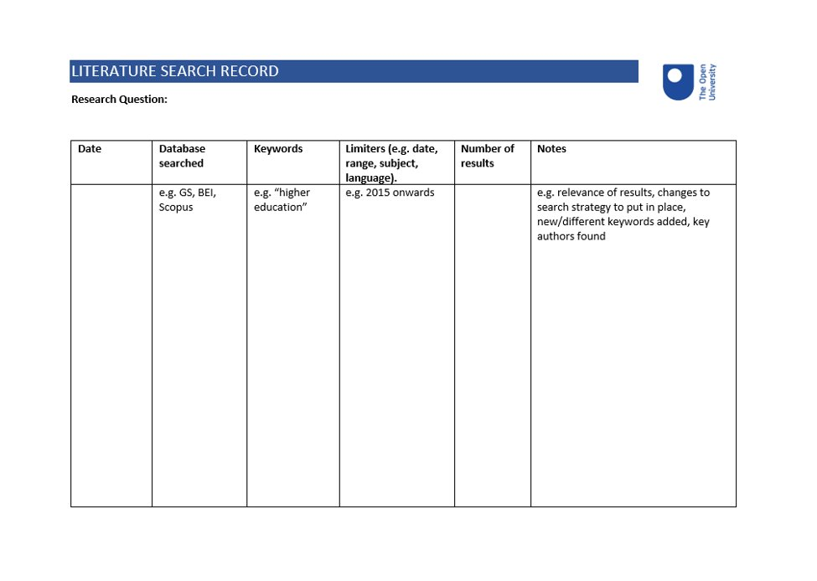
Literature Search Record

Slide 30
Scholarship Exchange
Repository of outputs related to OU’s scholarship.
Moving to a new platform - soft launch this month.

Slide 31
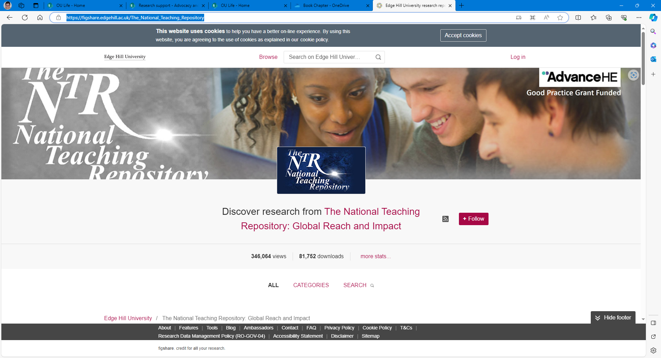
National Teaching Repository
Notes:
The National Teaching Repository is an open access online searchable database where tried and tested strategies ‘that work’ can be housed and harvested.
A space where colleagues can upload and share teaching resources, pedagogical research, approaches and ideas. Their innovations and strategies and in doing so not only help others, but gain recognition and be acknowledged for and e able to evidence of the impact of their work in practice.
It is a space that anyone can search and access hands-on, practical ideas and resources, off the shelf ready to use or to adapt for implementation in their own settings.
It is a space that facilitates your ability to showcase your practice in a range of non-traditional research formats including data, books, reports, code, videos, images, audio recordings, posters, and presentations.

Slide 32
Other sources
Twitter (X)
Mailing lists
ResearchGate
Bibliographies in articles/books
Teaching Journals Directory - Center for Excellence in Teaching and Learning
Notes:
CETL provides an extensive list of external disciplinary and interdisciplinary journals in the Scholarship of Teaching and Learning (SoTL) focused on undergraduate and graduate education for teachers at colleges and universities, organized alphabetically.

Slide 33
Evaluation
Advanced Evaluation – PROMPT
Presentation
Poor presentation and inappropriate or confusing use of language can hinder your use of content. Try not to let poor presentation stop you from using what might otherwise be good quality, relevant information.
Relevance
Relevance is not a property of the information itself, but rather of its relationship to the need you have identified. Consider geography, level and the emphasis of the content.
Objectivity
All information is presented from a position of interest, although this may not be intentional. You need to be aware of possible bias in what you
Method (research reports only)
Do not assume that because a research report has been accepted for publication, it is error free. You need to assess the accuracy of information produced as a result of using particular methods.
Provenance
The ‘credentials’ of a piece of information support its status and perceived value. It is important to be able to identify the author, sponsoring body or source of your information.
Timeliness
Timeliness is an aspect of relevance. You need to be aware of the date of production or publication, and assess whether this has been superseded, or is still useful to your needs.

Slide 34
Reference Management tools
Enable you to keep track of the references you have found.
Can automatically generate references, reference lists and bibliographies in a variety of reference styles.
OU Library does not recommend a particular reference management tool.
EndNote Click – google chrome plugin that allows you to locate full-text copies of outputs
Notes:
Reference management tools and open office – you can use EndNote, Mendeley and Zotero with open office. For EndNote and Mendeley you need to download a plugin. https://support.clarivate.com/Endnote/s/article/EndNote-X3-and-later-Windows-Install-the-OpenOffice--OpenOfficeorg-Writer-3x-Tools?language=en_US. For Mendeley it is here https://github.com/Mendeley/openoffice-plugin but looks complicated to install. Zotero seems to be the only one that works with Google docs.

Slide 35

Slide Title 4
Help and Support

Slide 36
Help and Support
library-research-support@open.ac.uk for Open Access, Research Data Management, basic literature searching enquiries
lib-help@open.ac.uk for library online resources and general enquiries
ilmail@open.ac.uk for document delivery and interlibrary loan

Slide 37
Slide Title 31

