Slide 1


Welcome
New to OU Maths Study?
A session to get you started
on M140 . Tuesday 24th Jan 7-8pm and repeated Sunday 29th Jan 3-4pm
To help fellow students who could not attend this session will be audio recorded

Slide 2
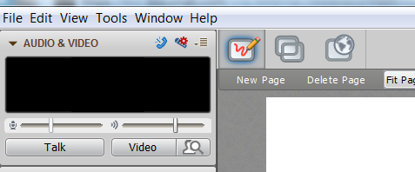
You’ve made it into your OU live room- great
Quick tour OU live – Polling!!
Some comments from previous students
Items to aid your study
No Sound??
Try
Tools>Audio>
Audio set up wizard

Slide 3
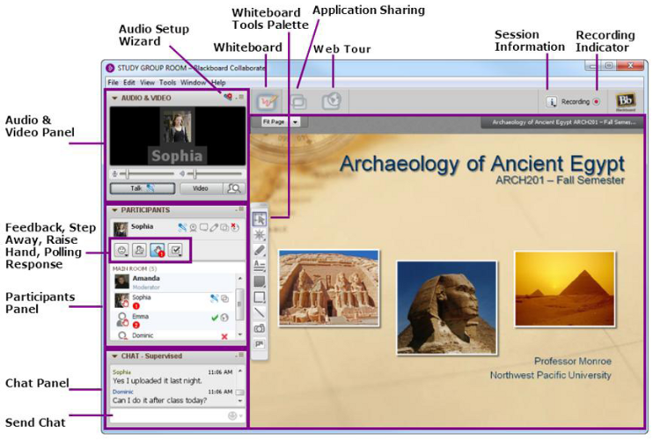
OU Live
Click on the tick

Slide 4



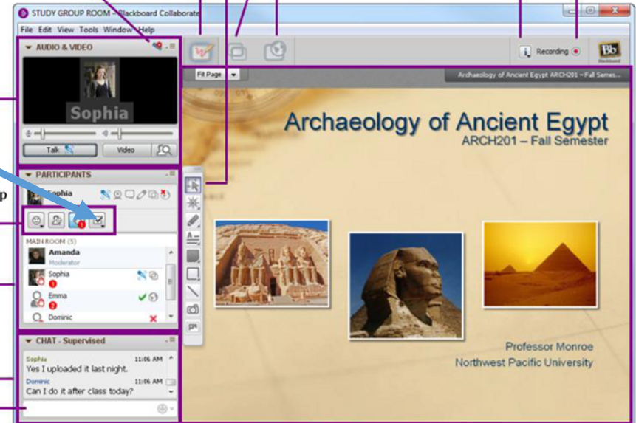
Main messages from your peers last year:
Adopting a positive ‘can do’ attitude to studies, willing to try out different approaches;
and
Get organised and making full use of what the OU provides, particularly the study planner.
Try clicking on this symbol on your screen to add a symbol to the whiteboard

Slide 5

M140… what’s in the ‘paper box’?
A quick Poll :
A – I have the box and I have opened it
B – I have the box and I have not opened it
C – What box?

Slide 6
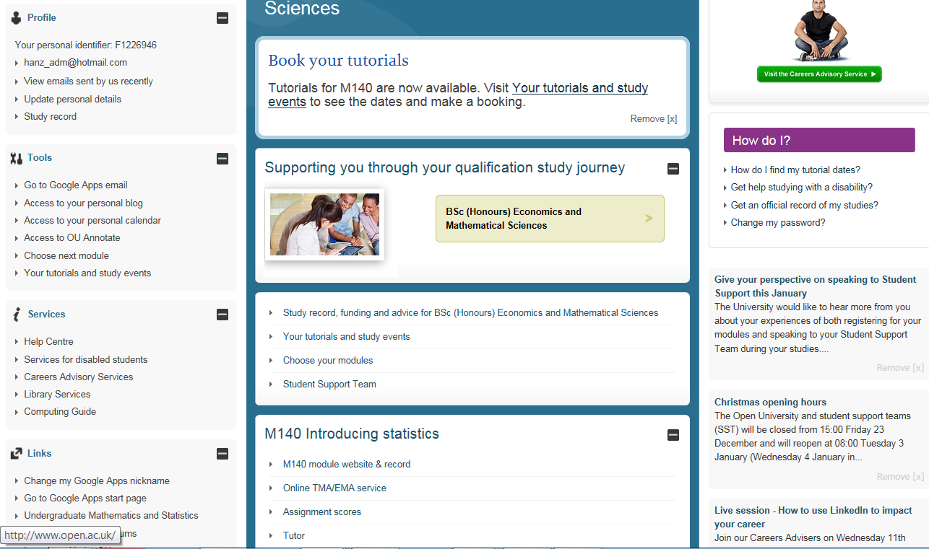
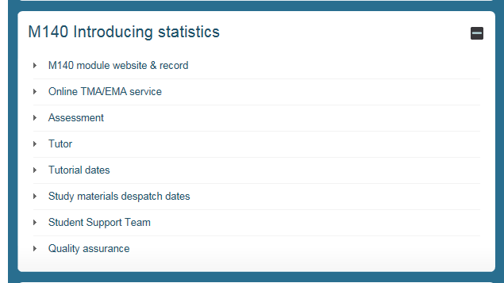
Your student home
Your route into the electronic box
Submitting your assignments
Who is your tutor

Slide 7
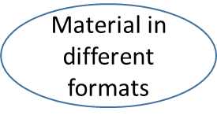
Overview of ‘everything’ in the M140 ‘electronic box’
- Application sharing/screenshot (see next two slides) to view these
STUDY PLANNER
Screencasts
ASSESSMENT RESOURCES
TMAs, iCMAs, EMA
Good academic practice
Practice quizzes
Assessment Calculator
STUDY RESOURCES
pdfs of printed materials & errata
Accessibility Guide
M140 Website
FORUMS
Exchange ideas and difficulties with other students
COMPUTER RESOURCES
Datasets
Minitab software
Interactive resources
NEWS
Important messages, e.g. new errata, posted here

Slide 8
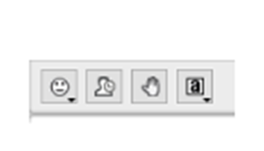
Saying hello to your tutor
I have responded to a welcome email from my tutor
Poll
A – Yes
B – No
C – I’ve not had a welcome email from my tutor

Slide 9
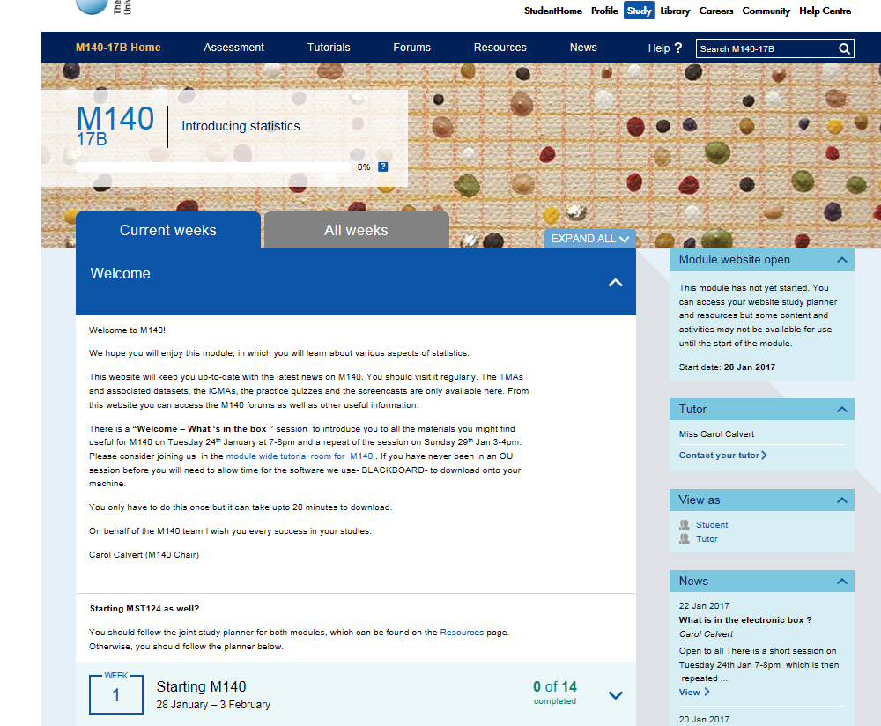
Access to that electronic box- start at M14O from your student home page – application share
Tabs to give you quick access
Study Planner

Slide 10
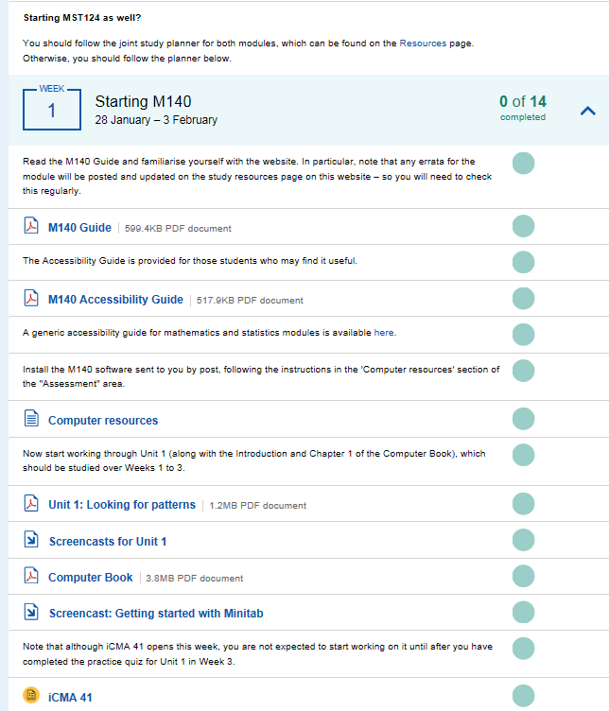
Study planner takes you through what you need to do and when
Loading Minitab
The resources tab will take you to all the screencast, computer resources and pdfs of units
Assessment appear in the study calendar- this is for the first computer marked assignment – or you can use the assessment tab to see them all
A pdf version of the Unit 1 from Book A

Slide 11
The M140 website
Poll
A – Yes, I had seen it before
B – No, I had not seen it before but I have seen similar on other modules
C – No, it’s all new to me!

Slide 12
M140 Website
STUDY PLANNER
Tips and ideas:
Try out different strategies when planning and organising your studies. What you try straight away may not work; try a different way ; it is about finding methods and approaches that work for you. – so try the practice quizzes (assessment tab) or watch the screencasts (resources tab) or ask in the forums (forum tab) or ask your tutor or book onto a tutorial ( application share to tutorial tab)
Put aside time for planning, reflection and monitoring your own progress.
Adopt a business-like approach to study: set clear goals; find the right environment in which to study; identify when you can study; develop the discipline of good time-management.
Be consistent - a relatively modest amount each day (rather than a large amount every now and then) seems to build confidence and stamina. Also remember to take a break from time to time. PACE YOURSELF.

Slide 13
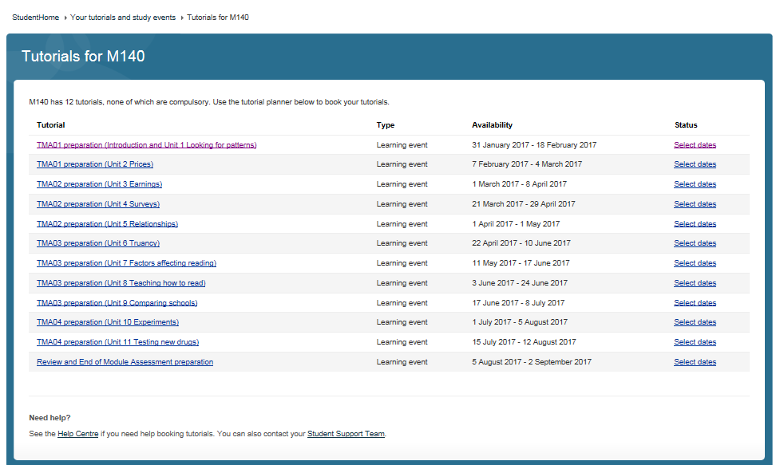
Booking a tutorial- will look something like this- start at student home and take tutorial dates for M140
<screenshot>

Slide 14
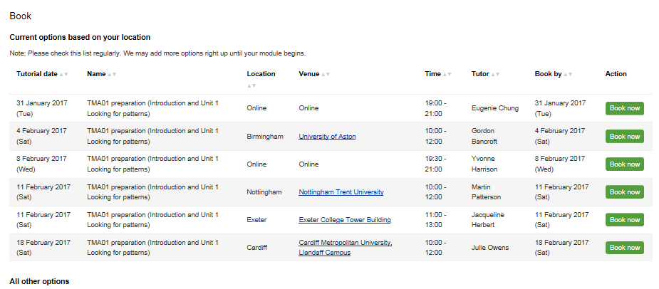
As student in Devon sees:

Slide 15
Exploring the study planner further…. Tips and ideas:
Have a warning system in advance of an important deadline (TMA, iCMA, EMA, Tutorial), e.g. an alert on your mobile phone, put in outlook calendar or diary.
Plan what you’re going to study, when and where, dependent on what you find works best for you.
if you slip behind schedule contact your tutor at an early stage as soon as problems start to arise.
Make full use of the additional resources to complement the study text. Our students used these to explore, clarify and revise topics, particularly when they found them difficult to follow in the text. The quizzes are considered good practice for iCMAs, and the activities suggest forms of words when writing up TMAs. Students found the video clips of lectures very useful.

Slide 16
Have you matched the study planner to you your own/ family work diaries?
Poll
A – No and I had not thought to do that
B – No and I doubt that will be helpful for me
C – Yes / partially yes

Slide 17
Our students’ tips include:
Messages from students:
“Don’t be scared or threatened by it at the beginning, it’s not as bad as it looks!”
“Make sure you fully understand each concept before moving on, rather than just mechanically remembering how to apply, e.g. a formula. Deeper understanding contributed to the enjoyment of the content.”
“The module is do-able as it takes you step-by-step through the concepts; enjoy the module!”

Slide 18

Students outlined the following as the main benefits of attending tutorials as:
Gaining valuable support from an M140 tutor
Meeting with other students; you may be able to find a ‘study buddy’ or form a study group.
Opportunity to discuss ideas and ask questions.
Remember that tutorials are part of the module package to help you succeed. These may be held online or face-to-face at various venues; sign up on your StudentHome page. They aim to review and illuminate the material that you have been studying, as well as covering communication and study skills.
Messages from students:
“I missed the support of tutorials when I couldn’t attend.”
“All of this face-to-face tuition was fantastic. It really helped provide motivation and allowed discussion of interesting aspects of the material. Go to tutorials!”

Slide 19

Thoughts of students on tutor support:
Be proactive and open the dialogue with your tutor at an early stage. One student felt that he needed feedback at an earlier stage than the first TMA. One suggestion is to send in a dummy e-TMA (TMA00) early on with your solution to an exercise in M140 that you have found challenging.
Discuss areas of difficulty with your tutor when studying the material
Collect your marked TMA- not just the mark- and use the feedback to confirm what you have mastered (tick this off) and to revisit the areas where you need to improve your understanding. Contact your tutor if there’s anything in the feedback that you don’t understand. Note down any learning points to be put right in the next TMA. Build this into your plan.
One student that he was ‘amazed’ at the amount of feedback received (marked TMA) and described it as ‘complete’.

Slide 20
Thank you for attending and can you take a moment to help us improve this session for future students?
What was most useful?
What was least useful?
What single extra thing would you like to have seen covered ?

