Slide 1
CALRG Conference 2021
Student Support Networks During Lockdown
15th June 2021
Vicky Murphy, Jo Buxton, Natalie Temaga

Slide 2


Thanks for the support

Slide 3

The Problem
Research aims:
Who did students turn to for academic support during lockdown?
Who did students turn to for emotional support during lockdown?
What role did the OU play in this?
How can we do better?

Slide 4

The methods
Methodology
Mixed-methods Social Network Analysis
Team
Jo Buxton
Laura Dean
Natalie Tegama
Eileen Scanlon
Kate Lister
Victoria Murphy
Data Collection
Network maps
Interviews
Focus groups
Participants
8 STEM students
7 non-STEM students
6/8 STEM ALs (focus group 1)
6 OUSA reps (focus group 2)
Data Analysis
Network statistics
Thematic analysis
This Photo by Unknown Author is licensed under CC BY-SA

Slide 5
The network map
Facebook group
Inner circle = essential support
Middle circle = strong support
Outer circle = some support
Person 2
Person 1
ME
Organisation 1
Person 3
Organisation 2

Slide 6
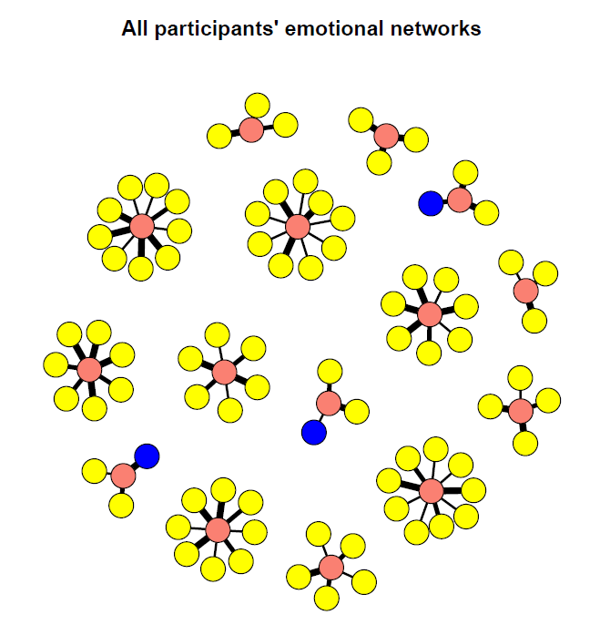
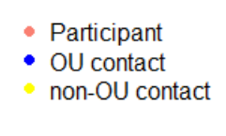
The network results

Slide 7
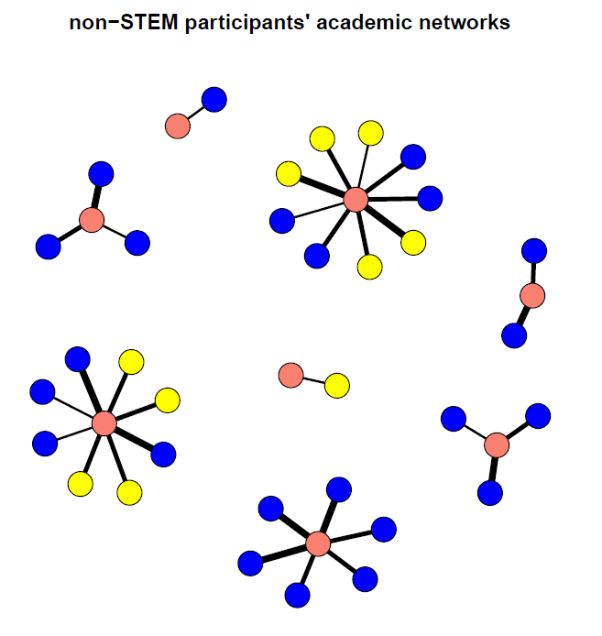
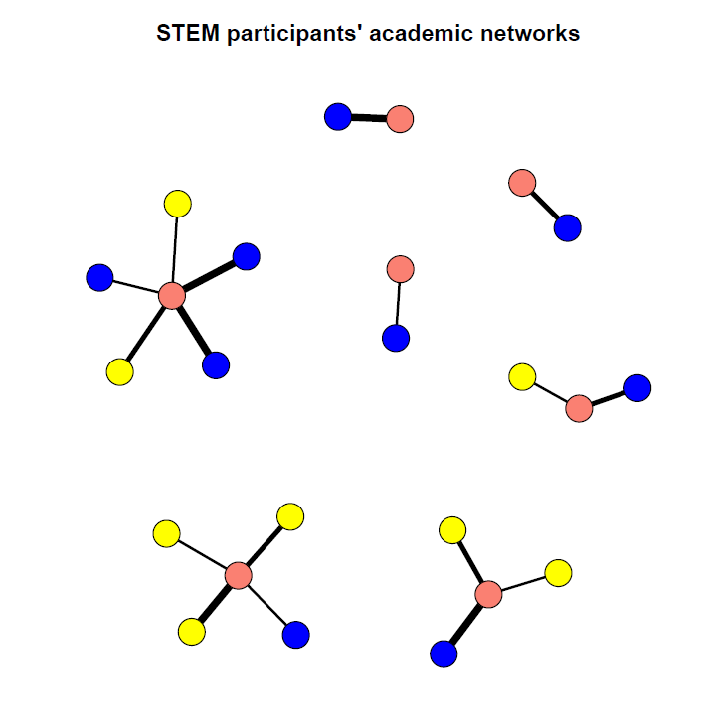
The network results

Slide 8
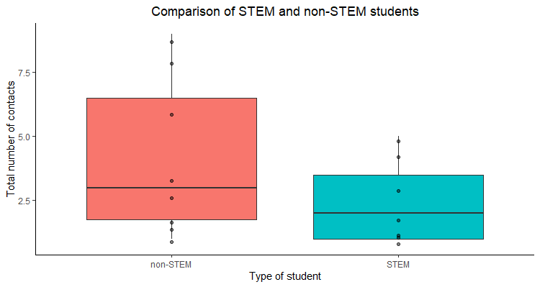
The network results
Non significant difference (p = 0.34)

Slide 9
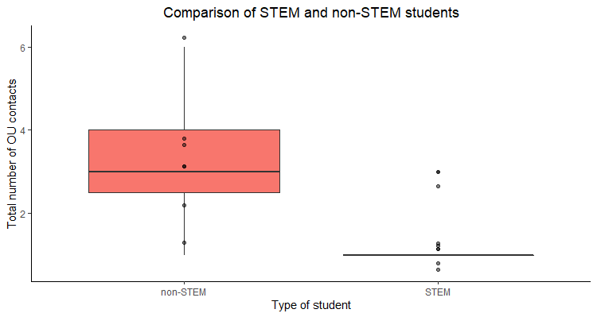
The network results
Significant difference (p = 0.01)

Slide 10
Quantitative Take-aways
Suggests that the OU doesn’t play a large role in providing emotional support
The number of OU contacts that STEM students reached out to was lower than non-STEM
For the majority of the STEM students (four out of seven), their AL was a source of support

Slide 11

Qualitative Themes
Communication
“It went to the students first before it went to ALs. So we were on the back foot and made to look quite silly because we didn't know. The students were quoting things to us where it should have been the ALs first and then to the students.”

Slide 12

Qualitative Themes
Emotional support
“I had totted up and worked out that I had about 8 times the email contact with students that I normally have, which sort of drove me underground really. Which is, it's the unpredictability of it, it made trying to plan and organize myself almost totally impossible. So every day that I faced, I just wasn't sure what was going to happen next as to how much I'd have to do or which module I'd have to be catering for. And I think that brought with it some stresses that I hadn't even thought about”

Slide 13

Qualitative Themes
Unique experiences
“When coronavirus hit in March basically it all went quiet. I got an email saying your are not going to do your final examination part. The phones went down so you couldn’t contact the phone and of course. I haven't got the web support either and also when I sent an email they said the offices aren’t open at the moment… I did send my [TMA?] through the post but the first issue I really had was whether they ever got hold of it because they weren’t ?arbitrary? posts. So I had an issue there never had any contact with my tutor whatsoever.”

