Slide 1
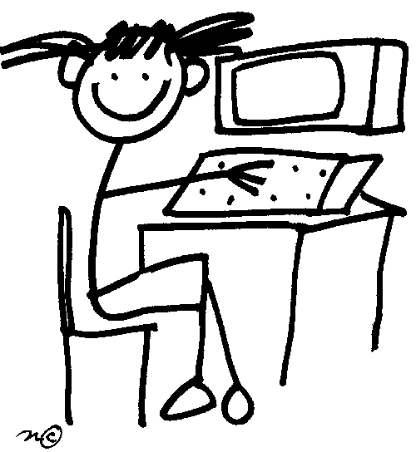
Encouraging active learning through student participation in online tutorials
Claudi Thomas, Hilary Holmes, Katrine Rogers
eSTEeM Conference, 8th May 2019

Slide 2


Recent research
Maths is not a spectator sport …
2016 CBMS `ensure that effective active learning is
incorporated into post-secondary
mathematics classrooms’
2016 Lowe et al: online tutorials tended to be lecture style
2016 onwards: more online tutorials, less face-to-face
2018 Butler et al: tutors tend not to use online tools
2018 Campbell et al: tutors think students expect lectures
This Photo by Unknown Author is licensed under CC BY-SA-NC

Slide 3

Maths tutorials
Offered face-to-face and online
GTP strategies
Adobe Connect … some teething troubles but…
Some tutors used online tools
to run highly active tutorials
Did the students participate?

Slide 4
The study
How effective are polling, screen activities and the text chat in engaging undergraduate maths students in active learning during online tutorials in Adobe Connect?
3 maths modules – all undergraduate levels
3 carefully selected tutors
11 tutorials specifically designed: Feb – May 2018

Slide 5
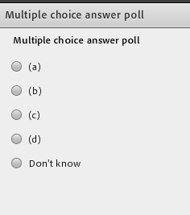
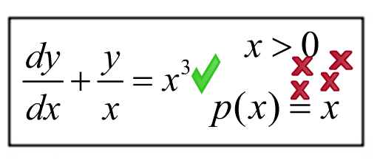
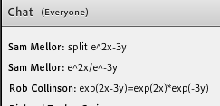
Active tasks
Screen activities
Asking questions
Polling

Slide 6
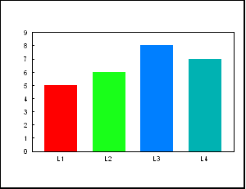


Data Collection
Tutor perceptions
Student perceptions
Counting interactions
Notes:
11 tutorial observations, tutor focus group and survey, 80 student survey responses (51 live, 29 recordings, issue: possibly a small number of duplicates?), 9 student interviews.

Slide 7
A typical tutorial
25% - 65% time spent on activities
Half that time is tutor explaining answer
Screen activities
Least used
2 – 12 min
Asking questions
Frequent
1 – 3 min
Polling
Most used
2 – 8 min
Notes:
More thinking time in polling and screen – used for fuller activities, screen in 5/11 tutorials, 1 occurrence of using microphone
Polling most used in terms of proportion of tutorial time. Asking questions is used more often if counting occurrences.

Slide 8
Achieving student engagement
Notes:
Data from live student survey data (51 responses in total, but not all students answered every question). 94%+ tried the activities sometimes/mostly or always, 80%+ mostly or always.
70%+ agreed that the activities aided their learning and 66%+ enjoyed the activities.
These methods are successful at engaging students. Percentages that share their answers are lower (still over 80% s/m/a) and 50% (m/a)), encouraging for tutors that students are attempting even when not sharing.
Polls shared most (85% m/a), anonymous (st ints and survey comments)
Positive st attitudes. Others neutral (none negative to useful, 2-3% less enjoyable)
Chat box shared slightly less often (50% s/m/a) – once one student answers others don’t bother (lots of comments in st ints) – can go too fast for some.
Chat box less enjoyed.
Main reasons for not participating: lack of time and confidence (both over 30% in survey) Positive st attitudes., zero for ‘did not think useful’.

Slide 9
Perceived benefits
Notes:
Students perceive benefits as ‘revise a skill’ , ‘enable me to tackle similar questions’, ‘understand a new mathematical idea’ (live survey responses for ‘very well’: 67%, 65% and 54% respectively). Less voted for were ‘highlighted an error I had made’, ‘realised I had misunderstood a problem’ and ‘helped me explain my ideas’ (live survey responses for ‘very well’: 30%-40%). The least popular (most voted for ‘not at all’) were ‘highlighted an error I had made’, ‘realised I had misunderstood a problem’ and ‘helped me explain my ideas’ (live survey responses for ‘not at all’: 20%-25%).
St ints: the main themes are benchmarking [6/9 polling], that the activities get them working things out [6/9 polling, 4/9 screen, 2/9 chat], highlighted an error or area of weakness [3/9 polling]

Slide 10

Improving aspects that work less well
Identifying and correcting misconceptions
  Emoticons and careful question design
Explain…
  Breakout rooms
  Leave students alone!
Harder problems?
Notes:
Emoticons: student-teacher interactions
St ints not positive, much greater barrier than to looking confused (imagine putting hand up f2f and saying I’m confused)
Question design can go some way to exposing misconceptions, but limited – multiple choice polling activities could be designed to catch some common misconceptions, but requires overheads for tutors in terms of prep time
Adapting to student needs during tutorial is harder online – more time and skill to produce materials on fly
Breakout rooms: explain and student-student interactions
Not much evidence of successful use
Unwillingness to use microphone
Peer-peer easier f2f?
Technically more challenging, so probably not so suitable for many tutors
Short text polling pods can be used to ask students to explain ideas (anonymous), e.g. with question types of ‘spot/explain the error’
Harder problems
Tutors play it safe – reduce waiting time – can’t see when or how they need to intervene due to lack of instant st feedback
Different levels? E.g. create two polls on one slide – a standard question and a harder question and direct st to relevant one for them – but again overheads for tutor and potential timing issue during tutorial when explaining the answers
We can do: staff development (limits!), recognise limitations of online conferencing software, students expect things to happen instantly
Requiring a significant new skill of tutors, need them to be highly conversant with software
Harder to adapt online
Expectations of things happening instantly online (waiting time is wasted – real and perceived)

Slide 11
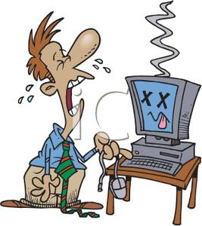
Technological issues
Significant issues with mathematical notation
“it [screen activity functionality] is not sophisticated at all”
“When question was full-screen, could not see or use chat box”
“the audio was not in sync with the screen”
“I think a technical problem prevented
me from entering text in chat box some
of the time”

Slide 12
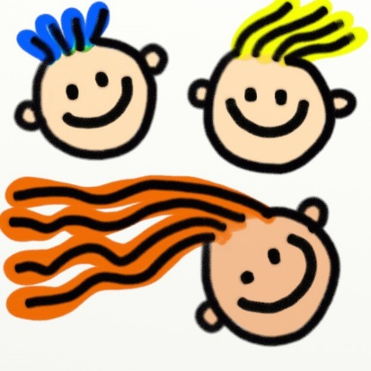
Student expectations
“we really need as much mathematical content
delivered to us as possible in the short amount
of time”
“Some of the tutorials, they were like lectures”
“there is just no time for individual tuition in that sort of setting so even if I had got it wrong I would feel uncomfortable about getting more attention if you like because actually the other students, they want to be getting on and bashing through getting to the end of the agenda“
“This is a great convenience for them, but it might reinforce the idea that the main function of university teaching is lecturing: the transfer of information, without the interactive learning that – one hopes – took place in the lecture.” – Biggs and Tang 2007
Notes:
Biggs: “Emphasizing depth of learning, rather than breadth of coverage.”

Slide 13

Tutorial recordings
From interviews and other sources: students want full recordings but:
“at the back of your mind is that dozens of people will be watching […] it is a slight inhibition but not, I don’t think, enough to make me not get any value from it”
Survey responses are less positive, more negative about interactive activities in recordings and participation in activities seems reduced
Navigation difficult
Different uses: some students use
recordings like live sessions, but
most look for specific topics or
listen again and again to grasp
a point
Notes:
Particularly noticeable were the small number of negative comments in the recordings survey linked to activities and the time taken: ‘time wasted waiting for responses’. There were no such negative survey comments for the live sessions.

Slide 14
Conclusion
3 tools for active learning: polling, screen and chat activities
  Students engage
  Students are positive
☺
Students find activities both useful and enjoyable
Polling useful place to start for tutors and students
Recordings are valued but for activities some would like the option of skipping straight to the answer
Notes:
Polling pods easy to set up and re-use for other questions (questions given on the slides) – polling pods can be quite versatile (multiple choice, short text answers)

Slide 15
Where next?
Greater variety in tutorial delivery
More use of module-wide room
Improve navigation of recordings
More staff development
More research on incorporating higher level skills
More research on how online tools can be used effectively
for teaching and getting feedback to control pace and plan

Slide 16
Questions?

