Slide 1

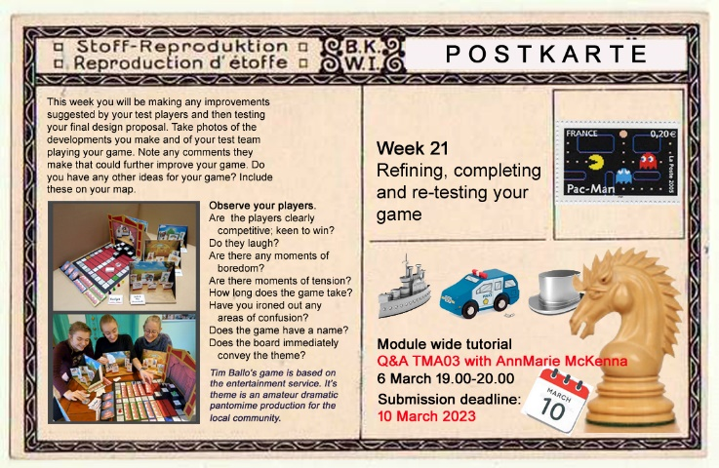


The Postcard Project (U101)
Aiming to improve retention through a small graphic intervention
Theodora Philcox and Elouise Huxor
Retention on U101 has been declining in recent years and so the module team have been investigating reasons for this. We have been exploring if there is any correlation between the level of communication between the tutor and their student groups and their engagement with the module materials.
Inspired by Sue Nieland’s eSTEeM project where students were sent weekly emails, we have set up a similar weekly communication, but to match the thrust of the module, ours are image based for quick consumption, highlighting key learning points and upcoming tutorial events.
Weekly digital postcards, designed by the project leads, will be emailed out by the tutors of 13 groups – one in each region.
No new material is provided, to ensure the pilot group have no academic advantage.
All cards are mailed out BCC to comply with GDPR.
The impact of this intervention will be evaluated through using OU Analyse and Power BI, and interviews with tutors within the pilot, to track engagement and retention.

