Slide 1


Virtual microscope and students:
What support strategies work and why
Christothea Herodotou
Professor of learning technologies and social justice
Institute of Educational Technology
eSTEeM seminar series, 21st Sept. 2022
Notes:
I am Thea…
Kate could not join is today.
My presentation is about the new version of the VM and its assessment with OU students

Slide 2
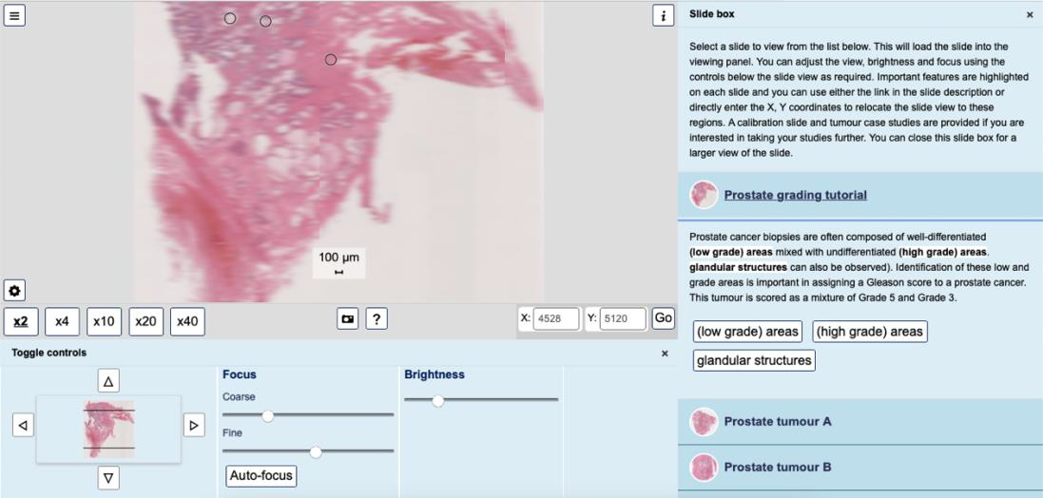
An overview of the VM showing slides of prostate tumours
Herodotou, C., Fox., K. & Scanlon, E. (2021). Evaluation of the new version of the Virtual Microscope (VM) with OU students. eSTEeM funded project. Final Report.
Notes:
This is what the new interface of the VM looks like
We run the study prior to embedding the VM in OU courses.
Now it is use on one course S290: Investigating human health and disease
There is a not permanent link you can use to access it – the one I used for the study is below.
On this slide you can see a prostate tumour slide, the magnification area, focus and brightness control and slide descriptions.
https://students.open.ac.uk/shared/imd/tools/microscope/ver/1.0.0/?dataset=s290/s290_tumour_histopathology

Slide 3
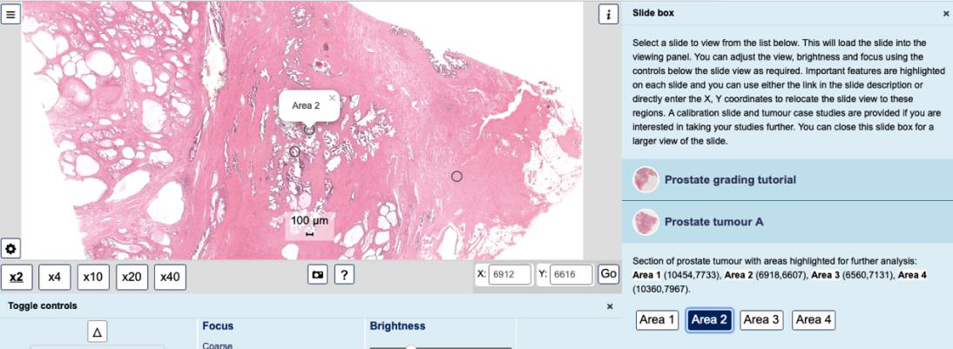
Areas for further analysis highlighted for each slide
Herodotou, C., Fox., K. & Scanlon, E. (2021). Evaluation of the new version of the Virtual Microscope (VM) with OU students. eSTEeM funded project. Final Report.
Notes:
In this slides, some areas have been highlighted for further analysis by students – see area 2

Slide 4
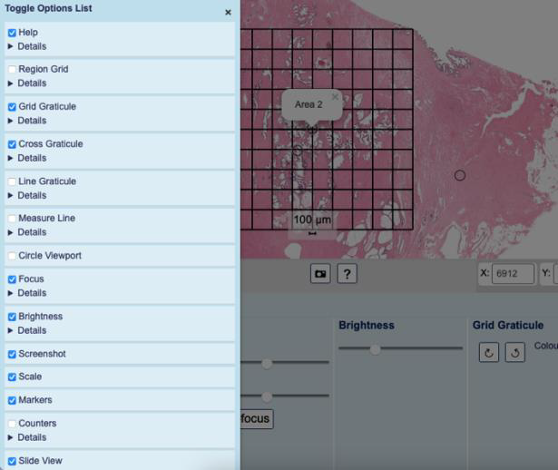
Additional functionality
Herodotou, C., Fox., K. & Scanlon, E. (2021). Evaluation of the new version of the Virtual Microscope (VM) with OU students. eSTEeM funded project. Final Report.
Notes:
And here you can see all available functionality – you can activate or deactivate any of the options on the list such as show or hide the region grid, measure line etc.

Slide 5
Existing studies about the VM (1/3)
Technical specifications of the microscope
  improving the client response time when requesting an image
  portability across computer platforms (Çatalyürek et al., 2003; Fereira et al., 1997
VM developments
  graphical annotation of slides,
  addition of hypertext links (Whalley et al., 2011),
  zooming,
  'share' button for embedding into external sites, and meta-data for each specimen
Notes:
WHAT DO WE know about theVM?

Slide 6
Existing studies about the VM (2/3)
students’ impressions of physical versus VM (e.g., Kumar et al., 2004),
students’ level of satisfaction and learning outcomes (e.g., Brown et al., 2016
the pedagogical integration of the VM in blended and online settings (Herodotou et al., 2019).
usability and learning issues students may face when interacting with it (Rehatschek & Hye, 2011).

Slide 7
Existing studies about the VM (3/3)
eSTEeM funded projects
  Students (Herodotou et al., 2019):
    VM in OU online courses vs blended courses at a campus-based university.
    Need for ongoing support and guidance when using the tool that can confirm or correct their interpretations of slides and clarify any misconceptions
  Teachers (Herodotou et al., 2022):
    12 Health and Earth Science university teachers, through in-depth interview
    the need for support through- out the lifecycle of a course, and while students are using the VM
    the design of VM learning activities that promote higher order thinking skills.
  How can we improve the design and/or integration of the VM in online courses to effectively support or guide students’ understanding?
Herodotou, C., Muirhead, D. K., Aristeidou, M., Hole, M. J., Kelley, S., Scanlon, E., & Duffy, M. (2020). Blended and online learning: a comparative study of virtual microscopy in Higher Education. Interactive Learning Environments, 28(6), 713-728.
Herodotou, C., Aristeidou, M., Scanlon, E., & Kelley, S. (2022). Virtual Microscopes and online learning: Exploring the perceptions of 12 teachers about pedagogy. Open Learning: The Journal of Open, Distance and e-Learning, 1-25.
Notes:
This study was based on a previous study funded by esteem about the VM.
We used the previous version of the VM

Slide 8
Aim and Research Objectives
Aim:
  identify which form of support works best with OU students by helping them to overcome potential difficulties while using the VM.
Research Objectives:
  how VM design characteristics facilitate or inhibit learning
  what type of scaffolding, that is,
    (a) live feedback from a tutor accompanied by basic activity explanations,
    (b) detailed activity explanations written in a workbook*,
    (c) basic activity explanations only
  works best to support students’ learning with the VM
*Workbook - informed by difficulties tutors and students reported over the years when using the previous version of the VM,
accompanying new VM version.
Herodotou, C., Fox., K. & Scanlon, E. (2021). Evaluation of the new version of the Virtual Microscope (VM) with OU students. eSTEeM funded project. Final Report.

Slide 9
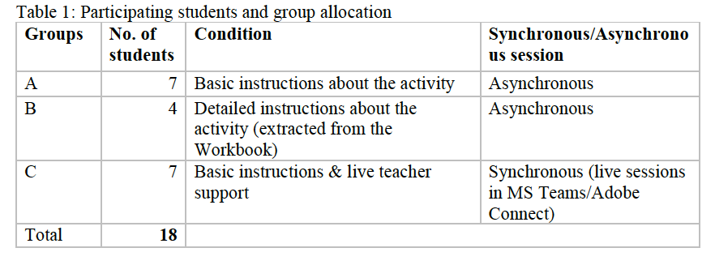
Sample
Herodotou, C., Fox., K. & Scanlon, E. (2021). Evaluation of the new version of the Virtual Microscope (VM) with OU students. eSTEeM funded project. Final Report.
Notes:
Refer to implementation here:Groups A and B completed the activity asynchronously while Group C synchronously in a live online session accompanied by a tutor. By the end of the activity all three groups completed a questionnaire assessing their experience of using the VM, difficulties they faced, use and effectiveness of support provided, and were asked for suggestions for improvements (See Appendix 2). Each student received an amazon voucher of £15 as a thank you gift.

Slide 10
Group A and C Basic written task instructions:
a brief overview of how a light microscope works,
how the digital microscope relates to a laboratory microscope,
a brief overview of how human biopsy samples can be used to assess the grade of prostate tumours
brief instructions for carrying out the activity - did not identify key features of the VM or its navigation.
Group B Instructions extracted from the Workbook
In addition to Group A and C instructions:
far more detailed: included step-by-step instructions for how to select the correct slide, navigate the site and samples, alter magnification, add a scale bar and graticule and how to use the Measure Line tool.

Slide 11
Data collection: Assessment task (marked)
Question 1. Were students able to capture and submit a clear image of the low-grade prostate tumour sample at x20 magnification?
Question 2. Were students able to accurately measure the width and length of a specific gland using one of the appropriate VM tools?
Question 3. Could students give a scientific description of a low-grade prostate sample versus a high-grade prostate sample?

Slide 12
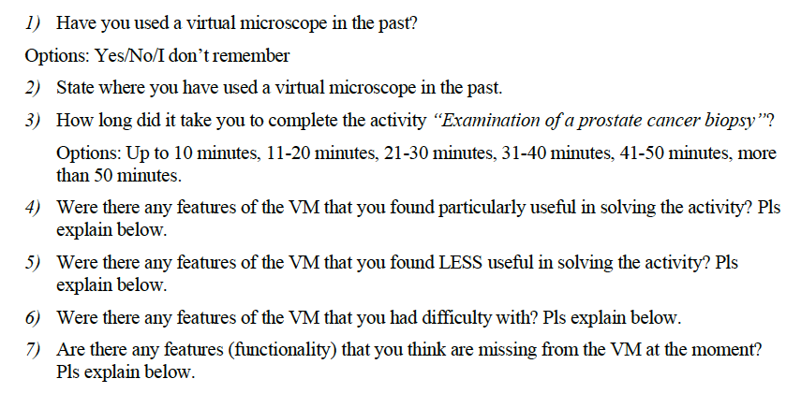
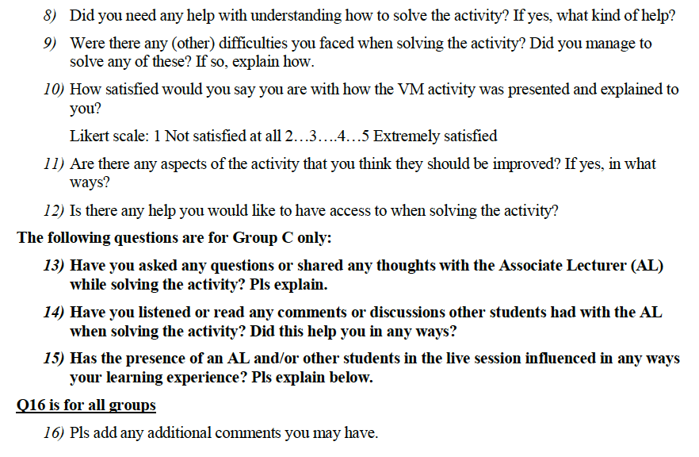
Data collection: Follow-up questionnaire

Slide 13
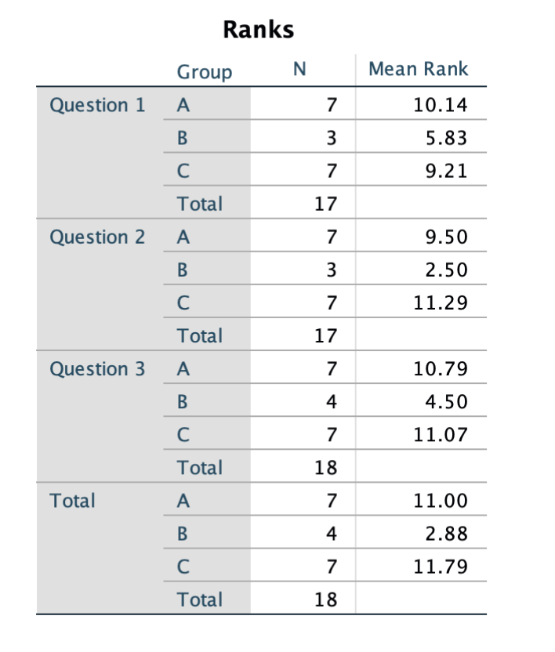
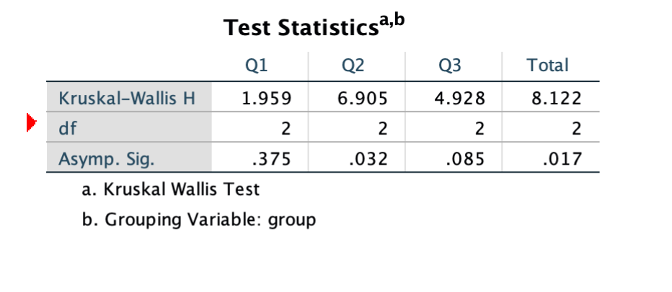
Assessment task
  R02: what type of scaffolding works best to support students’ learning with the VM?
Q2: Significant differences between the three groups (p=.032)
Group A (MeanRank=9.5) and Group C (MeanRank=11.3) scored higher than Group B (MeanRank=2.5)
These insights suggest that Group B that had access to detailed activity guidance (extracted from the Workbook) performed less well in Q2, than the two other groups that had access to basic instructions and, Group C to a teacher
***Preliminary insights, small sample, confounding variables
Notes:
Exploratory, larger sample, previous best score may explain differences –confounding variables

Slide 14
Questionnaire
Facilitating features:
  measuring line tool - useful yet difficulties in finding and using it,
  instructions, the autofocus tool, and brightness adjustment
Inhibiting features:
  Identifying different tools on the VM interface (brightness, graticule, measurement line, drop-down menu with additional functionality),
  Double measurement functionality,
  A scale bar with more numbers to improve accuracy of measurement,
  Mark of the coordinates,
  Slide name clarity.
RQ1: how VM design characteristics facilitate or inhibit learning
Across groups:
  students had used a VM in the past (SK299, SDK100, SD111, SD112)
  30+ minutes needed to complete the activity.
  Satisfied with the design and presentation of the VM activity
  Some needed help to complete the activity.
Notes:
Of most interest are students’ responses to features they had difficulty with or they considered as missing from the VM

Slide 15
Group C- synchronous session in MS Teams
Students asked the tutor questions, listened or read discussions
These conversations helped e.g., how to rotate the measurement tool.
The presence of the tutor made the experience feel like a tutorial (instant response).
Increased student confidence - any issues would be resolved immediately.
A student noted that they would like to use it on their own time should they have access to help resources or someone to contact.
Importance of immediate or instant support while students are engaging with the VM e.g., a live session, email or chat

Slide 16
Conclusions
In all three groups:
Students noted difficulties with completing the activity
  missing VM features or features they could not identify).
All stressed the importance of immediate or instant help that would help them resolve any difficulties they faced.
  helpdesk with quick replies, email/chat functionality, live support.
Students in the live support group:
importance of having a tutor while completing the activity; this boosted their confidence by having any issues resolved immediately

Slide 17
Thank you! Your questions?
christothea.herodotou@open.ac.uk
eSTEeM seminar series, 21st Sept. 2022

