Slide 1
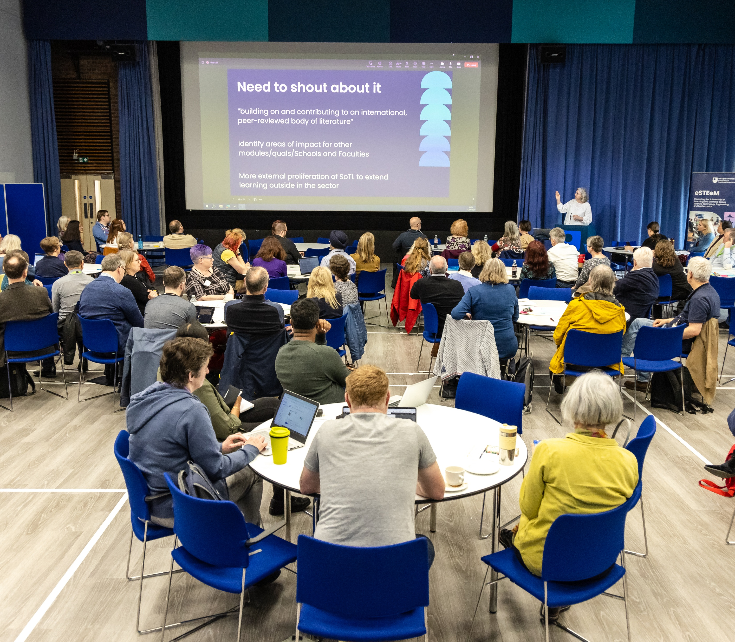
Intro Slide Title 2
15th eSTEeM Annual Conference
29-30 April 2026
Teaching Innovation Talks

Slide 2


Teaching innovation in SPS – using tablets to facilitate discussion-based assessments
Becca Whitehead, Gemma Warriner and Judith Croston

Slide 3
Why use discussion based-assessment?
Our online assessment is becoming increasingly vulnerable to the use of Generative AI to answer questions
Part of our response to this could be to have conversations with students to ensure that they are answering questions in real time and the person we are expecting to be there
With the rapid improvements in AI it is now very difficult to be sure that a student in an online setting is answering any questions without making use of AI?
With the improvement of video avatars would we be able to spot that a student wasn’t real?

Slide 4
Challenges of online discussion in STEM
In STEM subjects we typically want to discuss topics that include graphs, diagrams and equations which is challenging in an online conversation
We propose that a tutor and student using a graphics tablet in an adobe connect room can have a natural and authentic discussion that is resilient against Gen AI
We have a three-phase eSTEeM project underway to test if this method can be used for repeatable and reliable online assessment
Phase 1 – six tutors all taking part of tutor and student COMPLETED
Phase 2 – two ALs testing assessment with 14 students UNDERWAY
Phase 3 – we will test concepts further with ~80 students 26J

Slide 5
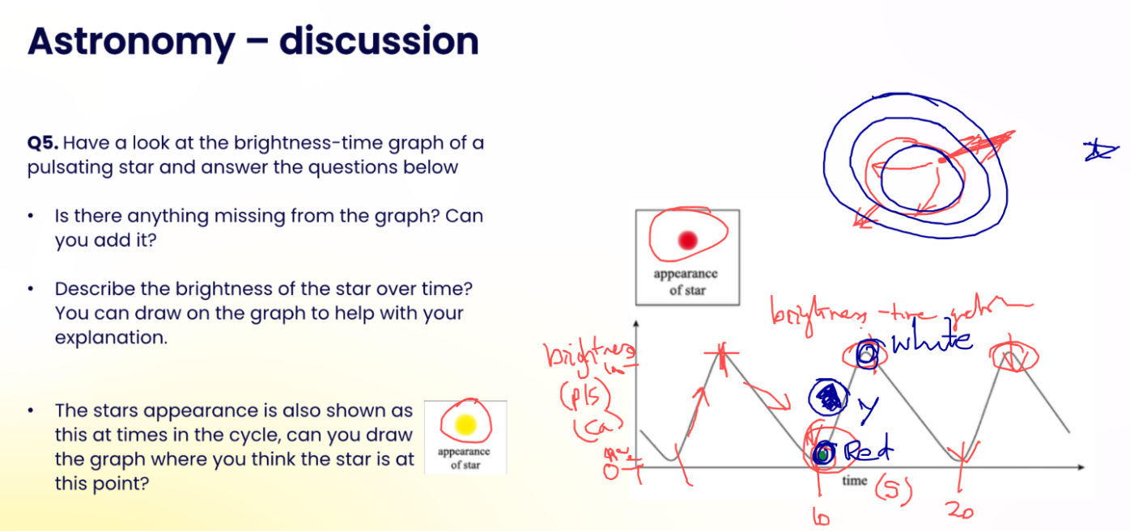

Slide 6
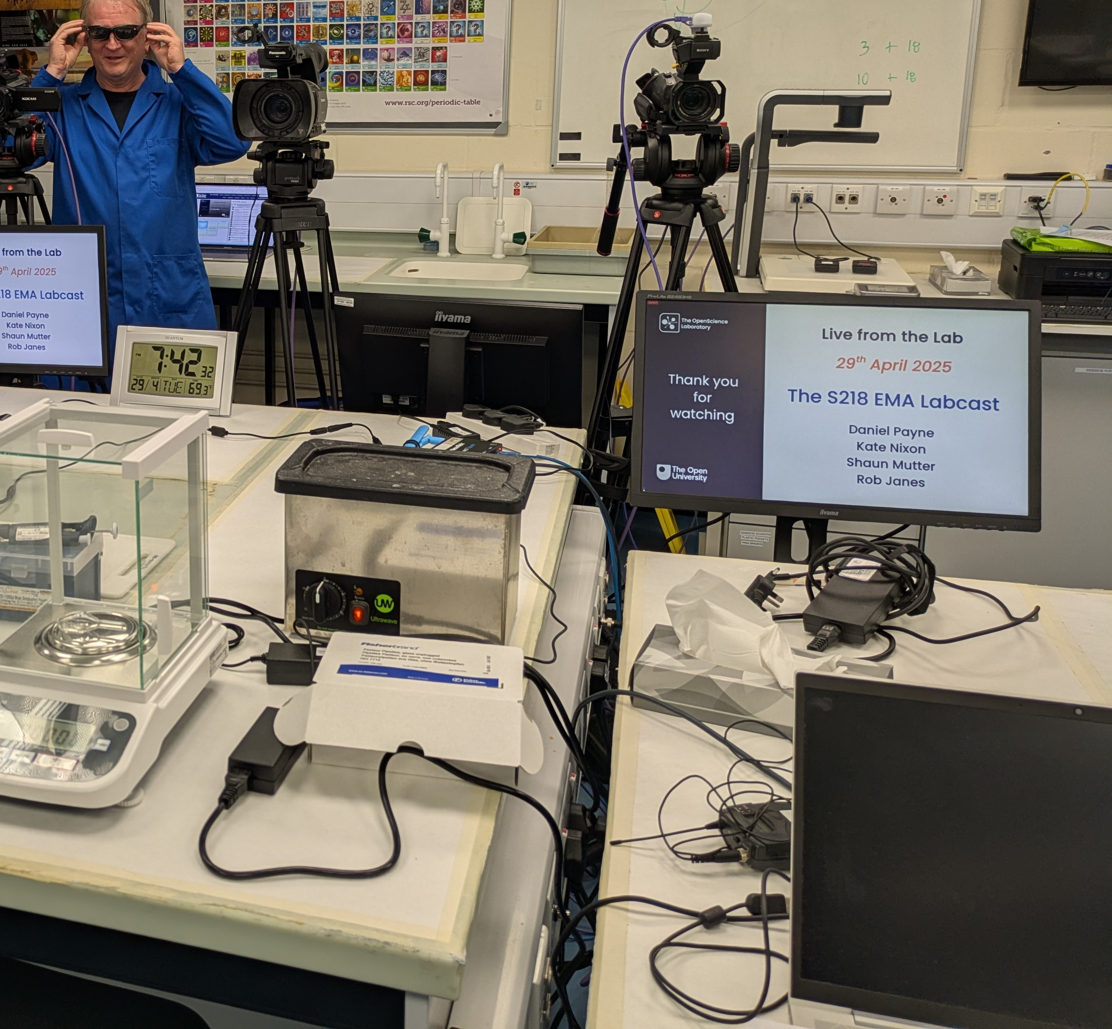
Using labcasts to make chemistry assessments more authentic
Shaun Mutter, Daniel Payne, Kate Nixon, Rob Janes
School of Life, Health and Chemical Sciences
29th April 2026

Slide 7
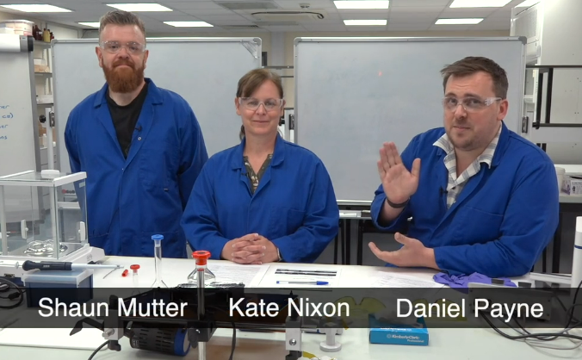
Introduction
Labcast on S218 Concepts in chemistry
Live event filmed within the laboratory
Synoptic experimental investigation combining multiple topics from the module
All aspects of the labcast contribute to the EMA

Slide 8
Investigation and aims
Measuring the kinetics of the photoisomerization of azo-dyes
Part 1: Chemical synthesis
Part 2: Demonstration of “photo switching” by irradiation
Part 3: Measure the rate of relaxation
Example of a “real-world” chemical problem due to azo-dyes possible applications
Part 1: Synthesis
Part 3: Relaxation
Part 2: Irradiation

Slide 9
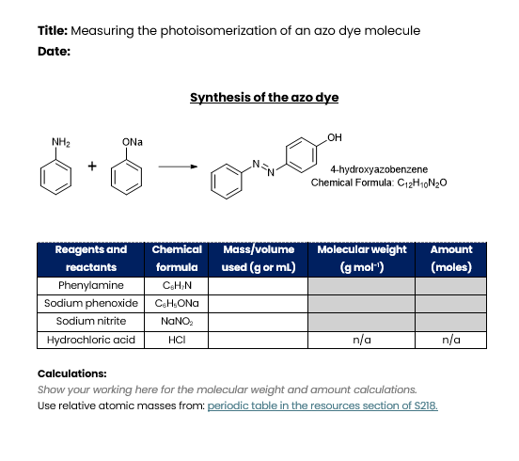
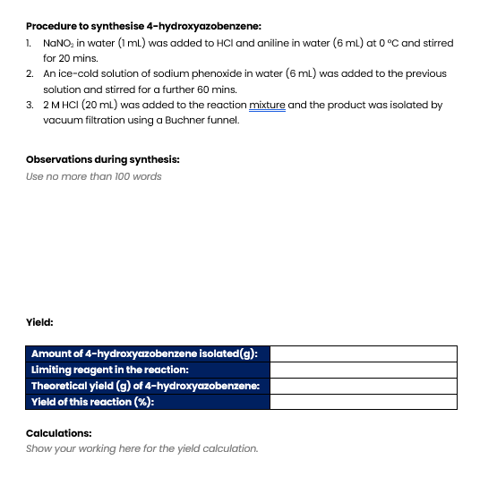
“Lab book page”

Slide 10
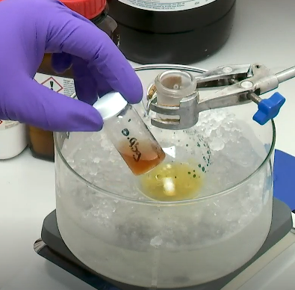
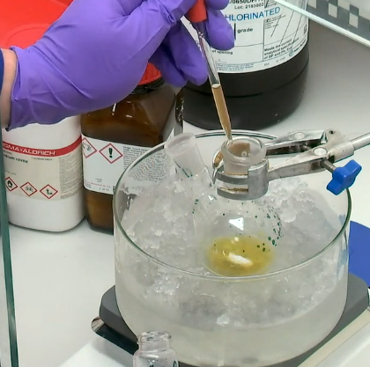
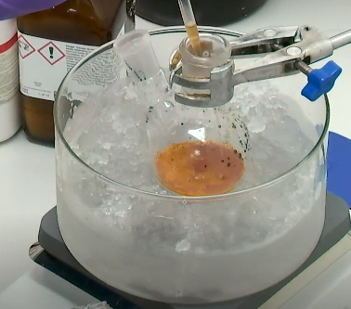
Live chemical synthesis

Slide 11
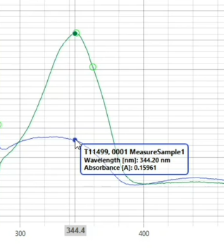
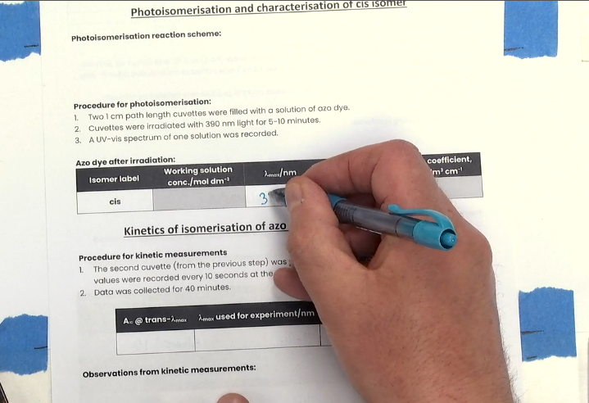
Observations

Slide 12
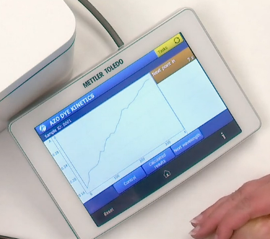
Live generation of data
Full datasets are generated live
Students can see the data as it is generated
This data is provided to students after the labcast
Analysis of this data is assessed in the EMA

Slide 13
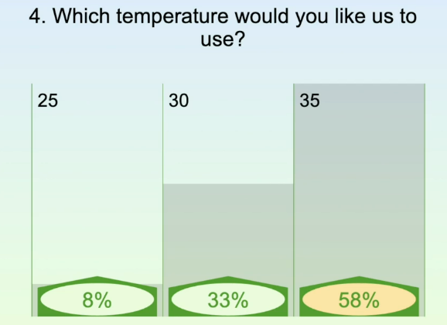
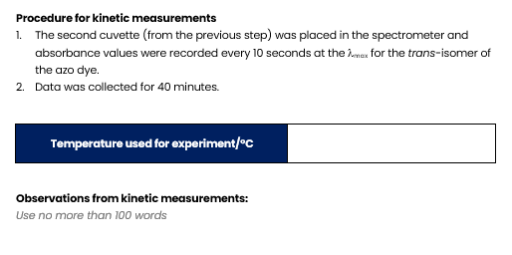
Student interaction
Interactive widgets give students the opportunity to choose experimental parameters
These parameters impact the datasets

Slide 14
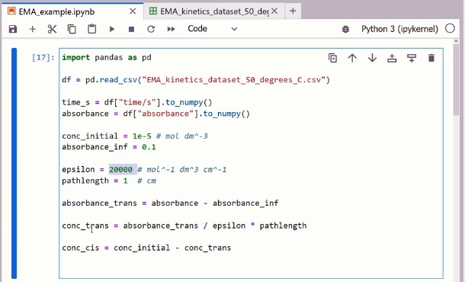
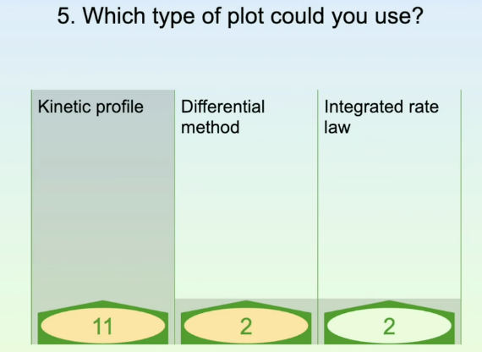
Analysis
Guidance on approaches for analysis is provided

Slide 15
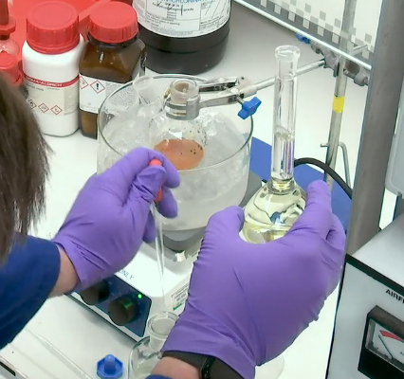
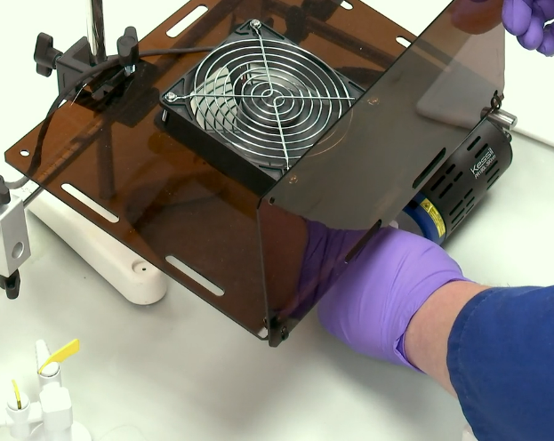
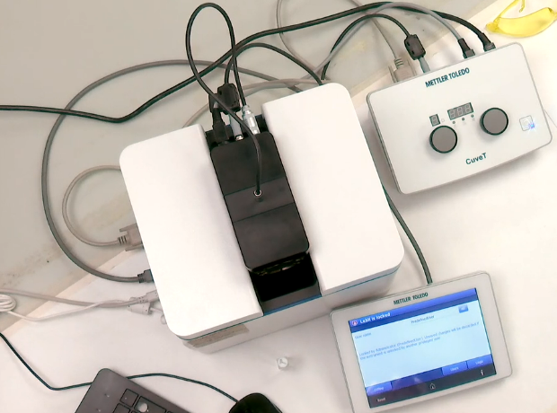
Authenticity
The entire labcast contributes to the EMA
- Observations and record keeping
- Data generation
Increases student engagement
Real world chemical problem using “real” data (with experimental noise) that the students have input on
Scientific record keeping skills are assessed for a live experiment
The labcast directly contributes to ~50% of EMA marks
Remainder of the EMA uses the same theme as the experimental investigation

Slide 16
Thank you

Slide 17

Lessons from Teaching Environmental Scientists Coding
Dr Phil Wheeler
School of Environment, Earth and Ecosystem Sciences

Slide 18

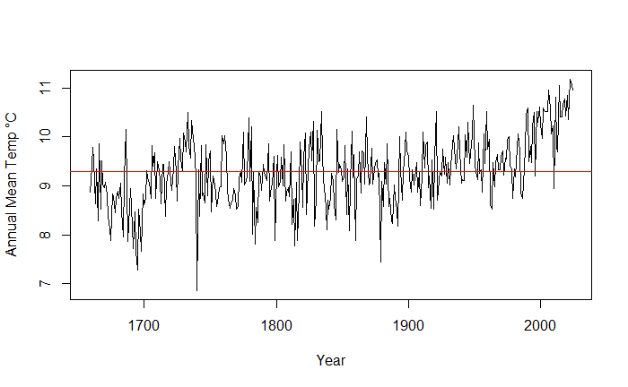
Why code?
An essential tool for 21st Century environmental science
More accessible than other ways to teach data skills
Empowers students to take control of their learning
A steep learning curve, but limitless opportunities
For God’s sakes Jim! I’m an Environmental Scientist, not a computer programmer
plot(Annual~Year,
data=cetr,type="l",
ylab="Annual Mean Temp °C")

Slide 19
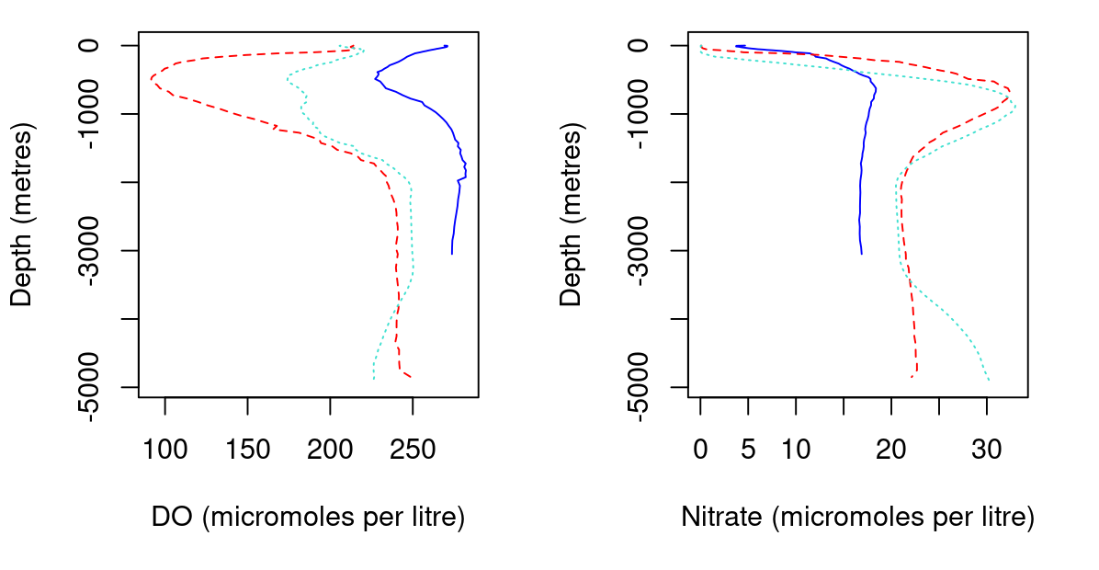
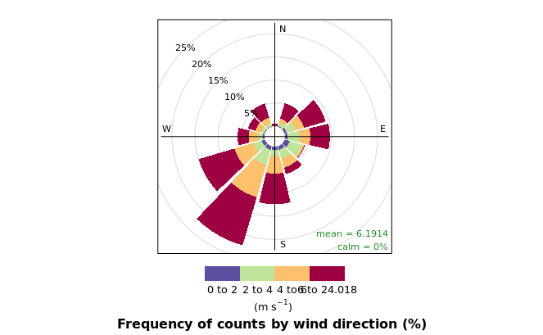
Aims for S226
Learn about coding not (necessarily) ‘how to code’
Simple organising and managing data
Summarising, plotting and basic analysis skills

Slide 20
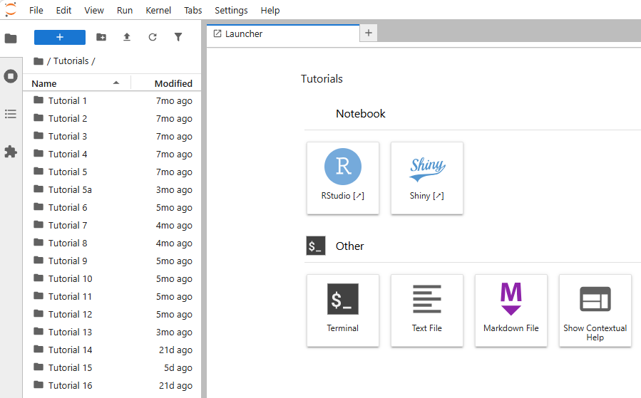
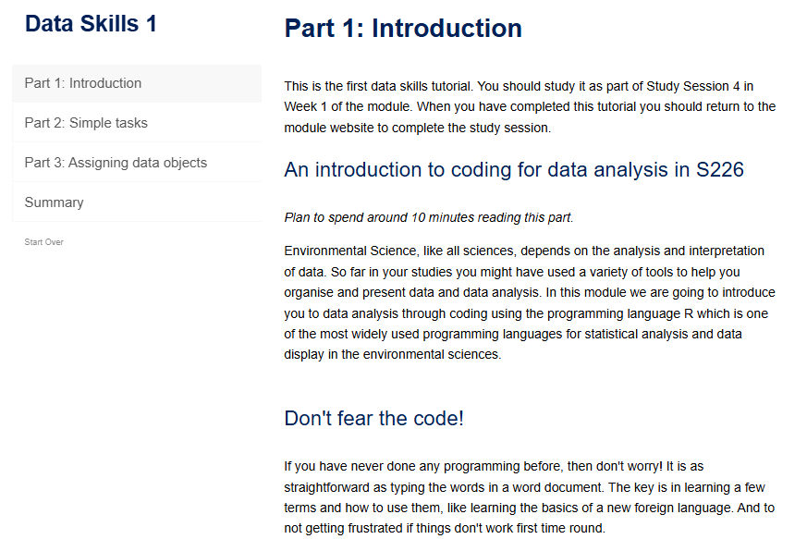
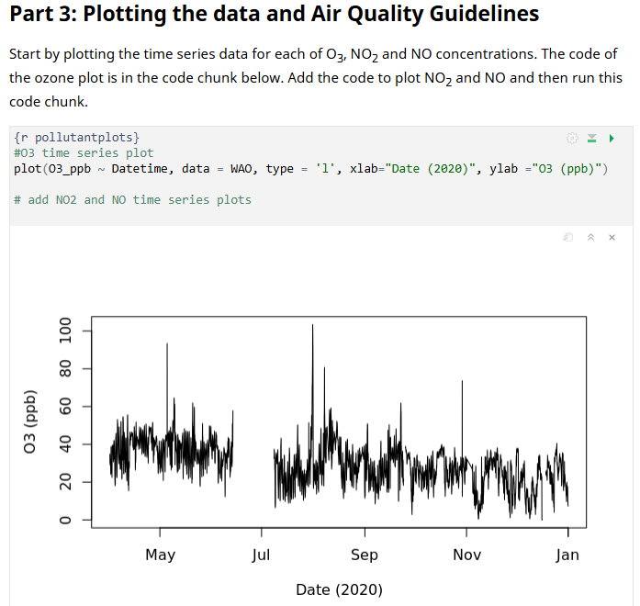
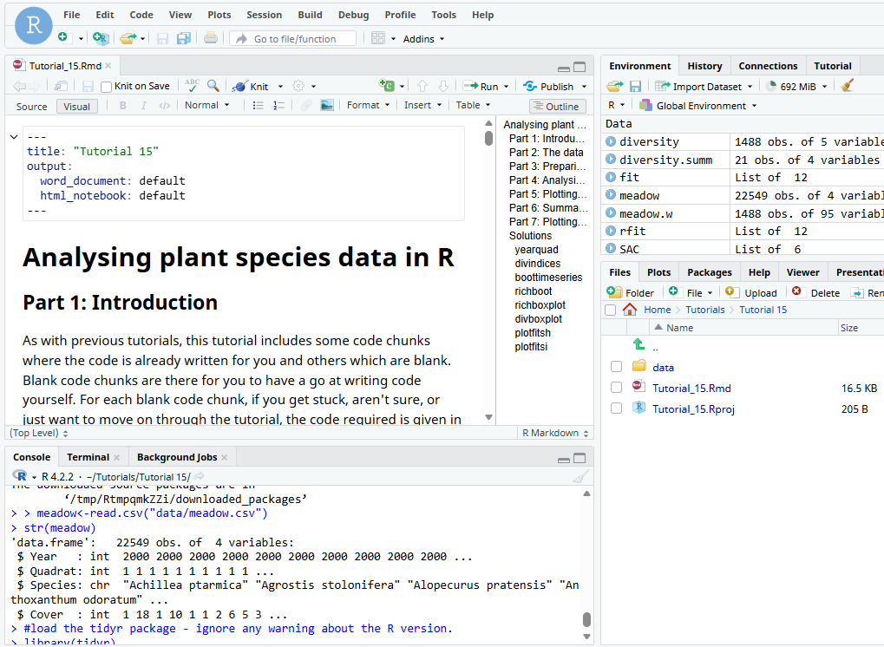
Tutorials in the OpenComputing Lab
Structured tutorials linked to module content:
Introductory tutorials in Shiny and learnr package
More advanced tutorials in Rstudio with RMarkdown Notebooks
Notebooks generate ‘instant’ alternative formats

Slide 21
How did it go?
OCL worked well: v. few access issues
Plenty of forum support required
Need to train tutors
Mixed experience from student perspective:
Most felt challenged, some liked the challenge, others not
Activities took some students longer than expected
Lack of engagement with ‘solutions’
Frustrations with glitches
Many comfortable with coding independently by later stages

Slide 22
Thank you for listening!

Slide 23
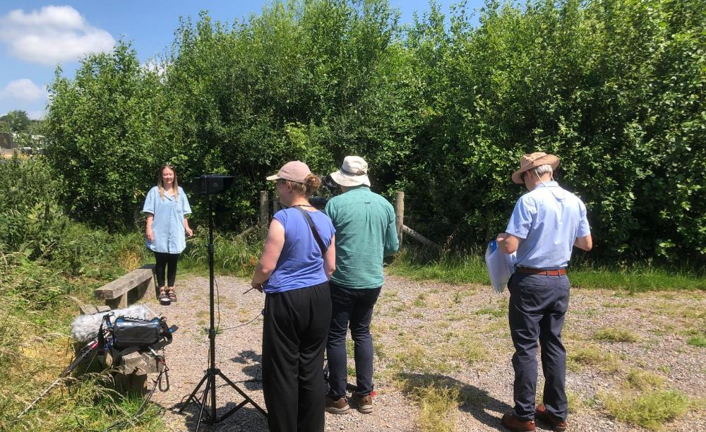
Intro Slide Title 1
Building awareness of values in environmental managers
T330 Environmental Management: Pathways to Sustainability
Leslie Mabon
School of Engineering and Innovation
29/04/2026

Slide 24

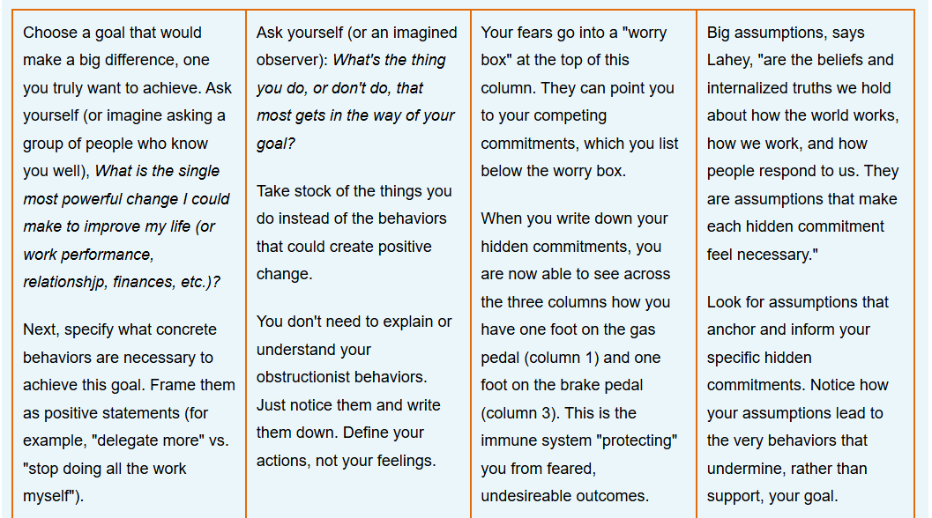
Slide Title 22
The challenge
T330: level 3 environmental management module, first presentation 25J;
Broad student base: environment, engineering, open degree;
Climate change and biodiversity: value-driven, emotive. Links between personal and professional?
How to guide technically-minded students through values and reflection?

Slide 25
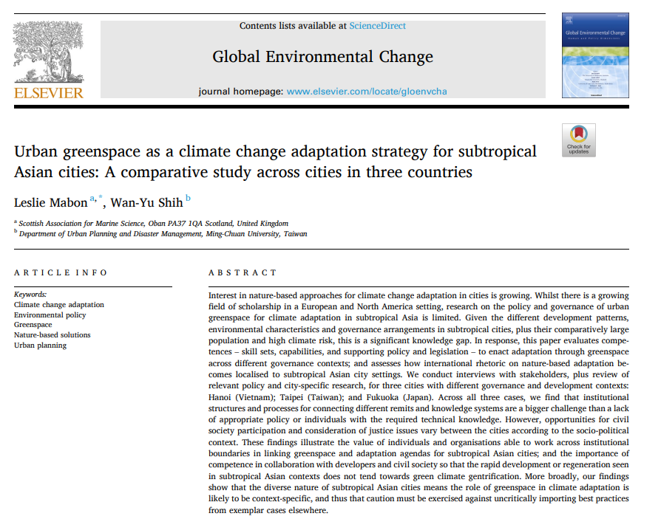

Slide Title 22
Competencies
Running theme: competencies for environmental management;
Competencies: skill sets and knowledges for complex sustainability challenges – professional competency frameworks;
Research-led: ethical/ normative competence (Mabon + Shih, 2021);
Students reflect on their own competencies across their learning journey, including in assessments.

Slide 26

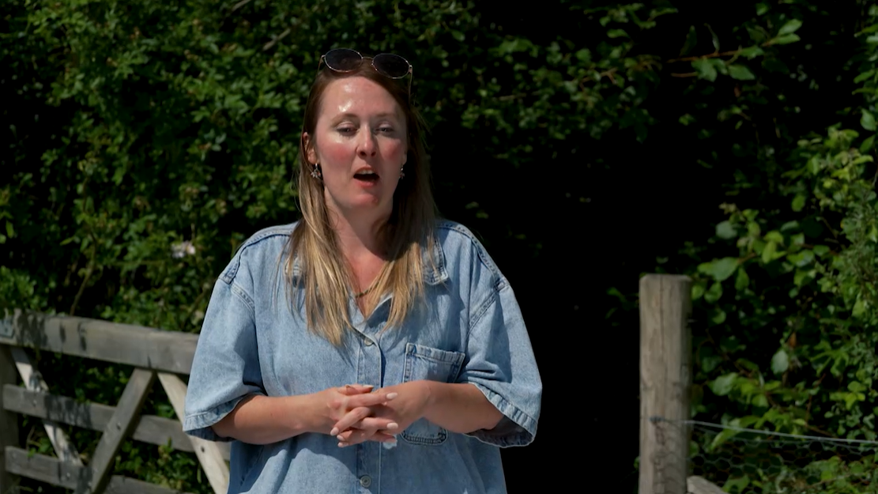
Slide Title 22
The student journey
Early blocks: individual level -> immunity to change, eco-anxiety, calls with tutors – build confidence in reflection;
Later blocks: the environmental manager in the community, 2x student EDIA interns on urban environmental management – get students thinking ‘what next?’
E-journal – most popular item on VLE! – and Digital Badges (Sustainability Literacy; Scientific Report Writing).
Andreea Chitescu
T330 EDIA Intern
Hayley Graham
T330 EDIA Intern

Slide 27
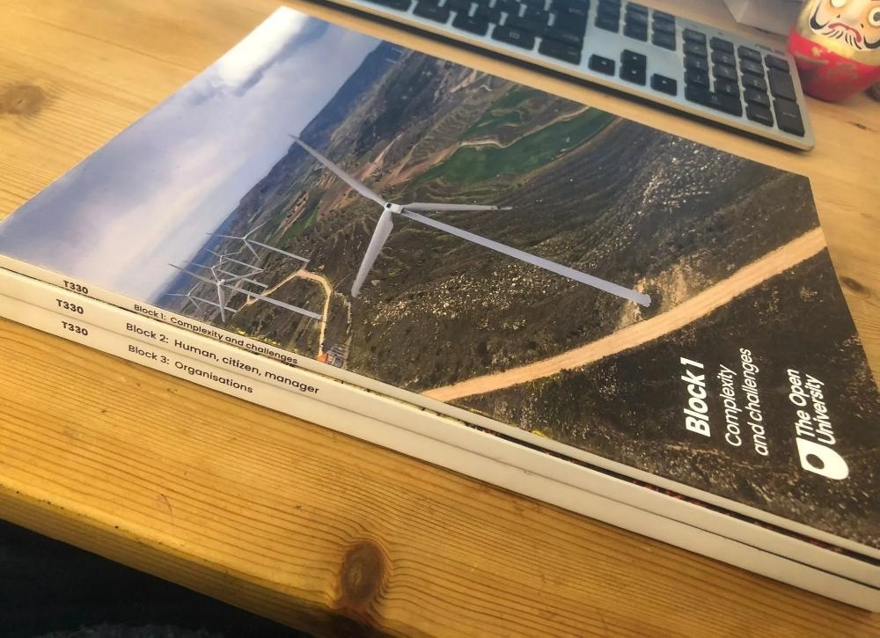
In sum
Understanding values important for environmental management: not one ‘right’ answer or outcome!
Move beyond ‘environmental manager’ as government/company employee – environmental managers in community;
Make reflection on values less intimidating for students: introduce early and build confidence;
Demonstrate importance of reflection, articulating values and showing competencies within professional development.
T330 Module Production Team: Block authors/module team: Leslie Mabon, Daphne Chang, Kevin Collins, Chris Corcoran, Jenny Duckworth, Alice Fraser-McDonald, Andy Lane, Stephen Peake, Tarek Rashwan, Catherine Rolph
Curriculum manager: Nathalie Richard

Slide 28

Beyond Detection: strategies
for assessment integrity in the
GenAI era
Dr. Soraya Kouadri Mostefaoui and Stuart Auton
STEM-C&C
Soraya.Kouadri@open.ac.uk
Stuart.Auton@open.ac.uk

Slide 29
To GenAI or not GenAI
Resistance
Early adopters / lack of clear guidance
Different approaches in different modules - confusion-
Most detection tools perform poorly on GenAI content and produce false positives that disproportionately flag non-native English speakers. Turnitin's own documentation acknowledges significant error rates.
So far….
Process visible questions
Case study based questions
Collaborative tasks
Reflection questions
AI-transparent assignments

Slide 30
Slide Title 30
Thank you

Slide 31
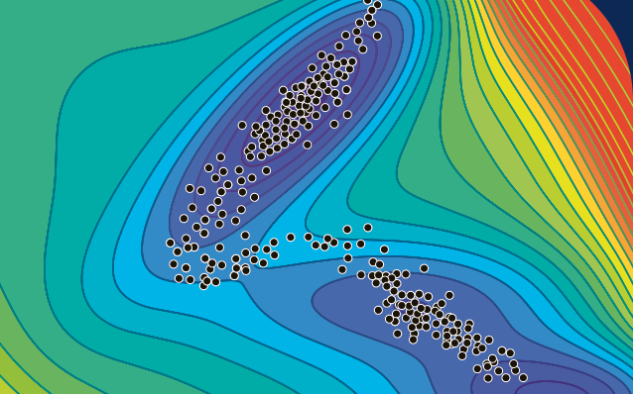
Computational Applied Mathematics
Optionality in a
Stage 3 emTMA
(MST374)
Tim Lowe
MST374 Module Team Chair
School of Mathematics and Statistics

Slide 32
MST374: Computational applied mathematics
Student population (25J: n=395)
Maths (Q31, Q36, Q46) | 33%
Physics/Science (Q77, R51, Q64, M06, F77) | 23%
Data Science/Computing (R38, Q67, F66) | 18%
Open (QD, R28) | 12%
Engineering (Q65, M04, Q78) | 7%
Standalone | 6%
Economics (Q65) | 2%
Final unit (Unit 10): 3 Case studies
covering areas of
applied maths
theoretical physics
data science
(topics vary each presentation)
TMA 04 (emTMA)
[30% of module score]
One question on each Case study
Students answer one of them
Notes:
A popular module attracting students from a range of disciplines …
Want to make the final assessment attractive and relevant to the individual students’ interests, so a choice

Slide 33

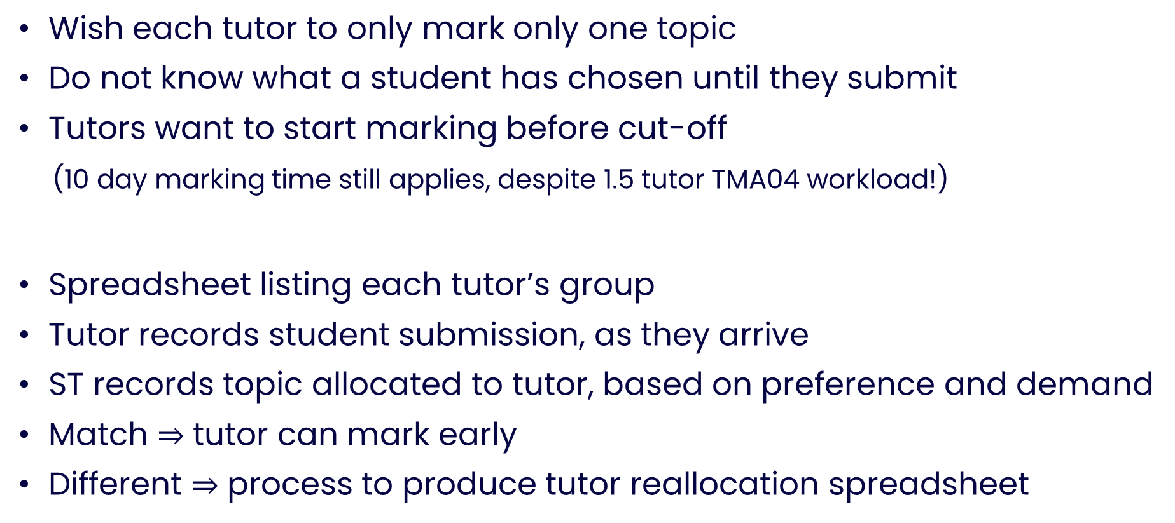
Problem
Wish each tutor to only mark only one topic
Do not know what a student has chosen until they submit
Tutors want to start marking before cut-off
(10 day marking time still applies, despite 1.5 tutor TMA04 workload!)
Spreadsheet listing each tutor’s group
Tutor records student submission, as they arrive
ST records topic allocated to tutor, based on preference and demand
Match $⇒$ tutor can mark early
Different $⇒$ process to produce tutor reallocation spreadsheet
Solution

Slide 34
Slide Title 8
Standardisation of TMA 04 (emTMA) question marks
Regulations permit it
TACQ discourage it (assume a tutor rather than question issue)
SAMSA does not support it
Agreement with TACQ
Module team offline standardisation (using CIRCE data and knowledge (spreadsheet) of what topics students did)
Manual mark replacement in SAMSA by TACQ
Only needed for 1 of 2 presentations so far . . .

Slide 35

Slide Title 8
The future . . .
Stage 3 emTMA illegal under New Assessment Framework
Will need to move to an EMA
Unclear how specialist marking can continue
Non-submission of EMA $⇒$ fail
Removal of TMA 04 marking from AL FTE, replace with EMA marker allocations?

Slide 36
Slide Title 31

