Slide 1
Support for Students. Teaching for Tutors. An Investigation into Ideas on Encouraging Students to Engage
Dr C Peoples
cathryn.peoples@open.ac.uk
15 December 2021

Slide 2
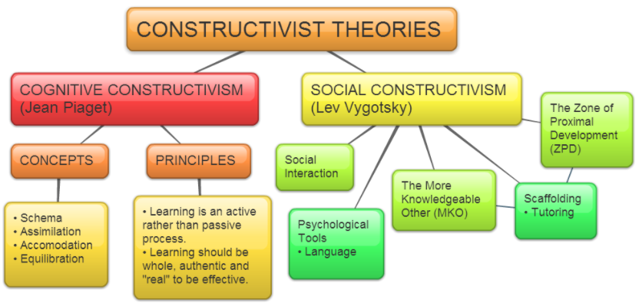
Project Goals (1/2)
1. To encourage student interaction
https://www.structural-learning.com/post/embracing-the-learning-theory-constructivism
Notes:
There was a first phase of this project.
The intention of the second phase was to try to encourage the lower-performing cohort to engage.
According to the social constructivist model of learning, social elements are considered to be important through their positive influence on the educational experience. When students engage in an online model of learning, however, they may do so with a view to exploiting the asynchronous benefits that it allows.

Slide 3
Project Goals (2/2)
1. To acknowledge the input from tutors to support such a programme in practice.
Notes:
This second phase of the programme also varies in that another Associate Lecturer (AL) became involved in delivery of the personalised support, with a view to supporting understanding of the impact of running the programme on a per tutor basis, and the overhead involved if this scheme were to be rolled out in a more widespread way. From the perspective of the co-AL, the scheme was, as expected, found to be an extra commitment beyond the work that an AL is expected to do. Ultimately, the AL was glad when the programme came to an end, although he did find the experience to be a positive one. This was from the perspective of having very focused weekly tutorials, in addition to having the opportunities to get to know some of the subject material much more closely.

Slide 4
Who are our students?

Slide 5
What makes you proud?
“To pinpoint the one aspect I am most proud of would be my partner and family.”
“Personally, my 3 children: Jake, Charlie, and Daisy.”
“My Son”
“These days, I'm proud of my family, and particularly the way my two young boys (4 and 8) are turning out. I should also mention, I have a very patient and understanding wife!:)”
“My son Frank, my husband Mark”
“My wife and children”
“Balancing raising a child, studying and working all full time.”
“Probably my children - sorry!”
“I recently became a father in July”
“My son”
Notes:
Out of 18 responses to this question, 10 around family

Slide 6
Is there anything else you would like me to know?
“Before starting my studies at the OU my only other educational experience was back in 1996/7 where I studied a GNVQ advanced in IT at college. The course touched upon the areas of programming with Pascal, secretarial studies, and embedded systems. I found that this course was not very well organised and after completion I moved into studying media rather than continuing in further in IT. My main struggles back then were with the quality of teaching and the lack of support for my dyslexia. Although I have a different, maybe more grown up approach to my studies now, I still find that it can take longer for me to absorb certain aspects of programming, for example seeing a problem and working out an efficient approach to solving it. Something I feel that my study of M269 will help rectify.”
“My mum is in and out of hospital for last couple of years and is awaiting a Liver transplant and expected to be on Dialysis. She was also expecting a Kidney transplant which has now been ruled out. This means unexpected disruption mentally at any time. PreCOVID it also meant additional travel time to support. Butin this COVID world I cannot visit or pick up from hospital or even go to my parents house.”
“I've reduced my hours at work compared to last year but I now have a 4 month old baby and I'm unsure how much of an impact this will have in my time management.”
Notes:
Out of 18 responses to this question

Slide 7
Is there anything else you would like me to know?
“In the past year and a half I have found the level of study manageable, but as the subjects are becoming more advanced I feel that having extra support would help aid me in achieving the most from the course. I found toward the end of M250 I became fatigued and struggled with some of the concepts, something I wish to avoid over the coming year. I believe my dyslexia tilts my confidence when I hit barriers in my understanding and ability to convey my understanding (if that makes sense). I found this slowed down my progress overall and with other subjects running along at the same time this started to cause a backlog as I was spending more time stuck on one subject and less time on the others. Taking part in program I hope to learn how to overcome some of these problems as well as being able to have the confidence to reach out for help when I need it.”
“During the 12 modules I’ve studied previously, I’ve been guilty of not interacting enough with tutors, or the rest of my cohort. In hindsight I think that’s probably been to my detriment, and I may have missed out on opportunities. In my current job I take a lot of pride in supporting my staff, and I’ve seen the benefit it has given them. So, hopefully that could work for me going forward!”
Notes:
Out of 18 responses to this question

Slide 8
Is there anything else you would like me to know?
“I've been aiming for at least a 2:1 from the outset. Unfortunately I failed a year 2 module exam due to other things happening in my life at that time and only got a grade 4 pass for the resit. My grades are currently hovering just below the 2:1 threshold and If my appeal against the standardisation which was applied to my TM351 module result is unsuccessful I will require a grade 2 in this andTM470 to be sure of a 2:1. Ordinarily this wouldn't phase me however the prospect of an open book exam in this module in June and will no doubt lead to higher than average results more standardisation algorithms being applied. With this in mind I feel I will need to secure a score considerably higher than the usual 70% in order to achieve at least a grade 2 in this module. With this in mind I intend to take advantage of as much help as I can.”
Notes:
Out of 18 responses to this question

Slide 9
You have decided to participate in the co-designed and personalised student support. What is your main reason for opting in?
“Curiosity more than anything. I'm the sort of person that would normally shy away from things like this, but to be honest, I'm probably one of those most likely to benefit given my situation. With regards to the seizure that I had on the morning of our first tutorial, this was my first in almost 5 years. Last week was pretty awful, mostly because of having to re-adjust to my medication, but I'm now feeling surprisingly well. I think I'm just going to have to be careful in future, and just keep an eye out for any warning signs. I will let you know should I have any problems.”
“Because during previous modules I have studied with the OU, I have at times suffered in silence when I haven't really understand something or was unsure of my approach, and this has sometimes reflected in my exam results. (I have passed all exams but my scores haven't always been a true relfection of my ability!”
“Over the years with the OU I've learned good bunch of tricks and practices on how to study actively and remain engaged to pass the exam. I had never had a change to learn from anyone else in terms of how they approach their online studies. Maybe there is something that I'm missing out on.”
“I have been diagnosed with Autism (Aspergers') in the last two years and I have struggled to ask for support as I'm not100% sure of what support I need as I have always just had to cope and so it's the norm for me.”
“I found that last year I had struggled to remain on schedule for a couple of months and I felt detached from my studies.”
Notes:
Out of 18 responses to this question

Slide 10
Is there anything you would like to know about me?
“… how you have overcome problems in your studies. What tools or techniques have you found helpful?”
“How do you find time in your day to do everything?!”
“I was quite curious about the bit about interplanetary networking. I had never really even thought about that, but I'm curious now. If you have any interesting reads to recommend, that might be something to pop in my reading list.”
“What motivates you to teach students?”
“Any information about research or work you have done either inside or outside the OU would be interesting.”
“How did you manage to break into the IT industry?”
“When and how would you most prefer to communicate. What do you most enjoy about tutoring TM354?”
Notes:
Out of 18 responses to this question

Slide 11
Activities - Diaries

Slide 12
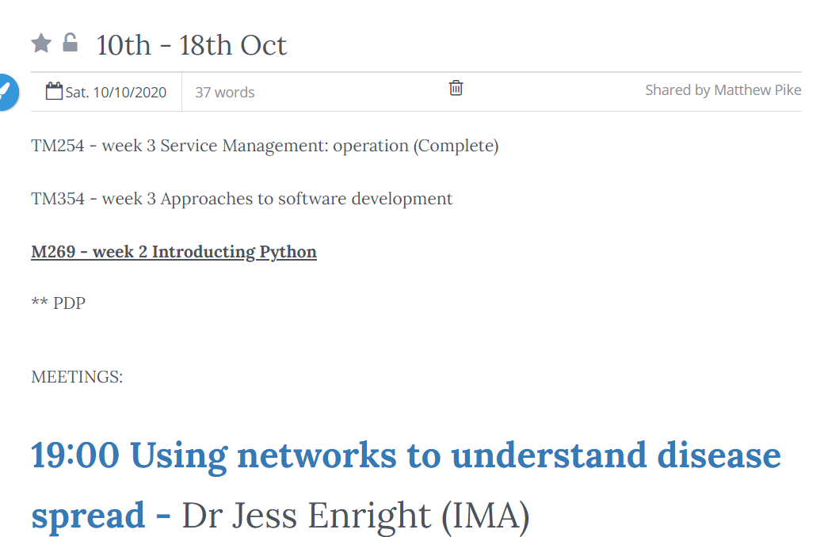
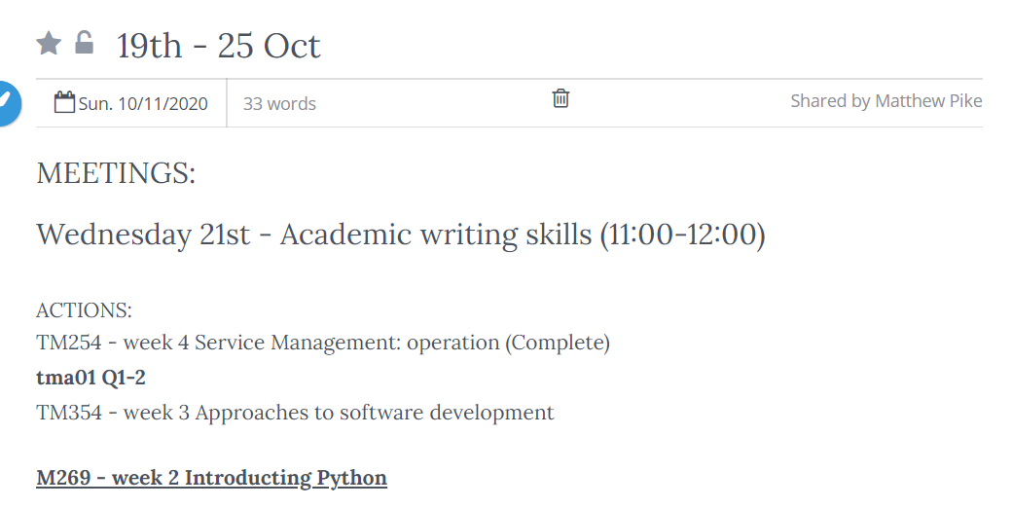
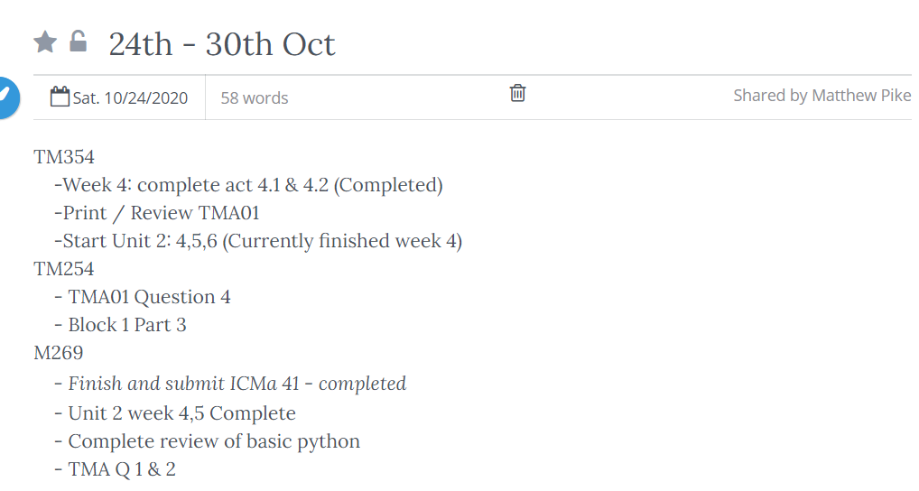
Diary Entries

Slide 13
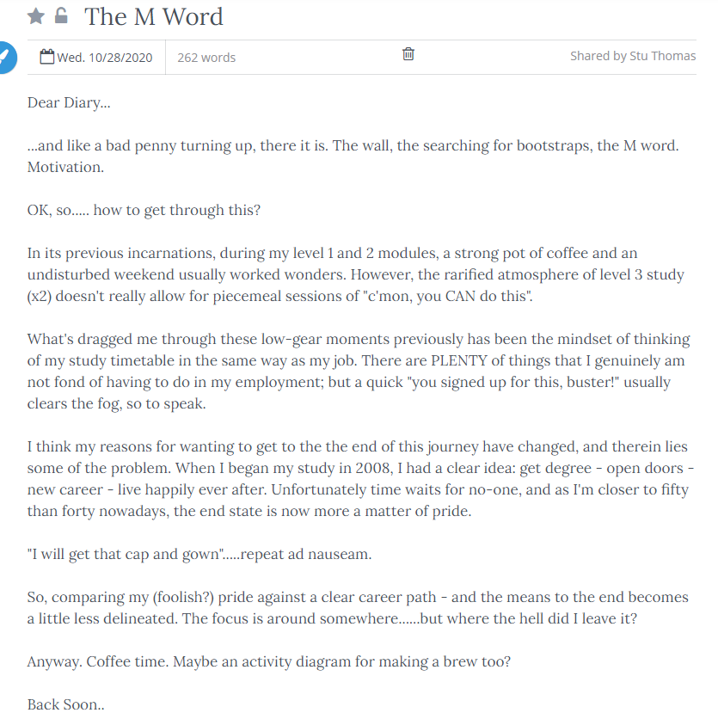
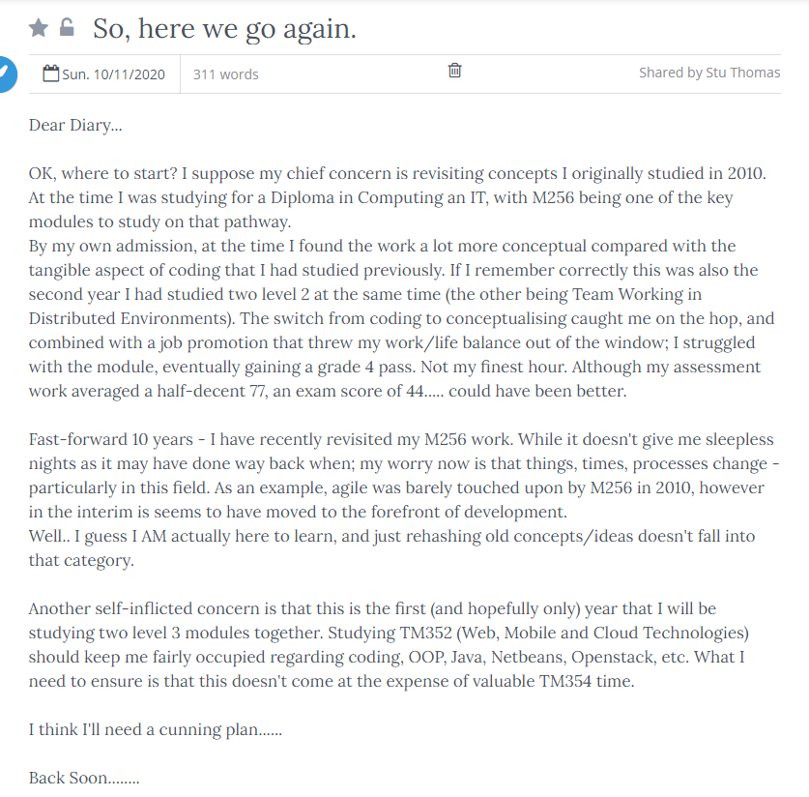
Diary Entries

Slide 14
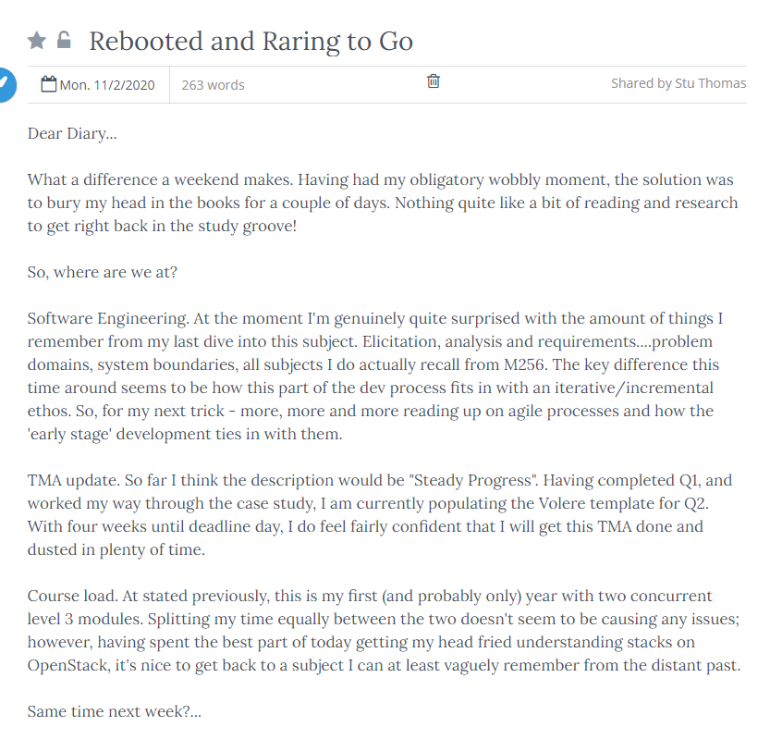
Diary Entries

Slide 15
Activities – Peer Learning

Slide 16
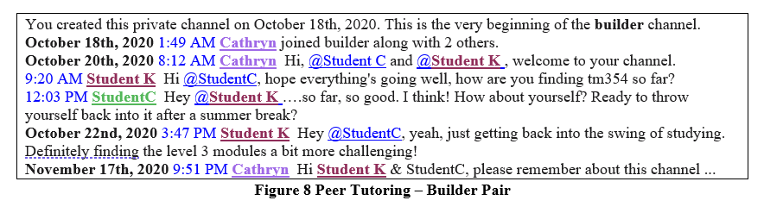
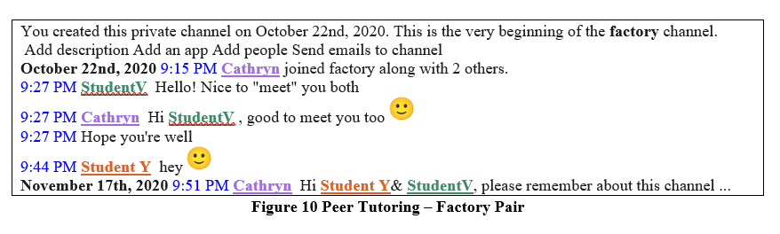
Peer Learning

Slide 17
January 2021 Review

Slide 18
Are you currently participating in the personalised support project? & Would you like the opportunity to explore the personalised support?
“No, I don't feel that I need extra support on this module.”
“I did agree to do so but haven’t really taken part so far.”
“In the group we have more challenging, and if have some problem I will write straight by email.”
Notes:
Interesting – students who did not participate but who responded to the survey

Slide 19
Are you currently participating in the personalised support project? & In what way is the personalised support beneficial to your TM354 experience?
“It certainly is, however, it is me who did not commit enough time for the module studies.”
“I feel it has allowed me to better understand concepts and topics from the material. It has also kept me more focused.”
“Having a touchpoint weekly with the group chat, and monthly as a 1-2-1, has made the course feel more 'personal' - as opposed to strictly email/forum communication.”
“I'm really enjoying the weekly group sessions, especially the practical examples and tasks as they really help me to better understand the key concepts. It has also made the learning experience far more enjoyable, this is certainly one of the modules in which I have interacted more with my fellow students.”
“The main benefit the support has given me is understanding what is required when completing the TMA. The walk through each week has helped me cement the concepts covered.”
Notes:
Students who are participating

Slide 20
Do you wish to adapt your support in any way? If yes, how?
“More engagement is required from my part. So it's up to me to improve on personalised support take-in.”
“The sessions we have so far are as a group and find them very valuable. Perhaps rather than being "pre planned" some sessions, or a session, or extra session designed around student requests for support.”
“Happy with the level of support I am receiving, no need to adapt at this time.”

Slide 21
June 2021 Review

Slide 22
Did you Participate in the Programme & What do you feel was the main benefit of the support programme to you?
“Less isolation. For distance learning that is absolutely a benefit.”
“I have not used it enough to judge.”
“To engage with the tutor and fellow students helps me maintain my study momentum.”
“The weekly one-to-one correspondence with my tutor was the most beneficial aspect of the support. It allowed them to steer me on the right track when I fell behind, and advise me on what topics to focus on.”
“A somewhat more personal approach to interacting with tutors without feeling like I’m bothering them. More of an open forum than my interrupting a planned tutorial.”
Notes:
Participants

Slide 23
Did you Participate in the Programme & In hindsight, was the decision to not opt in to the programme the best decision for you?
“Yes because I was only reliant on myself for everything which is how I prefer things in education.”
“No, for this particular module, I feel I would have benefitted from it.”
“I can't know since I didn't try it :(“
“I think so, the last year I have been very busy at work and I have limited time to engage with more activities. Although, a personalised support might have brought some benefits on that regard.”
“I would have done better if I had participated.”
Notes:
Not participants.

Slide 24
Impact on TMA Results

Slide 25
TMA Results

Slide 26
Teaching for Tutors

Slide 27
Teaching for Tutors
1. Students do not hear until they are ready to hear.
2. Students get teaching & learning value out of ‘lurking’.
3. Students value the diary method of support, although may need guidance with its completion and maintenance.
4. Students may have unrealistic expectations about how much support they can be given.

Slide 28
Conclusions

Slide 29
Conclusion
“thank you for setting this all up. I'm actually a little taken aback by the organisation and support mechanisms in place for this course, and it has left me pleasantly surprised. It's a real scary one for me, so it's really made it much more approachable!”
Notes:
This year, I have not offered a similar increased support programme to my students, and I do miss the level of familiarity and interaction with them. I have received few queries from students around the first assessment, which will be submitted shortly. Thinking to the previous years when the eSTEeM personalised support project was running, this is in stark contrast to the amount of interaction which would have taken place by this stage in the academic year. When students have the opportunity to ask questions, without fear that they are ‘bothering’ the tutor, the evidence may suggest that they are more likely to do so. I therefore feel more assured in my conclusion that offering a virtual online office, in which students can see when I am present and know that I am willing to talk, offers significant benefits in reducing the distance between students and tutors.

Slide 30
Support for Students. Teaching for Tutors. An Investigation into Ideas on Encouraging Students to Engage
THANK YOU
Dr C Peoples
cathryn.peoples@open.ac.uk
15 December 2021

