Slide 1

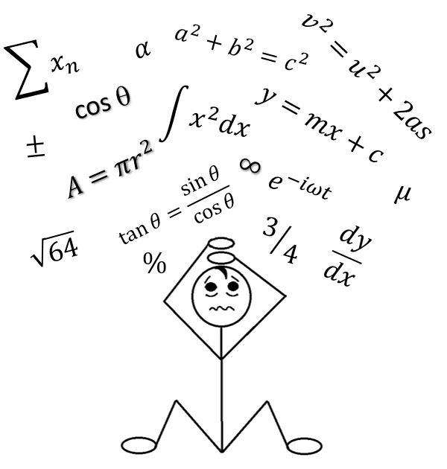

Exploring the extent of maths anxiety within the STEM faculty at the Open University
Susan Pawley, Sally Organ
Maths Anxiety can be described as “an emotion that blocks a person’s reasoning ability when confronted with a mathematical situation” [Spicer 2004], in an extreme form, “when confronted with a math problem, the sufferer has sweaty palms, is nauseous, has heart palpitations, and experiences paralysis of thought” [Krantz 1999].
Aims and Objectives: This project is intended to be the first of several, which will culminate with a STEM-wide program for supporting students with Maths Anxiety. It will identify the extent of maths anxiety within the community of STEM students and aim to identify some underlying reasons for the issues.
Stage one: Using the Maths Anxiety Scale, with additional questions on distance learning to survey students across the level 1 STEM curriculum to establish the extent of maths anxiety within the OU.
Stage two: Conduct in-depth semi-structured interviews to further investigate specific issues and explore how these might be addressed and supported.
Future projects: Create practical methods for addressing maths anxiety with a faculty wide program for supporting students, which will feed into additional projects on mental health issues in general.
Outcomes: Highlight the extent of maths anxiety for distance learning students at the start of their studies in STEM.
References: Krantz, S.G. (1999). How To Teach Mathematics. Providence:
American Mathematical Society
Spicer, J. (2004). Resources to combat math anxiety. Eisenhower
National Clearinghouse Focus 12(12)

