Slide 1
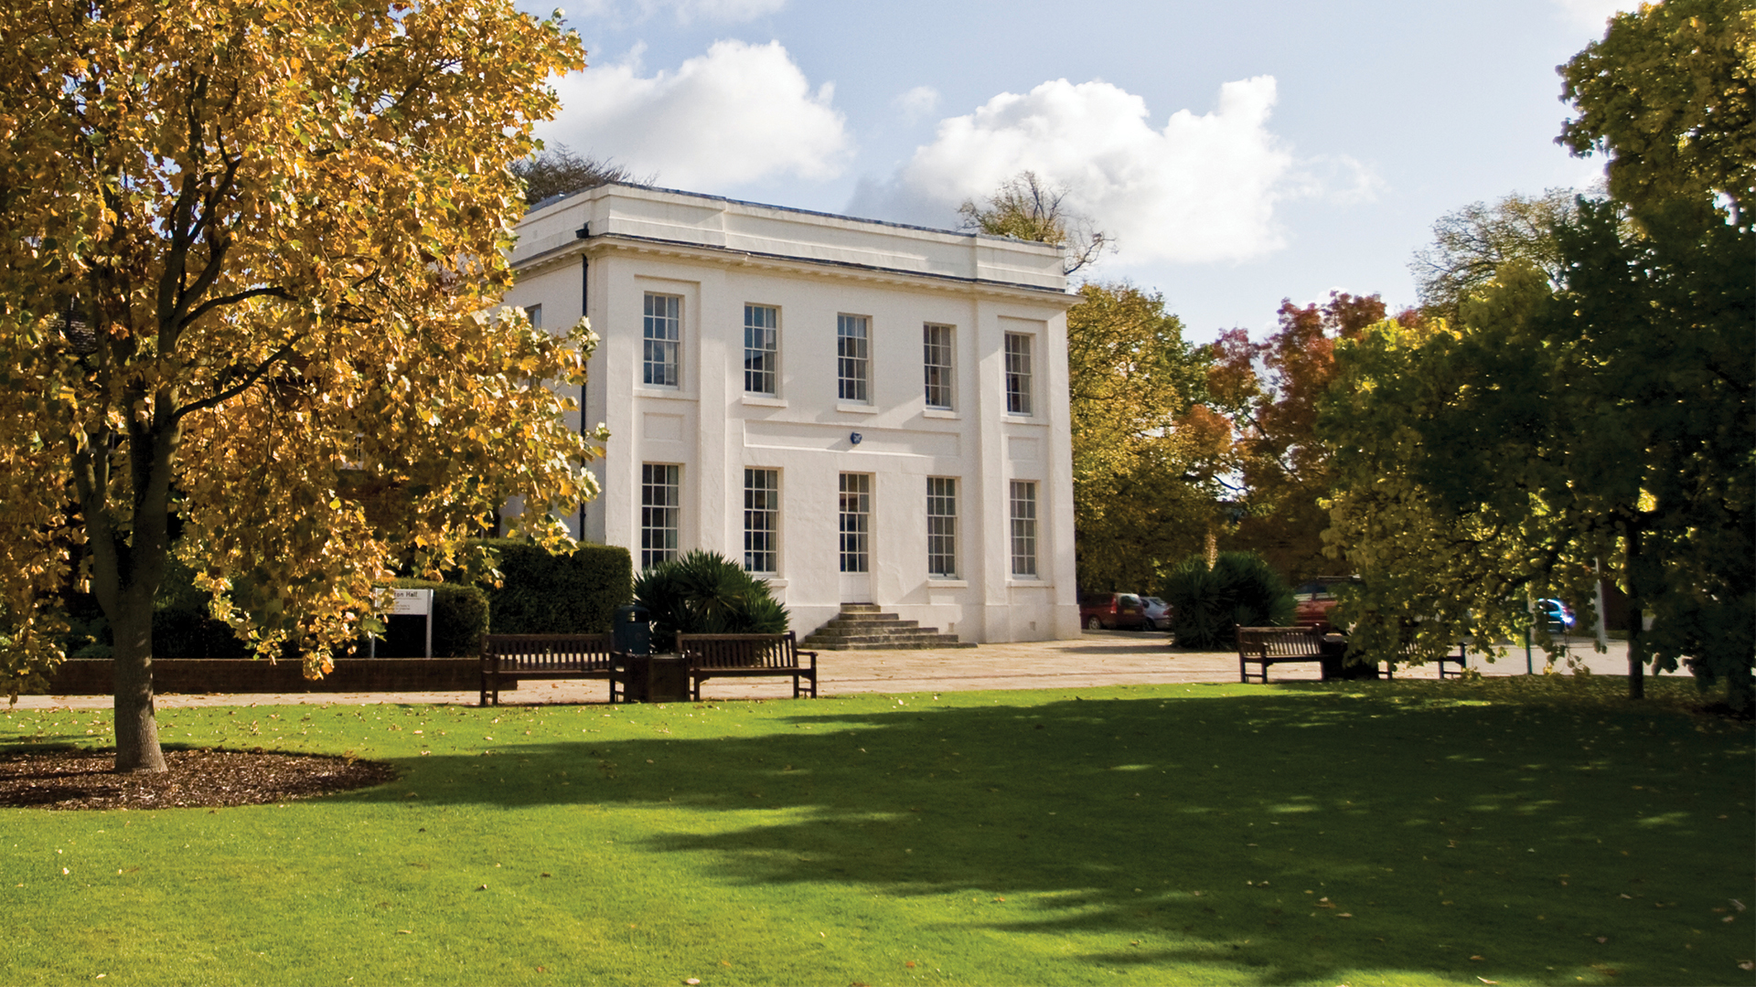
Exploring the extent of Maths Anxiety within the STEM faculty
Susan Pawley, Sally Organ
With thanks to Colin Blundell and John Morgan for arranging and conducting student interviews
Notes:
Sally

Slide 2
Background
Whilst maths anxiety has been recognised by academics for over half a century, little work has been done within the Open University to establish its extent within our population, how it is affected by distance learning and what techniques can be used to mitigate its effects.
“an emotion that blocks a person’s reasoning ability when confronted with a mathematical situation” [Spicer 2004]
"Math anxiety is an inability by an otherwise intelligent person to cope with quantification, and more generally, mathematics. Frequently the outward symptoms of math anxiety are physiological rather than psychological. When confronted with a math problem, the sufferer has sweaty palms, is nauseous, has heart palpitations, and experiences paralysis of thought ... this quick description does not begin to describe the torment ..." (Krantz, 1999)
Notes:
Sally - Maths Anxiety is a very emotive issue, with mental and physical symptoms, it can range from mild discomfort “I’m not very good at maths” “please don’t ask me” to extreme anxiety, where sufferers go to extensive lengths to avoid doing anything to do with numbers and maths and experiencing extreme discomfort and physical signs of anxiety.

Slide 3
Anxiety in mature students
These are some examples from our OU students
it makes you so anxious it makes you run away from it, you turn away from it whereas perhaps if you did confront it you might find there’s a way to understand it, but never really presented as something that’s possible and it certainly never addressed at either of my degrees. Nobody ever said are you struggling with the maths, how can I help you with that? (Student 3)
Every time a new maths page comes up, I go, Oh, my God, no. So I saw the scan read of it. And then I'm just like, Oh, my God, oh, no, oh, no, I can't do this. I can't do this. (Student 13)
your mind goes blank, that’s what happens to me, so my mind goes blank because of the sheer terror that I then think oh my god I’m going to give them the wrong number (Student 6)
Notes:
Sally - These quotes come directly from students interviewed that have been assessed as the most anxious.

Slide 4
Aims, Objectives and Project Plan
This project is intended to be the first of several, which will culminate with a STEM-wide program for supporting students with Maths Anxiety. It will identify the extent of maths anxiety within the community of STEM students and aim to identify some underlying reasons for the issues.
Stage one: Student survey across the introductory STEM curriculum to establish the extent of maths anxiety within the OU.
Stage two: In-depth semi-structured interviews to further investigate specific issues and explore how these might be addressed and supported.
Outcomes: highlight the extent of maths anxiety for distance learning students at the start of their studies in STEM.
Future projects: create practical methods for addressing maths anxiety with a faculty wide program for supporting students and staff, which will feed into additional projects on mental health issues in general.
Notes:
Sally - Be brief on what we have done – - this is the investigation stage to establish and articulate the range and extent of the problem - talk more about future projects
Our results shown today are just the tip of the iceberg on what we have collected but will give a flavour.

Slide 5
Module Surveys
  Introductory STEM modules in Maths, Computing and data science, Engineering, Design, Healthcare and Psychology and Science were surveyed.
Surveys used:
  Maths anxiety: The Maths Anxiety Scale (MAS) (Betz, 1978) plus two further questions on studying maths at a distance
  Maths resilience: The Mathematical Resilience Scale (MRS) (Mahmood & Khatoon, 2011, Kooken et al 2013)
Response rate:
  We were able to contact 10074 students (59.3% of students studying modules surveyed), of those contacted we gained a response rate of 13.8%.
As part of the survey students were invited to volunteer to be interviewed.
Notes:
Sally- These results refer to students who started studying introductory modules in a variety of STEM subjects in October 2021 or February 2022.
Started by using two standard surveys.
As part of the survey students were invited to volunteer to be interviewed, and Sue will say more about that later.
Good response rate, sample characteristic breakdowns (eg gender) were very similar to the cohort characteristics, however our repondees were slightly more female, slightly more white, slightly less declared a disability and slightly older. But no major discrepancies.
Due to lack of time we are only going to talk about maths anxiety today. If anyone is interested in the rest please get in touch.

Slide 6
Maths anxiety survey results
Notes:
Sally – sorted the results from modules into general subject areas, based on target qualification. Increasing levels of maths anxiety L to R. Numbers in brackets are the number of survey responses. 'Standalone' not linked to a qual.
Clear differences. A chi-squared test gives a result of p = 0.000, showing very strong evidence for an association between module studied and level of maths anxiety

Slide 7
Other
Science
Notes:
Sally – within these broad categories there are sub-categories, this slide shows the breakdown within the 'other' category, and the different branches of science that we offer.

Slide 8
Student characteristics – gender / disability
Gender Mean anxiety level
  female (546) 31.2
  male (661) 27.2
p = 0.000
Very strong evidence that mean anxiety level in females is higher than in males
Disability Mean anxiety level
  disability declared (235) 33.1
  no disability declared (1157) 28.5
p = 0.000
Very strong evidence that mean anxiety level in disabled students is higher than in those who have not declared a disability
(p-values from two-sided t-tests)
Notes:
Sally - For the whole cohort – clear differences in mean levels of maths anxiety related to gender and disability
Statistical analysis confirmed that these differences were significant.

Slide 9
Student characteristics - ethnicity
Ethnicity Mean anxiety level
  White (1253) 29.3
  Non-white (110) 28.9
p = 0.714
Little evidence that mean anxiety differs between white and non-white students, but some variations within those groups.
Notes:
Sally - For the whole cohort – more complex differences related to ethnicity.
White british vs white other , p = 0.000, very strong evidence
White other in the OU context means mostly white European
Asian vs black, p = 0.072, weak evidence
n.b. some of these numbers are getting quite small

Slide 10
Semi-structured interviews
 | Maths Anxiety Score | Qualification | Disability Declared | age range | ethnicity
Student 1 | 50 | Science | Yes | 26-35 | White
Student 2 | 50 | Computing and Data Science | No | 26-35 | Mixed
Student 3 | 50 | Science | No | 36-45 | White
Student 4 | 50 | Design | Yes | 36-45 | White
Student 5 | 50 | Science | Yes | 46-55 | White
Student 6 | 49 | Design | No | 36-45 | Unknown
Student 7 | 49 | Standalone | No | 56 and over | White
Student 8 | 47 | Healthcare & Psychology | No | 36-45 | White
Student 9 | 46 | Maths | No | 36-45 | White
Student 10 | 45 | Computing and Data Science | No | 36-45 | White
Student 11 | 45 | Science | No | 56 and over | White
Student 12 | 44 | Other (STEM) | No | 46-55 | White
Student 13 | 43 | Science | Yes | 26-35 | White
Student 14 | 43 | Science | No | 36-45 | White
Student 15 | 39 | Engineering | No | Under 25 | White
Notes:
Sue - 15 students – all visibly anxious, numbered with the highest score first
6 Scientists.
4 Declared a disability.
7 students between 36-45
Have been using Nvivo to analyse the interviews Drawn out a few of the themes

Slide 11
Anxiety at school and how they coped
Student 5 - It wasn’t explained to me properly and the more it wasn’t and the further we went along the further behind I got and the more terrified I got about it.
my worse fear was maths.
Student 5 -I asked the maths teacher first of all, she said well you’re just stupid if you can’t get it after all the times I’ve explained it to you, you are a lost cause and I was like oh my god, I’m a lost cause and so I talked to my parents who initially blamed me for being a lost cause …. I think I am still anxious
Student 9 - I think I felt alone, yes, my perception, I don’t know how accurate this was, but my perception was that everybody else could do it and I couldn’t.
Student 9 - I kind of tended to avoid it, like kind of pretend it wasn’t there and misbehave, you know that kind of thing, switch off, you know.
Student 13 - Yeah, definitely. [Anxious] All the time. Yeah.
Student 13 - at school, I just kind of stopped paying attention, and then I wasn't anxious anymore.

Slide 12
Anxiety at school and how they coped
Student 7 - terrified, absolutely terrified, you know that somebody was going to tell me that I was stupid because they would you know, they would say why can’t you do it
Student 7 - I would end up going into the toilet and put some hot water into the sink and just sort of put my arms in it and feel the hot water sort of trying to relax myself, trying to calm myself, trying to get my breathing and this is at the age of 7
Student 10 - I’m very much, I like to get things right, so not getting something right sort of makes me, makes me feel anxious.
Student 10 – I think my dad probably went into see the teacher on a few occasions because I was refusing to go to school because it just, it was just so terrifying and it never, it never got any better, it was awful.

Slide 13
Growth mindset
I would say it is something that grows and it is not you can or cannot do maths (student 7)
I think it can be grown and developed in anybody (student 9)
I think you are born and you can either do it or you can’t (student 1)
I think people are born with it…. and I just think I feel like I lost it, so I don’t know maybe I was born with it as well and whatever happened at that point in time it just kind of I lost it (student 4)
some people are born with a talent for it, or just get it that’s the way their mind works, but it doesn’t mean that other people don’t have that particular vent towards it, can’t learn it and be as good as them (student 5)
I think some people are better suited to it than others,… I’m sure if I studied 12 hours a day for five years I would be as good as anybody else (student 8)
Notes:
3 students – growth mind set – believe it can be done by everyone
2 students – either born with it or not (most anxious students)
Rest somewhere in the middle

Slide 14
Current anxiety and coping strategies
Student 1
Even as an adult now it’s like it’s that sinking feeling when you have done something, uh oh not again.
Student 1
I try and ask the husband, but he’s holding down a full time job and he’s on MST124, so I’m like help me out here and he’s going look I don’t have time and he doesn’t have the greatest amount of patients with maths idiots, so I just try and work it through and as I say I have been trying to get hold of my tutor for a few months now and he asked me which bits are you struggling with and I’m like all of it really..
Student 8
it is that panic of oh god I’ve got to work out what to do with these numbers. It is initial panic as soon as sort they say oh we are going to do some maths, we are going to do some, even just simple maths like multiplication I’m just crap at it, never ever sinks in.
Student 8
my husband is really good at, even though he gets frustrated he will keep repeating with me and he is really helping me and he has helped me more than any teacher has ever done.

Slide 15
Current anxiety and coping strategies
Student 10
I usually look at it and panic and think oh god that looks really complex,
Student 10
but actually when I start to look into things it’s not quite as bad as I thought it was going to be, but like I say my only worry with it being distanced is obviously coming across something that I really can’t get my head around what so ever and it is obviously not quite as simple as just say like you would in a lecture you can just say I don’t get this, it is distanced, so you’ve either got to send an email and wait for a response.
Student 13
if I see like a topic that's particularly maths heavy, I will have a bit of anxiety about that, because obviously, you want to stay on a timescale with the OU, don't you? I know that I'm gonna have to put at least another three, four, maybe five hours in to get my head around the maths of it
Student 13
I think being away from a classroom environment helps to, because I can spend as much time as I need to spend on something and that's quite good for the anxiety side of things.

Slide 16
Online specific issues (negative)
I need to be asking very many more questions than what they have time for (student 1)
But the tutorials, some of the students were so good and so brilliant and they got it, they managed to calculate and do the answer so quickly. It left me almost in tears. I'm like oh my God. (student 14)
there’s no almost direct teaching if that makes sense, so you know you might read through a page or two pages and you find something on page two that you don’t understand, it almost feels like you don’t want to ask because you don’t know what other people are asking. That whole scenario of they might know and I might not and I might look like an idiot. (student 15)

Slide 17
Online specific issues (positive)
[distance learning] is absolutely positive, as I mentioned before when I even threw up at secondary school because of the stress that was partly because I had to face the same place, you know the same class, the same teacher and I was in the same environment all the time and I just couldn’t get a break from it, but I had to be there and I didn’t have a space to breathe, to catch my thoughts. (student 2)
I’m at home learning I feel like I have time, so the time is there to have a go in the first place even if it is wrong and then I have got time to ask either people in my tutor group or my tutor, so it is that timescale, you know when you are in the classroom and you get half an hour lesson and you’ve got to do it all and give your answer and you might get picked on, not picked on (student 4)
you are not in a classroom where you would feel stupid not understanding the answer as quickly as everyone else, you can sit and work through it. You can get someone to talk it through with you, you can print it out and take it to work and say look I don’t understand this can you explain it to me and yes I have found it really helpful for understanding the problems we have in our module. (student 8)

Slide 18
What advice would you give to a maths teacher
Yes, accept that everybody learns differently and find what works for that child or that person, that adult, whoever and don’t assume because you find it easy they find it easy or should find it easy. (student 3)
I don't know how you're going to assess, but you need to assess that every, every student who is in front of you has got that information before you move on. (student 11)
Well, I believe it is knowing your student and the learning style of that student (Student 7)
Be open to asking questions, encourage asking questions, I think as well try and foster the attitude that, what am I trying to say, that nobody feels stupid, nobody is too shy to ask (student 9)
To slow down. (student 13)
Don’t be so scary! (student 4)

Slide 19
Semi-structured interviews (words from interviewer)
Feedback from interviewer “The interviews are real eye openers for me and have made me think about my own delivery of tutorials and feedback in assignments for lots of different reasons.”
Notes:
Sue –

Slide 20
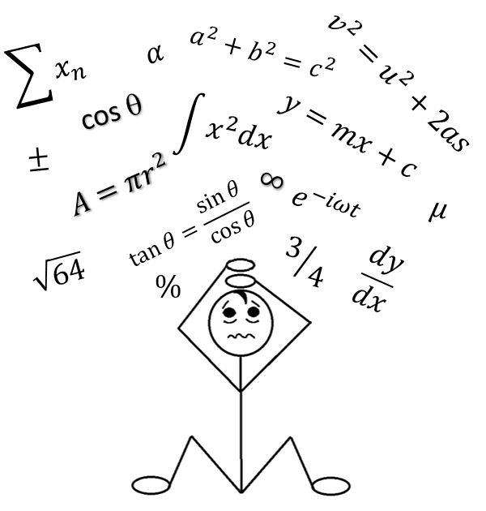
Possible interventions to be explored at OU?
One-to-one support for students who have been referred by tutor
Student self-help Website where they can establish their own level of maths anxiety and gain knowledge on ways to manage it
Staff development on how tutors can support students with maths anxiety
?
?
Advice for student support staff
Tutor experts, trained to give advice and help students/ other tutors
Notes:
Sue

Slide 21


External resources
Positive Digital Practices - Home (weebly.com)

Slide 22
References
Betz, Nancy E. (1978). Prevalence, distribution, and correlates of math anxiety in college students. Journal of Counselling Psychology, Vol 25(5), 441-448. doi: 10.1037/0022-0167.25.5.441
Kooken, J., Welsh, M., McCoach, D., Johnston-Wilder, S., Lee, C. (2013). Measuring Mathematical Resilience: An application of the construct of resilience to the study of mathematics . Paper presented at national conference of the American Educational Research Association, San Francisco, CA.
Krantz, S.G. (1999). How to teach mathematics. Providence: American Mathematical Society
Mahmood, S. & Khatoon, T. (2011). Development and Validation of the Mathematics Anxiety Scale for Secondary and Senior Secondary School Students, British Journal of Arts and Social Sciences, ISSN: 2046-9578, Vol.2 No.2
Spicer, J. (2004). Resources to combat math anxiety. Eisenhower National Clearinghouse Focus 12(12)

Slide 23
THANK YOU

Slide 24
Research on Maths Anxiety and maths resilience
Previous research has been mostly concerned with the school experience. Some key themes are:
Maths anxiety is a real and disabling condition (Dowker et al, 2017) that reduces a student’s ability to engage with mathematical ideas, often leading to avoidance strategies (Ashcraft & Krause, 2007).
Classroom experience is often the source of maths anxiety, with unsupportive teachers and the practice of singling out a student to give an answer identified as particular risk factors. Teachers may themselves be maths anxious, which adversely affects their ability to support their students (Ashcraft & Krause, 2007).
Maths anxiety can be ‘caught’ from an anxious teacher, with girls being particularly susceptible (Beilock et al, 2010), or from parents (Maloney et al, 2015).
Maths anxiety may be particularly acute due to the ‘gatekeeper’ nature of mathematics qualifications (Douglas & Attewell, 2017) and sufferers often avoid qualifications and career paths that they fear may involve maths (Dutton & Dutton, 1991).
The development of a growth mindset (Dweck, 2000) and adoption of teaching methods designed to build positive teacher-pupil relationships in maths classes (Lee and Johnston-Wilder, 2017) can help to build maths resilience.
Notes:
Sally – there’s a large body of literature on maths anxiety, and some more recent studies on how to build resilience in students, but it’s almost entirely concentrated on schoolchildren. These are some of the key messages from the literature, which resonate with what our mature students have been telling us. (References listed at the end)
It does exist – a common response is to try to avoid it.
Often stems from something that happened in the classroom, and that can be a single traumatic incident like being asked to do something publicly and feeling humiliated by not being able to do it.
Teachers, particularly at primary school, can themselves be anxious – also parents – and that can be passed on.
Being unable to engage with maths can close down career options.
There are things that can be done – we’ll say a bit more about maths resilience later, but the development of a growth mindset is an important part of that.

Slide 25
Studying maths at a distance
Notes:
Sue
Those students that are visible anxious about maths are more worried that studying at a distance will make it harder and increase their anxiety, whereas those that are not anxious, most think it won’t make a difference.
So overall most seem fairly happy that studying at the OU won’t make it worse.

Slide 26
Studying maths at a distance
Notes:
Sue - This one has the likert display reversed so that those that are most concerned are at the bottom. Understandably those that are anxious about mathematics has the highest percentage of those not looking forward to it, however

Slide 27
High/low anxiety subjects
Degree subjects with >50% visibly anxious students
  Design
  Healthcare and Psychology
  Science - Biology, Combined Science, Geology, Environmental Science
  Other – Geography and Environmental Studies
Degree subjects with <50% visibly anxious students
  Maths
  Standalone
  Computing and Data Science
  Engineering
  Science – Chemistry, Physics
  Other - Open and Open Education, Economics and Business Management, Combined STEM
Notes:
Sally – we wanted to know whether these differences by characteristic differed by subject area because, for example, we know that women are more maths anxious overall, and we also know that they are more likely to study the less mathematical subjects – so we wondered whether the same gender trend was seen in all subjects.
As a first approximation, divided the subject areas into two groups.

Slide 28
Very strong evidence that mean anxiety levels are higher in females than in males (p=0.000)
Very strong evidence that mean anxiety levels are higher in students who have declared a disability (p=0.000)
Strong evidence that mean anxiety levels are higher in females than in males (p=0.005)
Strong evidence that mean anxiety levels are higher in students who have declared a disability (p=0.006)
Very strong evidence that mean anxiety levels are higher in females than in males (p=0.000)
Very strong evidence that mean anxiety levels are higher in students who have declared a disability (p=0.000)
Notes:
Sally – this was what we found when we looked at gender and disability.
Difference balance of males and females but overall trends the same in both groups.
Both the gender and disability differences are slightly lower in the subjects with higher anxiety levels, but still there.

Slide 29
Maths resilience scale
The maths resilience scale measures students' attitudes toward studying mathematics, using 3 factors:
Value Refers to the extent to which students find studying mathematics important in attaining their current or future goals.
Struggle Refers to a student's belief that they sometimes have to exert a great deal of effort because mathematics can be a challenge to learn, but their difficulty is not interpreted as an indication of personal incompetence.
Growth A growth theory of learning mathematics refers to the belief that people can improve their knowledge of mathematics.
Results from the MRS help to gauge the likelihood of student participation and persistence in mathematics. ​
Notes:
Sally – not looked at this in any detail yet – need to develop a better understanding of its significance

Slide 30
Maths Resilience Scale – example questions
Value (8 questions in total)
Maths is very helpful no matter what I decide to study.
Maths is essential for my future.
Maths will be useful to me in my life’s work.
Knowing Maths contributes greatly to achieving my goals.
Growth (7 questions in total)
Only smart people can do Maths.
Maths can be learned by anyone.
If someone is not a Maths person, they won’t be able to learn much Maths.
If someone is not good at Maths, there is nothing that can be done to change that.
Struggle (8 questions in total)
Everyone struggles with Maths at some point.
Good Mathematicians experience difficulties when solving problems.
People who work in Maths-related fields sometimes find Maths challenging.
Everyone makes mistakes at times when doing Maths.

Slide 31
Maths resilience survey results
Notes:
Sally – Slightly smaller sample as not all students completed MRS. LH graph shows the mean MAS scores for this group of students – same subject order as previously. Larger graph shows MRS scores, with scale chosen to emphasis the variations.
Higher anxiety often corresponds to lower resilience but not a simple relationship.
Lots of detail here and no time to discuss in detail but consider the value results....

Slide 32
Maths at school
OK – I can’t say it was easy, but I can’t recall struggling as much as I probably do now. (student 1)
from early ages up until GCSE I was really, really good then it just went downhill. (student 4)
I enjoyed math. That's insane. I really enjoyed maths, and I thought I was good at it. (student 12)
To be fair I was absolutely terrible at it right from the beginning (student 2)
maths was extremely traumatic for me. (student 6)
I was absolutely terrified of maths when I was at school (student 7)
I have never coped with maths, the numbers just jumble up together as soon as they are put on a screen and never been able to look comfortably at them. (student 8)
maths especially at primary school absolutely terrified me.(student 10)
Notes:
“ how well did you cope with maths in school?”
Not all of those interviewed hated maths, some enjoyed it. But most have always had issues

Slide 33
Consequences
I very nearly put me off and instead of doing a BSc or just moving my entire career hopes and plans to something completely different and doing a BA. (student 1)
it probably narrowed my career options I don’t know if that’s the right word I don’t think I was ever going to a hardcore finance role, but I just felt quite stupid you know being the ultimate word because mathematics is such a requirement in the world how you look at it, no matter how you splice it, it is something that’s a requirement (student 6)
I would avoid it at all costs, even now I’m in a job where I have to use maths and I just get someone else to do it. (student 8)
I mean it almost made me not want to go into engineering, so when I first looked, I’ve always liked engineering from a, right from being a kid I’ve always done stuff with my dad and my grandad and it were always something I looked to do, but when I started, not failing maths, but almost, almost knowing I was going to fail in maths it almost completely put me off it (student 15)

Slide 34
References
Ashcraft, M. & Krause, J. (2007) Working memory, math performance, and math anxiety. Psychonomic Bulletin & Review, 14 (2)
Beilock, S., Gunderson, E., Ramirez, G. & Levine, S. (2010). Female teachers’ math anxiety affects girls math achievement. Proceedings of the National Academy of Sciences – PNAS, 107(5).
Betz, Nancy E. (1978). Prevalence, distribution, and correlates of math anxiety in college students. Journal of Counselling Psychology, Vol 25(5), 441-448. doi: 10.1037/0022-0167.25.5.441
Douglas, D. & Attewell, P. (2017) School mathematics as gatekeeper, The Sociological Quarterly, 58:4.
Dowker, A., Sarkar, A., & Looi, C. Y. (2016) Mathematics anxiety: what have we learned in 60 Years?, Frontiers in Psychology, 7.
Dutton, W.H. & Dutton, A. (1991). Mathematics children use and understand. Mountain View, CA: Mayfield publishing Company.
Dweck, C. (2000). Self-theories: their role in motivation, personality, and development. Psychology Press.
Kooken, J., Welsh, M., McCoach, D., Johnston-Wilder, S., Lee, C. (2013). Measuring Mathematical Resilience: An application of the construct of resilience to the study of mathematics . Paper presented at national conference of the American Educational Research Association, San Francisco, CA.
Krantz, S.G. (1999). How to teach mathematics. Providence: American Mathematical Society
Lee, C. & Johnston-Wilder, S (2017). The construct of mathematical resilience. In Xolocotzin E. S. ed. Understanding Emotions in Mathematical Thinking and Learning. Elsevier, pp. 269-291.
Mahmood, S. & Khatoon, T. (2011). Development and Validation of the Mathematics Anxiety Scale for Secondary and Senior Secondary School Students, British Journal of Arts and Social Sciences, ISSN: 2046-9578, Vol.2 No.2
Maloney, E., Ramirez, G., Gunderson, E, Levine, S. & Beilock, S. (2015) Intergenerational effects of parents’ math anxiety on children’s math achievement and anxiety. Psychological Science, 26(9).
Spicer, J. (2004). Resources to combat math anxiety. Eisenhower National Clearinghouse Focus 12(12)

