Slide 1
Intro Slide Title 1
Engaging Students as Partners in Scholarship
Mark Jones and Sue Pawley
eSTEeM Annual Conference
Wednesday 19th April 2023

Slide 2
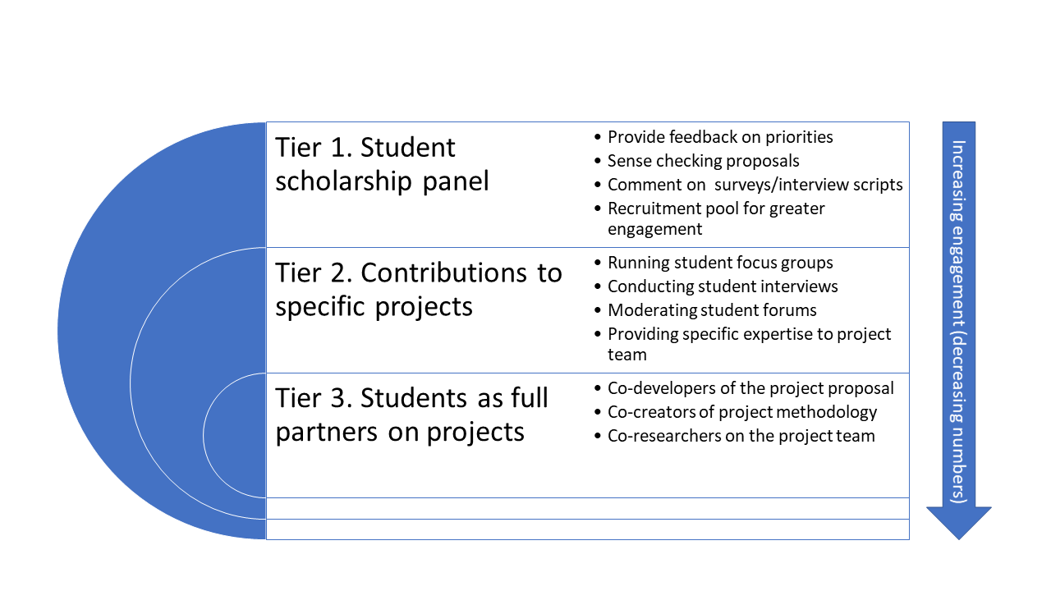
Slide Title 8
Students as Partners in Scholarship Activity Model
Collins, T.D. (2022). Student Engagement Framework: Students as Partners in Scholarship. Scholarship Steering Group Report. The Open University, UK. October 2022. Available at: https://www.open.ac.uk/scholarship-and-innovation/esteem/resources/students-partnersscholarship-framework

Slide 3

Slide Title 27
Students as Partners in Scholarship

Slide 4

Slide Title 27
Students as Partners in Scholarship

Slide 5
Workshop Activity
Thinking about a scholarship project, what benefits do you anticipate both to the project and the students involved by undertaking any of the following tasks?
For in person delegates please use the A1 sheets on your tables
For delegates online please visit https://bit.ly/3Z1HNDT

Slide 6
Slide Title 30
Thank you

Slide 7
Slide Title 31

