Slide 1

Intro Slide Title 1
eSTEeM Workshop
Supporting scholarship researchers in engaging students through the research journey
Bart Gamber / Steph Lay / Emma Street / Kim White
DSA
19/04/2023

Slide 2
Introduction
Who are we, and why are we here?
Student Research Project Panel – our purpose, contribution and expertise
How we add value to research - The Student Research Project Panel (SRPP) was established to ensure that all research involving Students, Open University enquirers and alumni is of benefit to them and the institution and meets all relevant university guidelines.
Range of knowledge and expertise – our panel's Working Group is comprised of 45 cross university research experts representing each of the faculties as well as a range of other university offices (Academic Services, Marketing, the Library, etc.)
How have researchers benefitted from our feedback? Our panel's constructive feedback and recommendations routinely receive top marks in our applicant feedback questionnaire. These comments from our applicants are representative of their feedback to us:
  "Extremely helpful and supportive"
  "Positive experience"
  "Very useful"

Slide 3
On a journey together
Well-designed research is key to student engagement
Why People Get Lost
We've heard from a number of researchers that the variety of application processes they are required to navigate to secure approval for their research can be burdensome, complex and sometimes confusing.
A New Initiative
Working in close partnership with HREC, Data Protection, all of the OU's Scholarship Centres and the Library, the SRPP launched a new project called The Researcher's Journey. This project seeks to support those wishing to conduct educational research with OU students.

Slide 4
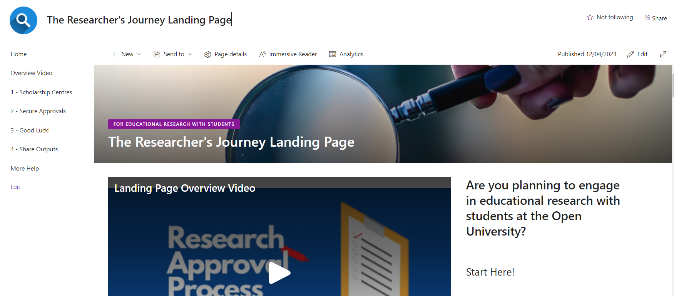
On a journey together
Well-designed research is key to student engagement
A Clearer Road Map
The Researcher's Journey Project was created to support educational researchers through a strategy of:
The creation of a new community of practice for educational researchers at the OU, offering workshops / drop-ins / symposia
Better coordination and communication between the various research approval processes at the OU
Clear signposting of key sources of help and support for researchers

Slide 5


Slide 6
Won’t somebody talk to me?
The challenges we face in engaging students in educational research
The Response Rate Problem
Our evidence from recent years, and across all types of engagement channels, has shown that we call out to many, but few reply.
Engaging students where they are
We are learning that embedding research invitations within the VLE can be effective in boosting response rates.
How we talk to students matters
Recent evidence from a large-scale brand survey has shown that offering an appealing incentive can have a real impact on response rates.
More testing, more learning
The OU is taking this seriously. A new task and finish group will be starting this spring to test and learn ways we can help to improve engagement.

Slide 7
The response rate problem
Response rates across a range of surveys within the OU have been in decline in recent years.
We’re keen to listen – but it’s hard to get students to talk to us!
  In recent years, there has been a decreasing trend in response rates across our core surveys.
  From our Brand Tracker, we’ve found that it is particularly hard to engage younger students
  With response rates for SEaM, ISS and Brand Tracker below 10%, there are concerns about how well we can truly represent the student experience.
  The Early Student Experience survey has shown that B presentation students are harder to engage than J/K presentation students.

Slide 8
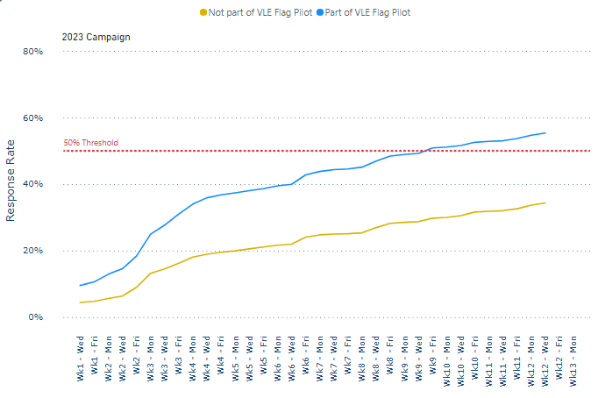
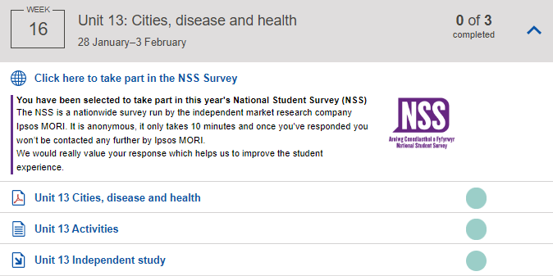
Engaging students where they are
We are learning that embedding research invitations within the VLE can be effective in boosting response rates.
  We need to hit 50% response rate for the NSS – this is a challenge!
  We’ve been experimenting with notifying eligible students with a flag on their study calendar during the fieldwork period.
  This is proved very effective – so far, students with the flag are ahead by over 20 percentage points.
  We are exploring how this could be scaled up in future years.
55.4%
34.4%

Slide 9
How we talk to students matters
Compelling evidence from the latest Brand Tracker wave shows the impact of offering an appealing incentive to take part.
2 x £150 ‘Tango’ retail vouchers
Shorter 10 minute survey
Adopting a bold subject line

Slide 10






More testing, more learning
 | Student Barrier to engagement | Problem(s) to solve | What could we try? | Why do we think it might work?
 | “I’ve got too many emails, I’m not going to read that invitation to a survey!” | We know that our students receive a lot of communications: how can we cut through the noise? | Expert review of our communications, creation of ‘known good’ templates for impactful subject lines and email content through thorough testing. | Students have told us they filter their communications carefully and on occasion only open emails from the OU that appear to be directly related to their study. There is evidence that bold subject lines work better.
 | “There’s no point spending my time on this!” | The value of engaging isn’t clear. | Improve awareness of actions taken in response to feedback. | Students are more likely to spend their time engaging with feedback if they can see it will make a difference. (Student Voice focus groups, 2022)
 | “This is going to take forever to do!” | Surveys are too long, or aren’t relevant. | Work to reduce the length of surveys – use critical, relevant questions only. Cut out ‘nice to know’ and make every item worthwhile. | c.10 mins is long enough, but with other measures to support, can be longer. Younger students in particular likely to favour shorter
 | “What’s in it for me?” | Time spent engaging with research doesn’t feel rewarding enough to prioritise over study time. | Offering incentives to students to encourage them to take part. | March 23 Brand Tracker wave is trialling an incentive for completion: record response numbers throughout fieldwork.
 | “I didn’t even know there was a survey!” | Emails can get missed, or arrive at the wrong time. | Explore new options for technology enhancements that present key surveys as part of the module. | Surveys advertised on the VLE do well: (NSS VLE Flag pilot: 55% vs 34% RR, Microcredential surveys 18-20% RR, RTSF surveys average 20-70% RR)

Slide 11
Breakout / discussion
Over to you!
We will look to add insights to the Researcher’s Journey or SRPP FAQs after this event.
What else can we do to engage students with scholarship?
What works on you – what persuades you to take part in surveys / research in everyday life?
What have you tried in your own scholarship? What would you like to be able to try?
Timing is everything! When’s the ‘right time’ for your call?
What would help you in engaging your students?
Share your thoughts here:
https://padlet.com/steph_lay/
engaging-students-in-scholarship-xqyomyr731uaouj3

Slide 12
A final take-away
If you only remember one thing from this session…
As we close:
We’re with you on your journey! Come meet us at our monthly drop-ins!
We will be here tomorrow and we're eager to meet you.
There’s real value in continuously improving how we listen to the student voice

Slide 13
Slide Title 30
Thank you

Slide 14
Slide Title 31

