Slide 1

A Quantitative Investigation into the “Student Progression” in STEM subjects at a Post-92 UK University
Stenford Ruvinga, Gordon Hunter, Mastaneh Davis
Kingston University, London

Slide 2
Background
The Problem
Poor progression between levels of degree programmes.
Low levels of engagement by students with their studies.
Disappointing levels of student attainment.
The nationally-observed “Attainment Gap” between certain groups of students in higher education
  HEA Equality Challenge Unit (2015) “Ethnicity, Gender and Degree Attainment Project: Final Report”.
How do the attainment gaps vary between institutions, subject areas and groups ?
How does the attainment gap vary between groups of different ethnic backgrounds ?
Can this be used to improve recruitment and retention of students ?

Slide 3
“New” (Post 1992) Universities in the UK
In 1992, many UK HE institutions formerly categorised as “Polytechnics” or “Colleges” were granted University status – the so-called “Post 92 Universities”.
Many of these were in large cities, tended to focus on more vocational subject areas, and had rather different demographic profiles of students compared with the older “Pre 92” Universities.
The “Post 92” universities tend to have :
  higher proportions of BAME students,
  higher proportions of mature students, and students caring for children or other relatives,
  higher proportions of students from less affluent socio-economic groups,
  higher proportions of students doing substantial amounts of paid work whilst studying (even if notionally studying “full time”),
  high proportions of students who commute long distances to University.
Kingston University (KU) seems fairly typical of a “Post 92” university.
Hence, the types of “attainment gap” described previously is likely to raise issues in relation to student progression and achievement at Kingston, and at other “Post 92” universities – possibly more so than at typical “Pre 92” universities.

Slide 4
Desired outcomes
Aims of this Study
How big a problem are attainment gaps between different groups of students (BAME v White, Mature v Younger, etc) at Kingston University ?
To identify the principal factors that are causing the described problems.
To enhance the progression, achievement and experience of as many students as possible.
To suggest possible approaches towards addressing and rectifying the problems identified.

Slide 5
Data Available
Data from all main UG programmes in Faculty of Science, Engineering & Computing (SEC) at KU between 2011-12 and 2013-14.
Anonymised students’ First Year (L4), second year (L5) and third/final year (L6) (where available) module marks for students still registered (or just completed) STEM Undergraduate (UG) programmes, plus their ages, ethnicities, subjects of study and their previous educational attainment (as UCAS points) on entry to their course.
Some issues with the data : The period of data straddled a major reorganisation of Undergraduate courses (the RAF) in 2013-14, so many students would have a mixture of 15 credit and 30 credit modules.
Notes:
In such cases an appropriate weighted average of students 15 and 30 credit courses was used at that level.

Slide 6
Methodology
Data Analytics
Large amounts of data, stored in both digital and hard copy form.
Identifying relevant information from this data gives the potential of helping staff to support students and improve their retention and experience.
A “pilot study” was carried out in Summer 2015, and a Research Masters student (SR) has just finished working on this project.
We employ several statistical methodologies (ANOVA, Regression Models, “Multi-Level Modelling”) to investigate the problem.

Slide 7
Initial Investigations
A Preliminary Regression-based Statistical Analysis
Anonymised records of students’ first year, second year and third year (where available) modules marks for students still registered (or just completed) in Summer 2014
Only main SEC (Science, Engineering & Computing) undergraduate programmes considered
Research questions:
  How well correlated are students’ marks at one level with their marks at other levels ?
  How well can a student’s level N marks predict his/her level (N+1) marks ?
Assumptions:
  Produce one model per level transition per SEC subject area (e.g. Civil Engineering, Pharmacy, etc.)
  The analysis was based on First Attempt marks only.
  The model was based on each student’s average mark at each level.
  No attempt was made at this stage to investigate differences between individual students.
Finding: Fairly strong and highly significant correlation between successive University levels,

Slide 8
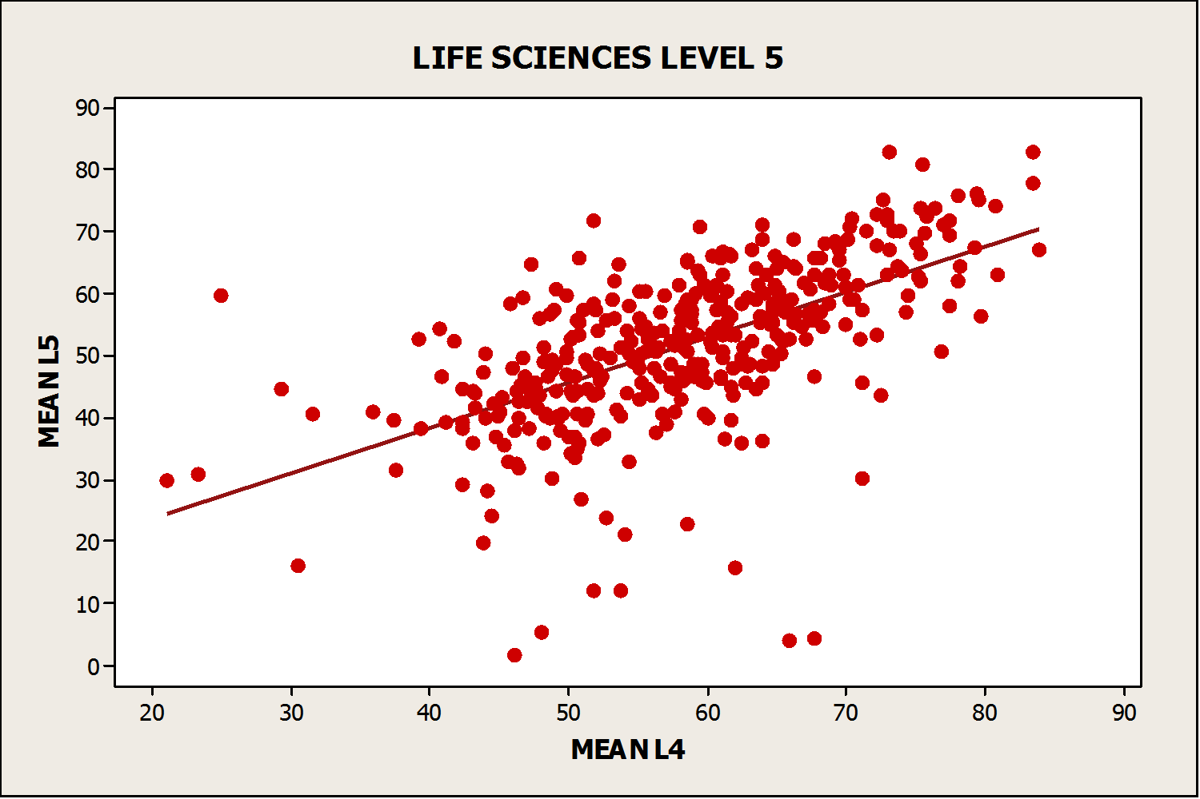
Scatterplot for Life Sciences
L4 & L5 (Years 1 & 2) Data
Life Science Courses | Mean L5% = 9.27 + 0.728(mean L4%) | Adjusted R² 35.5%

Slide 9
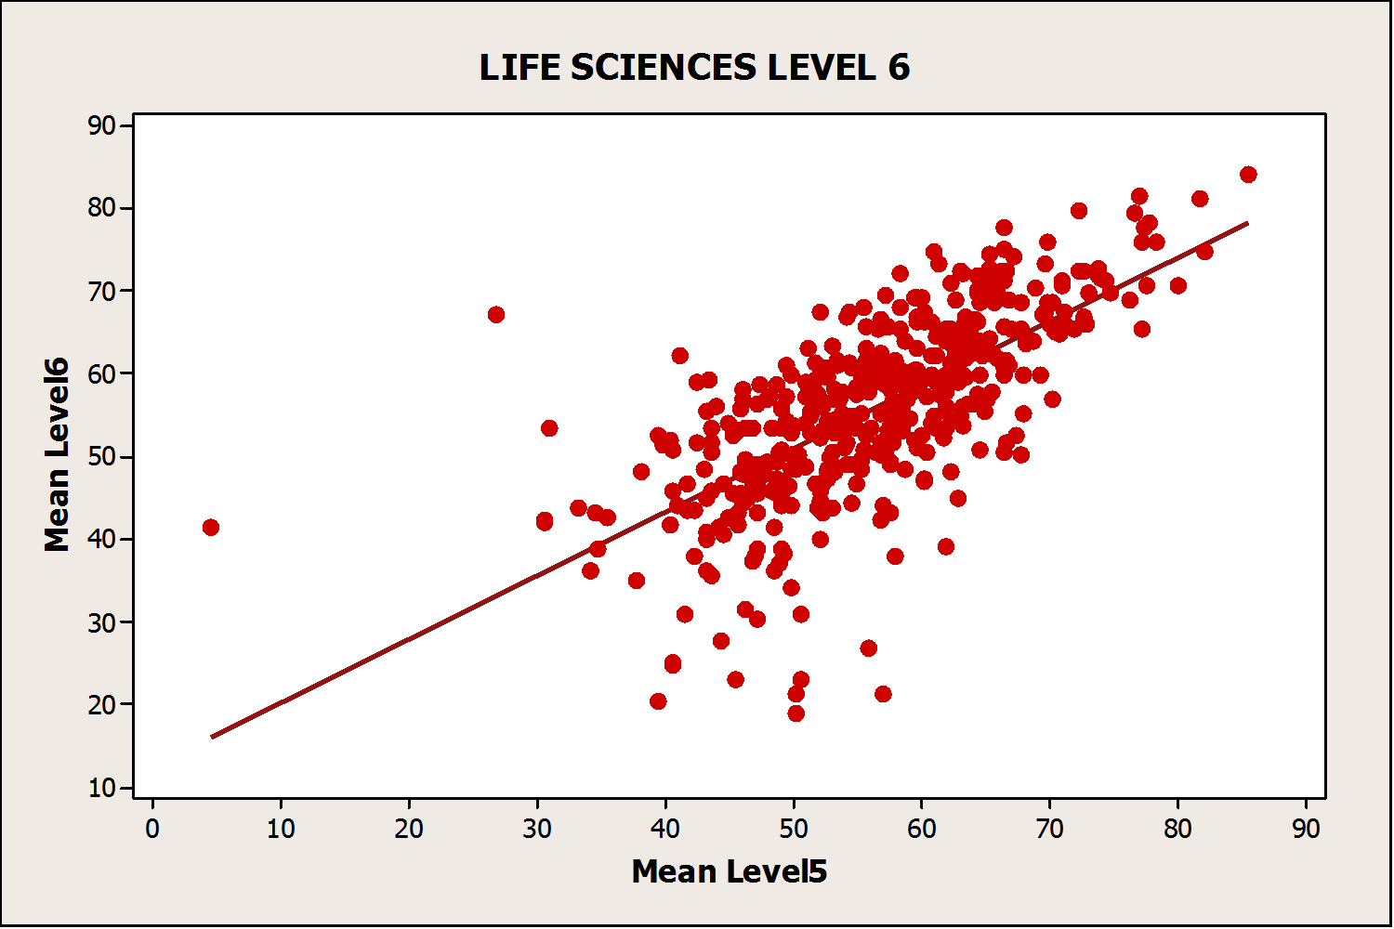
Example Scatterplot for Life Sciences
L5 & L6 data

Slide 10
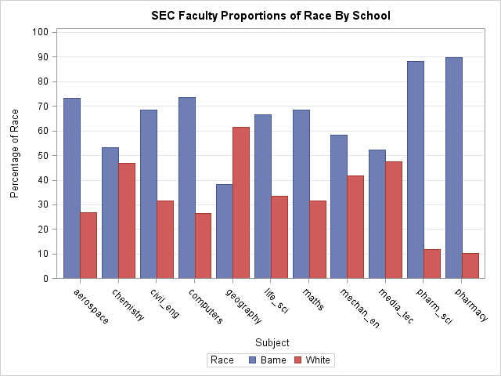
Descriptive Statistics for KU-SEC :
Proportions of BME Students by Subject Area
Notes:
The sample used in this study had 3296 undergraduate in SEC which 2243 of them were BAME students and 1053 were white students.
Pharmacy and Pharmaceutical science have 89.55% and 88.24% BAME

Slide 11
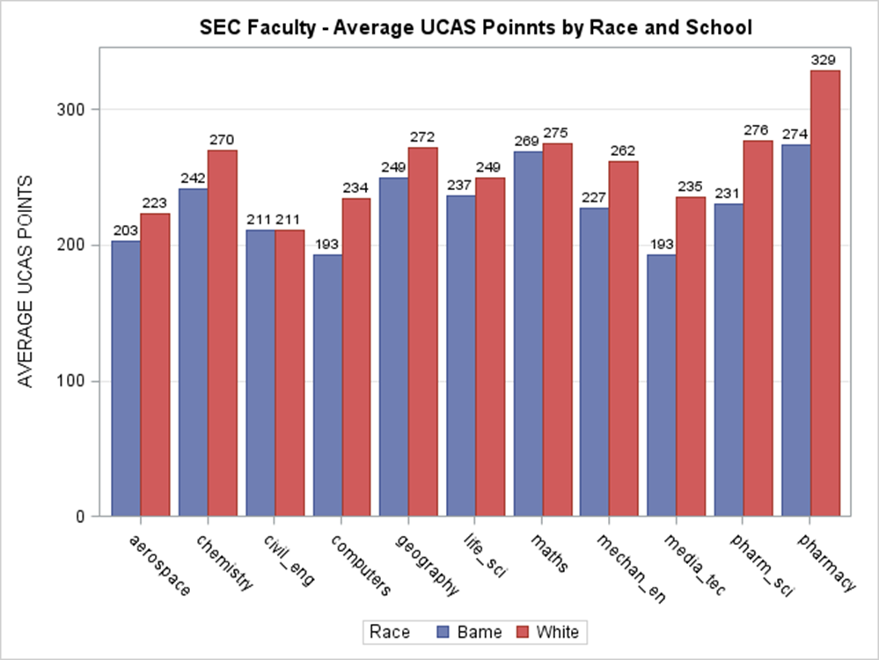
Entry Qualifications (UCAS Points) by Subject and Ethnicity
Considerable variation by subject, for most subjects BME students tend to have fewer UCAS points than White, particularly in Computing, Media Tech and Pharm.

Slide 12
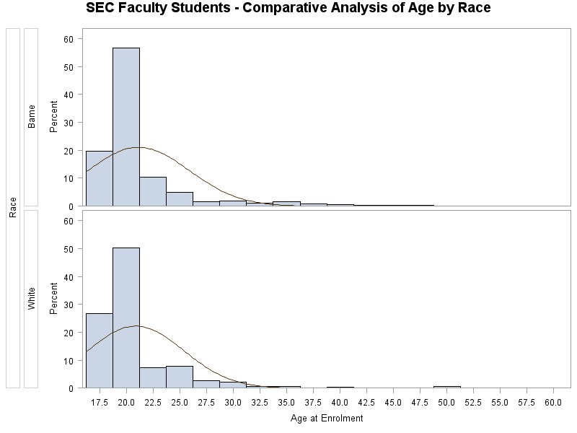
Descriptive Statistics for KU :
Proportions of BME Students by Age Group
Slightly different distribution by age between the two groups :
White students have higher proportion of under 20s, lower proportion of 20-25, but slightly higher proportion of over 25s.
There is also considerable variation by subject area – Pharmacy (38%) and Pharm Sci have highest proportions of mature students, Maths and Chemistry (13.5%) the lowest

Slide 13
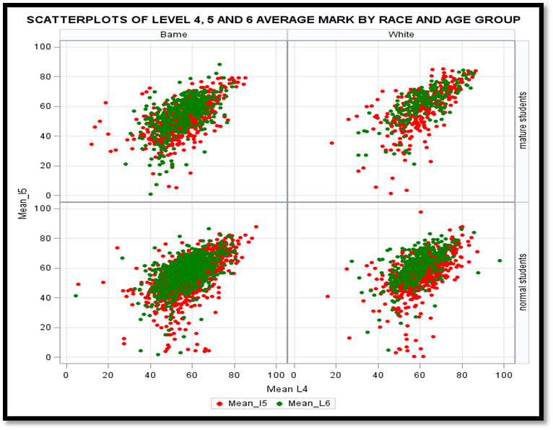
Cross-Faculty Scatterplot : Relation between Students’ Mean Marks at successive levels by Ethnicity and Age Group
In all cases, there are substantial numbers passing at one level but failing badly at the following level (have they effectively “given up” ?)
BME students’ marks seem more tightly clustered. No clear picture (from visual inspection) for mature students.

Slide 14
Investigations
Research Question : “How well correlated are students’ marks at one level with their marks at other levels, and their UCAS points at entry to University ? What other factors significantly affect their marks ?”
Hypothesis : Strong positive correlation between consecutive levels, weaker between non-consecutive levels.
Findings : Fairly strong and highly significant correlation between successive University levels, L4 to L5 R = 0.6044, p < 0.001;
L5 to L6 R = 0.6045, p < 0.001
Weak but still highly significant correlations between UCAS points and University results :
Entry to L4 R = 0.2183, Entry to L5 R = 0.1632, Entry to L6 R = 0.1789
All highly significant (p < 0.001), but weak, and there was a significant negative correlation (R = -0.2460, p < 0.001) between UCAS points and Age at Entry to course. Older students are less likely to have attempted so many A Levels, some may have come in through “Access” routes, etc.

Slide 15
“Good” degrees
One observation made in previous research studies is that BAME students do not achieve as high a proportion of “good” degrees (defined as being first or upper second class honours degrees) as their white peers.
In order to investigate this further, we have thresholded student’s average marks at 60% (just enough, if sustained through his/her studies, to get an upper second class degree), and produced a logistic regression model for the probability of a student with given attributes gaining such a “good” degree.
We attempt to model the effects of various factors (Subject of Study, Student’s Level of Study, Ethnicity, Age, Previous Academic Attainment) on this probability.

Slide 16
Two Types of Regression Models
Model student progression (as a function of several variables : subject of study, level of study, ethnicity, age, UCAS points and Previous years’ average marks) in two ways :
“Simple” (Linear) Regression, where Average mark at current level is a simple function of the “predictor” variables,
(Current year average mark)
= a + b(previous year’s average) + c(subject of study) + …
“Logistic” Regression, where the logarithm of the odds of a student obtaining a “good” average grade (60% or better) is modelled as a simple function of the “predictor” variables.
  If p is the probability of a given student getting a “good” grade, then :
  log( p / (1 – p) ) = α + β( subject of study) + γ (age) + …

Slide 17
Summary Results : Linear Regression
Quite a lot of variability according to subject of study, but in nearly all cases and for all levels, the linear regression models were statistically significant, but proportion of observed variation explained by the model was not always so high.
Most commonly significant predictors were Ethnicity, Age, UCAS points and Average mark at previous level in most cases.
Typically, BME and older students tended to perform slightly less well than white or younger ones, at all levels, but not for all subjects (and BME did better than white in Level 6 Mech Eng).
Students with more UCAS points and/or higher previous year’s average tended to preform better.
Notes:
(Typical R² values were around 0.1 at L4, 0.3 at L5 and 0.4 at L6).

Slide 18
Summary Results : Logistic Regression
Studied how “odds” of a student getting a “good” grade varied according to predictor variables
Subject of study included as a categorical (non-numerical) variable.
At Level 4, significant predictors were UCAS Points (↑), Geography (↓), Maths (↓), Pharmacy (↑), Chemistry (↑), Computing (↑), White (↑).
At Level 5, the significant factors were Mean_L4 (↑), Age (↓), Computing (↓), Pharmacy (↑), White (↑).
At Level 6, the significant factors were Mean_L5 (↑), Civil Engineering (↑), Chemistry (↓), Pharmacy (↑), White (↑).
Overall, a Chi-squared test indicated that BME students at KU were significantly less likely than their White peers to achieve a “Good” degree overall (p < 0.0001)
Notes:
“Pharmaceutical Science” was taken as “baseline” subject (arbitrary choice), as was BAME for Ethnicity.

Slide 19
Conclusions
There is evidence of a White-BME “attainment gap at Kingston University, but it is probably less marked than the UK average.
Older students also tend to perform slightly less well than their younger peers, however older students may typically have fewer UCAS points than their peers.
The patterns vary quite a lot between different levels and subjects of study.
Previous academic achievement is positively correlated with later attainment.
Thresholding/Classification by “Good/Poor” degree may make attainment gap appear even worse : consider case where average mark for a typical BME student is 4% lower. This may tip substantial numbers of BME students out of the “Good degree” category into the “Poor degree” group.

Slide 20
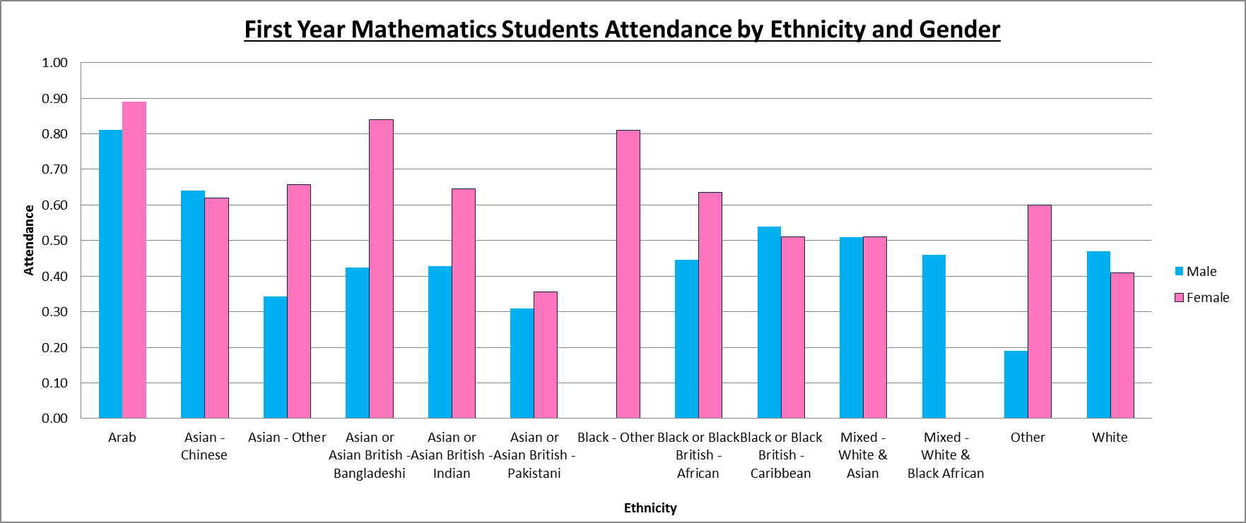
Attendance rates by Gender and Ethnicity for the 2014-15 Level 4 Mathematics Students.

Slide 21
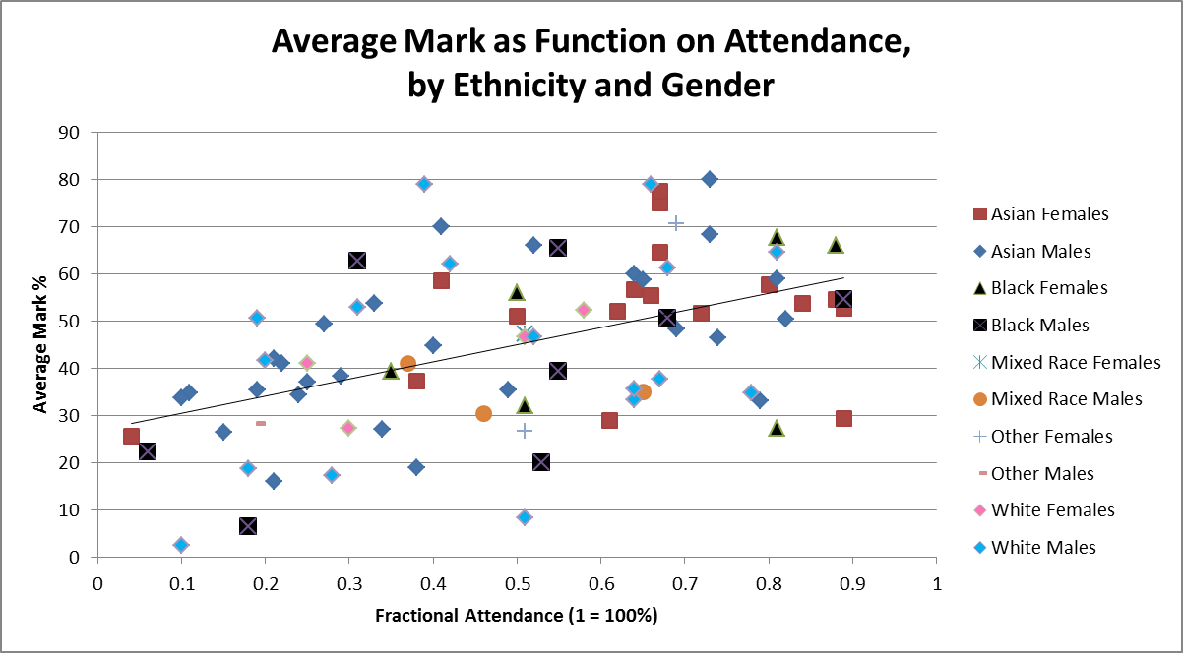
Students’ year average module marks as a function of their fractional attendance, by ethnicity and gender.

Slide 22
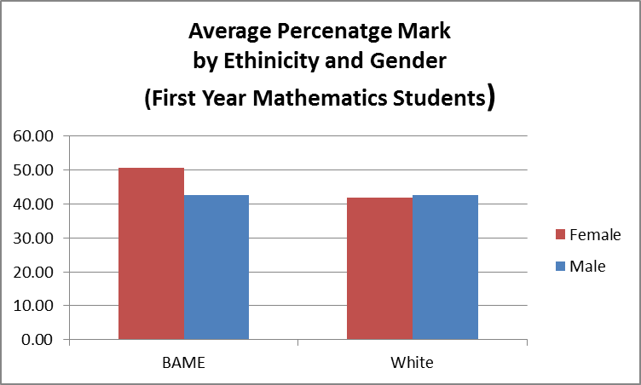
Performance of First Year (2014-5) Mathematics Students :
Comparison of BAME and White, Male and Female

Slide 23
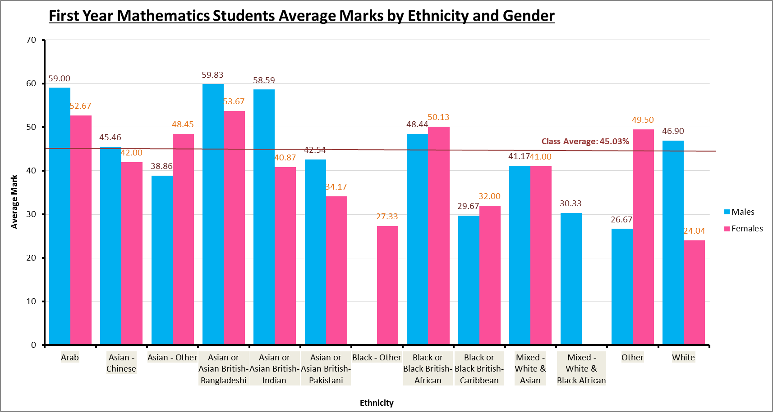
Average student module marks by ethnicity and gender

Slide 24
Further Work ?
Obtaining more up to date data, if it is made available ?
“Multi-Level” Hierarchical Models : Programmes within Schools, Levels within Programmes, Students within Levels, Time observations for each student ?
Explore possibility of comparison with other institutions ? Possibility of regional or urban-rural differences ?
Explore causes and remedies for the observed features.
Investigate further potential factors, such as socio-economic background.

Slide 25
Thank you !
Any questions ?
Contact us :
stenfordruvinga@hotmail.com
G.Hunter@kingston.ac.uk
mast@kingston.ac.uk

