Slide 1

Supporting Degree Apprenticeship students:
Tutors’ and Students’ perspectives
Focus is on the OU’s Digital and Technology Solutions Professional Apprenticeship, starting from May 2017
Soraya Kouadri Mostéfaoui (TT284 Chair)
Christine Gardner (Staff Tutor, TMXY130 module team)

Slide 2
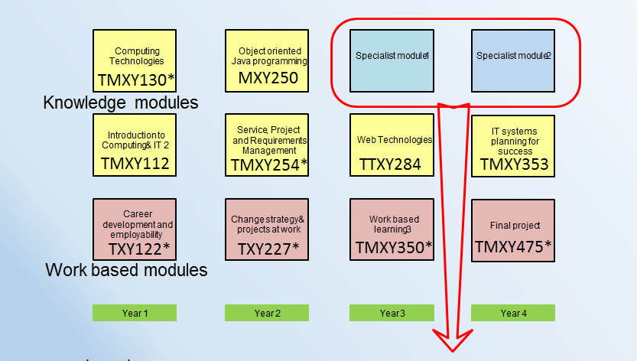
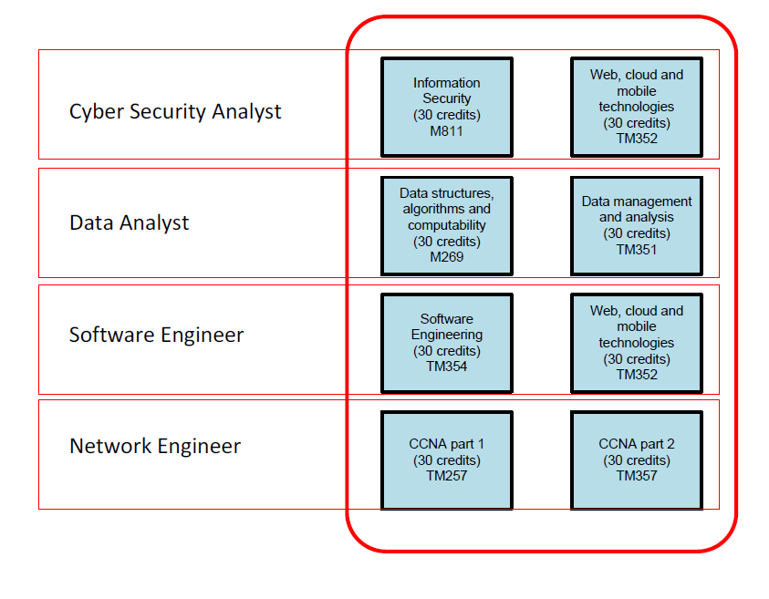
DA programme – C &C
Possibly other specialisms
in Y3/4, e.g. Microsoft
Practice Tutor
Academic Tutors
Notes:
The programme lasts 4 to 4.5 years
Explain about the types of modules:
DA-specific e.g. TMXY130
OU general modules, mixed groups for 18D e.g. TM112
WBL modules e.g. TXY122, adapted for the DA programme.
There is a three way relationship – OU, employer and student. Employers set entry requirements (e.g. A Level), and allocate 20% of apprentice time for study.
Practice Tutor – Helps apprentices to integrate learning into the workplace across the entire programme and supports the delivery of all of the work-based learning modules and the final work-based project. Apprentices and their line managers will have face-to-face or virtual meetings with their practice tutor at least four times per year.
Academic Tutors – Subject-matter experts who facilitate learning within each of the knowledge modules, through personalised tuition, support and feedback.

Slide 3
Research questions
DA students tuition support
  Support from subject-specific tutors;
  Support from practice tutors;
DA students employer support
  How the OU can/should work alongside employers to improve support;
DA students assessment
  Work-based assessment (relevant to the students’ work place);
How can we make the OU offering stand out?
Notes:
The project will investigate the issues on supporting DA students. Our case study will be the level 1 module TMX130. Both the students’ and the tutors’ perspectives will be considered, issues will be identified and good practices noted. This work will inform production of new modules and the tuition strategies of other DA modules. It will also feed into potential new eSTEeM projects and pave the way for new eSTEeM project on DA students’ experiences at Level2.

