Slide 1

Using social media to guide teacher participation and development:
Cisco MOOC experience
ESTEEM May 2019

Slide 2
Potted Back Story!
Recognising a Digital Skills Shortage
Amongst Teachers!
Supported by Cisco Systems
Focussed on Network Engineering, Hardware Systems Support – more recently adding Python, Linux and CyberSecurity
Notes:
LINK BULLETS
Following Laura’s style previously - Clear / Ordered / Opportunity to input into during the meeting - almost workshop style / then Circle back at the end
Would want Andrew/ Nuno to see presentation before to input into – as setting the parameters of the partnership

Slide 3

It is popular!
For the first course, we anticipated 300, instead attracted 1130! – Feb17
Then we saw 600 for a rerun (Oct 17), and 1192 on another course (Feb18)
Now with IoC (Institute of Coding) – we are seeing 2750+ since Feb19
Even more we already have 750+ queued for our Sept19 presentation
Notes:
LINK BULLETS
Following Laura’s style previously - Clear / Ordered / Opportunity to input into during the meeting - almost workshop style / then Circle back at the end
Would want Andrew/ Nuno to see presentation before to input into – as setting the parameters of the partnership

Slide 4

So!
We created a hybrid xMOOC
Notes:
LINK BULLETS
Following Laura’s style previously - Clear / Ordered / Opportunity to input into during the meeting - almost workshop style / then Circle back at the end
Would want Andrew/ Nuno to see presentation before to input into – as setting the parameters of the partnership

Slide 5

How!
Blending:
        Facebook Live – Optional Weekly Webinars
        MailChimp – Weekly Digests
        Social Media – Automation
        Associated with relevant content online packaged content from Cisco NetAcad
Notes:
LINK BULLETS
Following Laura’s style previously - Clear / Ordered / Opportunity to input into during the meeting - almost workshop style / then Circle back at the end
Would want Andrew/ Nuno to see presentation before to input into – as setting the parameters of the partnership

Slide 6
Facebook Live!
Live streaming direct to a Facebook Page – via phone, browser or application (such as OBS)
Weekly sessions, based on course study schedule
Facebook allows sessions <=90mins to auto-record to page
3400+ followers!
https://www.facebook.com/OpenUniversityCiscoASC/
Notes:
LINK BULLETS
Following Laura’s style previously - Clear / Ordered / Opportunity to input into during the meeting - almost workshop style / then Circle back at the end
Would want Andrew/ Nuno to see presentation before to input into – as setting the parameters of the partnership

Slide 7

MailChimp!
Weekly emails – setting the pace (heart beat)
Study guidance – when deadlines occur, assessment requirements as well as ‘how to’ information.
Notes:
LINK BULLETS
Following Laura’s style previously - Clear / Ordered / Opportunity to input into during the meeting - almost workshop style / then Circle back at the end
Would want Andrew/ Nuno to see presentation before to input into – as setting the parameters of the partnership

Slide 8

Automation!
Daily social media posts – scheduled by Hootsuite
Subject and context relevant
Subject and study experience reminders
Notes:
LINK BULLETS
Following Laura’s style previously - Clear / Ordered / Opportunity to input into during the meeting - almost workshop style / then Circle back at the end
Would want Andrew/ Nuno to see presentation before to input into – as setting the parameters of the partnership

Slide 9
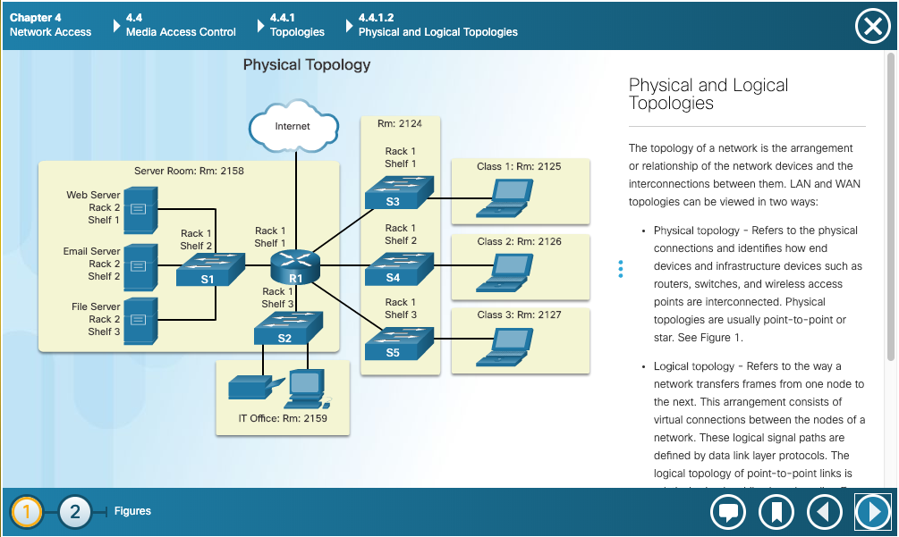
NetAcad!
Notes:
LINK BULLETS
Following Laura’s style previously - Clear / Ordered / Opportunity to input into during the meeting - almost workshop style / then Circle back at the end
Would want Andrew/ Nuno to see presentation before to input into – as setting the parameters of the partnership

Slide 10
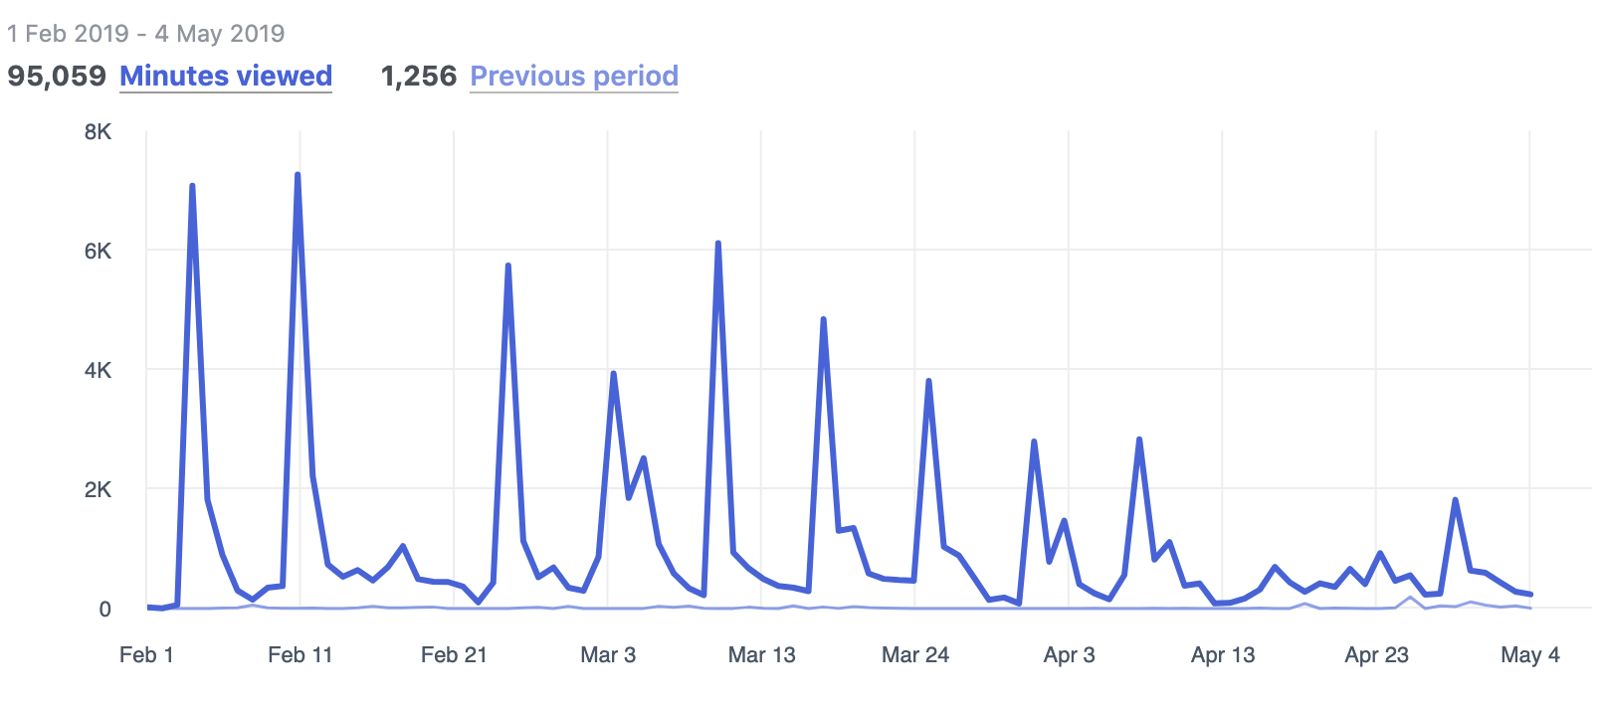
Engagement - Facebook!
Half Term
Easter
Notes:
LINK BULLETS
Following Laura’s style previously - Clear / Ordered / Opportunity to input into during the meeting - almost workshop style / then Circle back at the end
Would want Andrew/ Nuno to see presentation before to input into – as setting the parameters of the partnership

Slide 11
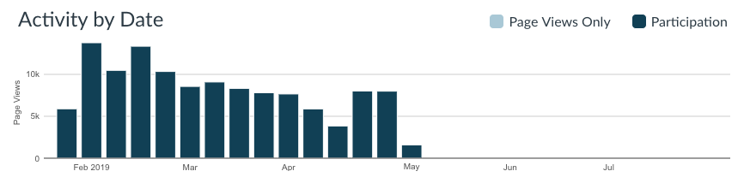
Engagement - NetAcad!
Half Term
Easter
Notes:
LINK BULLETS
Following Laura’s style previously - Clear / Ordered / Opportunity to input into during the meeting - almost workshop style / then Circle back at the end
Would want Andrew/ Nuno to see presentation before to input into – as setting the parameters of the partnership

Slide 12

Retention!
22%, 23%, 35% from previous hybrid xMOOCs – potentially supporting (Hone and Said 2016) – interaction has an effect on MOOC retention
Current figures, yet to be seen
Exploring the factors affecting MOOC retention: A survey study
Author links open overlay panel Kate S.HoneªGhada R.El Said^{b} Computers & Education
Volume 98, July 2016, Pages 157-168

Slide 13

So What!
We have Cisco rethinking their global ‘teacher training’ model
It has opened up our reach into a broader education community
We are attracting interest from other ‘vendors’ around our ability to reach underserved communities of practice

Slide 14


