Slide 1

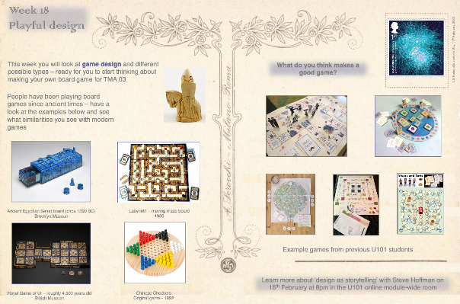

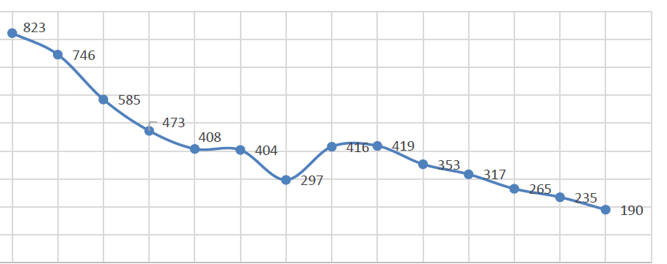

Gamification to increase participation in maths practice quizzes in Level 1 Engineering modules
S. Varagnolo, Z. Golrokhi, C. McKenna, J. Openshaw, S. Hayes-Budgen, E. Mathews
What?
The broad aim of the project is to improve progression and retention of students in the Engineering Qualifications by strengthening their maths preparation by fostering their practice.
How?
1) Gamification
Gamification applies game elements or a game framework to existing learning activities:
2) Evaluation
Engagement with the quizzes (number of clicks)
Comparison of the outcomes (iCMAs and overall course grades) achieved by students who took part in the gamified quiz and students who did not
Survey
In-depths interviews
Expected outcome
To devise an effective approach for students’ success in maths through practice
Dissemination
Presentations at conferences
Internal guidelines to quickly implement this gamification framework
Scholarship article in a peer-reviewed journal
Further developments
To extend the same approach to other Level 1 Engineering modules
To inform other OU modules that embeds any Moodle quizzes about this approach
Eye-catching introduction to the quiz, possibly with an image of a postcard, including the explanation of the “gamification”
Existing Moodle quiz
Conditional feedback according to the achieved score. If above the threshold, the student is rewarded with a piece of a badge. On completing a series of quizzes with a score above the threshold, the student is reworded the full badge
Context
T192 (the first module in the Engineering Qualification) includes practice quizzes, but students’ engagement with them decays in time:
800
Number of students engaging with the quiz
200
1
5
10
15
Quiz number

