Slide 1

Scaling-up Active Collaborative Learning for Student Success
Alison Hartley, University of Bradford
a.s.hartley@bradford.ac.uk
@AlisonSHartley

Slide 2



HEFCE Catalyst Project: Addressing barriers to student success
Report: Causes of difference in student outcomes (HEFCE 2015)
Curricula and learning
Relationships between staff and students
Social, cultural and economic capital
Psychosocial and identity factor
Collaborative Project:
https://aclproject.org.uk/
Nottingham Trent University
University of Bradford
Anglia Ruskin University

Slide 3
Our overall aim
To increase the use of two active learning pedagogies as a strategy to address attainment disparities
SCALE-UP
  Student-Centred Active Learning Environment with Upside-down Pedagogies
TBL
  Team Based Learning
Our proposal

Slide 4

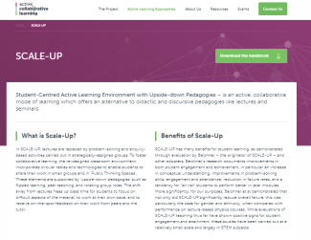
What is SCALE-UP?
Evidence on addressing barriers to student success?
Lectures replaced by problem-solving & enquiry based activities
Strategically-assigned groups
Collaborative classroom environment
Upside-down pedagogies:
  Flipped, peer teaching, rotating group roles
  www.aclproject.org.uk/scale-up/

Slide 5

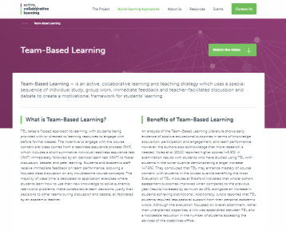
What is TBL (Team Based Learning)?
Evidence on addressing barriers to student success?
Special sequence of individual study before class, collaborative group work during class, immediate feedback and teacher-facilitated discussion and debate
Majority of time students earn how to use their new knowledge to solve authentic, real-world problems, make collaborative team decisions, justify their decisions to other teams during discussion and debate
https://aclproject.org.uk/team-based-learning/

Slide 6
Support:
  Educational developer role
  Course team recruitment started
  Redesign modules delivery 17/18
Quantitative:
  Student performance & retention
Qualitative:
  Surveys and interviews (staff & students)
  Insights into the benefits and challenges
Dissemination blueprint Oct 2018
The Evaluation

Slide 7
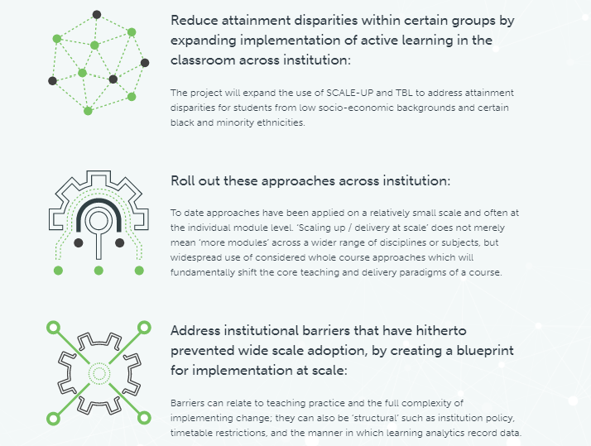
What we aim to achieve
Expected benefits
Benefit for range of students
Blueprint will be widely shared and accessible
Growing community of practice
Strengthen evidence base

Slide 8
References
Beichner et al (2007).
  The Student Centered Activities for Large Enrollment Undergraduate Programs (SCALEUP) Project. Research-Based Reform of University Physics. http://www.compadre.org/per/items/detail.cfm?ID=4517
Koles et al (2010)
  The impact of team-based learning on medical students’ academic performance. Academic Medicine 85 (11), 1739-45
Project website
  Scaling Up Active Collaborative Learning for student success
  https://aclproject.org.uk/

