Slide 1


Intro Slide Title 1
What holds students back from attending live tutorials and using online forums on level 2 biology modules?
A focus on students experiencing mental ill-health
Sarah Daniell and Lorraine Waters
School of Life Health and Chemical Sciences
8th October 2024

Slide 2
Background
Tutorials are an essential part of our tuition offer throughout the university and forums are often relied upon for activities and communication, hoping to build a sense of community.
In LHCS many level 2 students don’t attend online synchronous tutorials.
Many level 2 students don’t engage fully with forums – even for activities associated with their assessment.
Notes:
Lorraine

Slide 3
Key questions:
Why don’t we see high attendance at our online tutorials?
Why is it always a struggle to get students to engage on our forums?
What holds people back?
Is this a particular problem for students experiencing mental health issues?
How can we improve this?
Notes:
Lorraine

Slide 4
Why focus on students with mental health issues?
Equality of access to online resources.
Avoid students feeling excluded or isolated.
Improve retention as well as student learning and module results.
Notes:
Sarah

Slide 5
Our approach:
Surveyed students from SK299: Human Biology and S294: Cell biology in 20J and 21J: combination of quantitative and qualitative questions.
    20J: 784 students surveyed, 89 responses (11% response rate)
    21J: 460 students surveyed, 34 responses (7% response rate)
Students indicated on survey if they considered themselves to have mental health issues and were happy to be approached for interview.
Carried out semi-structured interviews with 6 students.
    4 from 20J
    2 from 21J
Notes:
Sarah

Slide 6
Slide Title 11
Outcomes from survey:
123 students responded overall
44 students were studying S294
102 students were studying SK299
37 indicated mental health issues (30.1% of cohort)
40.5% of students indicating mental health issues were declared to the university (59.5% undeclared)
Majority of students preferred contacting their tutor via email or forums, few preferred telephone contact
Students indicating mental health issues were more likely to use module-related social media platforms (32.4% students using these always or sometimes, compared to 15.1% with no declared mental health issues)
Notes:
Lorraine

Slide 7
Slide Title 11
Findings from survey - tutorials
Students indicating mental health issues were not deterred from attending live tutorials or listening to recordings.
Main reason for all students not attending was due to time constraints.
Some indication that anxiety was a factor for students declaring mental health issues not attending live tutorials, but numbers were low.
Overall good practice by tutors delivering tutorials.
Value for all students having access to tutorial recordings.
Notes:
Lorraine

Slide 8
Findings from surveys – forum use
Students indicating mental health issues were less likely to post on a forum and they may not use forums at all.
Students indicating mental health issues preferred posting to forums moderated by tutors/module team members.
Students indicating mental health issues were less likely to see the benefit of peer support/discussion with students/group activities.
Notes:
Lorraine

Slide 9
Findings from survey – reasons for not engaging with forums:
The main reasons students don’t engage with module-based forums are:
Time limitations.
Anxiety about posting to the forum.
Students indicating mental health issues are more likely not to engage with forms due to accessibility via mobile devices and the visual format of the forum.
**
*
** p<0.01; *p<0.05 – Chi² analysis
Notes:
Lorraine

Slide 10
Findings from survey – confidence using forums:
Students indicating mental health issues are less confident about:
Posting onto module-based forums.
Asking their tutor a question.
Engaging with forum-based activities.
*
**
*
*
*
** p<0.01; *p<0.05 – Chi² analysis
Notes:
Lorraine

Slide 11
Interviews: Students who have declared mental health issues
An opportunity to talk to students who declared having experienced mental health issues during their studies.
Gaining a deeper understanding of the key issues.
Rich insight into students’ experience of attending tutorials and using forums.
Thematic analysis of transcripts using NVivo.
Notes:
Sarah

Slide 12
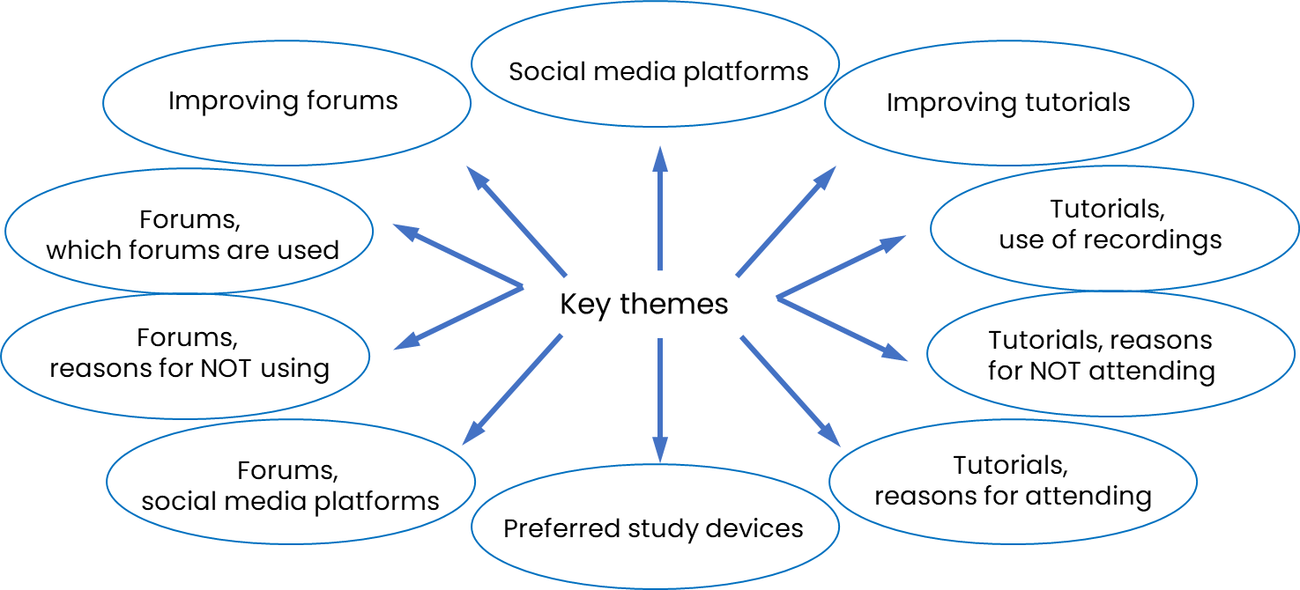
Thematic analysis of combined qualitative questionnaire data from 2020J and 2021J respondents
Notes:
Sarah

Slide 13
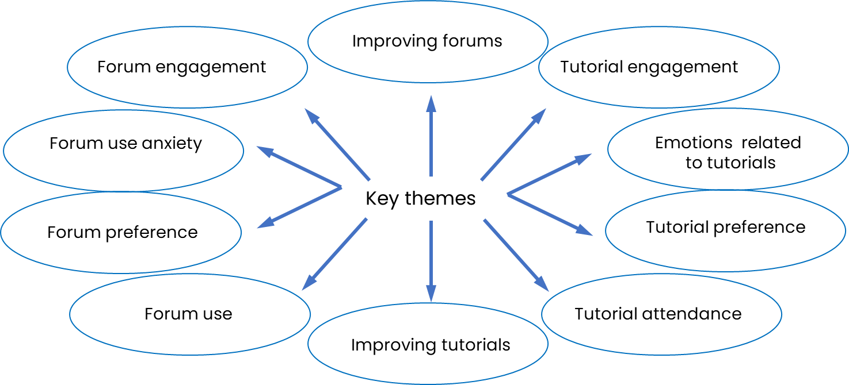
Thematic analysis of interview transcripts from students self-declaring mental health issues
Notes:
Sarah

Slide 14


Attending live tutorials
Our least expected result -
For some students, tutorials build community.
But are also a source of anxiety.
Harder to interact when you can’t see people.
I tend to go along to most when I can. It’s very rare that I can’t attend. I do enjoy the live tutorials, I prefer to be involved in the conversation, …
I’m anxious! Even if I know that I chose to do it and even if I know that If I talk and I make mistakes because maybe I got anxious , nobody will judge me, ……
Horrible! I just feel really uncomfortable I think it is that no face to face contact, you can’t see the tutor, you can’t see anyone and I’m saying that as someone who has spent I don’t know 10 years on Teams and I hate Teams with a vengeance.
Notes:
Sarah

Slide 15

Forum use anxiety
Reinforcing what we saw in the survey -
I guess I’m someone who gets quite anxious about stuff like that, as it’s sort of putting your opinions down in black and white, for everyone to see.
No I don’t think it makes me feel part of the community – it actually it makes me feel more disconnected from my peers!
Forums aren’t serving to build a sense of community.
I don’t ask questions on them, I’ll read through them but I don’t interact on them – I don’t put up questions and I don’t introduce myself particularly to other students…..
Notes:
Sarah

Slide 16

Slide Title 11
To summarise:
Students indicating mental health issues were not deterred from attending live tutorials or using recordings, but they can be a source of anxiety exacerbated by not seeing faces.
Time is a key reason for students not attending live tutorials or engaging with forums.
Tutors are doing an excellent job of delivering tutorials!
All students value having high quality tutorial recordings.
Students indicating mental health issues were more likely to use forums as ‘read only’ or not use them at all and less likely to see their benefit.
It’s easier to post for a TMA task, but not to ask a question.
Posting to forums is a source of anxiety for students experiencing mental health issues.
Forums don’t help to build a sense of community.
Accessibility and the visual format of forums is off-putting and could be simplified & updated.
Notes:
Sarah

Slide 17
Slide Title 11
Recommendations to take forward
Think about how we use forums for activities and make them less intimidating. Different approaches to consider.
Consider other ways of building community on our modules that don’t rely on forums.
Time is a universal factor affecting engagement and students are keen to have more reminders, closer to tutorial dates.
Use cameras as much as we can in tutorials to make them feel more personal.
Recordings are a crucial part of our tuition offer. We could encourage good practice in recording tutorials through observations, and staff development.
Notes:
Sarah

Slide 18
Slide Title 30
With many thanks to eSTEeM for all their support!

Slide 19
Slide Title 31

