Slide 1
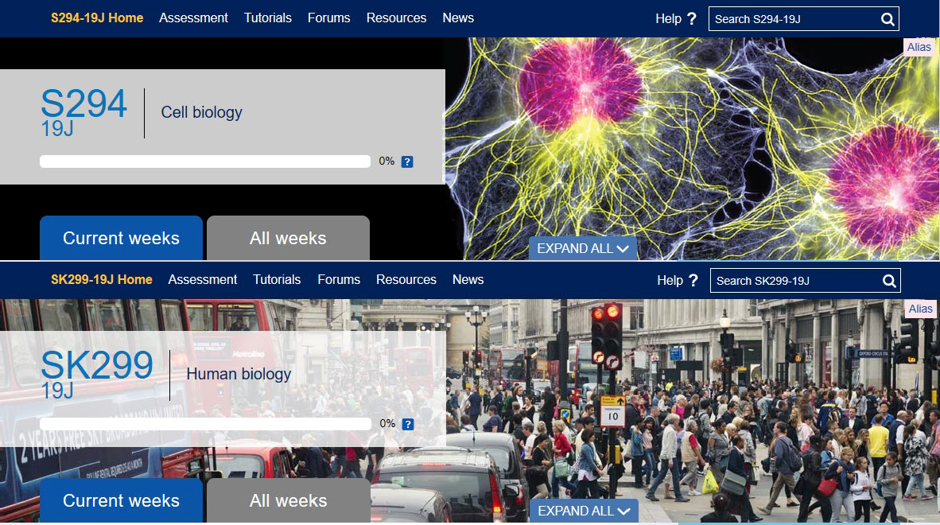
Evaluation of D-flag students accessibility to and use of online tutorials and forums in L2 modules
Sarah Daniell, Lorraine Waters
Background
It seems that many level 2 students in LHCS don’t attend online synchronous tutorials or engage fully with forums, and this is even more so for students with D flags.
Why is this important? If students don’t attend tutorials or engage with forums,
they will miss valuable tuition as well as peer to peer learning. Additionally, this could impact on the chance to build a relationship with their peers, their tutor, become part of a team and have a far more cohesive experience during their studies.
What might put students off engaging? There are probably many reasons
such as fear of the online environment, technical issues, lack of confidence and a sense that the benefits of attending don’t outweigh the issues. It may also be the type of learning expected; for tutors this tends to be active, but students would prefer passive learning.
What might they be using instead? We’ve seen an increase in use of social
media sites such as WhatsApp and Facebook, a great source of community and support for students, but these aren’t moderated by tutors or module teams so there’s no guarantee that the information they receive there is accurate or that they’re sufficiently supported.
Why are we particularly concerned about D-flag students in this
case? We need to ensure that there is a realistic equality of access to online resources so that these students aren’t becoming disenfranchised with online learning. There may also be a sense that issues they have can’t be fed back to their tutors, due to the perceived hierarchical and academic barrier.
Why is this a concern? If this happens you could end up with a sub-group who feel excluded or isolated. In turn this might impact retention as well as student learning and module results.
In this study we are aiming to look at data relating to this as well as understanding why this might be the case. We will target level 2 students, particularly D-flag students, and find out how they feel about what we offer in terms of tutorials and forums and what inhibits their participation
Proposed Methodology
Our cohort of students will be SK299 and S294 L2 health sciences and biology students in the 20J presentation.
We will look at historical data to see if there is any correlation with D-flag students with mental health issues
and tutorial attendance and forum use.
Send out questionnaires, based on our assessment of the historical data, to a broad spectrum of students relating – Quantitative data (January 2021)
Specifically interview D-flag students following on from the questionnaires – Qualitative data (March 2021)
Analyse data – Spring/Summer 2021 onwards
Outcome
Understand what inhibits student, particularly D-flag student, participation, so we can consider practical ways of building confidence and overcoming this.
Look at ways to improve accessibility and gain a better understanding of what we’re getting right and things we
could potentially improve on.
Disseminate information to module teams, eSTEeM and the wider scholarship community

