Slide 1

Confidence Matters:
Self-Efficacy in STEM Modules
Sam Johnson
Project supported and funded by eSTEeM – Project Reference ESTEEM232419
Notes:
The session will look at student’s self-confidence, also known as self-efficacy, and the impact it can have on student’s persistence and success.
We will discuss research that quantified student’s self-reported self-efficacy levels on two level one STEM modules, tracking how self-efficacy changed over the module timeline.
We will also look at the factors that students report affected their self-efficacy, and whether lower self-efficacy correlated with lower retention rate, and whether this is comparable across presentations and modules.
We will then look at the effect of a targeted intervention aiming to increase self-efficacy within the modules.

Slide 2
Self-efficacy
‘Self-efficacy refers to an individual's belief in his or her capacity to execute behaviours necessary to produce specific performance attainments’
Bandura, 1977

Slide 3
Self-efficacy
Higher retention
Higher grades
Higher pass rates
Higher course satisfaction
Bandura, 1997, Cabell, 2021, Gore et al, 2006, Kim et al, 2022, Schunk, 1989, Zimmerman, 2000
Notes:
As shown by studies discussed in this literature review, high self-efficacy has been linked to positive study outcomes e.g., higher retention numbers and performance (Gore et al, 2006, Cabell, 2021, Kim et al, 2022). This effect has been attributed to more positive emotional states, a reduction in procrastination, improved ability to initiate a particular task, more perseverance in the face of challenges and increasing the amount of effort expended in carrying out the task (Schunk, 1989, Zimmerman, 2000b).The reverse has also been demonstrated; lower self-efficacy has been associated with poorer emotional states, higher rates of procrastination, poor task initiation, lower levels of perseverance, the tendency to view challenges as insurmountable problems and applying less effort to a particular task (Bandura, 1997).

Slide 4
Self-efficacy
Mastery experience
Social persuasion
Verbal persuasion
Emotional arousal

Slide 5
The research
Two level 1 STEM modules included
  SDK100 Science and Health
  MST124 Essential Mathematics 1
First 14 weeks of SDK100
First 8 units of MST124

Slide 6
The research
Notes:
Percentage withdrawal rates for October (J) and February (B) presentations of level one 60 credit science modules available through The Open University. Modules include Science and Health (SDK100), Questions in Science (S111), Science: Concepts and Practice (S112), Working with People in Sports and Fitness (E119), and Environment: Journeys Through a Changing World (U116).
Percentage withdrawal rates for October (J) and February (B) presentations of level one 60 credit science modules available through The Open University. Modules include Discovering Mathematics (MU123), Essential Mathematics 1 (MST124), Essential Mathematics 2 (MST125).

Slide 7
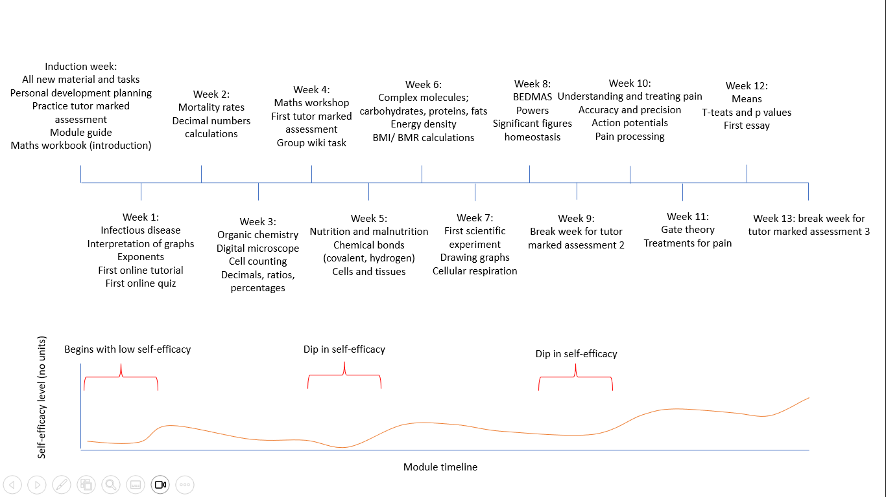
Notes:
Brief overview of SDK100 for the first 14 weeks. This was done in detail for both modules to look for tasks, skills, knowledge. Also sources of self-efficacy

Slide 8
Sources of self-efficacy: gap analysis
Notes:
Gap analysis of two online introductory STEM modules available through The Open University, where the first 14 weeks of study/8 units were analysed for tasks, knowledge and skills and their associated source of self-efficacy
The aim is to not make these equal, as some have more weight than others, but to address any deficits.

Slide 9
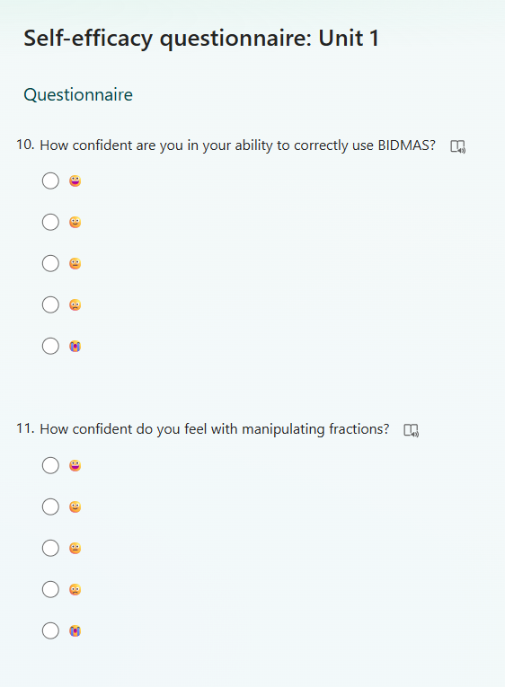
Data collection
Links to questionnaires added to study planner
Recruited participants to complete reflective journals
Weekly/ per unit

Slide 10
October 24
February 25
Notes:
Kendall’s tau. There was a moderate positive correlation, which was statistically significant ( 𝜏𝑏 = 0.356, p = 0.008).
It is unknown whether some February participants had previous experience with the module, for example starting to study on the October presentation then deferring to the February presentation. This difference may be due to differences in previous education, for example 21.42% of the February 2025 full module cohort have previous higher education qualifications, compared to 16.49% of the October 2024 presentation

Slide 11
October 24
February 25
Notes:
There was a moderate-strong positive correlation, which was statistically significant ( 𝜏𝑏 = 0.535, p = 0.046).
Unlike Science and Health, there is a negligible difference regarding previous education, for example 24.22% of students on the October 2024 presentation of Essential Mathematics 1 had a previous higher education qualification, compared to 23.83% of those studying on the February 2025 presentation.

Slide 13
Study skills
Communication
IT and assessments
Maths topics

Slide 14
Notes:
Comparison of module outcomes for students categorised as having either high or low self-efficacy based on their questionnaire scores for Science and Health and who provided their PI.

Slide 16
Thematic analysis: SDK100
Chemistry and maths; the side of biological science students didn’t sign up for
With familiarity, comes confidence
Connection improves confidence
Stress; the under-appreciated barrier to study
The unrecognised value of reflection
Managing time and distractions
Inaccurate calibration of self-efficacy

Slide 17
Thematic analysis: MST124
The art of never giving up
With familiarity, comes confidence
Connection improves confidence
Stress; the under-appreciated barrier to study
The unrecognised value of reflection
Managing time and distractions
Inaccurate calibration of self-efficacy

Slide 18
Example intervention
Executive functioning
Goal setting/ motivation
Stress management
Time management
Reflection
Notes:
Science and Health, it was agreed with the module team that an additional tutorial would run during week 13.
MST124 was ran during unit 2,
N=20
N=10
A Mann-Whitney U test was performed to compare pre- and -post intervention scores for both modules. There was a significant difference in self-efficacy score between pre- and post-intervention groups when scores from both modules were combined; z = -2.229, p = 0.026 (n=180, n=90).

Slide 19
Notes:
Baseline = 3.35

Slide 20
Summary
High self-efficacy correlated to higher retention/ pass rate
There were areas of the module timeline associated with lower self-efficacy
Fluctuations in self-efficacy between presentations showed a mod-strong correlation
No correlation between modules
Benefit to understanding the areas/ tasks associated with lower self-efficacy in a module – targeted interventions
Benefit to providing support – stress management

Slide 21
References
Bandura, A (1977) Self-efficacy: Toward a unifying theory of behavioural change. Psychological Review Vol 84, No. 2, pp. 191-215
Bandura, A. (1997). Self-efficacy: The exercise of control. W H Freeman/Times Books/ Henry Holt & Co.
Cabell, A.L (2021) Career Search Self‐Efficacy and STEM Major Persistence. Career Development Quarterly, 69(2), pp. 158–164
Gore, P.A., Jr., Leuwerke, W.C. and Turley, S.E (2006) A Psychometric Study of the College Self-Efficacy Inventory. Journal of College Student Retention: Research, Theory & Practice, 7(3–4), pp. 227 –244
Huang, X, Mayer, R, Usher, E (2020) ‘Better together: Effects of four self-efficacy-building strategies on online statistical learning’. Contemporary Educational Psychology Vol 63 pp. 101924
Kim, Y, Yu, S, Koenka, A, Lee, H, Heckler, A (2022) Can Self-Efficacy and Task Values Buffer Perceived Costs? Exploring Introductory- and Upper-Level Physics Courses. Journal of Experimental Education, 90(4), pp. 839–861
Schunk, D (1989) Self-efficacy and achievement behaviours. Educational Psychology Review Vol 1, No. 3
Zimmerman, B (2000) Self-Efficacy: An Essential Motive to Learn. Available at: https://doi.org/10.1006/ceps.1999.1016

Slide 22

Any questions?

