Slide 1


eSTEeM Seminar Series 2020-21 Reducing inequitable outcomes for BAME students
Prof John Butcher - Director Access and Open Darren Gray - Manager APS
24th September 2020

Slide 2
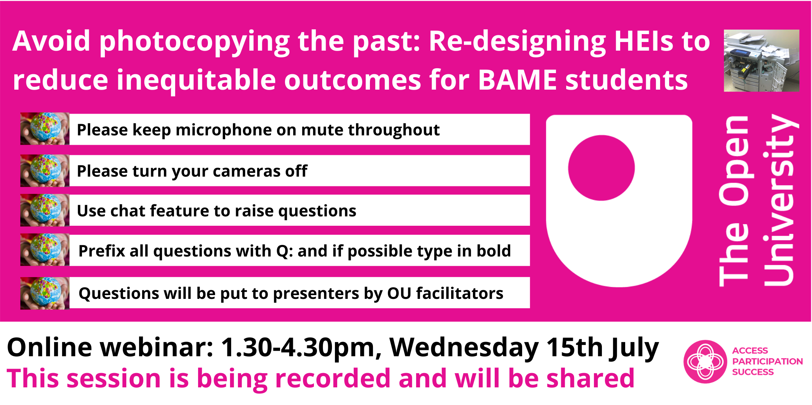
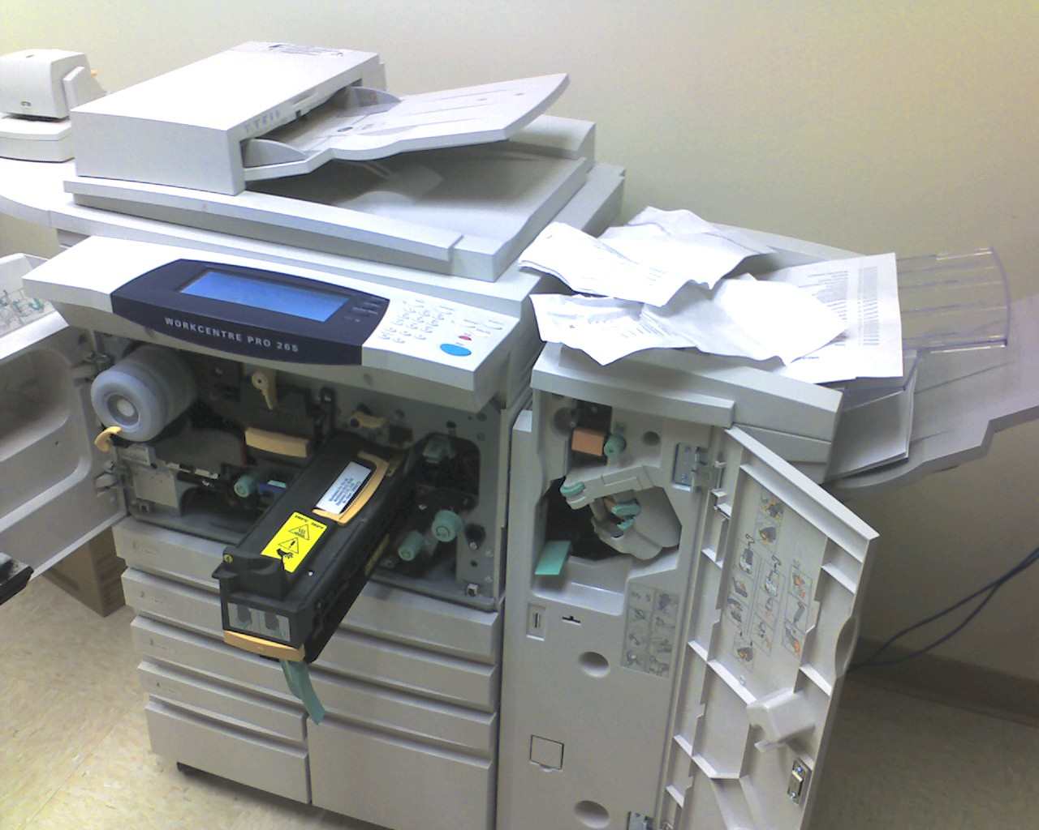
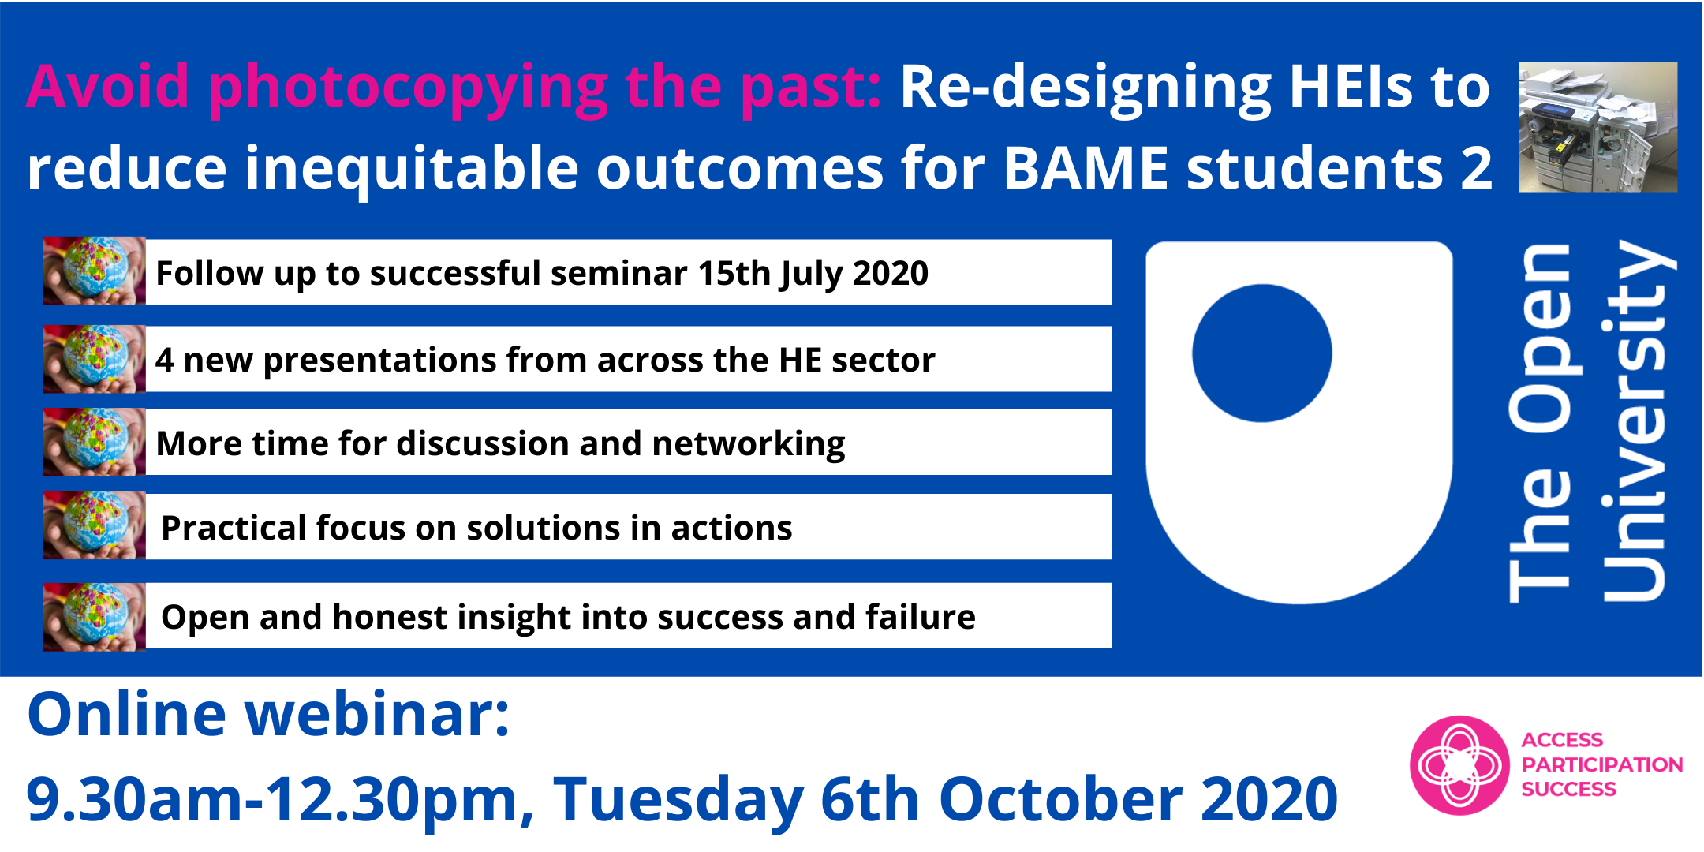
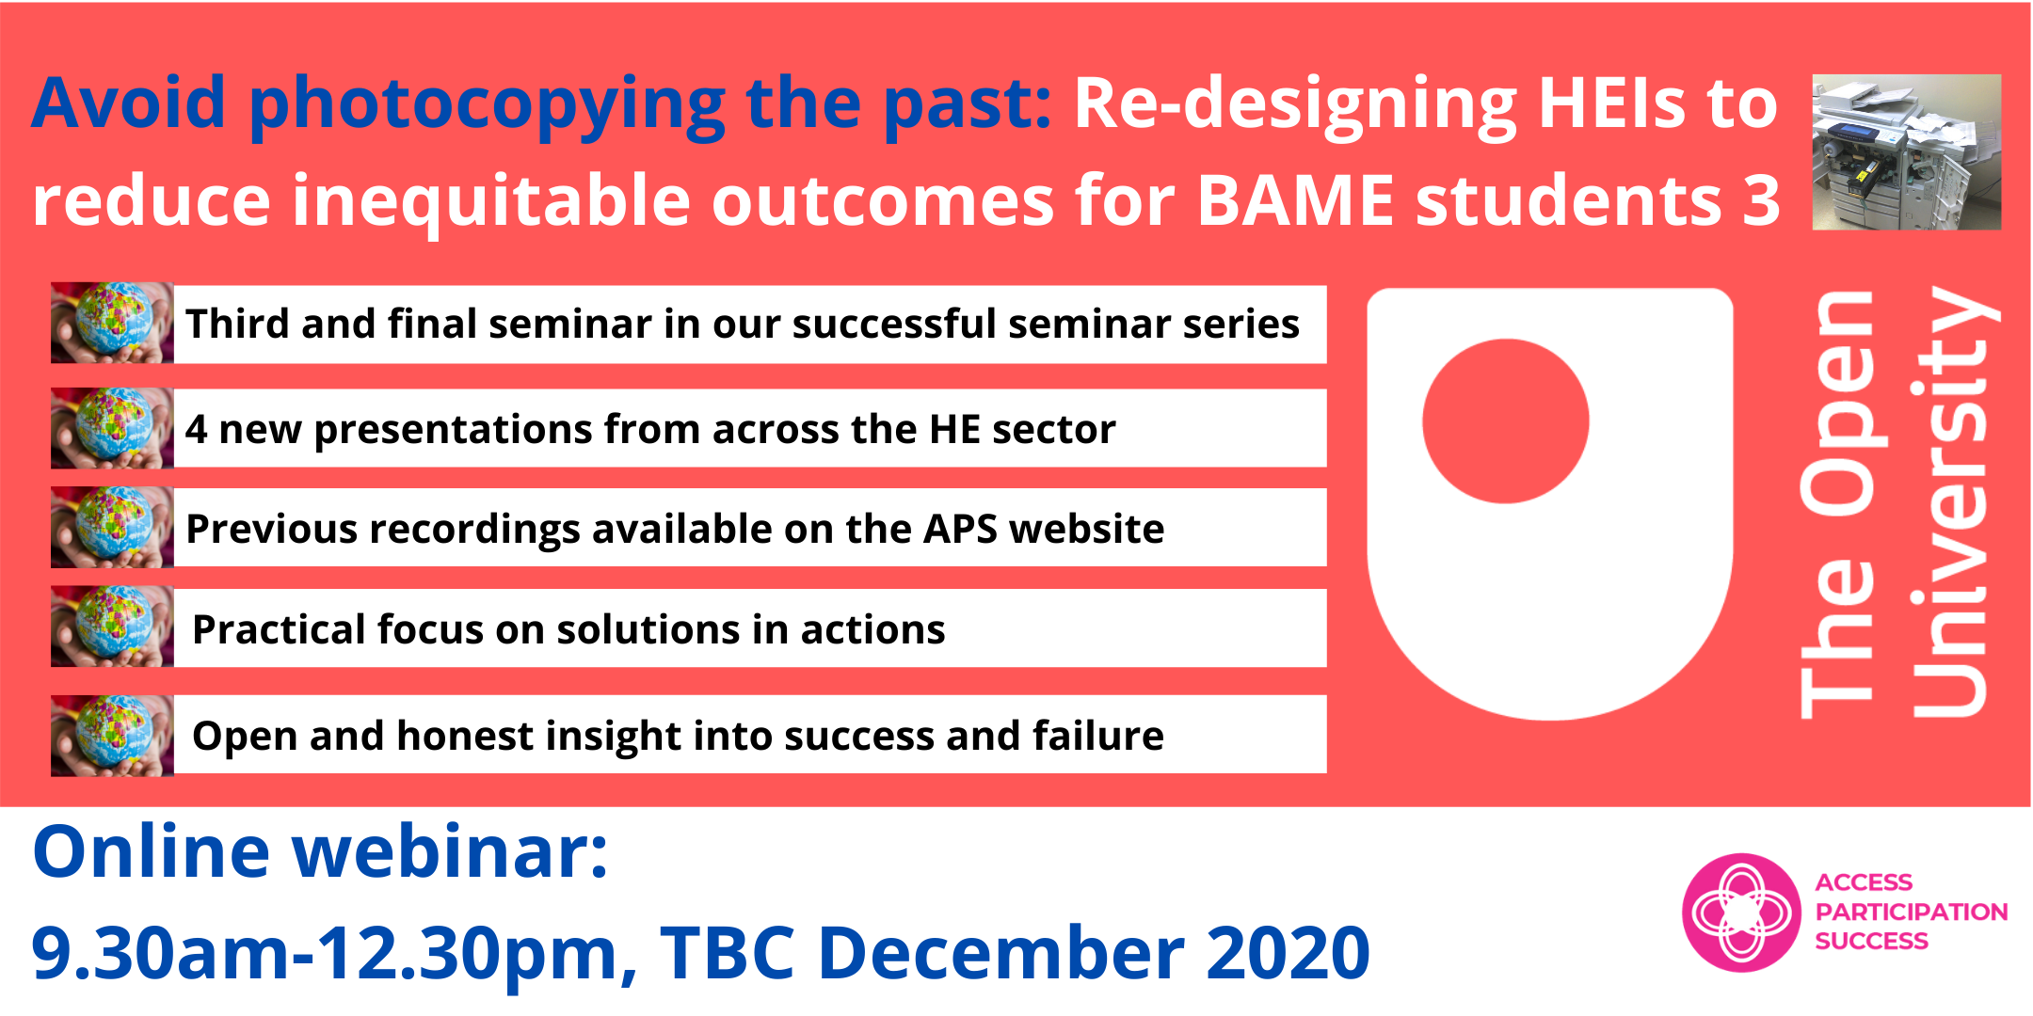
Avoid Photocopying the Past
Sector-wide seminar series
Why a photocopier?
Link to 15th July 2020 seminar recording

Slide 3
Completion Gap:
BME
FTE | OU | STEM | C&C | E&I | EE&ES | LH&CS | M&S | PS
2015/16 | 4436.38 | 1076.00 | 270.17 | 149.83 | 33.75 | 211.83 | 312.42 | 98.00
2016/17 | 4419.08 | 1041.21 | 245.08 | 175.67 | 28.58 | 194.21 | 309.92 | 87.75
2017/18 | 4285.37 | 997.46 | 240.17 | 175.58 | 44.92 | 185.79 | 282.67 | 68.33
2018/19 | 4379.67 | 1029.75 | 274.17 | 196.33 | 41.75 | 183.17 | 269.42 | 64.92

Slide 4
Pass Gap:
BME
FTE | OU | STEM | C&C | E&I | EE&ES | LH&CS | M&S | PS
2015/16 | 3770.92 | 896.67 | 221.42 | 131.79 | 27.33 | 171.96 | 273.00 | 71.17
2016/17 | 3820.88 | 890.12 | 209.00 | 153.96 | 24.42 | 154.83 | 270.42 | 77.50
2017/18 | 3834.46 | 883.46 | 212.75 | 163.58 | 39.42 | 151.46 | 255.17 | 61.08
2018/19 | 3857.92 | 877.42 | 232.33 | 173.33 | 35.75 | 144.33 | 236.25 | 55.42

Slide 5
Good Pass Gap:
BME
FTE | OU | STEM | C&C | E&I | EE&ES | LH&CS | M&S | PS
2015/16 | 568.17 | 159.67 | 42.75 | 21.92 | 4.75 | 26.00 | 53.50 | 10.75
2016/17 | 589.50 | 165.50 | 37.75 | 21.25 | 5.75 | 27.25 | 58.00 | 15.50
2017/18 | 692.50 | 161.75 | 38.50 | 28.00 | 3.75 | 31.50 | 48.50 | 11.50
2018/19 | 825.25 | 159.75 | 37.00 | 25.00 | 6.75 | 34.50 | 44.50 | 12.00

Slide 6
Reflection 1
The term BAME, and its use, needs to be considered carefully and whether there is something better we can use. BAME homogenises and masks difference. This homogenisation can act to devalue difference, and as an acronym can feel dehumanising. BAME also suggests white and others.
What will you do?

Slide 7
Reflection 2
There is a need for open institutional conversations that own up to the need for change, and enable staff and students to shape change.
We must be careful presentation of gaps does not demotivate students and staff.
What will you do?

Slide 8
Reflection 3
Change needs to happen at an institution-wide level, and be properly resourced.
We must create an inclusive framework rather than tackling curriculum in isolation
What will you do?

Slide 9
Reflection 4
EDI is often seen as a legal obligation, ticking boxes to satisfy bureaucrats. A nice to have leading to passive capture of status and tinkering of structures.
EDI is more. Change is needed to deconstruct and reassemble a new inclusive system.
What will you do?

Slide 10
Reflection 5
Student involvement is key. Co-creation of curriculum, assessment and systems brings in lived-experience and expertise currently in short supply in a predominantly white workforce.
What will you do?

Slide 11
Reflection 6
There is a big difference between diversity and inclusion.
Diversity is being invited to the party
Inclusion is dancing and having a good time!
What will you do?

Slide 12
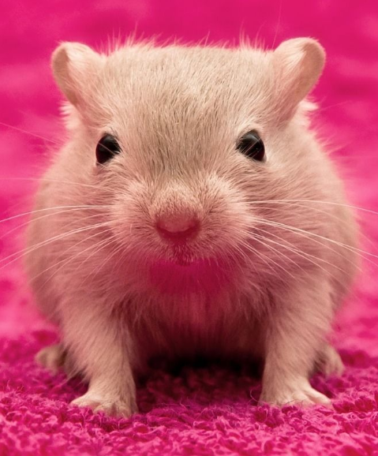
Why are you here?
What about all the people that are not here?
‘Real change, enduring change, happens one step at a time’
Ruth Bader Ginsberg

Slide 13

Journal of Widening Participation and Lifelong Learning
STEM Special Edition?
Link to Journal

Slide 14
Sign up for the APS seminar
How The Open University is working to address reduce inequitable outcomes for BAME students
Professor Tim Blackman: Vice Chancellor
The Open University
Enabling and Increasing Belonging and Success amongst the BAME Student Community in Hertfordshire Business School
Sara de Sousa: Students Success Lead
University of Hertfordshire
Decolonising and diversifying the Curriculum – Wider Lessons for Truly Developing the Inclusivity Agenda
Jill Childs: Principal Lecturer/ Programme Lead Social Work and Wellbeing
Oxford Brookes University
Anti-discriminatory, Anti-racist Attainment Policy
Dr Tamsin Bowers-Brown: Associate Professor of Learning and Teaching and Head of Social Justice and Pedagogic Practice
Dan West: Policy and Research Lead, Social Mobility
Jo Astley: Evaluation and Evidence Manager, Social Mobility
All based within the Centre for Excellence in Learning and Teaching, University of Derby
Is This the Real Life? Critical Perspectives on Whiteness
Anita Pilgrim: Lecturer and Consultant
The Open University
Link to register for 6th October seminar

