Slide 1

MY PERSONAL JOURNEY INTO THE STUDENT VOICE ARENA: MAKING THE CONNECTIONS BETWEEN POLICY, RESEARCH AND SCHOLARSHIP
Professor Jane Seale
WELS
Image: photostock / FreeDigitalPhotos.net
Notes:
http://tel.ioe.ac.uk/tel-seminars/teldi2012/
TEL Digital Inclusion Conference
January 17th 2012
Sheffield

Slide 2
overview of 3 student voice projects Project that used participatory methods
LEXDIS- external funding | PAIRS- internal scholarship funding | PIE- internal scholarship funding
2007-2008 | 2007-2008 | 2011-2012
Institutional focus | Departmental focus | Programme focus
Technology related learning experiences | General learning experiences | The “first” year learning experience
UG and PG Disabled students | UG and PG | UG
Different disciplines | Education | Education
31 | 20 | 11
University A | University A | University B

Slide 3
Theoretical and epistemological frameworks can provide a useful foundation on which to build valid and meaningful student voice initiatives
ARGUMENT ONE

Slide 4
My search for a conceptual framework to underpin my student voice work was influenced by learning disability research
Countering oppression in life and in research: “Nothing about me without me”
Ensuring research topic is one that people with LD consider worthy of investigation
Asking people with LD to act as consultants or advisors to projects
Provision of support, training and payment so that people with LD can undertake their own research

Slide 5
..and therefore led me to participatory research methods
Early and continual participation of learners in order to produce improved teaching and support practices;
Engaging learners in the design, conduct analysis and dissemination of student voice projects
Encouraging learners to own the outcome by setting the goals and sharing in decisions about processes.
The construction of non-hierarchical relationships between researcher and participants

Slide 6
LEXDIS: Overview of Participatory Phases
Phase One: Consultation regarding proposed research questions and research methods; p=56
Phase Two: Opportunity to contribute own experiences of using e-learning, interview plus own “artefact”; p=31 and rising
Phase Three: Opportunity to validate and interpret the results of the study and to contribute to the design, content and dissemination of project deliverables and outcomes, including website; p=15

Slide 7
PAIRS: Overview of Participatory Phases
Phase One: Tell us “your stories” about your learning experiences and whether your needs have been met- choice of methods (n=20)
  Write or audio-record a one-two page letter to an “imaginary” friend ;
  Write a diary describing learning experiences on course, over the period of a “typical” week;
  Write a reflective journal that describes a “critical incident”
  Produce a piece of creative writing or art (e.g.. poem, picture, sculpture, song);
  Alternatively, opt to be interviewed face-to-face, by phone or by webcam;
Phase Two: Help us understand and respond to your stories (n=5)
  Formed an advisory group with 5 students that worked with me to analyse the information and to decide how we would use the information about student learning experiences to design staff development initiatives in the School.

Slide 8
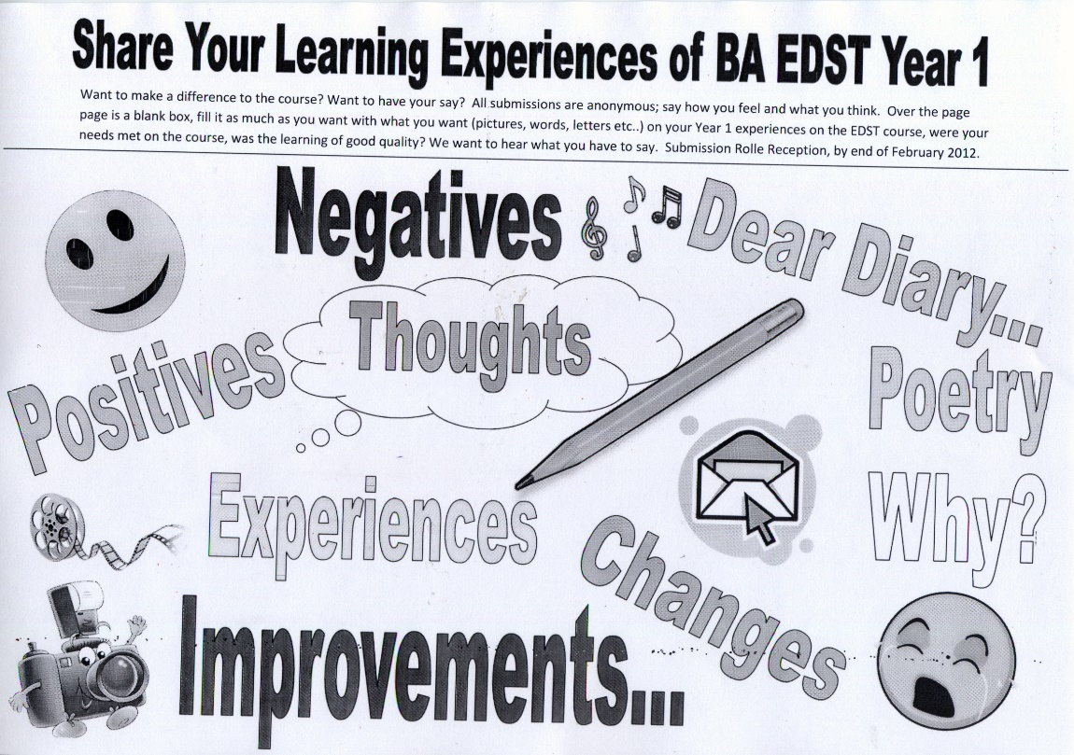
PIE: Overview of Participatory Phases
Steering Committee (n=3)
  Design of data capture tool (mood board)
Contribution of experiences (n=11)
Co-researcher (n=2)
  analysis, writing, presenting
Notes:
Complete a mood board (using either the attached template or flipchart paper which we can provide) where you can use anything you want (drawings, photos, words, textiles, comments, symbols etc) to express whether and how your learning needs were met on the course;
Write or audio-record a letter to an “imaginary” friend who is thinking of enrolling on the BA Education Studies course; telling them about your own personal learning experiences on your course and whether and how your particular learning needs have been met;
Write or audio-record a diary describing your learning experiences on your course, perhaps over the period of a “typical” week or just focusing on one significant day in the programme calendar;
Write or audio-record a reflective journal that describes a “critical incident”- something in particular that you have experienced on your course that was really positive or negative in terms of your learning experience and how your particular learning needs were met or not met;
Produce a piece of creative writing or art (e.g. poem, photograph, picture, sculpture, song) that expresses your feelings and experiences in relation to the quality of your learning experience and whether or not your particular learning needs were met or considered;
Alternatively, you can opt to be interviewed face-to-face, by phone, of by Skype by one of the project team.

Slide 9
There is a real need to critically examine the outcomes of student voice initiatives in order to make valid conclusions about their success or effectiveness
ARGUMENT TWO

Slide 10
PIE: Presumptions of voice ? A tutors perspective
“When I joined the programme the degree documentation made very explicit reference to student voice in its rationale: to enable students first to discover a voice, then develop a voice and finally to make their voice heard and join a community of voices in education as they completed the course. The promotion of student voice appeared to be an integral part of the degree’s official curriculum”
  Perhaps so few students took part in the PIE project because the programme in question had done such a good job of liberating voice in other ways.
  The resistance observed therefore may simply be a resistance to what is perceived as a redundant project initiated from outside the programme.
  Perhaps our experiences of resistance in the PIE project are a response to efforts made by universities to increasingly be seen as concerned with ‘student experience’ which has led to the higher education marketplace leaking into participatory approaches to teaching and learning in higher education.

Slide 11
An amplitude framework for evaluating student voice in higher education
FACTORS/CRITERIA | REACH | FITNESS
AIMS AND ASSUMPTIONS | The extent to which all participants 'bought' in to the aims, identified problems and assumptions of the student voice project. | The extent to which the assumptions on which the student voice project is based are accurate or evidenced based.
PROCESS | The extent to which all participants in the project had opportunities to influence, make choices and have a voice. | The extent to which processes are put in place/ planned into the student voice project to enable meaningful responses to the student voice The extent to which university personnel have the power or are willing to act on student voices
OUTCOMES | Extent to which transformation occurs for both students and tutors | The extent to which students and staff understand one another better
© Seale (2014)

Slide 12
If we as a community can underpin our work with theoretical and methodological frameworks and critically examine our findings then when we write up our internal student voice projects there is no reason why what we produce should not be labelled research instead of scholarship.
ARGUMENT THREE

Slide 13
Research that TRANSFORMS OUR OWN AND OTHERS UNDERSTANDING
SOMETIMES THE BIG THINGS MATTER (lexdis)
SOMETIMES THE LITTLE THINGS MATTER (pairs)
SOMETIMES THE SEARCH FOR WHAT we think MATTERS IS AN INTRUSION (pie)

Slide 14
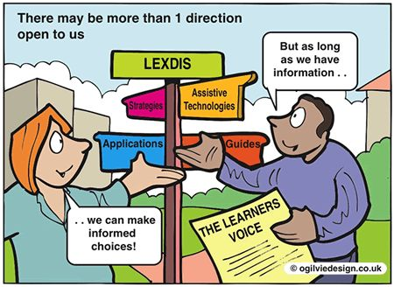
LEXDIS: The big things matter
Digital agility
Disastrous pedagogy
Digital decision-making
Digital dilemmas
Notes:
Many of the participants customise their computers to suit their preferences, swap and change from a range of technologies; are well-informed about the strengths and weaknesses of particular technologies in relation to design, usability, accessibility and impact on learning and have developed a range of sophisticated and tailored strategies for using technology to support their learning.
Many participants use technology with confidence. They feel comfortable with it and it holds no fears for them. Despite this confidence, some disabled learners identify “room for improvement” in terms of skill level and type of use.
Many participants are familiar with social networking tools such as Face Book. Some have used these tools for learning. Many have used these tools for personal or social reasons, but have given them up because they were too distracting or time consuming.
Participants generally know what support and training is available to them.
Some participants make explicit and conscious decisions not to use assistive technologies
Use marks them out as being different- fear of stigma
dislike being recommended assistive technologies based on “labels” rather than actual needs or preferences

Slide 15
PAIRS: The little things matter ..
The most funny and convenient thing is: instead of going to the post office that is 3 minutes on foot from our building we can leave our letters in a specific place in the reception and our letters will be posted for us. Sometimes I am saying to myself that all these things are spoiling us, but the best thing that I have to do is just to relax and enjoy them. Do you remember the problems we had in our old university? The university here and all the professors are much better than those we had there.[..] You can feel that they care about your progress, they care about your problems and of course they are continuously trying to make things better
Notes:
A “transformation of the familiar” (Batchelor 2008) or a “rupture of the ordinary” (Fielding 2004) that takes us beyond what is already known, to look at things differently

Slide 16
PIE: When searching for what we think matters is an intrusion
“The purpose of the project was to access student voice; an activity that has increased significantly with the consumerist focus of HE; however the opportunity to express my views about my course was not a significant motivator in my decision to take part. Firstly I am generally content with my university experience, so I did not feel that I had a particular grievance I needed to air or that I previously did not have a channel to do this if I did have a problem. I find people are more likely to seek the opportunity to air views if they perceive that something is wrong. Also, the University regularly designs questionnaires to harness student opinion, and it did feel slightly that I would be repeating views I had already expressed”.

Slide 17
References
Seale, J (2016) How can we confidently judge the extent to which student voice in higher education has been genuinely amplified? A proposal for a new evaluation framework. Research Papers in Education, 31,2, 212-233
Seale, J. Gibson, S, Haynes, J & Potter, A. (2014) Power and resistance: Reflections on the rhetoric and reality of using participatory methods to promote student voice and engagement in higher education. Journal of Further Education and Higher Education. 39, 4, 534-552
Seale, J (2010) Doing Student voice work in higher education: the potential contribution of a participatory framework, British Educational Research Journal, 36,6, 995-1015

