Slide 1
Students’ perceptions of online tutorials and forums in S294/SK299
Lorraine Waters & Sarah Daniell

Slide 2
Some background
In LHCS many level 2 students don’t attend online synchronous tutorials.
Many level 2 students don’t engage fully with forums – even for activities associated with their assessment.
Students experiencing mental health issues appear even less likely to engage.

Slide 3
Key questions
Why don’t we see high attendance at our online tutorials?
Why is it always a struggle to get students to engage on our module based forums?
What holds people back?
Is this a particular problem for students experiencing mental health issues?
How can we make this better?

Slide 4
Why focus on students with mental health issues?
Equality of access to online resources.
Avoid students feeling excluded or isolated.
Improve retention as well as student learning and module results.

Slide 5
How can we find out more?
Jisc survey sent to SK299 & S294 students from 20J
Combination of qualitative and quantitative questions
784 students surveyed – 89 respondents
  17 S294
  58 SK299
  14 both
27 disclosed mental health issues (14 with D flag for MH)

Slide 6
Survey quantitative data - tutorials

Slide 7
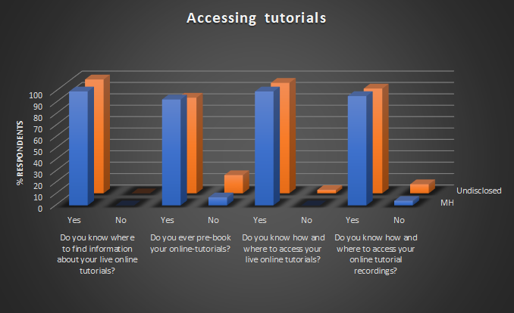

Slide 8
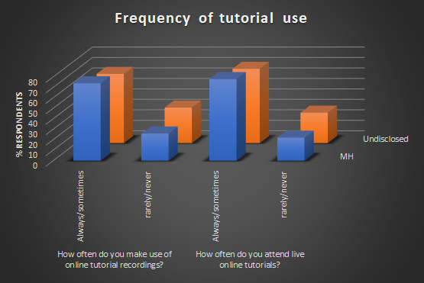

Slide 9
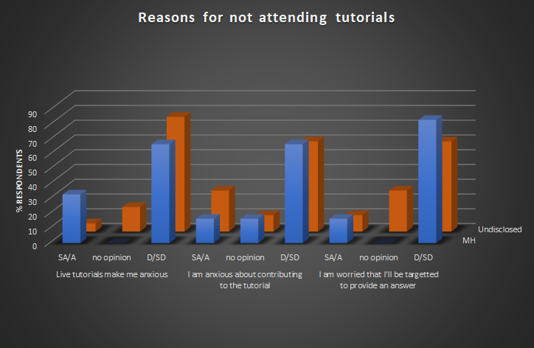

Slide 10
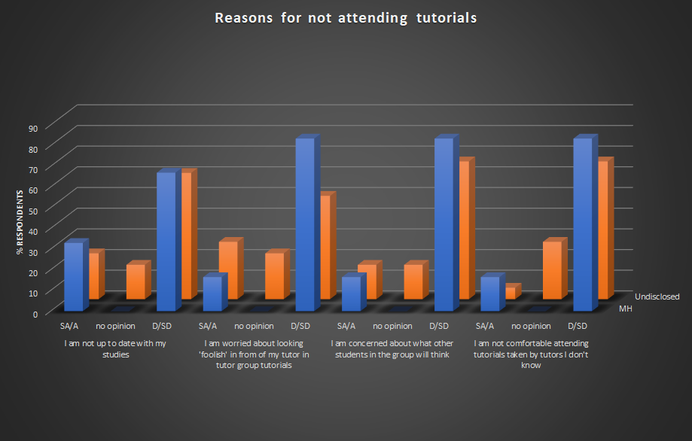

Slide 11
Survey quantitative data - forums

Slide 12
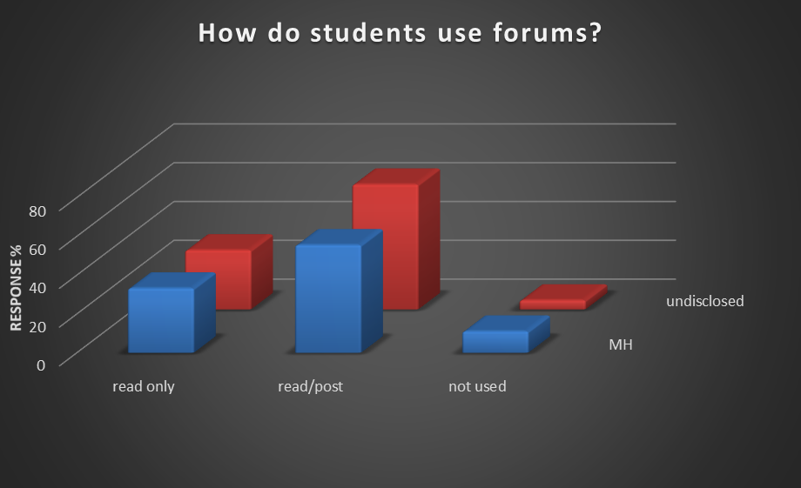
THE WAY STUDENTS USE FORUMS
We asked students how they used forums.

Slide 13
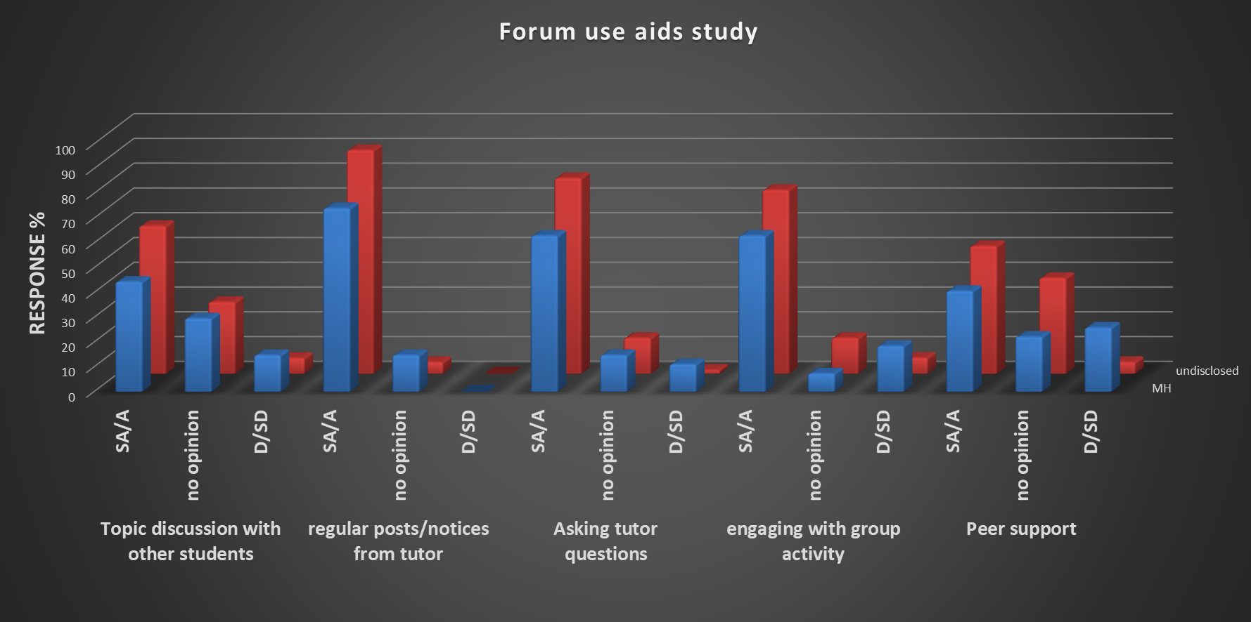
FORUM USE
We asked students how they felt forum use aided their studies?

Slide 14
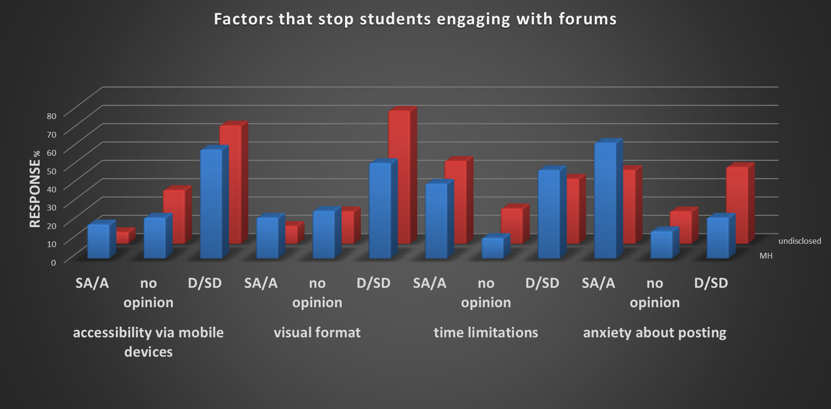
FORUM ENGAGEMENT
We asked students what factors stopped them engaging with forums?

Slide 15
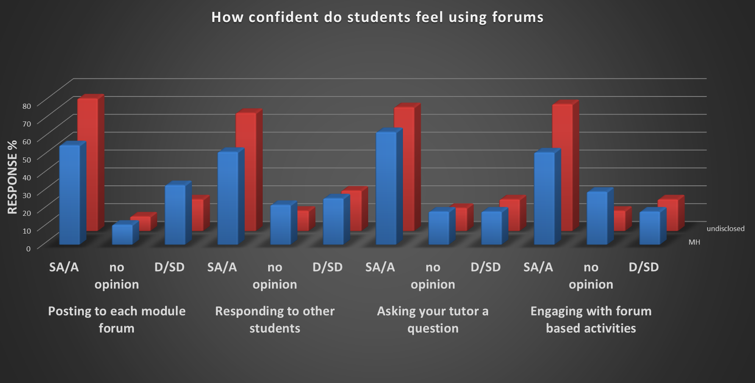
CONFIDENCE
We asked students which aspects of forum use they felt confident about?

Slide 16
What does this mean?

Slide 17
Findings so far…
Students with MH issues appear to be more likely to attend live or make use of recordings of online tutorials.
Of those that don’t attend, the main reason for this is anxiety.
But, students don’t seem to be worried about being targeted/looking foolish – good practice by tutors.
Students with MH issues are less likely to use forums.
Those students disclosing MH issues are less likely to see the benefit of forums in relation to their studies – particularly student based discussions and peer support.
Main reason for non-engagement is anxiety with some issues around accessibility, visual format and time limitations.
Overall students declaring MH issues were less confident about all aspects of forum use.

Slide 18
What next?

Slide 19
Phase 2 of the study…
Conduct interviews with students declaring MH issues from the survey.
Analyse qualitative data from the interviews (combined with qualitative data from the survey) to better understand how these students feel about attending online tutorials and using forums.

Slide 20
THANK YOU

