Slide 1
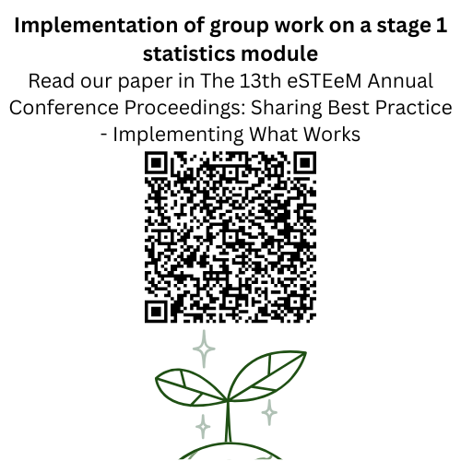
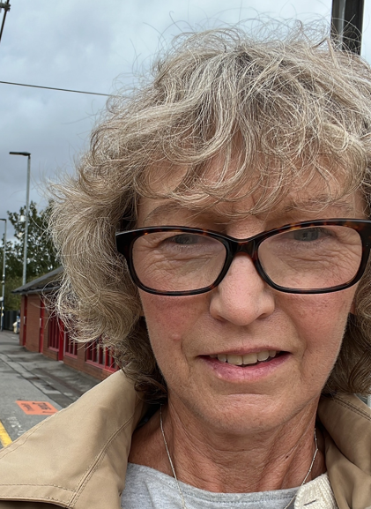


Intro Slide Title 1
M&S Scholarship session - Incorporating asynchronous group work into M140
Ruth Neal and Kellee Patterson
School of Mathematics and Statistics
October 2026

Slide 2
Slide Title 6
Assessment and feedback on the introduction of group work on an Open University first year statistics module (M140)
AIM To assess the suitability and impact of introducing group work on a first-year statistics module.
PURPOSE To increase the employability content of the module by enabling and encouraging students to work in small groups to discuss their statistical results.
It is generally considered that group work affords invaluable opportunities for students to develop their collaborative skills and this, in turn, is a key employability skill. However, students do not always recognise the importance of group work (Evans et al, 2020). It is also noted that opportunities for group work via the current online tutorial provision may be few and far between, with facilitation of it being varied. (Butler et al, 2018).
01
Notes:
KP We were asked to introduce employability to our modules.
A number of our students are studying data science and in this line of work will need the skills of working with large data sets as well as communicating and collaborating with others. Therefore we wanted to introduce something that would help enable our students take the first step towards developing these skills.
Also, maths and stats students are generally not the most well developed when it comes to working with others since maths is traditionally seen as a somewhat independent pursuit!

Slide 3
What is group work?
We define group work as 'collaboration and cooperatively working with others to complete a task or project'
Thinking about situations in which you have taken part in online group work, please rank the following aspects of group work from top (worked extremely well) to bottom (did not work well).
Collaboration between all group members
Understanding of individual roles within the group
Communication between group members
Use of online technology for collaboration
Successfully working as a group
Meeting the project timescales
Notes:
KP Poll
We asked students the same question before and after we started – we’ll look at what they thought worked well on M140 in a short time.

Slide 4
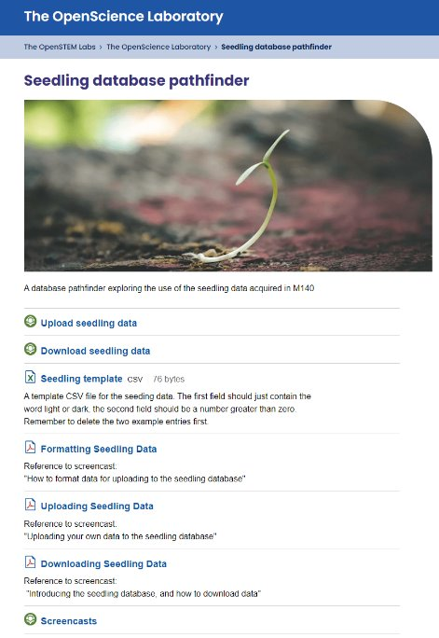
The group work
Students are encouraged to conduct an experiment as part of the final assignment. Students grow some seedlings in different light conditions and measure the root lengths.
This data is then uploaded into a combined database. We ask the students to download this data and then investigate the full database using the software Minitab.
Students can produce plots and data summaries and analyse these as a group.
The aim is for the students to produce a summary report.
Notes:
Ruth

Slide 5
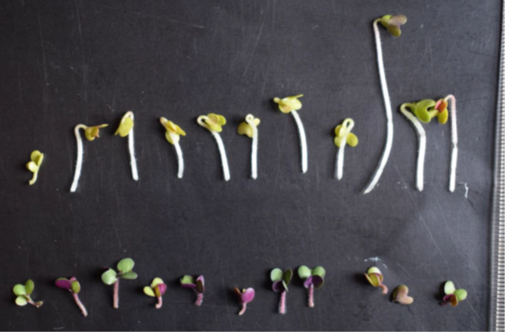
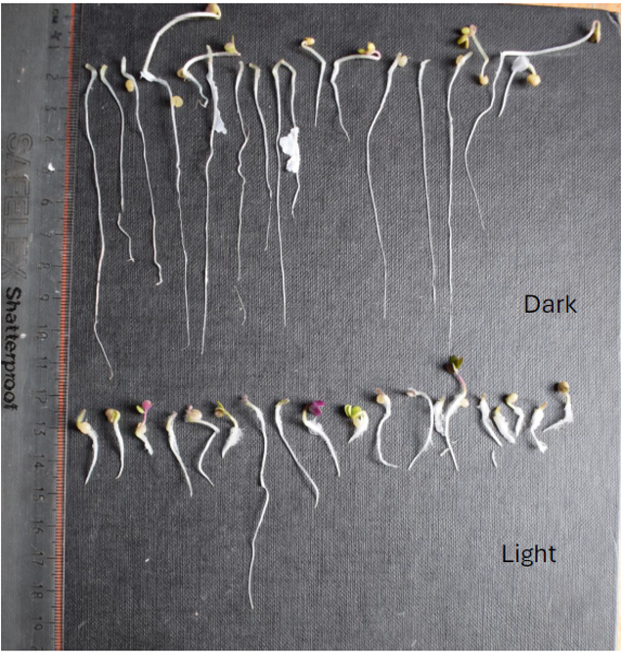
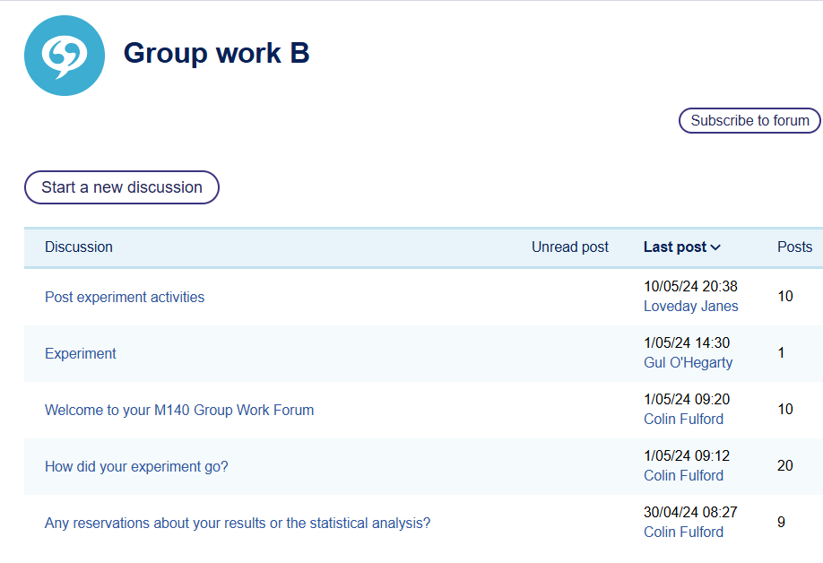
Group work 2023/24
What did we do in 23J/24B?
Seedlings grown by students whilst conducting the experiment
Setting up the project
Set up group work surveys (JISC).
Set up seedling database, along with instructions for students to format, upload and download their data.
Asked all students to upload their seedling data to the new database.
Asked for student volunteers to be involved in group work.
Recruited tutors to manage the groups.
Group work took place in tutor group forums small groups.
Minimal instructions for students.
23J
Notes:
Ruth Tutors had different levels of response this shows contributions from 8 students from a group of about 12
Despite approx 60 students volunteering, many did not take part

Slide 6
2023/24 final survey (21) versus initial survey (119)
1 – did not work well
5 – worked extremely well
Notes:
KP Question before: Thinking about situations in which you have taken part in online group work, please rate the following aspects of group work from 1 to 5 where 1 – did not work well and 5 – worked extremely well.
Question after: Please rate the following aspects of group work on this module from 1 to 5 where 1 – did not work well and 5 – worked extremely well.
We would like the greens in the final results to match more closely the greens in the initial results - there is clearly work still to do here.
Final survey is a much smaller sample, ~21 verses 119 in initial survey

Slide 7


Slide Title 6
2024/25 what we did next
More direction
We made the instructions for students (and tutors) clearer, setting deadlines and giving the students specific tasks.
We created a set of prompts for tutors to use with students and a timeline to guide the group work discussions more closely.
Make it count!
As students indicated that they may be more enthusiastic if the group work was to count towards the module assessment, we have allocated marks for this work in two places in the final assessment.
Student quotes regarding future development of the group work
Notes:
KP based on student feedback we made these changes

Slide 8
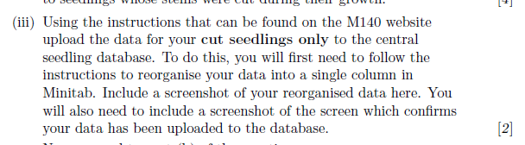
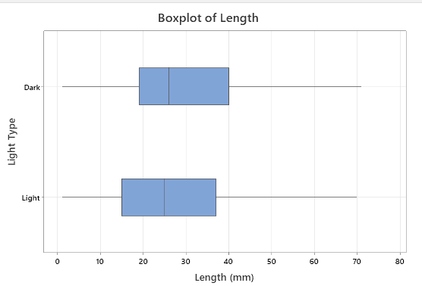
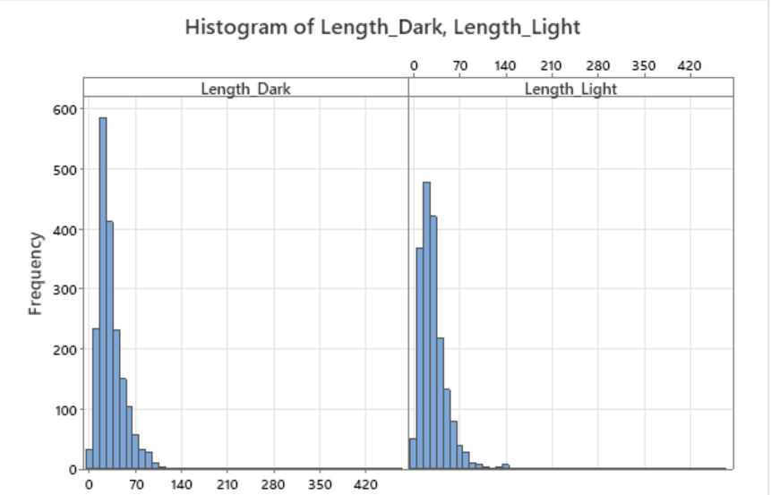
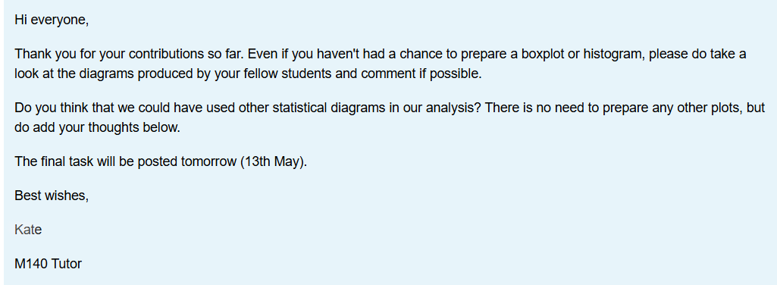
TMA04 Q1 24J
Group work 2024/25
What did we do in 24J/25B?
Developing the group work activity
Sent out surveys
Students upload their data to the shared database
Asked for student volunteers
Tutors helped with the group work
Group work had more detailed instructions
Notes:
Ruth We included a question on the TMA to ensure
We put together a suggested time schedule for the tutors and included prompts they could use in their forums.

Slide 9
How do you think students felt about group work before taking part?
Notes:
Ruth Add word cloud
Choose words that you think students would use to describe their feelings and add them to the word cloud.

Slide 10
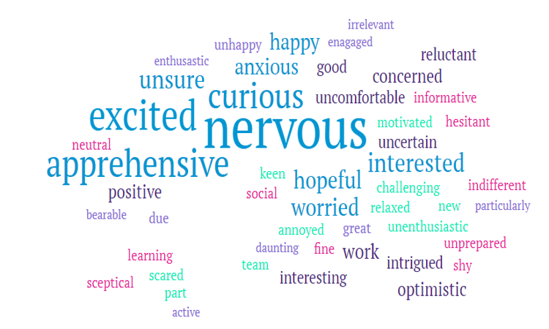
How did the students feel about group work before taking part?
Notes:
KP We did ask the students after taking part in the group, but the results reflected the earlier graph.
They had not developed their group work skills as much as they (and us) would have liked

Slide 11
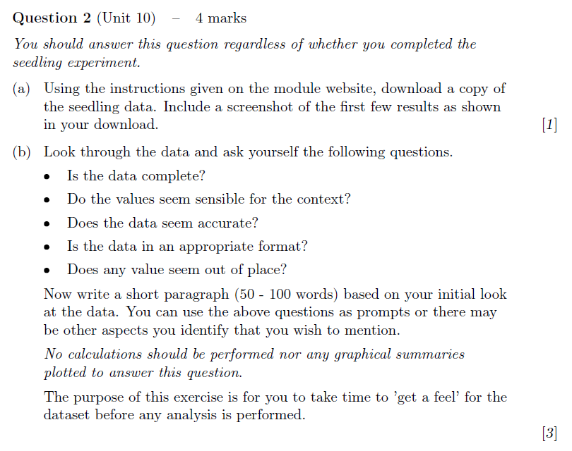
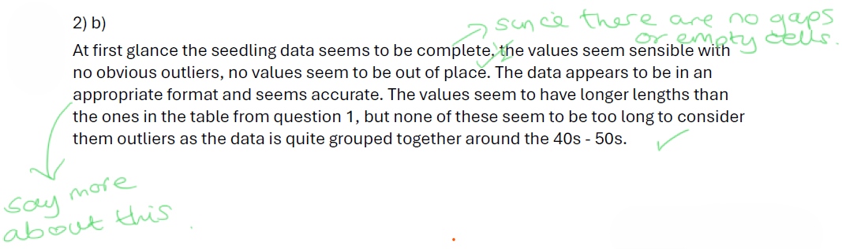
TMA04 25J
Group work 2025/26
What did we do in 25J/26B?
Developing the data summary
Students asked to download data as well as upload
We prepared tutors by asking them to post in their tutor group forums
Asked students to do part of the group work activity in the final TMA
Notes:
KP Even though some tutors tried hard to get some response from students, there were few responses.
Anecdotal analysis of responses to TMA question 2 suggests a number of students did not attempt this.

Slide 12
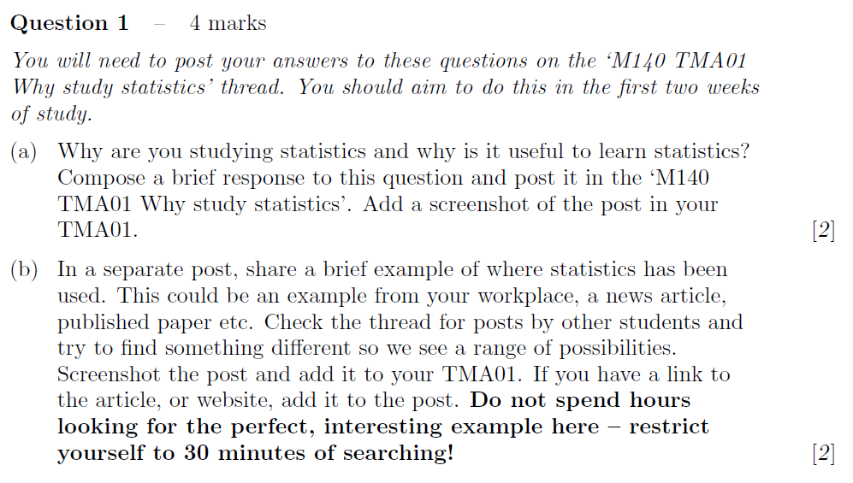
Group work 2026-27
Group work rolled out to the whole module and included in the assessment
Changed outward facing module description to include group work
Mentioned group work in the M140 student intro session
Explained the group work developments and implementation at initial tutor meeting (another tutor meeting planned for March 2027)
Incorporated forum posting as part of all TMAs
Students will be expected to work with the shared database in their tutor group forums with tutors prompting and monitoring the discussion
We are developing alternatives for those with accessibility requirements
We will send out the surveys again to assess the impact of the introduction of group work
TMA01 26J
Notes:
Ruth Throughout all communication have tried to familiarise all involved with rationale for group work
Discussion within module team about what really constitutes groups work ‘just posting in a forum is not group work!’
Tutors appeared surprised that they would need to work in the TG forums despite previous build up over presentations
Students seemed fine with it in module welcome
SiSE and students with reasonable adjustments will receive alternative materials
Purpose of tutor group forum posting throughout module is to build student familiarity and confidence with using the forum so they feel more comfortable to discuss there when it comes to the group work towards the end of the module – TMA01, just post. TMA 02, respond to another post. TMA03, use tutor feedback to develop advice for future M140 students. TMA04, group work discussion.

Slide 13
Have we met our aim and purpose?
AIM To assess the suitability and impact of introducing group work on a first-year statistics module.
PURPOSE To increase the employability content of the module by enabling and encouraging students to work in small groups to discuss their statistical results.
Main challenge | Resolution
Getting everyone on board - tutors, students and module staff. | Communicating our rationale to all concerned. Building up slowly using input from all involved. Providing prompts/scaffolding to help make the challenges more manageable.
Next step - assessing whether students are engaging with the activities.
Are more students doing the experiment?
Are students communicating in the tutor forum?
Are students answering the relevant TMA questions?
Notes:
Ruth
AIM Yes, although it has taken longer than original planned as we needed to take smaller steps to make it workable because the change impacts on so many other aspects of the module
PURPOSE Yes, however we need to assess the impact of this change to content – are students engaging?
We will also run the before and after surveys again to see how students feel about the group on the module. Our goal is to meet their expectations i.e. for the green bars on the final survey to match the green bars on the initial survey!

Slide 14
Slide Title 30
Thank you
Any questions?
Ruth Neal ruth.neal@open.ac.uk
Kellee Patterson kellee.patterson@open.ac.uk
​

Slide 15
References
Butler, D., Cook, L., and Haley-Mirnar, V., 2018. Achieving student centred facilitation in online synchronous tutorials. eSTEeM project.
Evans, S., Graham, W., and Malik, M., 2020. Strategies to support students and tutors with online collaborative projects: an action research project. eSTEeM project.
Macbean, J., Graham, T. and Sangwin, C. (2001) Group work reluctance in maths education. LTSN Maths, Stats And OR Network, Birmingham, UK pp. 24-25.
Smith, D. (2014) Collaborative Online Forums in the Social Sciences: Participation, Value and the Student Experience. eSTEeM project.
Notes:
Kellee

