Slide 1
Supporting students through their study journey: the use of qualification wide Study Sites
eSTEeM Conference 2021:
STEM Scholarship for a Changing World – Disruption, Innovation and Impact
31st June, 2021
Rachel Hilliam

Slide 2
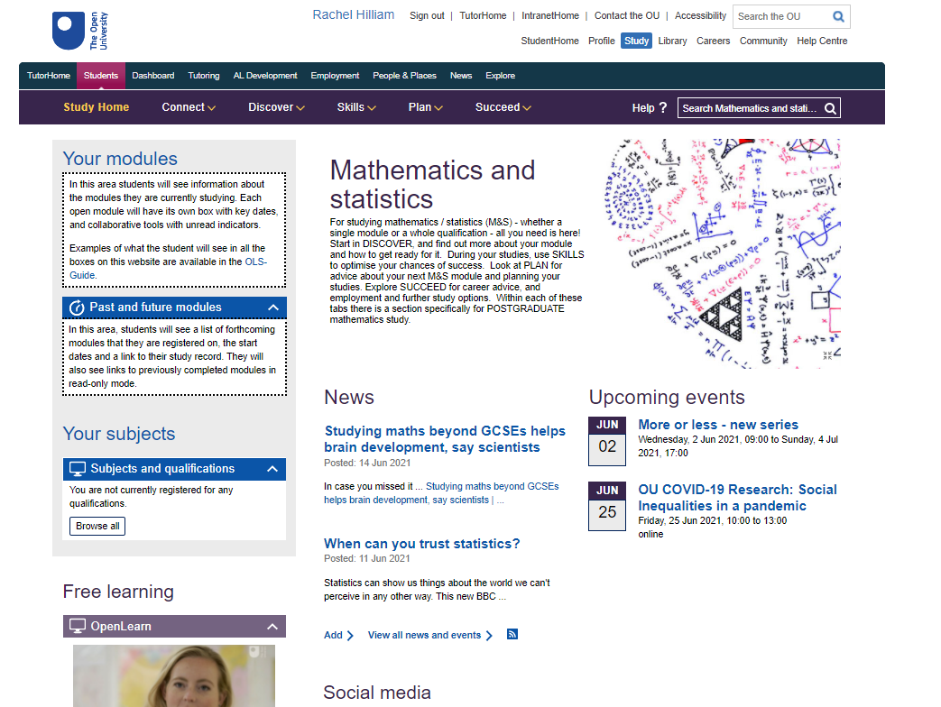
The Mathematics and Statistics Study Site

Slide 3
Study Site
Connect
Discover
Skills
Plan
Succeed

Slide 4
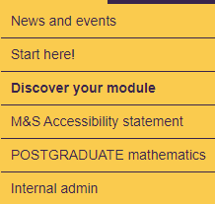
Mathematics and Statistics Study Site
Discover

Slide 5
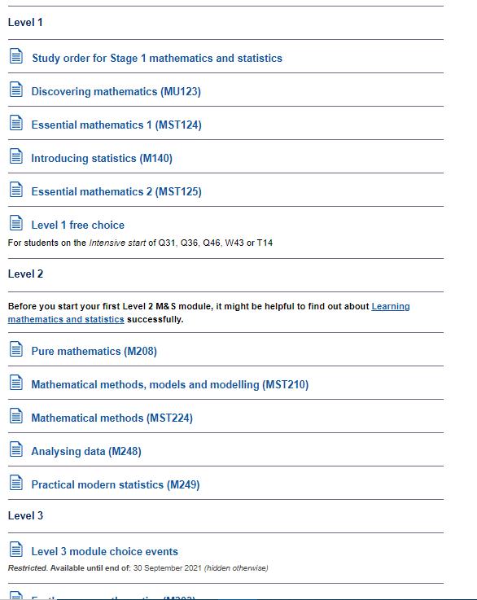
Discover
Discover your module

Slide 6
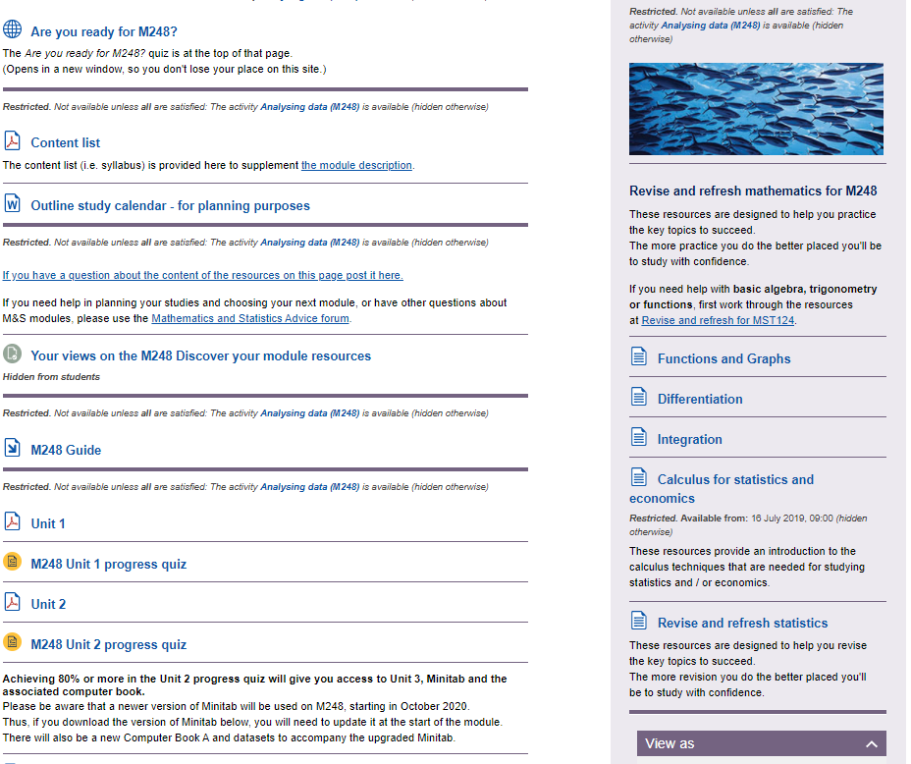

Slide 7
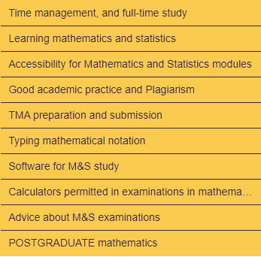
Mathematics and Statistics Study Site
Skills

Slide 8
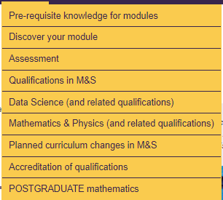
Mathematics and Statistics Study Site
Plan

Slide 9
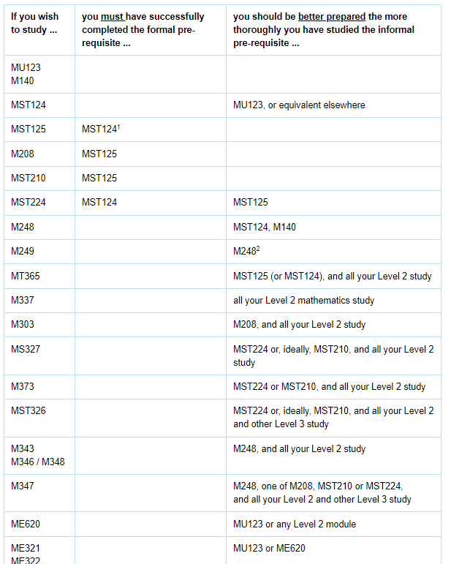
Plan
Pre-requisite knowledge for modules

Slide 10
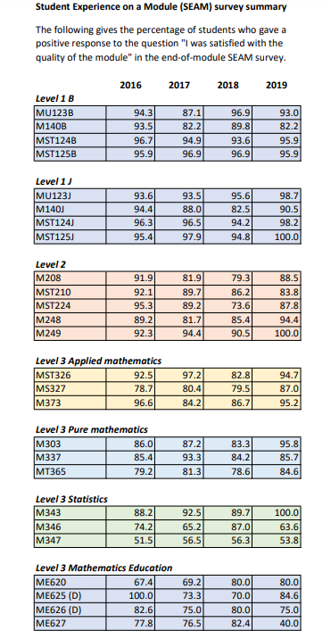
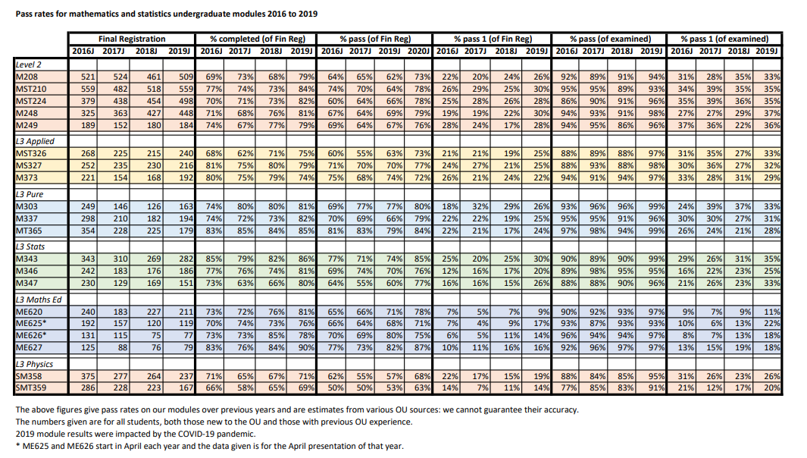

Slide 11
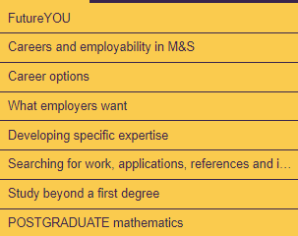
Mathematics and Statistics Study Site
Succeed

Slide 12
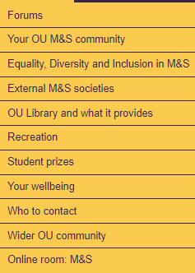
Mathematics and Statistics Study Site
Connect

Slide 13
Connect
Forums
Mathematics and statistics advice
Pre-module help
Mathematics and statistics student discussions
Mathematics, teaching and schools

Slide 14
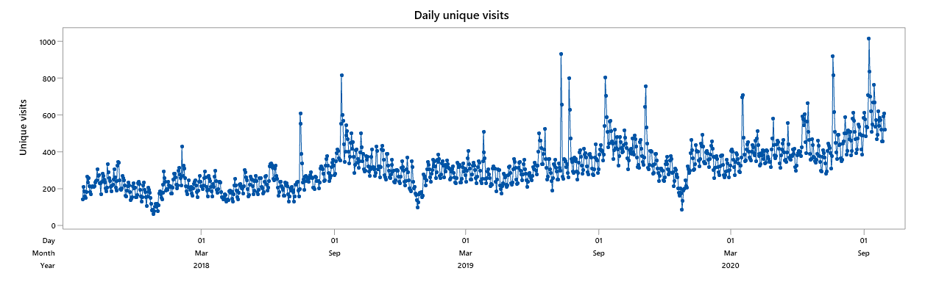
Number of daily unique visits from M&S qualification students

Slide 15
M&S Study Site
Initiatives to increase footfall
Embedded links into appropriate areas of the SS into MILLS messages
Study Site outline on back of OU module contents checklist
SS postcards
Reinforcement by SST individual contact
CAMEL in June (2020) to all students completing 19J highlighting SS
CAMEL in Aug (2020) to everyone registered on UG M&S module for 20J pointing to DYM sub-pages
Tweets, Student Hub Live etc
OpenInterval

Slide 16
Recommendations
The structure of the site should be improved, in particular students find fixed headings unhelpful
A site map and/or A-Z should be added
Ability to edit the front page with links to help navigation around the site
Student routing to the site needs to be more obvious
Analytics needs to be improved
Briefing and training needs to take place for all SRF staff
AL induction, staff development and CDSA need to include information about Study Site
Any School currently populating their site should involve SST staff in the development.

Slide 17
Conclusion!
The Study Site is an amazing resource with a great deal of information about M&S modules, and qualifications, collected together in one place. It does much better than many OU websites in having everything (for M&S students) all together in one place, without having to scroll through reams of generic information first.
I just wish it was more obvious, need it to stop being a hidden gem!

Slide 18
THANK YOU

