Slide 1

REMOTE PAIR PROGRAMMING
Ann Walshe, Bobby Law, Brendan Murphy, Janet Hughes,
Phil Hackett
School of Computing and Communications
Notes:
DAVID, CHRIS and JANET

Slide 2
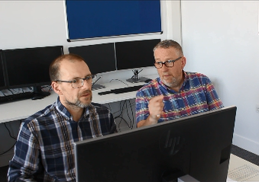
INTRODUCTIONS
Bobby Law
Brendan Murphy
Janet Hughes
Ann Walshe
Phil Hackett

Slide 3
Discussion points
How can we create effective pairs if the students haven’t met?
Which tools and technologies could provide the greatest ease of use for the OU?
Which other areas/subjects of OU study could remote pair working be useful for?
How the skills of remote pair programming map to the skills needed by new graduates working in a post-pandemic workplace?
Notes:
JANET

Slide 4
ACKNOWLEDGEMENTS
Our sincere thanks are due to the students of TM112 who participated in this work, to Paul Piwek (module team chair) who encouraged this work, and to eSTEeM for all its support.

