Slide 1

Through a glass darkly
challenges of making tutorials accessible
Dr H. Ryder and Dr T.C. O’Neil

Slide 2
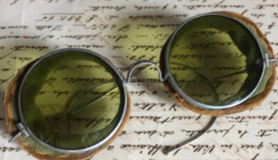
Scope
We are restricting our attention to tutorials (both live and pre-recorded).
What aspect of accessibility are we addressing?
This talk is mainly concerned with accessibility for students who have:
Visual or auditory processing disorders
Visual impairments
Auditory impairments
Such students are not a homogeneous group and even individuals with similar impairments may require different solutions.
Image from:
https://www.amazing-eyewear.com/focus/vintage-retro-glasses/opticians/
Notes:
Scope – we’re restricting to tutorials.
Which bits of accessibility.
Andrew Krause : part of a group of blind mathematicians -- all have different solutions for dealing with text/visual stuff.

Slide 3
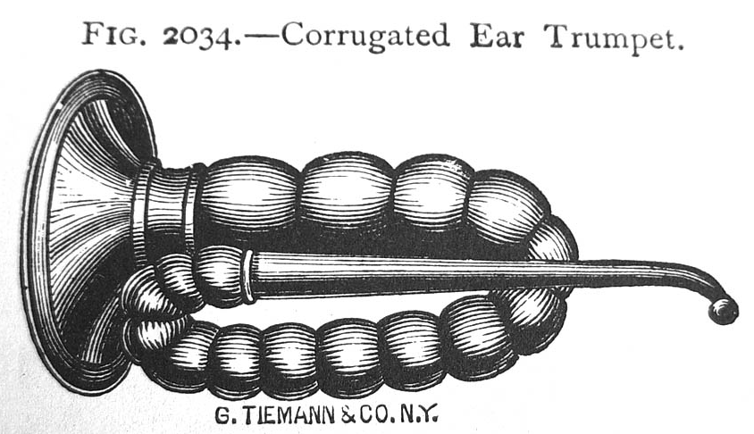
Caveats
Observer beware!
We do not have the answers, just suggestions
It all looks a bit expensive in either time or money (or both)
We are mathematicians and can only claim experience with mathematics (although what we discuss is surely of relevance to many subjects).
Some tutors are already addressing accessibility issues
Admission
Image from:
http://antiquescientifica.com/hearing_aid_corrugated_antique_ear_trumpet_Tiemann_1889_catalogue.jpg

Slide 4
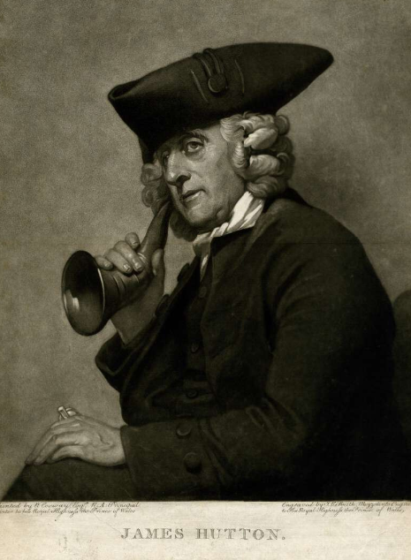
Structure of talk
We will talk about three areas:
The challenges of technical language and cognitive load.
Transcripts:
  What kind we need?
  What should we transcribe?
How tutorial images can be very different to those in text.
So first, some background on cognitive load theory…
Image from:
https://www.britishmuseum.org/collection/object/P_1902-1011-4998

Slide 5
Cognitive load theory
Some things to consider when transcribing tutorials or describing figures

Slide 6
Cognitive load theory
Working memory is very limited.⁽¹⁾
A limited number of concepts can be manipulated and maintained in working memory (somewhere between 3 and 9).⁽¹⁾
But multiple pieces of information can be integrated into a schema and then used in working memory as a single idea, enabling more complex ideas to be understood.⁽²⁾
Miller, G.A., 1956. The magical number seven, plus or minus two: Some limits on our capacity for processing information. Psychological review, 63(2), p.81.
Paas, F., Renkl, A. and Sweller, J., 2003. Cognitive load theory and instructional design: Recent developments. Educational psychologist, 38(1), pp.1-4.
Notes:
PROBLEM IS THAT WKING MEMORY LIMITED – MUST INTERNALTISE COMPLEX MATERIAL INTO ONE IDEA – ONE SLOT IN WKING MEMORY – IMPORTANT THAT ANY MATERIAL WITH HIGH ei THAT’S NEADED LATER IS INTERNALISE EARLY ON

Slide 7
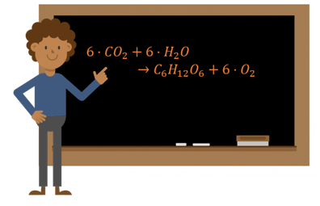


Implications
Technical language and notation is often used to ‘chunk’ ideas and concepts into schemas to aid understanding.
Notes:
PROBLEM IS THAT WKING MEMORY LIMITED – MUST INTERNALTISE COMPLEX MATERIAL INTO ONE IDEA – ONE SLOT IN WKING MEMORY – IMPORTANT THAT ANY MATERIAL WITH HIGH ei THAT’S NEADED LATER IS INTERNALISE EARLY ON

Slide 8

Implications
Technical language and notation is often used to ‘chunk’ ideas and concepts into schemas to aid understanding.
This Photo by Unknown Author is licensed under CC BY-SA
Notes:
PROBLEM IS THAT WKING MEMORY LIMITED – MUST INTERNALTISE COMPLEX MATERIAL INTO ONE IDEA – ONE SLOT IN WKING MEMORY – IMPORTANT THAT ANY MATERIAL WITH HIGH ei THAT’S NEADED LATER IS INTERNALISE EARLY ON

Slide 9


Implications
We need to preserve this chunking for visually impaired students, but saying ‘this’ and ‘that’ may not work.
The same is true whenever a pointer is used.
Notes:
PROBLEM IS THAT WKING MEMORY LIMITED – MUST INTERNALTISE COMPLEX MATERIAL INTO ONE IDEA – ONE SLOT IN WKING MEMORY – IMPORTANT THAT ANY MATERIAL WITH HIGH ei THAT’S NEADED LATER IS INTERNALISE EARLY ON

Slide 10
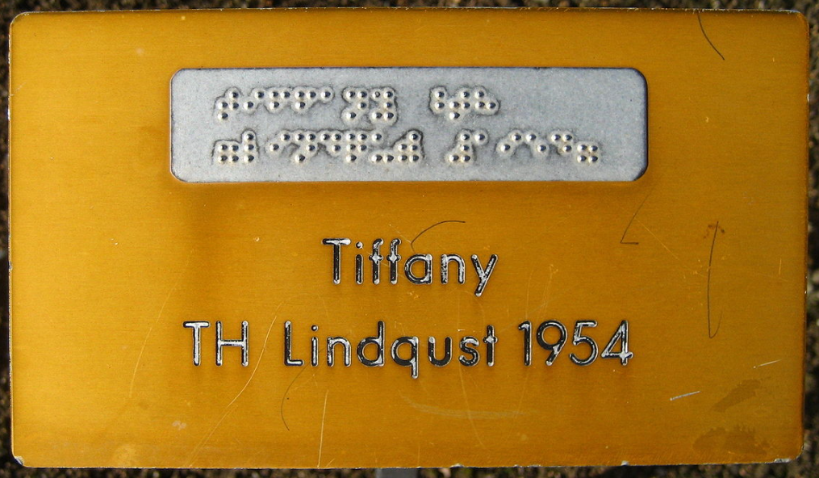
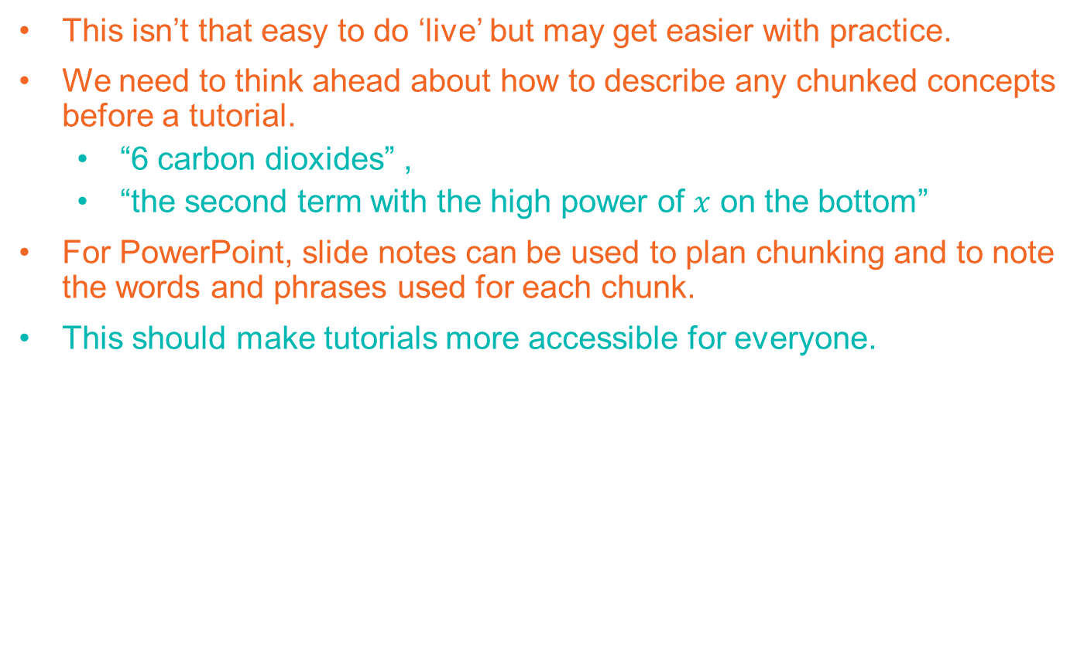
Recommendations
This isn’t that easy to do ‘live’ but may get easier with practice.
We need to think ahead about how to describe any chunked concepts before a tutorial.
  “6 carbon dioxides” ,
  “the second term with the high power of $x$ on the bottom”
For PowerPoint, slide notes can be used to plan chunking and to note the words and phrases used for each chunk.
This should make tutorials more accessible for everyone.
Image from:
https://en.wikipedia.org/wiki/Braille#/media/File:Rapperswil_-_Duftrosengarten_20080222_005.jpg

Slide 11
Transcripts
Things to think about

Slide 12



How do we transcript this?
Is this $\frac{a}{x+b}$ or $\frac{a}{x}+b$?
How do we fix this?

Slide 13
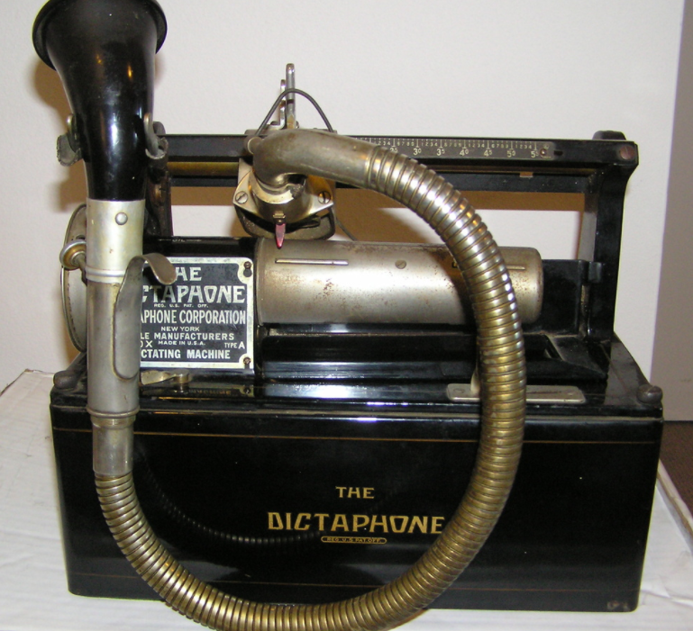
Another problem
What do we do about verbal fillers?
How about:
“And then we uhm, err, look, look at the uhm, err look at the formula for uhm the err molecule uhm…”
How do we fix this?
Leave out the uhms and errs? ☺
https://www.collectorsweekly.com/stories/23754-dictaphone-machines-and-shaver

Slide 14


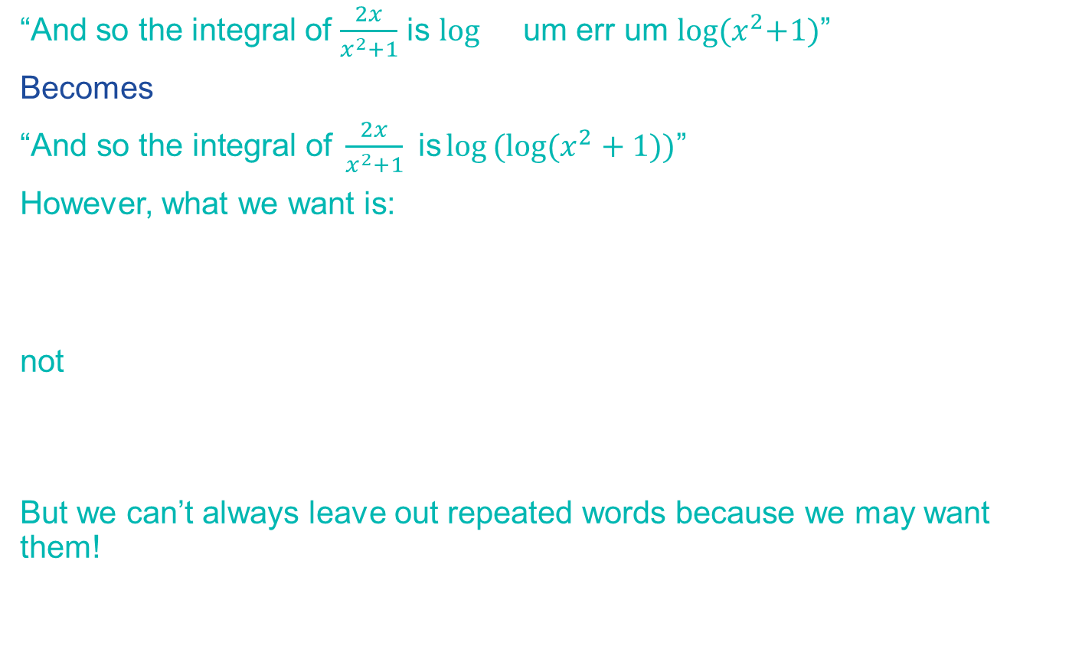
But this can alter meaning
“And so the integral of $\frac{2x}{x^{2}+1}$ is $\log{}$ um err um $\log{{(x}^{2}+1)}$”
Becomes
$\text{“}\text{And} \text{so} \text{the} \text{integral} \text{of} \frac{2x}{x^{2}+1} \text{is}\log{(log{(x^{2}+1))}}$”
However, what we want is:
not
But we can’t always leave out repeated words because we may want them!

Slide 15
Some different types of transcription
True Verbatim
  Includes all the uhms, errs and false starts
Standard verbatim
  Repeated words left out
  Uhms and errs left out
  The rest left in
Clean/intelligent verbatim
  Focus in on giving a good representation of the content.
  Uhms and errs left out
  Repeated words and false starts left out where appropriate
  Readability improved (grammatical mistakes left out)

Slide 16

Self efficacy
What do we transcript?
”Perceived self-efficacy is defined as people’s judgements of their capabilities to organize and execute courses of action required to attain designated types of performances”
Bandura, A., 1986. Social foundations of thought and action. Englewood Cliffs, NJ, 1986(23-28).
Self efficacy can be developed vicariously by watching similar individuals succeed.
A struggling student will only perceive others as similar of they see that others are also struggling
Questions raised by other students may also need to be transcribed since realising that other students are also stuck or confused is an important part of the learning experience.
Implications
image from:
https://www.sheffield.ac.uk/ssid/transcript

Slide 17
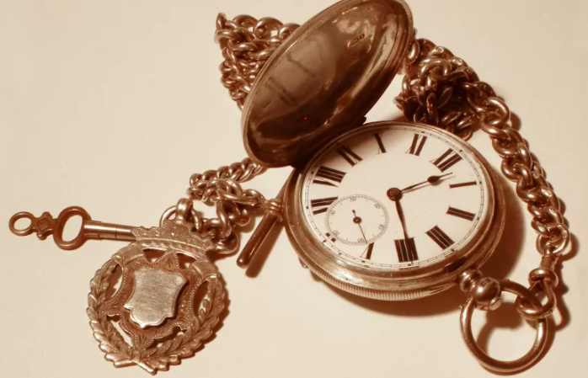
Recommendations
Intelligent transcriptions need to be produced by someone with specialist knowledge.
The process can be helped by using automated systems but a subject specialist (ideally the tutor) needs to be involved.
Selected student questions and comments (possibly anonymised) should be included as part of the transcript.
The time taken to produce a suitable transcript is likely to be at least twice as long as the session being transcribed.
Practical considerations
Image from:
https://antiques.lovetoknow.com/collectibles/antique-pocket-watches

Slide 18
Dynamic figure descriptions
How do we describe figures that are created live in a session

Slide 19
Tutorial pictures are often dynamic
Question: Draw the structure for 2-methylpropane-1-ol
First write the parent chain of 3 carbon atoms with no double bonds
Add a methyl group to the number 2 carbon
Add an OH group to the number 1 carbon
Add the rest of the hydrogen atoms

Slide 20
Tutorial pictures are often dynamic
Question: Draw the structure for 2-methylpropane-1-ol
First write the parent chain of 3 carbon atoms with no double bonds
Add a methyl group to the number 2 carbon
Add an OH group to the number 1 carbon
Add the rest of the hydrogen atoms

Slide 21
Tutorial pictures are often dynamic
Question: Draw the structure for 2-methylpropane-1-ol
First write the parent chain of 3 carbon atoms with no double bonds
Add a methyl group to the number 2 carbon
Add an OH group to the number 1 carbon
Add the rest of the hydrogen atoms

Slide 22
Tutorial pictures are often dynamic
Question: Draw the structure for 2-methylpropane-1-ol
First write the parent chain of 3 carbon atoms with no double bonds
Add a methyl group to the number 2 carbon
Add an OH group to the number 1 carbon
Add the rest of the hydrogen atoms

Slide 23
Tutorial pictures are often dynamic
Question: Draw the structure for 2-methylpropane-1-ol
First write the parent chain of 3 carbon atoms with no double bonds
Add a methyl group to the number 2 carbon
Add an OH group to the number 1 carbon
Add the rest of the hydrogen atoms

Slide 24
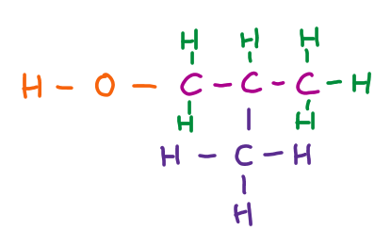
Tutorial pictures are often dynamic
Question: Draw the structure for 2-methylpropane-1-ol
First write the parent chain of 3 carbon atoms with no double bonds
Add a methyl group to the number 2 carbon
Add an OH group to the number 1 carbon
Add the rest of the hydrogen atoms
Compare with something like a standard figure description
“the figure contains letters and dashes. The top row is H dash O dash C dash C dash C. There is a vertical dash below the second to last C. Below this is H dash C dash H (with the C directly below the vertical dash)….

Slide 25
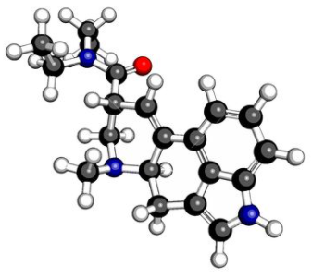
Dynamic description
The picture is built up as follows.
First three carbon symbols are drawn, connected with dashes.
A vertical dash is drawn below the middle carbon atom.
Another carbon atom, with three hydrogen atoms attached (a methyl group) is drawn below this dash…

Slide 26
Recommendations
Recognise that figures in tutorials are often dynamic
Where necessary describe how the figure is built up and don't just give a description of the final outcome
Think in advance about whether a dynamic figure or static figure is needed.

Slide 27
On a positive note…

Slide 28
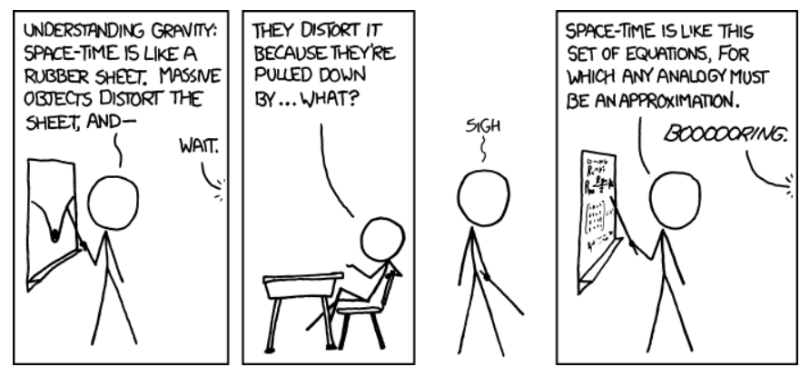
Things may already be more accessible than we think
A traditional maths “tutorial” (aka lecture) where the tutor reads out their notes whilst writing them on the board is, in fact, very accessible since everything is both audible and visual.
Image from:
https://xkcd.com/895/

Slide 29
THE END
Thank you for your time.
Dr H. Ryder and Dr T.C. O’Neil

