Slide 1
Improving the Learning of Programming at a Distance
Through Collaborative Coding
(Remote Pair Programming)
ADEOLA ADELIYI
MICHEL WERMELINER
KAREN KEAR
JON ROSEWELL

Slide 2


INTRODUCTION
Pair programming is a key aspect of Extreme Programming (XP), which encourages informal and immediate communication over joint coding work.
The technique involves two developers: one in a driver role writes the code, controlling the keyboard and mouse, and the other, the navigator, reviews the code as the driver writes it.
Results from experiments show that academic achievements are enhanced for students who participate in pair programming compared with non-paired students (McDowell et al 2003).
THE PEDAGOGIC ISSUE WE ARE ADDRESSING
Despite these proven academic benefits for collocated classroom settings, distance and online settings are yet to benefit. The isolation in learning experience some students report points to an urgent need for tools and methods that support remote pair programming in a remote educational setting to be developed.
PROJECT SUPPORTS STRATEGIC IMPORTANCE TO eSTEeM Scholarship
Innovation in STEM - explore the use of technology in new ways and gaining fuller understanding of changes in student expectation and aspirations in learning of programming.
Employability: Pair programming is a widely used technique within the software development industry. Exposing the students to pair programming practice at studies level provide the students with a valuable employability skill.

Slide 3

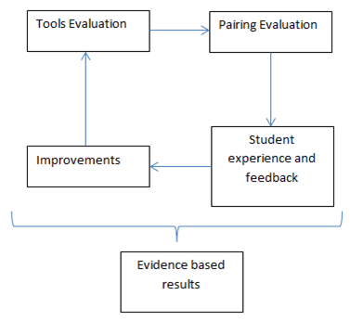
HOW WE ADDRESSED THE ISSUE
Students engaged actively as partner in the research work:
  Students as evaluators
  Students as agent for change
Phase 1: Evaluated available industrial collaborative tools that can emulate the best practices of pair programming in a remote setting.
Phase 2: In conjunction with student partners, we will carry out two user studies, which will evaluate
  The effectiveness of collaborative tools.
  Method of pairing
  Students’ experience and feedback.
Figure 1
Phase 3: Study Analysis and Results

Slide 4
PHASE 1
Collaborative Tools

Slide 5
Phase 1 – Evaluation of Collaborative Tools
Key Principles of Pair Programming
Remote Pair Programming
Synchronous Collaboration
  WYSIWIS (What You See Is What I See
Equal Access
Integrated Communication
A development workflow can only be considered pair programming if the two programmers work at the same time on the same code base.
Tools | Audio-Visual Communications | Whiteboard & Annotations | Mouse Cursor Control | Ease of swapping Roles
AdobeConnect | x | x
GoToAssist | x | x | x
Stride | x
Skype | x |  |  | x
TeamViewer | x | x | x
USEtogether | x | x | x | x
Zoom | x | x | x
Microsoft Teams | x | x | x | x

Slide 6
PHASE 2
User Studies

Slide 7
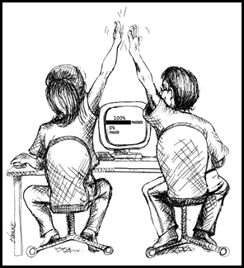
Phase 2 – User Studies
Goal 1: Analyse students’ experience for their evaluation of the perceived effectiveness of RPP collaborative tools.
Question 1: Can some industry-available collaborative tools be adapted for remote pair programming?
Goal 2: Analyse students’ experience for impacts of remote pair programming.
Question 2: Since previous studies have shown that students in face-to-face studies find pair programming beneficial, is there any indication that remote pair programming could provide the same or similar benefits?
Goal 3: Analyse students’ experience for evaluation of overall satisfaction, willingness to continue using remote pair programming as a learning tool and recommending it to other students.
Question 3: Will students who participated in the RPP study have a positive attitude towards further collaborative programming?
Project Website
https://learn1.open.ac.uk/course/view.php?name=OURPP
Invite students to join research
Remote Pair Programming Sessions
Reflective Journal

Slide 8
PHASE 3
RESULTS AND ANALYSIS

Slide 9
Phase 3
Goal 1: RPP collaborative tools.
Question 1: Can some industry-available collaborative tools be adapted for remote pair programming?
Student Experience | Study 1 |  |  |  | Study 2
 | USETogether |  | Microsoft Team |  | Microsoft Team
 | MED | IQR | MED | IQR | MED | IQR
It was easy to install | 4.5 | 1 | 5 | 0.5 | 4 | 1
It was easy to use with my programming partner | 4 | 1 | 4.5 | 1 | 4 | 1
It has a high impact on my computer systems' resources | 2 | 2 | 2 | 1.5 | 2.5 | 1
It froze or crashed sometimes | 2 | 2 | 3 | 2 | 2 | 2
The audio-visual quality is adequate | 4 | 0 | 4 | 0.5 | 4 | 0.5
We were able to record our sessions | 3 | 0.5 | 4 | 1.5 | 4 | 1.5
*Statistically significantly positive experience are shaded
Based on these observations and result, the answer to question 1 can be affirmed as positive: some industry-available collaborative tools can be adapted for remote pair programming.

Slide 10
Phase 3
Goal 2: Students’ experience
Question 2: Since previous studies have shown that students in face-to-face studies find pair programming beneficial, is there any indication that remote pair programming could provide the same or similar benefits?
Student impact | Study 1 |  | Study 2
 | MED | IQR | MED | IQR
My coding and debugging skills are better than before I used pair programming | 4.5 | 1 | 4 | 1
Participating in RPP has improved my confidence level when communicating my thought process | 5 | 1 | 4 | 1.5
My RPP sessions helped improve my time management skills | 4 | 1 | 3 | 2
My study habits were positively affected because of the RPP sessions. | 4.5 | 3 | 3.5 | 1.5
Most students agree or strongly agree that remote pair programming has improved their learning experience.
In study 2 groups, the opinion consensus on the impact on time management skills was neutral.
“… I found it difficult to arrange a mutually convenient time to take part in sessions with my partner.”
“… the peer cancelled session 3 with a five minutes notice and I never heard from her again. No reason was given and there was no attempt to reschedule.”

Slide 11
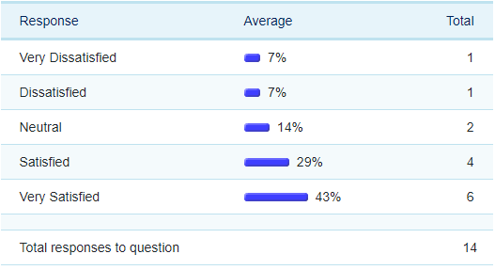
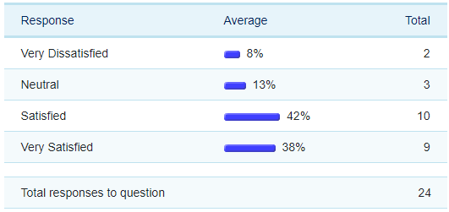
Phase 3
Goal 3: Overall Satisfaction
Question 3: Will students who participated in the RPP study have a positive attitude towards further collaborative programming?
 | What is your overall feeling about your experience of using Remote Pair Programming in your module?
Study 1
Study 2

Slide 12
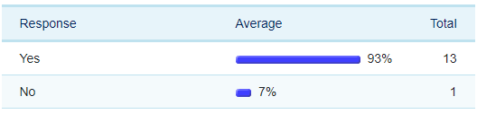
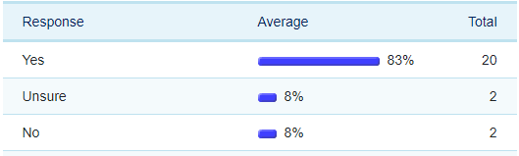
Phase 3
 | Would you recommend Remote Pair Programming to other students and its wider use with the Open University computing modules?
Study 1
Study 2

Slide 13

Phase 3
Improved feeling of inclusion and social interaction
Improved team working experience e.g. confidence in communication, motivation, skill for employment
A positive impact from peer pressure i.e. need to and keeping up with studies before sessions, time management and discipline.
Improved coding skills from learning from pair i.e. knowledge transfer.

Slide 14
THANK YOU

