Slide 1
Understanding the mental health retention and awarding gap in Design modules
Nicole Lotz and Muriel Sippel, E&I STEM
1st July 2021

Slide 2
Background
Consistently low and variable pass rates and variable attainment between presentations of modules across Design for students with Mental Health difficulties
Intersecting factors that impact on mental health students’ retention and attainment in the Design modules: U101, T217 and T317
  Discipline (knowledge and skills, coursework, assessment),
  Personal circumstances (work and family, caring commitments, life events),
  Support received during their studies from OU and elsewhere
Uncertainty of how best to support individual cases
Not only adjustment during presentation, but taking diverse experiences of students into account during module production and learning design

Slide 3
Aims and Objectives
Aims
Gain a deeper understanding of the specific issues experienced by Design students with mental health disabilities throughout their study.
Develop recommendations that could inform the learning design of modules in production and positive interventions in presentation to reduce the awarding gap and facilitate progression in D&I.
Objectives
Understand cross-sectional aspects of the study experience of design students with mental health disability
Disseminate insights and recommendations to Design module teams and qualification team to inform targeted inclusive design interventions in production and presentation
Inform the development of discipline specific student support guidelines for Design tutors (in collaboration with Design Disability Champion network)
Develop a methodology that could be employed more widely to understand experiences of other disadvantaged groups at the OU (other disability, ethnic background, low socio-economic background)

Slide 4
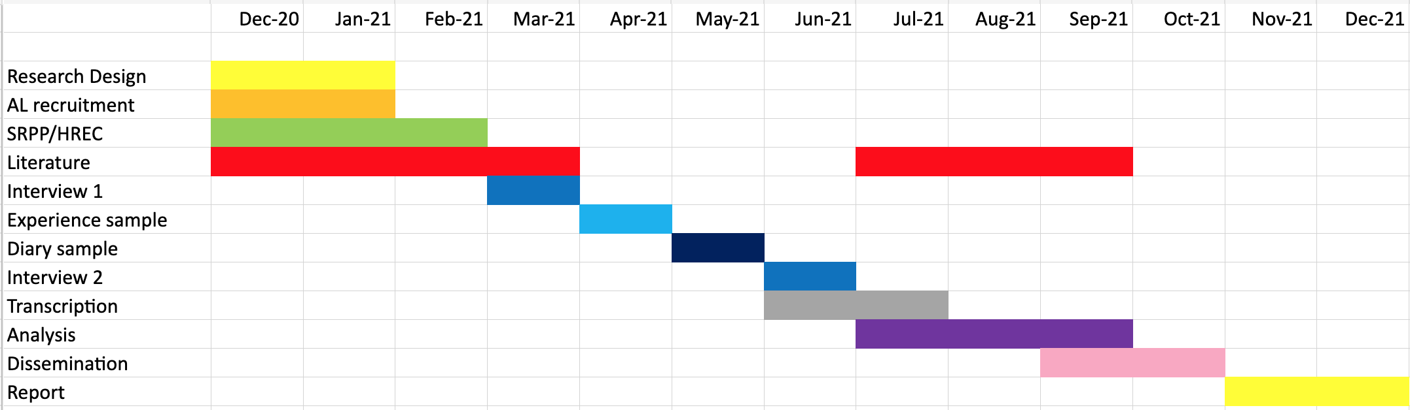
Project Timeline

Slide 5
Approach
Qualitative, in-depth, longitudinal over 4-5 months
AL recruitment - 4 passionate interviewers
Each interviewer works with 2 students from one module
  20J: U101, T217, T317, 21B: U101
Aim to build a conversational, trusting relationship, but not as a tutor, more like a friend with a good listening ear!
Student selection: aim for diversity
  Prev. high and low achieving
  Mix of gender and background (e.g. age, ethnicity)
  Low sample size at higher levels challenging

Slide 6
Recruitment
Student recruitment – 7 out of 8 recruited
Interviewers get diverse reactions from students
Immediate individual support sought
Voucher rather than Smartphone
Want to help (excitement even) but also need help
Students feeling overwhelmed
Audio recorded rather than signed consent

Slide 7
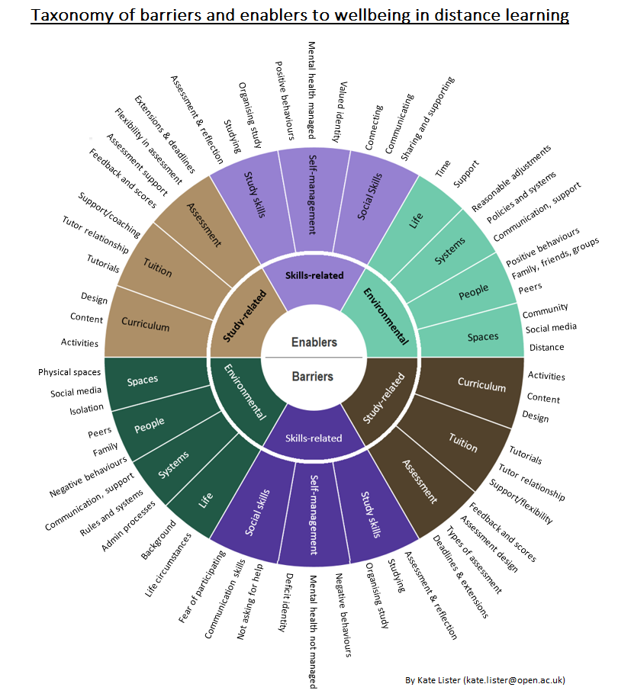
Interviews: beginning and end
Interview 1
30 question Interview audio recorded
Interview 2
50 question interview audio recorded
Prep well and accommodate individual:
Trigger words or phrases or painful memories or topics to avoid.
Agree tool for interview and format (video or audio only)
Inform we don't know what they have declared, e.g. what mental health disability
Ask for emergency contact number from the student or their advocate's contact information
Offer splitting interview sessions

Slide 8
Experience Sample and Diary
Experience sample
Scheduled prompts to mobile phone 3 times a day over a week split into 2 in the moment experiences and a reflective end of day recording
Diary
One message thread a day over 10 days (expecting that participant does not work on TMA every day)
Aim at collecting 7 entries over 10 days, describing how they have progressed their TMA project work.
First and second prompts during the day (in the moment experience)
Are you studying at the moment?
Yes
What are you studying?
How do you feel about what you are studying?
What do you think about what you are studying?
Or
Are you studying at the moment?
No
What are you doing at the moment?
How do you feel at the moment?
What are you thinking about at the moment?
Third end of day prompts
What study related work or other activity have you been doing today?
What aspects have you been struggling with most today?
What (or who) helped you most today?
Would you have liked any additional support today?
Have you been working on your TMA today?
If participants reply with ‘yes’ then prompt:
Describe and show us what you have done.
Has anything noteworthy happened?
What was it?
When did it happen?
How did you feel about it?
What questions did you have and could not answer?

Slide 9
Case 1: ‘Ben’
Level 1 student, male, 30’s.
Many attempts at brick and mortar uni
Obsessive Compulsive Disorder (OCD
Post-Traumatic Stress Disorder (PTSD)
Generalised Anxiety Disorder (GAD)
Emotional Dysregulation (ED)

Slide 10
Case 1
Background
Long term mental health
PTSD, OCD, Anxiety – fear of public crowded places, illness etc
Bad sleep – worsened anxiety
Variable daily rhythms needed
Rather homebound
Not many friends
Powerless in low phase
Creative person, Poetry, DIY, Hacking and designing online games, Photography – “makes me happy”
Asking for support is hard (initial step and when you are low)
DSA assessor conversation helpful – but drawback that it is scheduled, support in the moment missing, just 50% help
Financial struggles due to not being able to work but not on benefits because of study
Distance learning PT 2000 compared to brick Uni FT 14000
OU study good practice
Surprisingly perfect choice
“it’s a proper degree!”
Sunday plan weekly study
Colour coded day dictates routine, green - getting ahead of plan
Course/pace fluidity is appreciated
Keeping to recommended study times – helps with getting out of OCD loops, helps with studying flexibly due to exhaustion
ODS pace keeper, confidence giver
Creates designs that focus on the under supported (fashion for visually impaired)
WhatsApp group for module (main and tutor group - visual and textual, brainstorm, close bound developed, fundamental to progress, fear of losing it when moving to different module, works only when doing the same work)
Include family in study (partner MH social work professional helpful)
OU study struggles
Ideation might trigger anxiety
Obsessive loops prevent moving on
No immediate clarification of tasks
Putting off tasks and then falling ill
COVID delay to DSA (mentor, software, equipment)
Wasn’t aware of MH help from OU, but OU helped DSA application
COVID End of pandemic scary – less digital, might be missing out
COVID Module material /assessment adaptation needed in places but tutor can’t help to adapt (new tutor) – anxiety inducing
‘Small’ errors in material trigger anxiety
Module software limitations to show work done – depression inducing - fairness
Knowing which activities could be done in advance would be helpful
Less fees paid less service received

Slide 11
Case 2: 'Anna'
Level 3 student, female, 30s.
LGBTQ learner, full time carer for partner, voluntary work
Bipolar
Postural tachycardia syndrome (PoTS)
Anxiety

Slide 12
Case 2
Background
LGBTQ learner
Long term disabilities
Bipolar (diagnosed 2017) -anxious, doesn’t like noise, likes to know where she is, who she is with, struggles with meeting new people, going to new places.
Postural tachycardia syndrome (PoTS) more recent diagnosis
Full time carer for partner
Voluntary work as web page designer for charity (likes creative side), helps to keep Anna in the loop for career skills when she returns to work
Excellent school exam results, parents separated, took wrong pathway at college (not maths), lost best friend to cancer, struggled with timetable.
OU gives Anna "an opportunity" for a degree which would be difficult with her health, anxiety and role as carer
Enjoys Maths, studying Engineering, level 3 Design module, using different skills, achieved best results so far.
OU study good practice
Use L1 modules to work out study skills and mindset, ready for L 2
With Bipolar, some days are not good for studying, so stop, rest, wait for a better day to focus and push through a unit or an assignment.
Make sure you have an advocate set up for those times that you can't cope.
The disability mentor very supportive throughout studies – meet like friends, but not a subject specialist
Set up a study space, in that space you know it is your study time, then give yourself a break from that space.
Family and partner are supportive as know how best to support when things are more difficult.
With a summer school, someone can go with you, can make a huge difference.
Creative thinking can help your well-being as "quietens your mind".
Design modules are more social – asking for feedback about ideas from family
OU study struggles
Overthinking, not getting quick reply to question can make more anxious
Anxious with meeting others not being in known place
Anxious about Forums, ODS, like to remain more anonymous. "my work isn't good enough", then worried not doing good enough with studies.
Distance learning works well but miss not being able to read body language
Do want a specialist answer, student support services are less helpful with study skills or specialist information
Extensions are helpful but not always confident to ask for them, some tutors are more understanding than others
Module materials can be inconsistent in how things are explained or how you need to do something for an activity or assignment.
Design assignments questions work togther, feed into each other which can be hard if unsure of way working whereas, in math modules questions quite separate, so one answer less likely to affect other marks.

Slide 13
Reflections as an interviewer
A privilege to work with Anna and to be welcomed into a window of her life
Moving answers at times, hard not to respond to, emails to colleagues did help.
De-briefs after each stage of the process helped to overcome some of the limitations as an interviewer, helped to build more of an understanding between the two different roles
No trigger words for Anna, as used to being an "open book" when talking to therapists or professionals but was reassured by being asked about trigger words
Preferred to talk over the phone for interviews so could wander around while talking – PoTs
There is a need to be flexible with your approach for timings of interviews and recordings for the in the moment responses and the diary messages.
Using What's App for the messages worked well as students are comfortable with using it, questions worked well as prompts, helped with reflections, an interesting insight at times
To summarise the final de-brief, one student commented about working with the interviews, the diary and the in the moment responses by saying "I enjoyed it more than going to therapy and I know myself better now."

Slide 14
Reflecting on and informing my own practice as an AL
Understanding that it is important to respond to emails as soon as you can
Encourage D-flag students to contact you and reassure them that it is okay to ask for help
Referring a student is not always the right approach, students do value specialist support from their module tutor
Appreciating that D flag students often prefer email or text for communicating with staff, some are reluctant to use the phone or Forums
Technical language and module jargon can be difficult to interpret even for level 3 students, it does help to explain things more clearly and in steps – can take several emails.
D-flag students do worry and can over think things so an email to say your assignment is looking good, especially if there are delays in returning marks, can make a difference – reduce anxiety, stop sleepless nights
Supporting D flag students does take more time and empathy, but I have found that it is time that is worth giving, for the benefit of the student's well-being and for my own personal well-being.
The insights gained from the data collection will help to inform my practitioner research about creative thinking, distance design education and mental well-being.

Slide 15
Where Next
De-brief of overall process and perceptions with Interviewers
Discourse analysis of data from all students using NVivo – looking forward to seeing the whole picture and the outcomes
Comparisons made to literature review using NVivo
In-depth analysis of findings, exploring and understanding outcomes
Work together as a team to review outcomes and suggestions for AL development and provision of support for students with their mental well being whilst studying
Share findings with curriculum design team for new BDes
Consider wider training in workshops with ALs in Design modules and interviewees where possible
Share good practice to the wider network in E&I and STEMA

Slide 16
Conclusions
Overthinking and anxiety make study difficult, time and support can limit these
Supporting interviewers to cope
Specialist subject
support is valued
Keeping methodology flexible
Issues multi-dimensional, MH + trigger in tasks + no immediate support

Slide 17
THANK YOU

