Slide 1
Learning and Development Needs of Autistic Adults Studying STEM Subjects via Distance Learning
Dr Laura Dean

Slide 2
Agenda
Overview of what the autistic spectrum is
Introduce the current research
Findings and themes
Further information/resources

Slide 3
What is autism?
Autism is a lifelong, developmental condition that affects how a person communicates with and relates to other people, and how they experience the world around them.
(National Autistic Society)
Notes:
Lifelong
Affects
Experiences

Slide 4

The autism spectrum
Very autistic
Not very autistic
‘Low functioning’
‘High functioning’
Notes:
Common view
Many scales

Slide 5

Perception of others
Communication skills
Motor skills
Sensory filter
Executive function
Detail over ‘big picture’
Co-occurrence with depression / OCD / anxiety
Social understanding

Slide 6
Legal Obligations
The Equality Act 2010 (or the Disability Discrimination Act 1995 in Northern Ireland) gives provision that autistic people must not be treated less favourably because of their disability and 'reasonable adjustments’ must be made
Autism Act 2009 requires local authorities to assess and support adults with autism
Notes:
Because this was seen as normal most were not aware of their legal rights: didn’t ask for adjustments, accepted poor treatment, were happy when they got any adjustment at all.

Slide 7
Current Project
Semi-structured interviews with 14 adult learners on level 1 STEM modules
  Experiences of starting studying
  Issues with studying
  Things that worked well
Thematic Analysis of interview transcripts

Slide 8
Themes:
Second chance study
Conforming to stereotypes
Grateful to be heard
Understanding rules.
Struggles with online materials
Fear of face to face
Notes:
Already studied before: started several years ago and wasn’t successful - English, social work, science More than half already had a degree
Grateful to be heard – not wanting voucher, really thankful for opportunity
Understanding rules – when to contact/ what is allowed.
Knowing what is available.
Online materials poorly written

Slide 9
Themes:
Conforming to stereotypes
“So I just I picked a bad subject I suppose, and I couldn't really cope with it. This is before I knew I was autistic.”
“I mean, I'm planning to do a a degree in mathematics an that's always what I've been most comfortable with and [it] fits autism”
Notes:
First quote – had done English lit before
Second – started FE study but dropped out

Slide 10
Themes:
Understanding rules.
“The way things are often wrote, it's wrote in a way that expects students to 'read between the lines' and make up gaps in instructions which is fine for neurotypical people as they do this automatically all the time but autistic people can't do this”
(asking interviewer) “Can you ring?”
(later asking interviewer) “How many times can you email?”

Slide 11
Themes:
Fear of face to face
“So it was maybe a 20-30 minute bus ride and mean public transport aren't always the greatest. Like I can do it, but it’s hard from the start”
“So I had my assessment and stuff and then like they granted me like taxi fares so I can get there without public transport … [but I] was already scared”
“sensory issues were a big thing, that and stress really contributed to persistent migraines“
Notes:
Lots of sensations getting to the venue, needing to sit quietly beforehand etc.
Slow DSA assessment

Slide 12
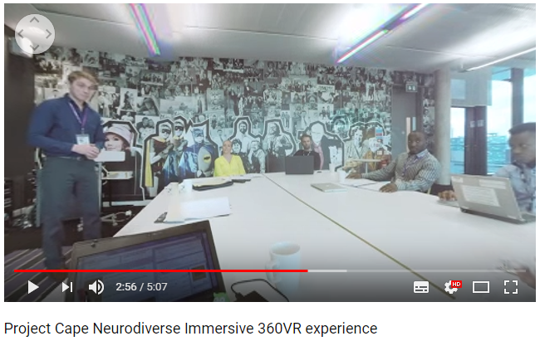
Sensory processing - stress
Atypical reactions in all five sensory modalities as well as kinaesthetic and proprioceptive sensation. Some of the common sensory issues include hyper-reactivity to stimuli including bright lights, loud noises, and strong odours.
(Harrison, J. and Hare, D. (2004) Assessment of sensory abnormalities in people with autistic spectrum disorders. Journal of Autism and Developmental Disorders)
Notes:
https://www.youtube.com/watch?v=ZLyGuVTH8sA&t=236s

Slide 13
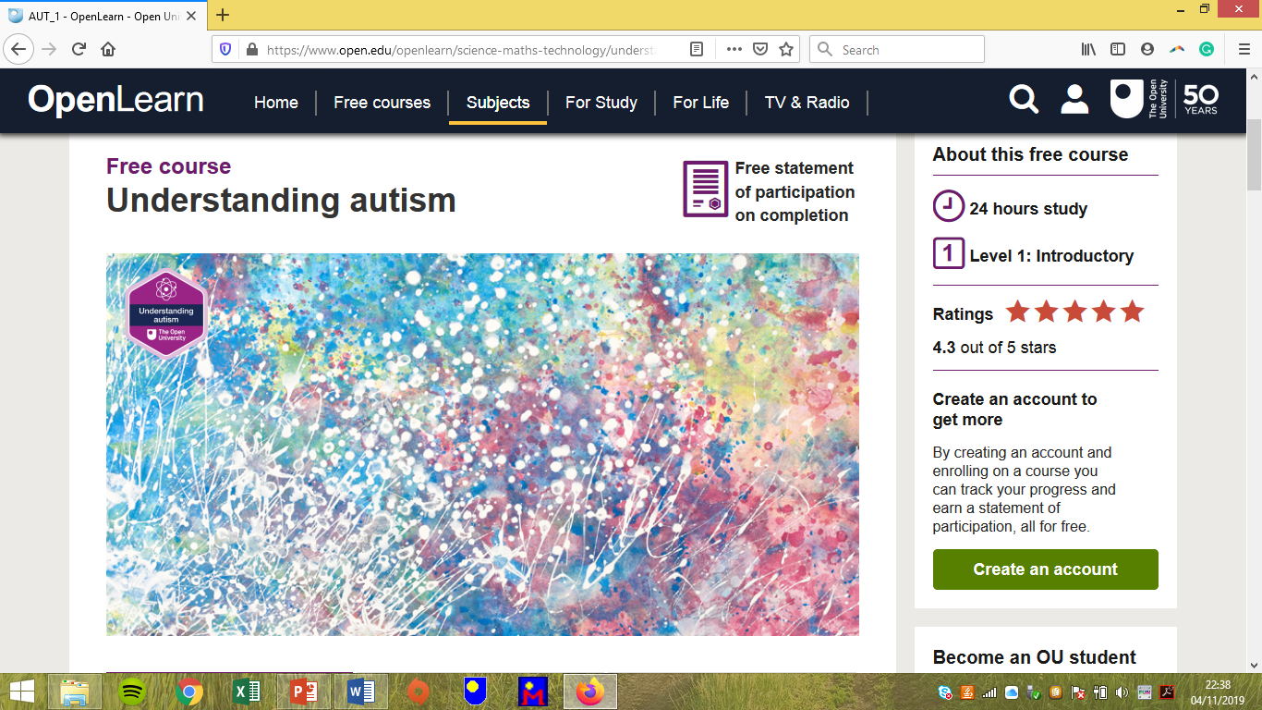
Further information
https://www.open.edu/openlearn/science-maths-technology/understanding-autism/content-section-overview?active-tab=description-tab

Slide 14

Pro Autism
Group of autistic and non-autistic people
Provide free training and workshops for employers to make their recruitment processes more autism-inclusive.
Workshops include:
Information on how autistic people might perceive the world and interact with others
Active learning around job adverts, interview questions, feedback and on-boarding processes.

