Slide 1

A classification scheme for OpenSTEM Labs experiments
Helen Lockett (helen.lockett@open.ac.uk), Kay Bromley, Kevin Gowans, Claire Richardson and James Smith
The Open University

Slide 2
Overview
Background to OpenSTEM Labs
Project aim and objectives
Classification schemes for remote and online labs from the literature
Proposed OpenSTEM Labs classification scheme
Trials using classification scheme
Initial findings

Slide 3
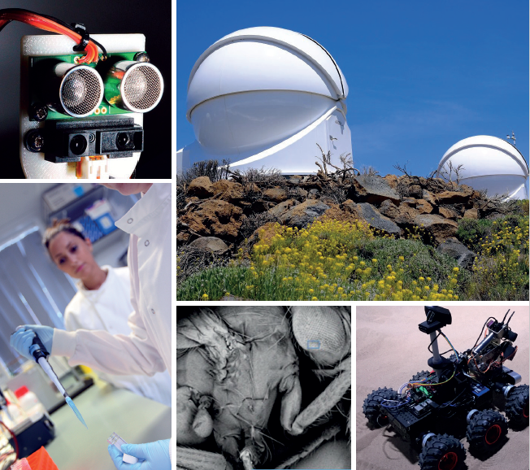
Background
The OpenSTEM Labs deliver authentic practical experiences to the Open University’s distance learning students using real time instrumentation, data and equipment for practical enquiries over the internet
Students interact with experiments via a web browser on their laptop or mobile device.
The OU has developed more than 100 activities that are used by more than 10,000 students/year

Slide 4
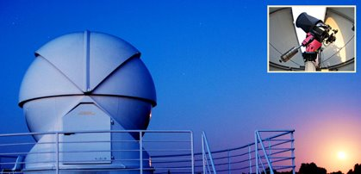
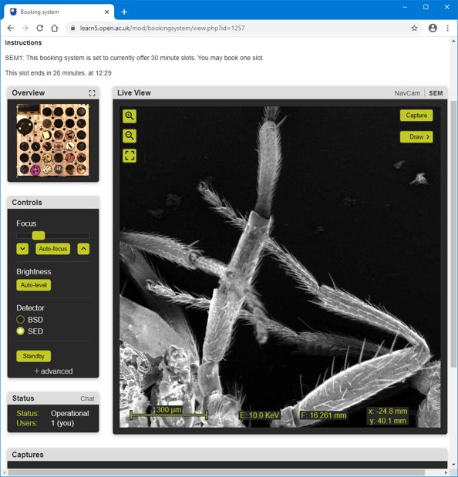
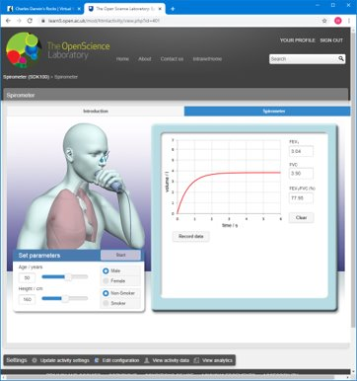
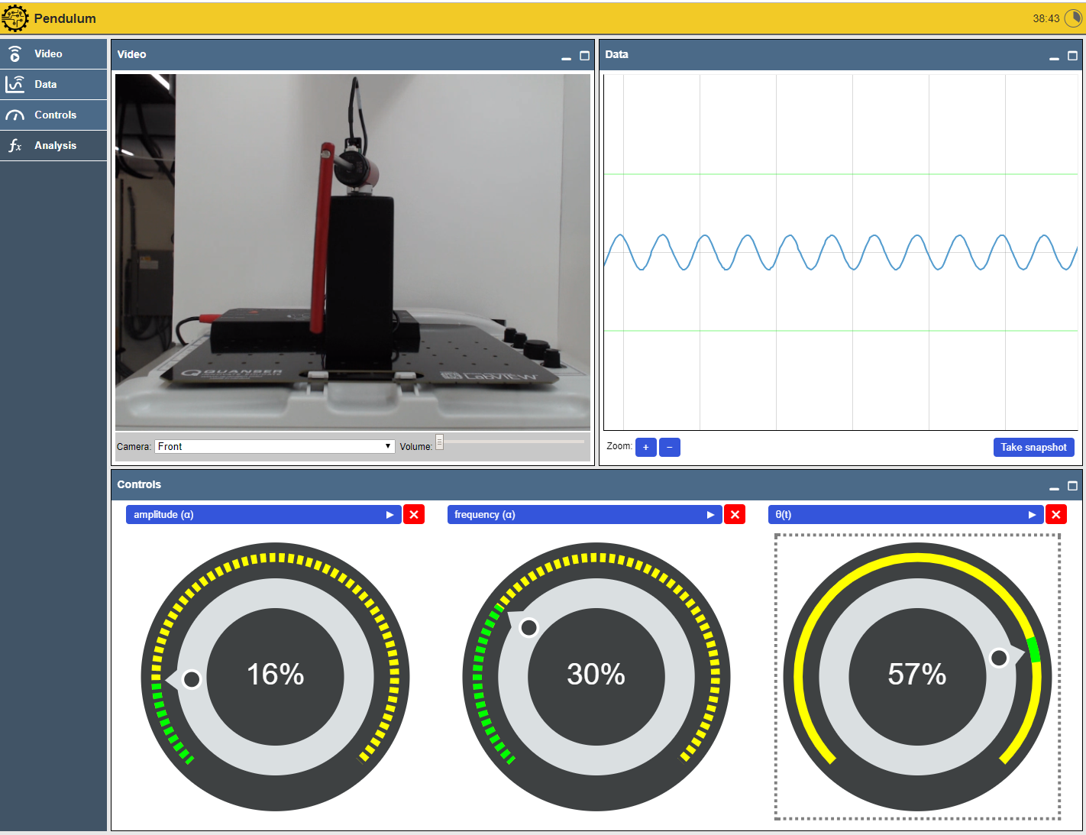
Example OpenSTEM Labs activities
OpenScience Observatories
Scanning Electron Microscope
Spirometer
Controlling a driven pendulum

Slide 5
Project aim and objectives
Aim:
To explore the breadth of activities, skills and educational outcomes developed in OpenSTEM Labs experiments and develop a learning design tool to inform future OpenSTEM Labs activities.
Objectives:
  Understand how remote and onscreen laboratories have been classified in the literature
  Develop a classification scheme for OpenSTEM Labs activities and their learning objectives
  Create a database of existing activities to understand the range of activities available and their learning objectives
  Develop a design tool to help module teams developing new OpenSTEM Labs activities

Slide 6
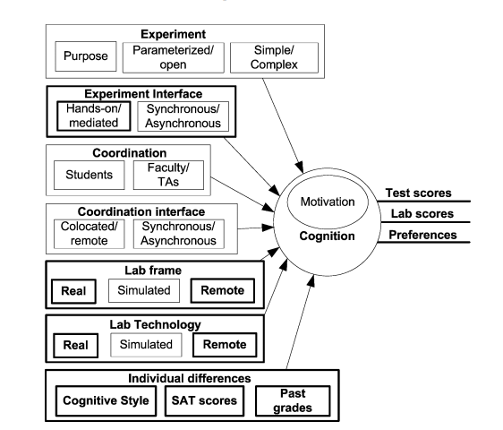
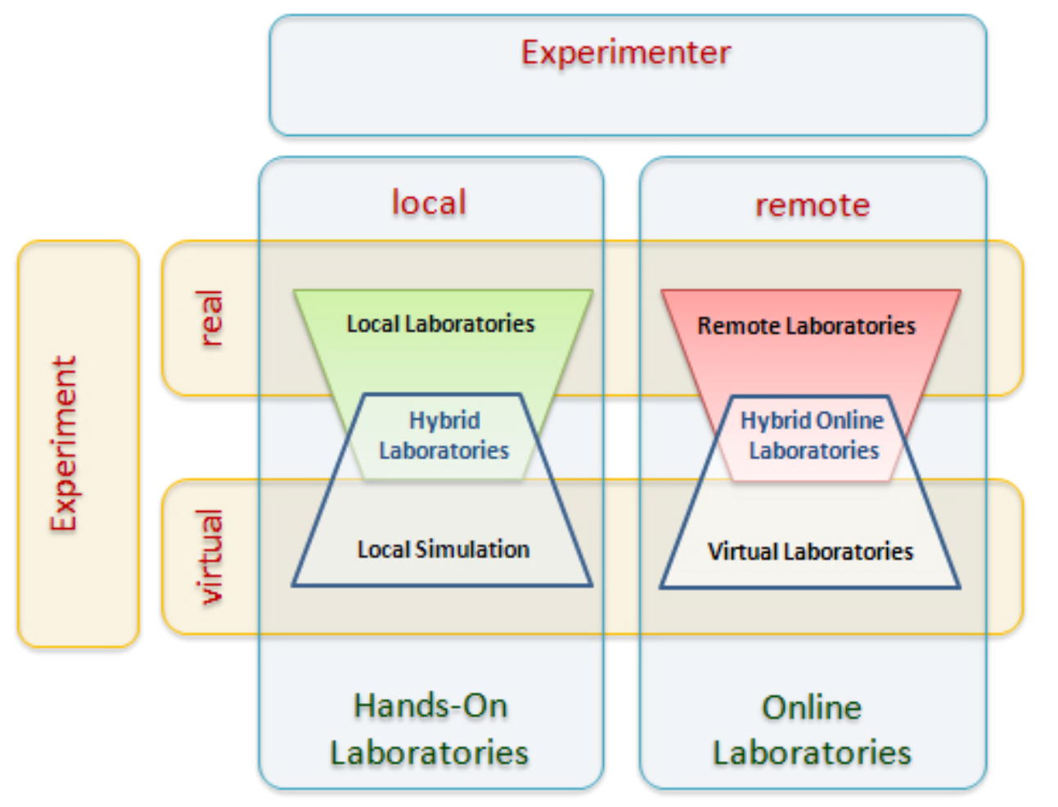
Classification schemes for remote/ online laboratories
Zutin et al. (2010)
Nickerson et al. (2007)

Slide 7
Classifications schemes for learning objectives of remote/ online laboratories
KIPPAS Learning Outcomes
Knowledge and Understanding
Inquiry skills
Practical Skills
Perception
Analytical Skills
Social and Scientific Skills
Fundamental Objectives of Engineering Instructional Laboratories
Instrumentation | Psychomotor
Models | Safety
Experiment | Communication
Data Analysis | Teamwork
Design | Ethics in the Laboratory
Learn from Failure | Sensory Awareness
Creativity
Brinson (2015)
Feisel & Rosa (2005)

Slide 8
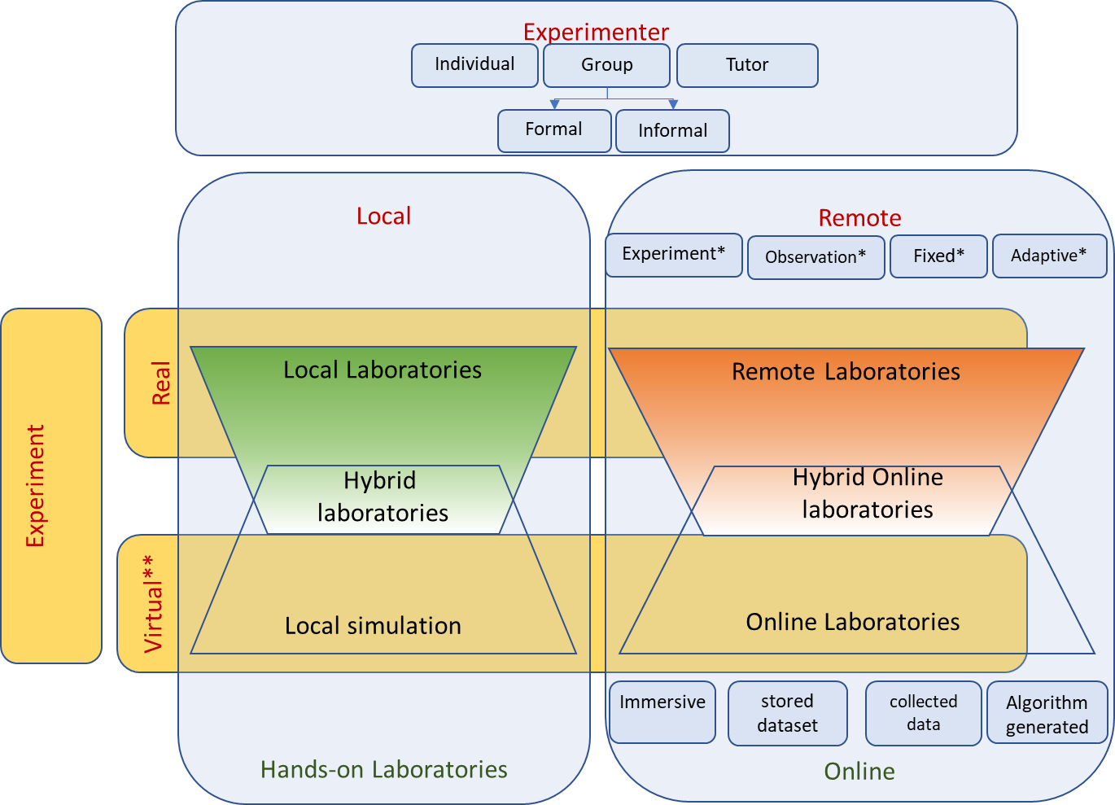
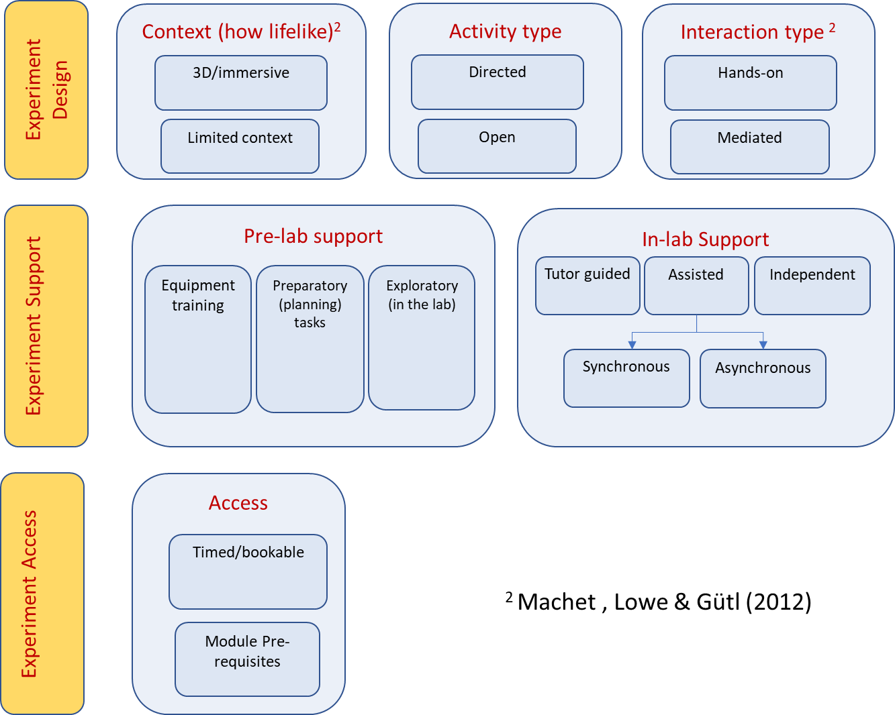
Proposed classification scheme for OpenSTEM Labs activities
Developed based on Zutin et al. (2010) and others

Slide 9
Proposed classification scheme for OpenSTEM Labs learning objectives
Apply subject knowledge and show understanding | Demonstrate creativity in problem solving
Apply appropriate instrumentation to make measurements | Demonstrate competence in operating apparatus
Use theoretical models to predict behaviour | Identify and deal with health and safety issues
Devise experimental approach | Communicate effectively about laboratory work
Collect, interpret and analyse data | Work effectively in teams
Design, build, or assemble a product | Behave with high ethical standards
Identify unsuccessful outcomes and learn from failure | Use human senses to gather information
Based on Feisel and Rosa (2005) with adaptations

Slide 10
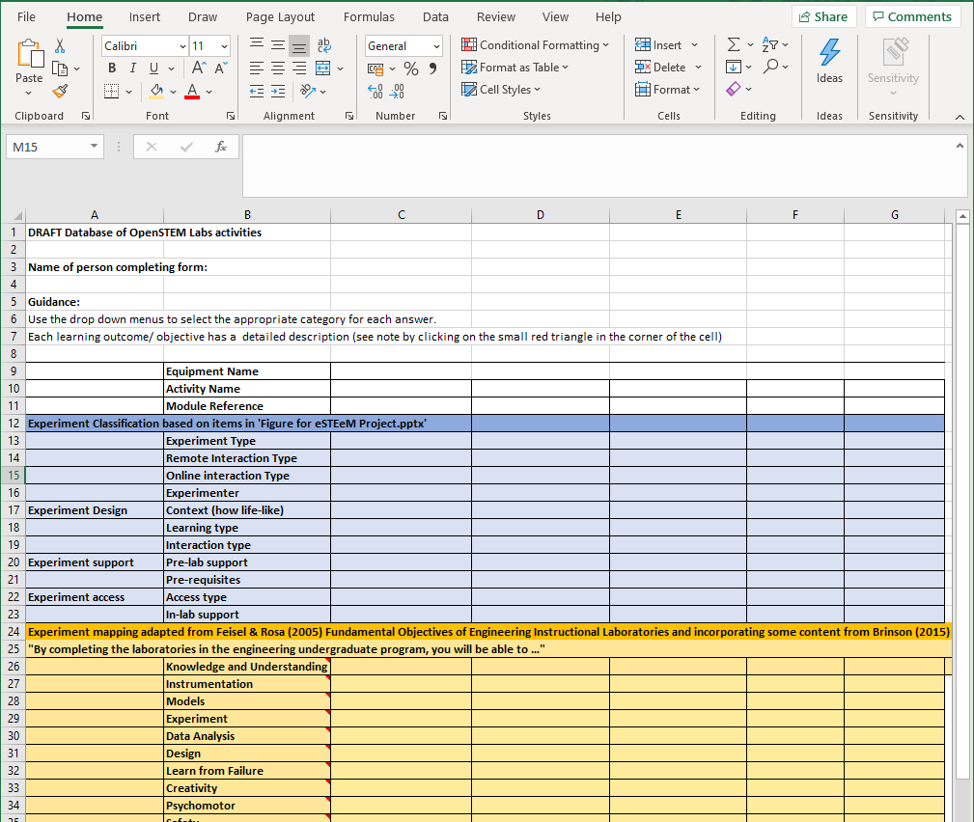
Database of OpenSTEM Labs activities

Slide 11
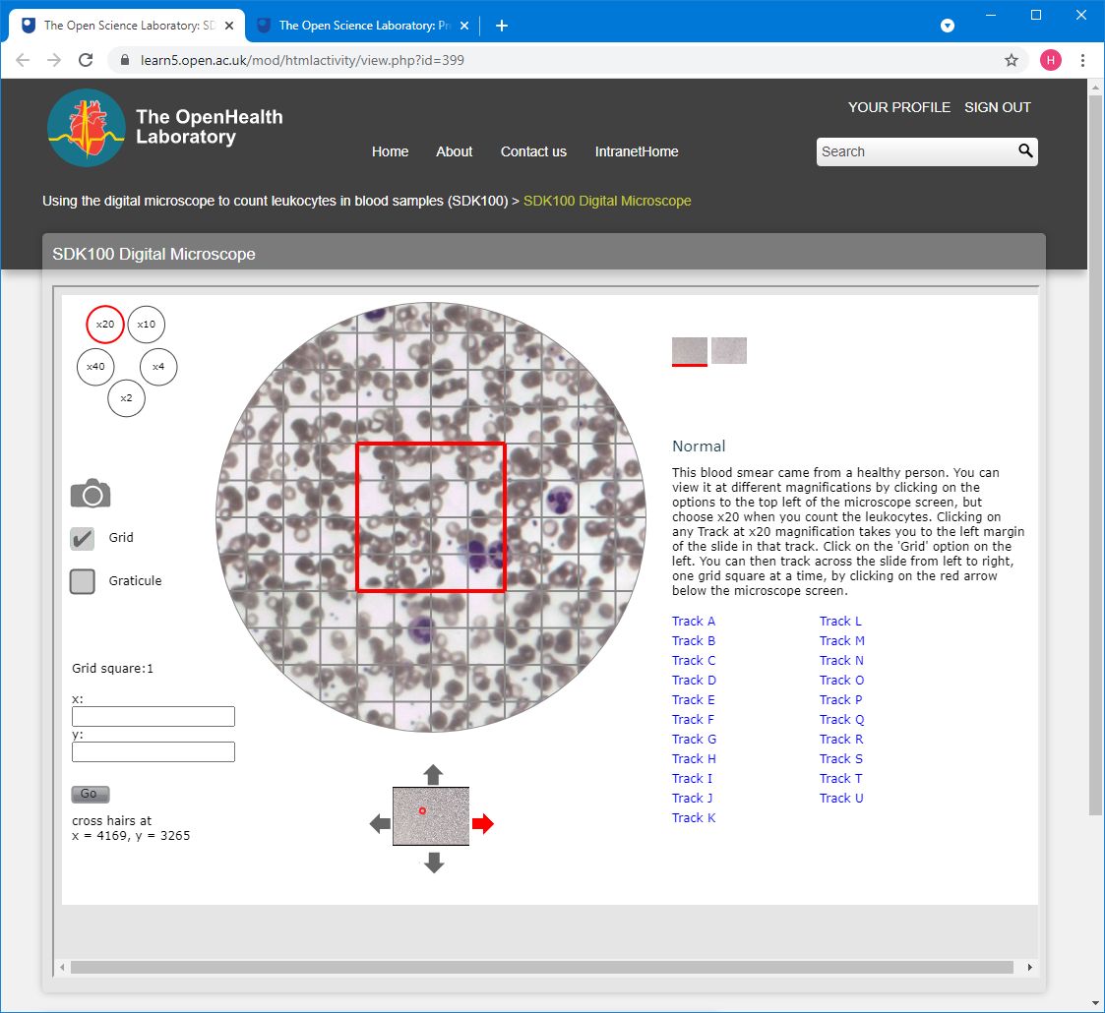
Trial Classification – Using the digital microscope to count leukocytes in blood samples (SDK100)
Experiment Classification (examples)
Experiment Type | Virtual
Interaction type | Stored dataset
Learning type | Directed
Access type | Open
Learning Objectives (examples)
Apply appropriate instrumentation
Devise experimental approach
Collect and analyse data
Communicate effectively
Use human senses to gather information

Slide 12
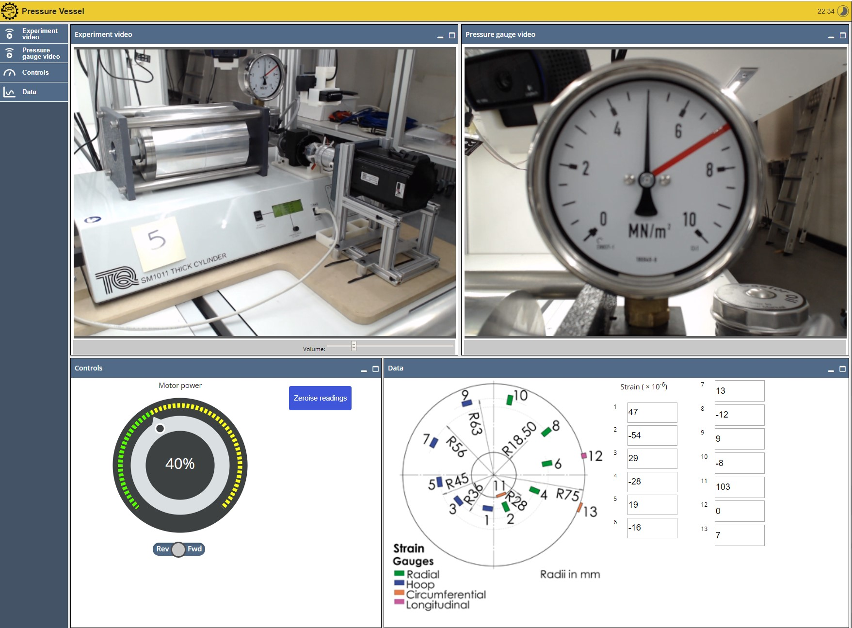
Trial Classification – Investigating strain in a thick-walled pressure vessel (T272)
Experiment Classification (examples)
Experiment Type | Remote
Interaction type | Experiment
Learning type | Directed
Access type | Bookable
Learning Objectives (examples)
Apply appropriate instrumentation
Use theoretical models
Collect and analyse data
Identify health and safety issues
Use human senses to gather information

Slide 13
Initial findings
Literature review has helped us to understand the types of remote and onscreen experiments used in Science and Engineering and their learning objectives
A classification scheme for OpenSTEM Labs activities has been developed
Initial trials of the classification scheme show how it could help module teams to identify existing OpenSTEM Labs activities for reuse or adaptation to other modules
Results provide a starting point for a design tool to help module teams developing future OpenSTEM Labs activities
We welcome your feedback!

Slide 14
Questions?

Slide 15
References
Feisel, L. D. and Rosa, A. J. (2005) ‘The Role of the Laboratory in Undergraduate Engineering Education’, Journal of Engineering Education, 94(1), pp. 121–130.
Brinson, J.R. (2015) Learning outcome achievement in non-traditional (virtual and remote) versus traditional (hands-on) laboratories: A review of the empirical research. Computers and Education, (87), pp. 218–237.
Nickerson, J.V., Corter, J.E., Esche, S.K. and Chassapis, C., 2007. A model for evaluating the effectiveness of remote engineering laboratories and simulations in education. Computers & Education, 49(3), pp. 708-725.
Zutin D.G., Auer M.E., Maier C., and Niederstatter M., “Lab2go – A repository to locate educational online laboratories,” in Proc. of IEEE EDUCON 2010 Conference: The Future of Global Learning Engineering Education, Madrid, Spain, 14-16 April 2010, IEEE, pp. 1741-1746.

