Slide 1

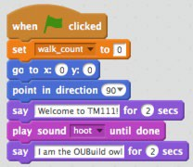
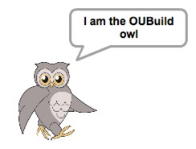

Remote sighted helper support for visually impaired students: exploring good practice
Christine Gardner, Sarah Mattingly, Richard Walker
Context
Entry level computing module TM111 uses a drag and drop programming environment. Novices can get going quickly and produce attractive programs without being frustrated by syntax errors, because blocks will only fit together in valid combinations.
Such a visual programming environment is inaccessible to students who are visually impaired (VI) and they need sighted help to manipulate the blocks and report the results of running the program.
In normal times this would be given by a non-medical helper physically present alongside the student. During the Covid-19 pandemic an alternative support method was needed and the TM111 Module team took emergency steps to provide remote sighted (RS) help, via online communications, for several VI students, who were all assisted by the same RS helper.
Method
After the students have completed the part of the module where the programming occurs we will conduct a short telephone/online interview with each of them. We will also debrief the RS helper in detail, and collect feedback from the ALs who tutor the students concerned.
Output
Following the interviews we plan to produce guidance about good practice in providing remote support, which may be considerably easier to facilitate than physically-present support, and is likely to continue after the current restrictions are lifted.
The aim is to produce a usable draft in time for the next presentation of TM111, which starts in October 2020. If the initial findings are useful, and the next cohort includes some VI students, we would aim to conduct a follow-up study and investigate what benefits our guidance has produced.
Project
The situation provides a unique opportunity to study how RS helper – VI student collaboration works and to investigate a number of questions:
How can the particular requirements and study preferences of the VI individual be incorporated?
What challenges are faced by each party?
What strategies does each follow?
What communication technologies are useful and what are the best ways of using them?

