Slide 1
REMOTE SIGHTED HELPER SUPPORT FOR VISUALLY IMPAIRED STUDENTS
Richard Walker, Christine Gardner and Sarah Mattingly

Slide 2
Context
Entry level computing module TM111 uses a drag and drop programming environment. Novices can get going quickly and produce attractive programs without being frustrated by syntax errors, because blocks will only fit together in valid combinations.

Slide 3
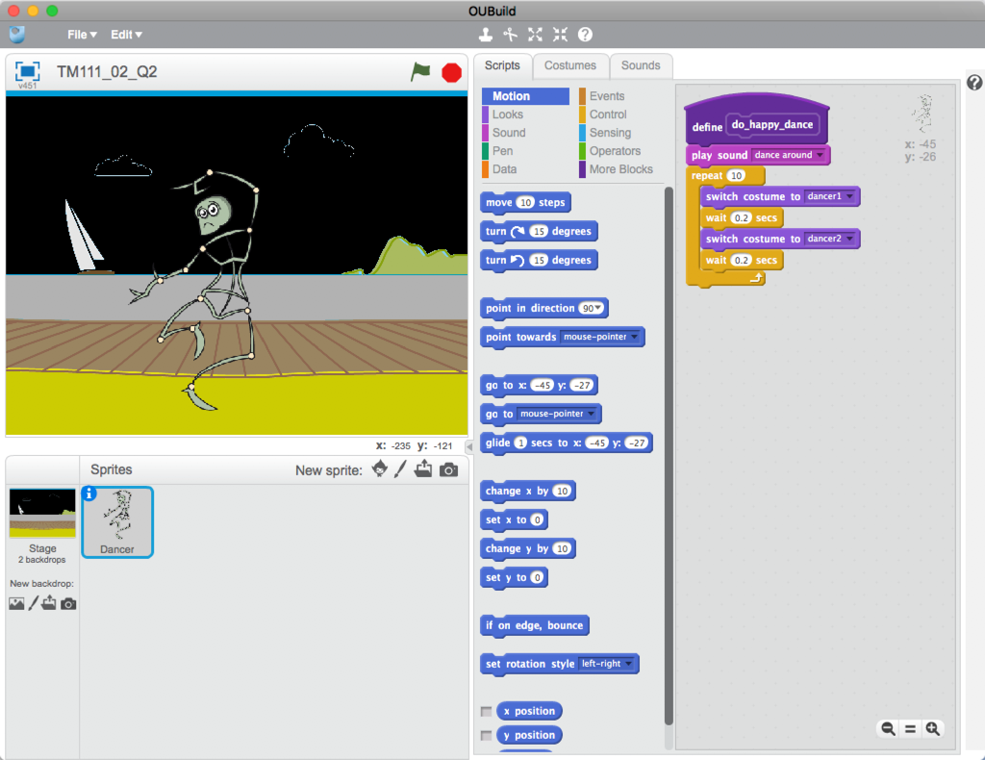

Slide 4
Such a visual programming environment is inaccessible to students who are visually impaired (VI) and they need sighted help to manipulate the blocks and report the results of running the program.
In normal times this would be given by a non-medical helper physically present alongside the student. During the Covid-19 pandemic an alternative support method was needed and the TM111 Module team took emergency steps to provide remote sighted (RS) help, via online communications, for several VI students, who were all assisted by the same RS helper.

Slide 5
PROJECT
The situation provided a unique opportunity to study how RS helper – VI student collaboration works and to investigate a number of questions, such as:
How can the particular requirements and study preferences of the VI individual be incorporated?
What challenges are faced by each party?
What strategies does each follow?
What communication technologies are useful and what are the best ways of using them?

Slide 6
METHOD
Via an agency a RS helper was recruited and briefed by a member of the project team, who then liaised with the helper on a weekly basis for the durtation of the block where the students were learning programming.
Once tne students had completed this part of the module we conducted a short telephone/online interview with each of them. We also debriefed the RS helper in detail, and collected feedback from the ALs who tutored those students.

Slide 7
OUTPUTS
As a result of the study we made three TM111 specific recommendations to the module team
To provide a comprehensive list of the OUBuild code blocks in textual form via the module website
To provide textual descriptions of starter projects in TMA02
To embed video resources within the website.
These suggestions, which stemmed directly from requests made by the VI students in the study, have all been implemented.

Slide 8
OUTPUTS
2. In the study the RS helper and one of the VI students evolved between them a highly effective way of working, whereby the RS took control of the student's computer via Zoom. The RS helper was then able to manipulate the programming blocks under the direction of the VI student anmd so enable them to assemble their program. This is an aproach we will recommend RS in future presentations.

Slide 9
OUTPUTS
Our study has led to enhanced tutor understanding of ways to support visually impaired students on TM111. We have set up a tutor forum TM111 Accessibility Matters to share information and this has helped answer several questions, e.g. Can participants in Adobe Connect see an enlarged view? (Yes but it's hard to find.)
More generally the study has led to an improved understanding of the sort of challenges faced by blind students and the diversity of their needs and study strategies.

Slide 10
FOLLOW UPS
The students in the study all passed TM111 successfuly and have progressed to other modules.
The following presentation of TM111 only had a single student that needed the same form of RS support and this was provided by the same RS helper, who was by then well-versed in what was required. Longer term other helpers will be involved and we will use a synopsis of our findings when briefing them.
We have been encouraged to submit a proposal for a second study of good practice in RS support for VI students, not just in computing but in other STEM areas, for example molecular modelling.

Slide 11
OUR REPORT
Remote sighted helper support for visually impaired students: exploring good practice: Stage 1
Available from the eSTEem web site
We have recently completed an impact assessment which will feed into an external-facing report that looks at a number of case studies relating to scholarship of teaching and learning in the School of Computing and Communications.

Slide 12
THANK YOU AND QUESTIONS

