Slide 1
The STEM Staff Tutors:
Where Do We Come From?
What Are We?
Where Are We Going?
Rachel Hilliam
SHARE 4th September 2015

Slide 2
The Team
Rachel Hilliam, Victoria Pearson, Shirley Northover, Elaine Thomas, Jean McCloughry, Katie Chicot, Martina Gibbons, Carol Calvert and Rosaria Gracia

Slide 3
The motivation
Spring 2014 Athena SWAN bronze award for Mathematics and Statistics and Department of Physical Science
Department of Physical Sciences also obtained a Project Juno Practitioner award
All three sets of feedback identified the staff tutor role as an area for further investigation

Slide 4
The differences between the departments
Department | Maths and Stats | Computing and Communications | Engineering and Innovation | Faculty of Science
No. of staff tutors (No. female) | 17 (11) | 17 (11) | 15 (9) | 22 (16)

Slide 5
Questions of interest - 1
Is there a difference between the STEM departments in range and depth to which Staff Tutors engage with all areas of their academic roles?

Slide 6
Questions of interest - 2
Why does the staff tutor role seem to attract a greater proportion of females and why does this differ between departments?

Slide 7
Questions of Interest - 3
How do staff tutors feel their role is perceived within the different departments, faculties, the university and the wider HE sector?

Slide 8
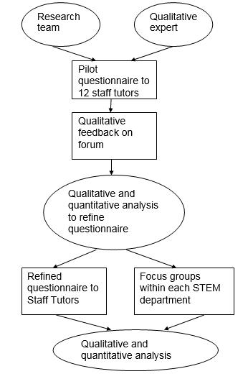
The project

Slide 9
Pilot stage
11 staff tutors invited
8 responses

Slide 10
Some early findings – Where do we come from
Data suggests that STs arrived at the OU after they had the chance to work in other areas.
Their personal reasons are varied but include family changes, the need of combining practical with theoretical work or reducing their workload from previous jobs.

Slide 11
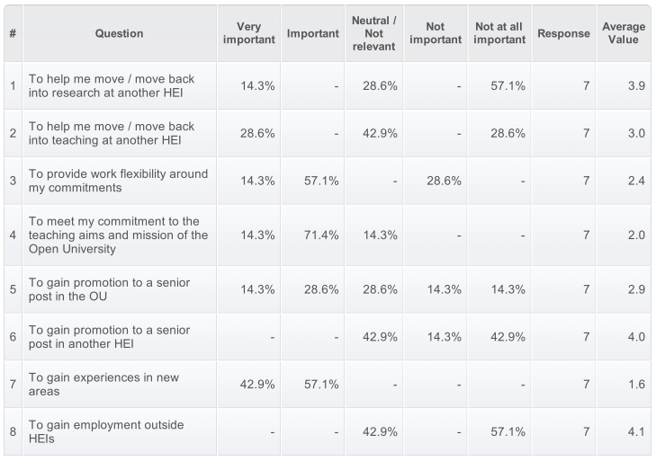
When you applied for your post as a staff tutor what were your main hopes that the post would enable you to
do and how important were they? Please answer by choosing the description which best fits how important each
factor was to you.

Slide 12
What are we?
STs divide their time between OU and other paid employment or activities (learning, teaching, children and further interests).
Time at the OU outside of regional work is mostly occupied with scholarship (60%) with research and external engagement both at 20%.
Despite working on scholarship, none of the STs have taken on research leave, the main reason given is that the rest of the work needs to get done and taking research leave would make this more difficult.

Slide 13
What are we?
4 of 6 respondents are engaged in scholarship, 1 in research and 1 in external engagement. The ability to invest time in research and take on research leave is jeopardized by the managerial aspect of the job.
In this context, respondents identified that they spend 40% of their time working for OU dealing with managerial issues, 9% in research and scholarship, 21% in teaching and18% in other tasks.

Slide 14
Where are we going?
Questions around what staff tutors would like the work split to be?
New promotions criteria
How the staff tutor role is perceived.

Slide 15
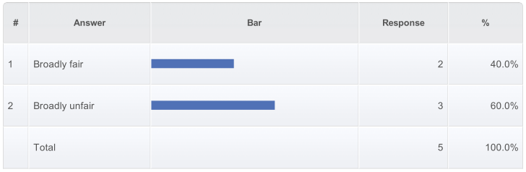
How fair do you feel the new promotion system will be for staff tutors in comparison to central academics?

Slide 16
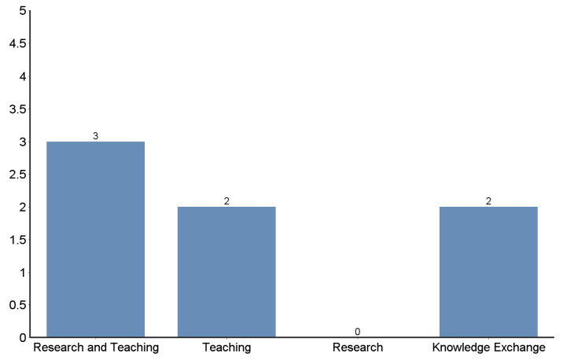
If you were considering promotion under the new promotion framework which categorie(s) would you
consider?

Slide 17
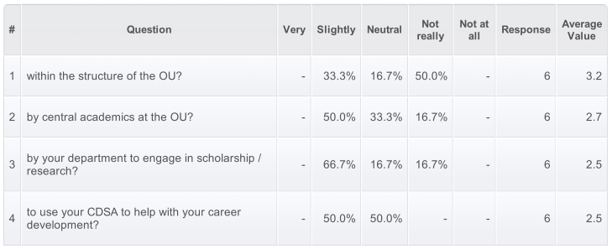
How valued and supported do you feel

Slide 18
Where are we going? – What do we need?
The lack of understanding and agreement on STs’ work tasks seems to impact the level of appreciation in the wider organizational structure. As two of the respondents put it:
‘I feel reasonably well supported by my faculty. It is difficult to know how valued I am but there seem to be a lot of staff, particularly at MK, who do not know what a ST does and therefore can’t give us value’
‘I think people realize that I do an important job but I am not nurtured and often feel forgotten’

Slide 19
Next Steps
Questionnaire currently being updated in response to the feedback from the pilot
Full questionnaire to go out November

