Slide 1
Quantitative methods for scholarship projects
Karen Vines

Slide 2
Getting started
Stages of an analysis….
Design of the study
Data cleaning
Getting a feel for your data (exploratory data analysis)
Straightforward inferential analysis
e.g simple hypothesis testing or fitting simple models
More sophisticated analysis
e.g. more complex hypothesis testing or fitting more complicated models
Actually will deal with this last
Actually tend to do at same time as 3.
Might stop here…
Or here…

Slide 3
Example – Performance on a module
Discrete
Categorical
Continuous
Continuous
Student | Number of OU modules studied | Completed pre-requisite module | OES on pre-requisite module | OES on module
1 | 3 | Y | 66 | 80
2 | 1 | N |  | 76
3 | 1 | Y | 61 | 66
4 | 1 | Y | 69 | 85
5 | 0 | N |  | 65
6 | 0 | N |  | 49
7 | 0 | N |  | 58
8 | 2 | N |  | 68
9 | 3 | Y | 59 | 58
10 | 4 | Y | 55 | 72
Notes:
To make things a bit more concrete going to focus on an example. Here have some data about performance of students on a module. (OK I admit it – its made up data. But still I hope its like data one might get in a project. In this (mythical) study the researches are interested in whether previous OU study, in particular on a particular L1 module, is associated with better performance on a particular L2 module. To try to find this out the researchers have gathered information about the following four variables
The number of OU modules they studied before this one
Whether they had completed the particular L1 module.
What exam score they got on the particular L1 module.
What exam score they got on this particular L2 module.
First is to think about what sort of variable each is going to be. It matters because it dictates what techniques are going to be appropriate and, more importantly, which are not.
What types of variable have people heard about?
Looking for continuous/discrete/categorical (nominal and ordinal)

Slide 4
Getting a feel for data - graphicallly
Single variable
Aim: get a feel for the distribution of the points.
which values are common?
which are less common
what is the range of values?
Examples include
  Bar Charts (For categorical data)
  Pie Charts (For categorical data)
  Histograms (For continuous and discrete data)
  Boxplots (For continuous and discrete data)
Notes:
I think the phrase ‘a picture tells the story of a thousand words’ is very pertinent here. The right plot allows you to very quickly get a feel for the data.
Remember that different plots are suitable for different data types.
Also a bad plot is worse than useless as it can mislead. Generally most likely to go wrong by ‘prettifying’. For example by attempting to make plots look 3d.

Slide 5
From the plot…
Only have ‘yes’s and ‘no’s. (Which would expect.)
More ‘no’s then ‘yes’s. (in fact about 100 more.)

Slide 6
A histogram
From the plot…
Number of modules studied previously in this group is between 0 and 4.
Most common is for one module to have been studied previously
Next most common (and not much less than the most common) is for no modules to have been studies previously.
Only a few students had studied 3 or 4 modules previously.

Slide 7
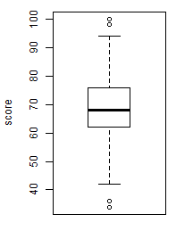
A boxplot
From the plot….
Scores between about 30 and 100.
Median score just under 70.
Lower quartile (bottom 25%) at just over 60.
Upper quartile (upper 25%) at about 75.
Almost all data between a bit over 40 and about 95.
Four potential outliers

Slide 8
Another histogram
From the plot
Lots of really low scores. (Actually happened to be all -1s.)
The other scores range from 30 to 90.
The most common other score is 60-70.
Not many fails (<40).
Notes:
Important to know about these really low scores…
Why are they there? In this case a coding for those students who did not take the pre-requisite. So just indicates a missing value. (Note many (all?) statistical packages allow you to specify a value or values that denote a missing value.)
If you don’t know they are there, could go very wrong. For example mean all the numbers (including these -1s) is just 24. Without the -1s it is 63.

Slide 9
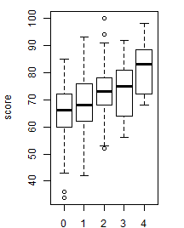
More boxplots
From this plot
Looks like score tends to be higher for those students who have passed more modules…
… in fact seems to go up from an average of about 65 to an average of about 80 …
… and steadily so
Spread seems to be roughly the same.
Quite a lot of overlap, so not clear whether this is going to be statistically significant.
Notes:
A plot of scores on the module depend on how many modules the student has passed before

Slide 10
A scatterplot
From this plot…
Can see the scores on both modules more clearly.
Generally the students who did better on the previous module did better on this module too. (positive relationship)
Relationship looks linear.
If there are outliers, they are not really outlying outliers.
Notes:
Linear relationship important if thinking about regression. Multiple regression and simple linear regression will just fit a straight line.
Other things can see from such a plot are things like digit preference. For example suppose a module only gave a score to the nearest 5 marks. That would show up
However beware of overplotting. Depending on how the scatterplot is done one point, or many points, in the same place might look exactly the same.
Also if have thousands of points likely to just look like a blurry mess.

Slide 11
Numerical summaries - 1
Summarising data with a few numbers
Location
Typical or average value
  Mean
    sum / (number of numbers)
    Nice mathematical properties
    Best when distribution is symmetric
    Not interpretable with categorical data
    Can be misleading if data has outliers.
  Median
    Middle value, if numbers are put in order
    Is robust. (That is skewness and/or outliers less of a problem)
    Interpretable with ordinal data
    Not used as much in hypothesis testing and estimation

Slide 12
Numerical summaries - 2
Spread
How much variation is there?
  Standard deviation
    Mean of the squared deviations around the mean
    If data are normally distributed, roughly 68% within 1 standard deviation and 95% with 2 standard deviations
    Best when distribution is symmetric
    Can be misleading if data has outliers.
  Interquartile range (IQR)
    Distance covering the middle 50% of the data.
    Is robust. (That is skewness and/or outliers less of a problem)
In both cases values go from 0 (no variation) upwards (as variation increases)
Location and spread measures are linked
  Mean and standard deviation
  Median and interquartile range

Slide 13
Hypothesis testing
Is a hypothesis plausible in the light of the data?
Basic scheme
Set up null hypothesis (H₀)
  e.g. Studying the L1 module does NOT make any difference to performance on the L2 module (as shown by the OES score)
Set up the alternative (H₁)
  e.g. Studying the L1 module does make a difference to performance on the L2 module.
Look to see how unusual the data looks when it is assumed that the null hypothesis is true.
Note looking for evidence against the null hypothesis. This is different to evidence that the null hypothesis is true.
Notes:
Note null hypothesis is a ‘dull’ hypothesis. Its essentially a ‘nothing is happening’ kind of thing.
Also need to be specific. What exactly mean by difference in performance? So specifying looking at the OES score. Also looking at the mean score achieve by those who studied the L1 module versus the mean score achieved by those who did not.
Only then get things specific enough to tie down what happens when null hypothesis is true in sufficiently mathematical way.

Slide 14
Example
OES scores on L2
If have done the L1 module…
Mean: 71.0
Standard deviation: 10.6
If not done the L1 module…
Mean: 67.4
Standard deviation: 9.8
Evidence summarised by a test statistic
t = -3.871
Compared with distribution of value expect to see when null hypothesis is true…
Notes:
Test statistic is a number that captures evidence against the null hypothesis in the favour of the alternative. These days usually don’t have to fret too much abut the formula – get it out from the stats package.
Can be helpful to know the gist of it. For example it is based on the difference between the two sample means – and standardises using the observed standard deviations.
The value of the test statistic is not much use by itself – need to see what would expect if null hypothesis is true.

Slide 15
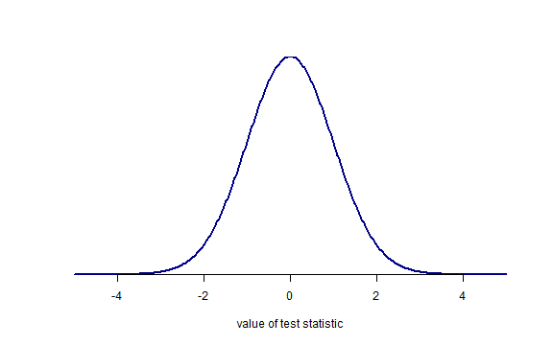
Notes:
In this case this is distribution of the test statistic, assuming again null hypothesis is true.
Note symmetric about 0. Most likely around zero – values where the observed means are roughly equal. Then values either way get increasingly unlikely. To the extent that values more than 4 or less than -4 are very unlikely.

Slide 16
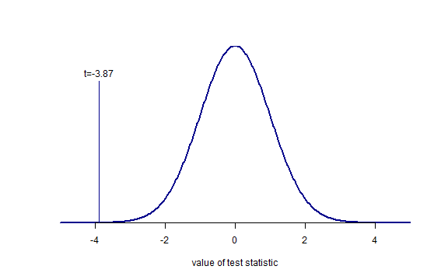
Notes:
Marked on here is the value we go. Notice is it in the zone of unlikely values. But don’t just consider the value we got, usually go a bit further…

Slide 17
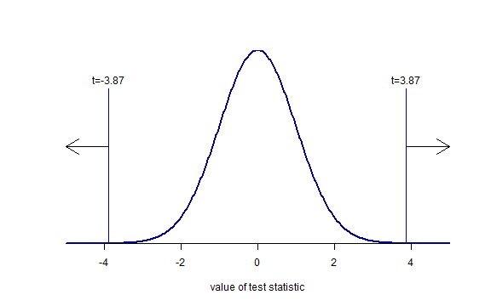
p approx 0.00006
p approx 0.00006
Notes:
Think about values as as extreme or more extreme. So the probability of getting a test statistic less than -3.87. (Remember assuming the null is true.)
Also the flip side what is difference went in other direction. (In this case studying the L1 module reduces the L2 score.
So the probability of getting a test statistics more than 3.87.
In both cases 0.00006. Giving a total of 0.00012. Very small.
So test statistic is very small if we assume the null is true. Thus very strong evidence against the null.

Slide 18
General points about hypothesis testing
Things to be careful of
Just looking for evidence against the null hypothesis.
  Do NOT find evidence for the null hypothesis. In particular cannot prove the null is true.
Difference between STATISTICAL significance and PRACTICAL significance
  Statistical significance – p-value
  Practical significance – what impact it actually makes.
Even if the null hypothesis is true, there is a chance will still get a statistically significant result.
  Matters if doing lots of significance testing. Finding at least one statistically significant results quickly gets quite likely.
  Easily get point if just looking for ‘something interesting’ in the data. (See https://xkcd.com/882/)
  Therefore very important to detail the key hypothesis you want to test before you even collect the data.
Notes:
Not being able to prove the null is true is a particular problem if want to investigate that two things are equivalent. Need a different approach
Practical significance. Depends on the context and is a subjective judgement. For example in a study about retention, an improvement in retention by 10 percentage points is almost certainly worth knowing about. (Unless the intervention is very costly.) An improvement in retention 0.001 percentage points almost certainly isn’t.
Can run into trouble either way. If gather lots and lots of data could find get strong statistical significance even when little practical significance. If don’t gather enough data could not have statistical significance even the intervention leads to a change that is highly practically significant.
This second risk can be quantified by calculating the power of the study. That is the chances that will get a statistically significant should be alternative hypothesis be true. Note the power can be calculated before any data is gathered. (At least in an approximate.) In many situations it is deemed unethical to go ahead with a study if the power is not good enough. (Basically shouldn’t mess participants around is have little chance of showing anything at the end.
If just looking at the usual ‘P < 0.05’ criterion, then would expect to get a statistically significant result at least 1 in 20 times.
Do 4 tests then chance of at least one significant (assuming null hypothesis is true) is already more than 1 in 5. Do 14 or more tests, it becomes more likely than not.

Slide 19
Estimation
Instead of testing hypthese can look to estimate values, and by extention fit models to data.
e.g. estimate the different in the mean score on the L2 module achieve by students who did not study the level 1 module compared with the mean score acheived by those who did.
Note an estimate by itself is rarely helpful
e.g. saying the estimate is -3.6 is not that helpful
Also need estimate of spread – often done by a confidence interval
e.g 95% confidence interval for difference in means is (-5.4, -1.8)
Notes:
Correct interpretation of the CI is convoluted. Random interval based on the data constructed so that 95% of the time it contains the true value. But admit the usual (but wrong) interpretation that 95% chance true value in interval is a good enough way to think about informally. (Just don’t put it in a paper or report!)
Note it address practical and statistical significance. The CI does not include 0, so the difference is statistically different from 0. But also get immediate sense of how big the difference might. Students who do not study the L1 module score between 2 and 5 marks lower on average.

Slide 20
Fitting models
Use models to
Quantify relationships between variables
  Eg. how does the score on the L2 depend on the score in the pre-requisite model?
Provide as means of predicting new values
  E.g. If a student scores 40 on the pre-requisite model how likely are they to pass the module?
Most common form of model is a regression model.
Notes:
Within regression model many different types of model. Covers a vast range of situations. Chances are these is a type of model that will suit your data, but might be sufficiently complicated that you don’t want to go there….

Slide 21
Example
From this plot…
Notice line generally follows data.
Slope of 0.51 suggests OES on this module generally increased by 0.51 marks for every mark increase on previous module.
Slight hint that line is a bit too high when the score on previous module is low, and too low when score on previous module is high.
More complicated model better?

Slide 22
Modelling - things to bear in mind
Start simple – and slowly elaborate from there
Parsimony rules. Simplest adequate model is almost always best.
Make you understand the structure of the model. If you don’t, don’t bother fitting it!
Be aware of what assumptions you are making.
Check assumptions where you can. The other assumptions, think whether they are reasonable in the context.
Useful maxim: No model is true, but some are useful.

Slide 23
And finally
Think about how you are going to do the analysis before you collect the data. Do not end up in the situation of collecting data you can do nothing with, or doesn’t really answer the question you are most interested in.
Start with simple analyses. Only move on to some more complicated once you’ve got everything you can out of the simple analysis.
If you don’t understand what you’re doing – don’t bother doing it. There’s a lot to be said for ‘quick and dirty’ analyses.
Using a stats package will take the grind of doing statistics, and protect you from some errors.
Doing a good analysis takes time. A general rule of thumb – expect to take as long analysing data as collecting it.
There is help out there. For example the OU’s Stats Advisory Service.
Notes:
On point 4. Not all errors. Think of it like a big calculator.
On point 5. Just like everyone else we statisticians tend to busy so have little capacity to help. But we are tempted by projects that interest us, by the carrot of collaboration and where the methodology is intriguing (ie requires something non-standard/new)

