Slide 1
Quantitative methods for scholarship projects
Karen Vines

Slide 2
A few quick questions…
Have you had experience of doing quantitative analysis before?
What are you most looking to get out of the session?
What is your experience with doing scholarship projects?

Slide 3
Getting started
Stages of an analysis….
Design of the study
Data cleaning
Getting a feel for your data (exploratory data analysis)
Straightforward inferential analysis
e.g simple hypothesis testing or fitting simple models
More sophisticated analysis
e.g. more complex hypothesis testing or fitting more complicated models
Actually tend to do at same time as 3.
Might stop here…
Or here…

Slide 4
Example – Performance on a L2 module
Discrete
Categorical
Continuous
Continuous
Student | Number of OU modules studied | Completed a particular L1 module | OES on the L1 module | OES on this module
1 | 3 | Y | 66 | 80
2 | 1 | N |  | 76
3 | 1 | Y | 61 | 66
4 | 1 | Y | 69 | 85
5 | 0 | N |  | 65
6 | 0 | N |  | 49
7 | 0 | N |  | 58
8 | 2 | N |  | 68
9 | 3 | Y | 59 | 58
10 | 4 | Y | 55 | 72

Slide 5
Getting a feel for data - graphically
Single variable
Aim: get a feel for the distribution of the points.
which values are common?
which are less common
what is the range of values?
Examples include
  Bar Charts (For categorical data)
  Pie Charts (For categorical data)
  Histograms (For continuous and discrete data)
  Boxplots (For continuous and discrete data)

Slide 6
A Bar Chart
From the plot…
Only have ‘yes’s and ‘no’s. (Which would expect.)
More ‘no’s then ‘yes’s. (In fact about 100 more.)

Slide 7
A histogram
From the plot…
Number of modules studied previously in this group is between 0 and 4.
Most common is for one module to have been studied previously
Next most common (and not much less than the most common) is for no modules to have been studies previously.
Only a few students had studied 3 or 4 modules previously.

Slide 8
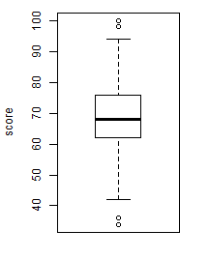
A boxplot
From the plot….
Scores between about 30 and 100.
Median score just under 70.
Lower quartile (bottom 25%) at just over 60.
Upper quartile (upper 25%) at about 75.
Almost all data between a bit over 40 and about 95.
Four potential outliers

Slide 9
Another histogram
From the plot
Lots of really low scores. (Actually happened to be all -1s.)
The other scores range from 30 to 90.
The most common other score is 60-70.
Not many fails (<40).

Slide 10
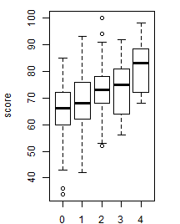
More boxplots
From this plot
Looks like score tends to be higher for those students who have passed more modules…
… in fact seems to go up from an average of about 65 to an average of about 80 …
… and steadily so
Spread seems to be roughly the same.
Quite a lot of overlap, so not clear whether this is going to be statistically significant.

Slide 11
A scatterplot
From this plot…
Can see the scores on both modules more clearly.
Generally the students who did better on the previous module did better on this module too. (positive relationship)
Relationship looks linear.
If there are outliers, they are not really outlying outliers.

Slide 12
Numerical summaries - Location
Location - Typical or average value
  Mean
    sum / (number of numbers)
    Nice mathematical properties
    Best when distribution is symmetric
    Not interpretable with categorical data
    Can be misleading if data has outliers
  Median
    Middle value, if numbers are put in order
    Is robust. (That is skewness and/or outliers less of a problem)
    Interpretable with ordinal data
    Not used as much in hypothesis testing and estimation

Slide 13
Numerical summaries - Spread
Spread - How much variation is there?
  Standard deviation
    Square root of the mean of the squared deviations around the mean
    If data are normally distributed, roughly 68% within 1 standard deviation and 95% with 2 standard deviations
    Best when distribution is symmetric
    Can be misleading if data has outliers.
  Interquartile range (IQR)
    Distance covering the middle 50% of the data.
    Is robust. (That is skewness and/or outliers less of a problem)
In both cases values go from 0 (no variation) upwards (as variation increases)
Location and spread measures are linked
  Mean and standard deviation
  Median and interquartile range

Slide 14
Hypothesis testing
Is a hypothesis plausible in the light of the data?
Basic scheme
Set up null hypothesis (H₀)
  e.g. Studying the L1 module does NOT make any difference to performance on the L2 module (as shown by the OES score)
Set up the alternative (H₁)
  e.g. Studying the L1 module does make a difference to performance on the L2 module.
Look to see how unusual the data looks when it is assumed that the null hypothesis is true.
Note looking for evidence against the null hypothesis. This is different to evidence that the null hypothesis is true.

Slide 15
Example
OES scores on L2
If have done the L1 module…
Mean: 71.0
Standard deviation: 10.6
If not done the L1 module…
Mean: 67.4
Standard deviation: 9.8
Evidence summarised by a test statistic
t = -3.871
Compared with distribution of value expect to see when null hypothesis is true…

Slide 16
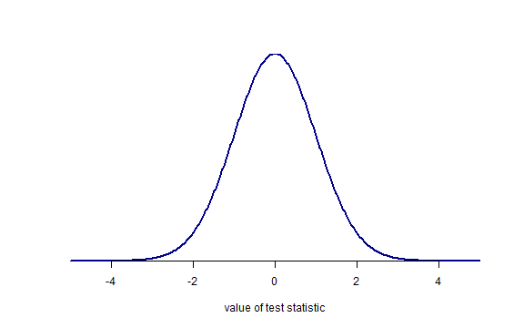
Distribution of the test statistic

Slide 17
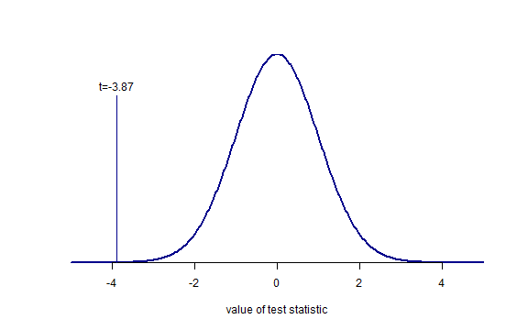
Distribution of the test statistic

Slide 18
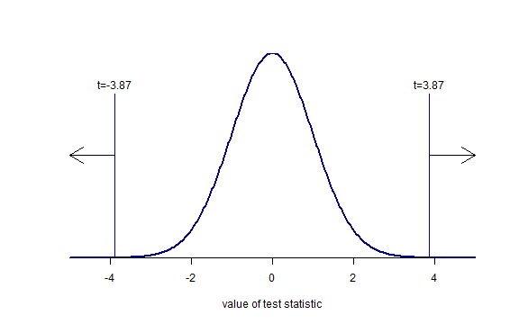
Distribution of the test statistic
p approx 0.00006
p approx 0.00006

Slide 19
General points about hypothesis testing
Things to be careful of
Just looking for evidence against the null hypothesis.
  Do NOT find evidence for the null hypothesis. In particular cannot prove the null is true.
Difference between STATISTICAL significance and PRACTICAL significance
  Statistical significance – p-value
  Practical significance – what impact it actually makes.
Even if the null hypothesis is true, there is a chance will still get a statistically significant result.
  Matters if doing lots of significance testing. Finding at least one statistically significant results quickly gets quite likely.
  Easily get to that point if just looking for ‘something interesting’ in the data. (See https://xkcd.com/882/)
  Therefore very important to detail the key hypothesis you want to test before you even collect the data.

Slide 20
Estimation
Instead of testing hypotheses can look to estimate values, and by extension fit models to data.
e.g. estimate the different in the mean score on the L2 module achieve by students who did not study the level 1 module compared with the mean score achieved by those who did.
Note an estimate by itself is rarely helpful
e.g. saying the estimate is -3.6 is not that helpful
Also need estimate of spread – often done by a confidence interval
e.g. 95% confidence interval for difference in means is (-5.4, -1.8)

Slide 21
Fitting models
Use models to
Quantify relationships between variables
  E.g. how does the score on the L2 depend on the score in the pre-requisite model?
Provide as means of predicting new values
  E.g. If a student scores 40 on the pre-requisite model how likely are they to pass the module?
Most common form of model is a regression model.

Slide 22
Example
From this plot…
Notice line generally follows data.
Slope of 0.51 suggests OES on this module generally increased by 0.51 marks for every mark increase on previous module.
Slight hint that line is a bit too high when the score on previous module is low, and too low when score on previous module is high.
More complicated model better?

Slide 23
Modelling - things to bear in mind
Start simple – and slowly elaborate from there
Parsimony rules! Simplest adequate model is almost always best.
Make you understand the structure of the model. If you don’t, don’t bother fitting it!
Be aware of what assumptions you are making.
Check assumptions where you can. The other assumptions, think whether they are reasonable in the context.
Useful maxim: No model is true, but some are useful.

Slide 24
And finally
Think about how you are going to do the analysis before you collect the data. Do not end up in the situation of collecting data you can do nothing with, or doesn’t really answer the question you are most interested in.
Start with simple analyses. Only move on to some more complicated once you’ve got everything you can out of the simple analysis.
If you don’t understand what you’re doing – don’t bother doing it. There’s a lot to be said for ‘quick and dirty’ analyses.
Using a stats package will take the grind of doing statistics, and protect you from some errors.
Doing a good analysis takes time. A general rule of thumb – expect to take as long analysing data as collecting it.
There is help out there. For example the OU’s Stats Advisory Service.

