Slide 1

Employability and Student Success: Virtual Internships for Underrepresented Students
Confidence and Catalyst:
Evaluating a Proof of Concept of STEM/FBL Virtual Internships for Underrepresented Students
Andrew Potter and Diane Butler, STEM
Catherine Comfort and Kristen Reid, FBL
15 November 2023

Slide 2
Aims of the seminar
Outline of Presentation
An overview of the virtual internships scheme
Key aspects of the scholarship study
Findings
Implications & impact

Slide 3

Slide Title 12
The Virtual Internship Scheme
Programme Overview 1
Aims to improve and support the progression of underrepresented students and disadvantaged groups into further study or graduate-level employment through virtual work experience
A small-scale pilot of virtual internships supported through ringfenced funding via the university's Access, Participation and Success (APS) team
Virtual internships were offered to students in underrepresented groups as defined by the APS strategy.

Slide 4

Slide Title 12
The Virtual Internship Scheme
Programme Overview 2
Joint project of the Faculty of Business and Law (FBL) and the Faculty of Science, Technology, Engineering and Mathematics (STEM) with the university's Careers and Employability Service (CES) Placements Team
Initial cohort offered 17 virtual internships, primarily 'university-based', i.e., working within the university setting on a wide variety of faculty projects, which were supervised by university staff
Varying lengths of internships offered over a 4-month period, usually part-time, and paid at the UK's 'living wage’
Highly flexible format

Slide 5


Key Aspects of the Scholarship Study
Study Design
Data collected from first cohort of interns (via two focus groups) and their supervisors (via semi-structured interviews)
Questions examined how the virtual internship worked for interns and supervisors, including:
  The process of applying
  The ‘virtual’, online nature of the work
  How interns developed skills, such as in independent working and team working
  The relationship between intern and supervisor
  Supervisor support and support for supervisors
  Other skills developed and supported in the internship.
We used thematic analysis (Braun & Clarke, 2006) to analyse our data.

Slide 6
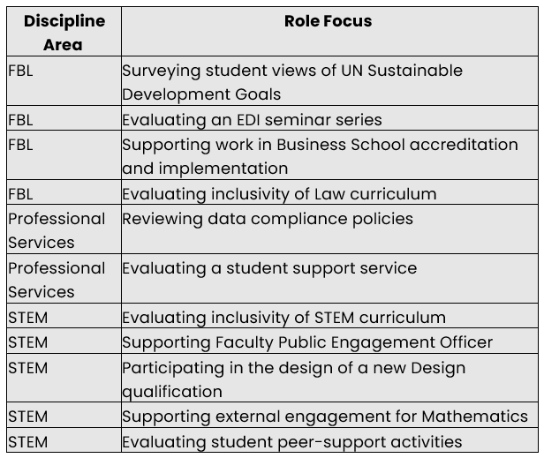
Key Aspects of the Scholarship Study
Sample
Numbers matter when thinking about bringing it to scale
20,919 students proactively targeted (4,569 STEM 16,350 FBL) | 133 students requested application packs | 43 students submitted applications | 17 students were selected as interns | 7 students participated in focus groups
8 of 16 supervisors interviewed with us.
Data from CES post-internship evaluations were also used to triangulate focus group and interview data.

Slide 7

Research Findings 1
Confidence: from the internship but experience of applying encouraged them also to apply for future job roles
Flexibility: when and how work carried out; less than full time, quality of experience not impacted by student location, caring responsibilities, work, studying, physical or mental considerations
Tailored tasks: suited to students’ talents and career requirements.
Sense of belonging: interns felt part of a team and that they, their lived experience and their views mattered

Slide 8

Research Findings 2
Communication and support: critical to success of internship. Flexibility of communication, value of feedback; clear, appropriate tasks and guidance when needed.
Distance working: counteracting loneliness from online meetings, emails, coworking space, equality of all being online. Considerable effort required from both sides.
Connection to discipline and career: practical application of skills in new contexts, better understanding of other options; career related support.

Slide 9

Research findings 3
  Students from underrepresented backgrounds benefitted from this targeted intervention, gaining confidence, technical and soft skills
  Problem-solving benefits from joint-working between academic and academic-related staff
  Supervisors benefitted from line management experience, and from training in coaching and mentoring
  OU benefitted through exposure to students as equal partners: new perspectives and ideas
  Interns’ work amplified voices of minoritized groups: 50%+ OU students but often marginalized

Slide 10
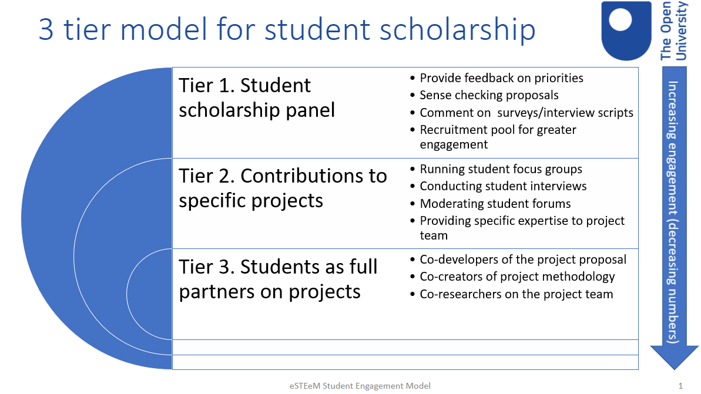
The Study’s Impact – Impact for our Students
We have gained a much better understanding of our students’ needs.
The programme has a hugely positive impact on completion and retention.
Virtual internships are becoming a model of student engagement across the university.
Inclusive curriculum work now actively engages with students, with more work planned to develop students as partners.
100% of students who completed an OU exclusive internship in 21/22 and 22/23 are either still studying with the OU or have completed their qualification.​

Slide 11

Impact – Impact for our Staff and Institution
Staff have more opportunities for meaningful engagement with students – the study’s findings have informed supervisor training sessions.
Virtual internships have become an important element of our APP and inclusive curriculum work (e.g., featured in our TEF and B3 reports).
Work experience and other practice/work-based learning opportunities are being given strategic importance.
There are huge impacts on the practice of developing inclusive curriculum.
External dissemination via journal publications and & conference papers.

Slide 12

Enablers to Innovation and Impact
  External:
    Office for Students requirements
    Covid-driven culture change
      Technological advances
      Expectations of workplace
  Internal:
    Funding
    Existing infrastructure and processes
    Inter-unit, cross-faculty collaboration –
    expertise and support
    Staff commitment to achieve goal for students

Slide 13

Conclusions and Next Steps
Proof of concept that internships can be offered successfully within the institution to benefit several agendas.
Developed an excellent model of partnering with students.
Offers an excellent model of cross-unit, cross-faculty partnership approaches.
Recognised importance of sufficient organisational resourcing.
Next steps:
  Pan-University study on employer engagement to support curriculum development and extra-curricular opportunities for students
  Developing an institutional approach for work experience.

Slide 14
Slide Title 30
Thank you

Slide 15
Slide Title 31

