Slide 1

BLENDED TUTORIALS IN MATHEMATICS: Simultaneous face-to-face and online events
Andrew Potter SFHEA Colin Blundell FHEA
Staff Tutor in Mathematics & Statistics Associate Lecturer
eSTEeM Scholarship Showcase
20th April 2022, 14:00

Slide 2
What is “blended synchronous learning”?
Definition

Slide 3
What is “blended synchronous learning”?
Definition
By “blended synchronous learning”, we mean:
A learning event which takes place as a face-to-face event, whilst simultaneously being broadcast online.
Students can choose to attend:
  Live, in person
  Live, online
  by watching the recording
Also known as: “hybrid synchronous learning”, “Here or There (HOT) instruction”, “synchromodal learning”, “Hyflex learning”, etc.

Slide 4
Background
M337 Complex Analysis

Slide 5
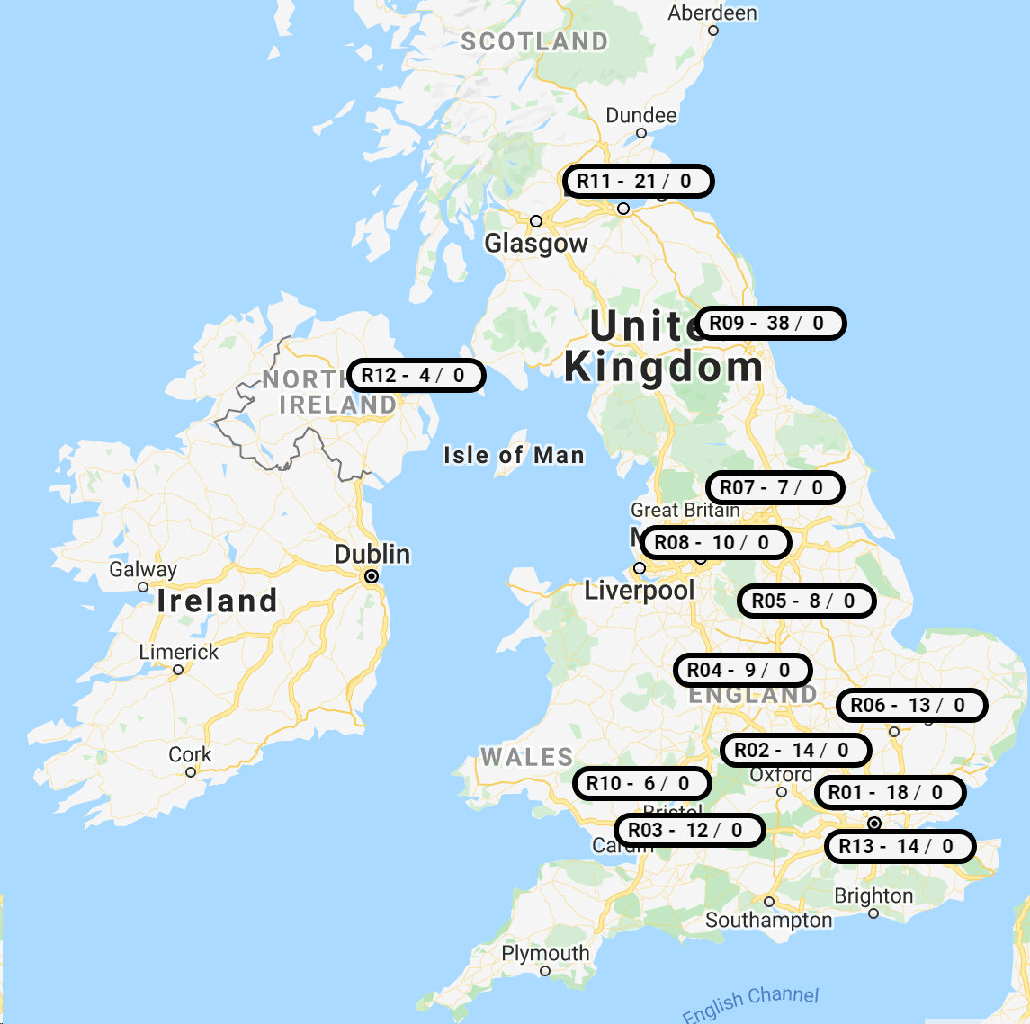
Background
M337 Complex Analysis
Level 3 Pure Mathematics module
Approximately 200 students (of which 30 outside UK and Ireland)
11 tutors; one group each
Face-to-face tutorials in Edinburgh, Glasgow, Leeds, Birmingham, Cambridge, Reading, London
Caption: Locations of face-to-face tutorials on M337

Slide 6
What did we do?
Our approach and setup

Slide 7
What did we do?
Blended Synchronous Learning Design Framework (Bower et al., 2015)
 | Pedagogy | Technology | Logistics / Setup
Presage (Design)
Process (Implementation)
Product (Outcome)

Slide 8
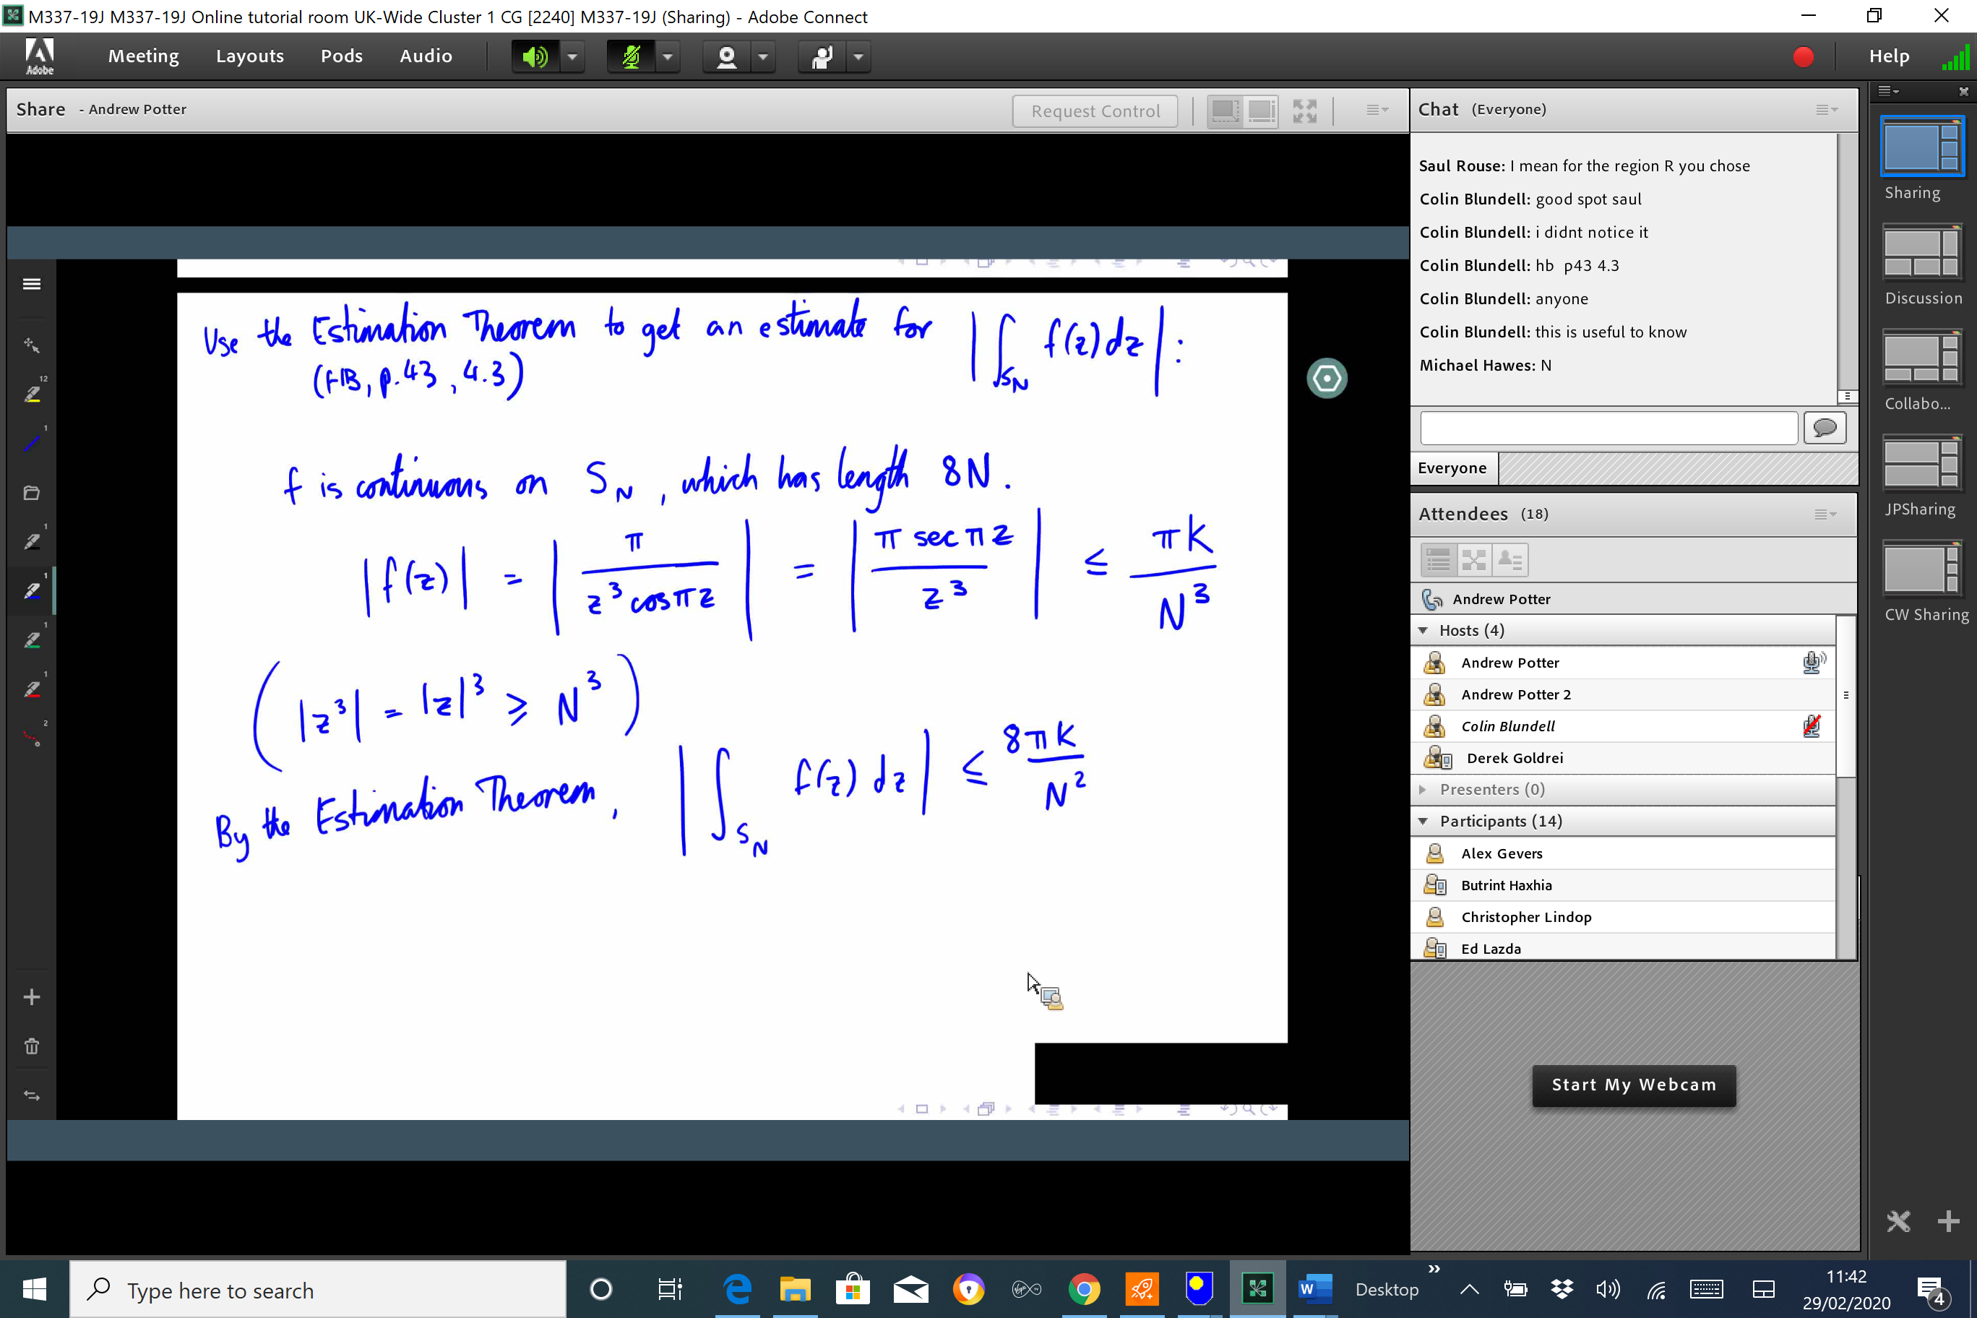
What did we do?
Pedagogy & Technology
Pedagogy limited by our technological worries
Worked through problems sent out in advance with input from students
One F2F tutor, one online, mediating interactions.
Caption: A screenshot of the blended tutorial from an online student’s perspective.

Slide 9
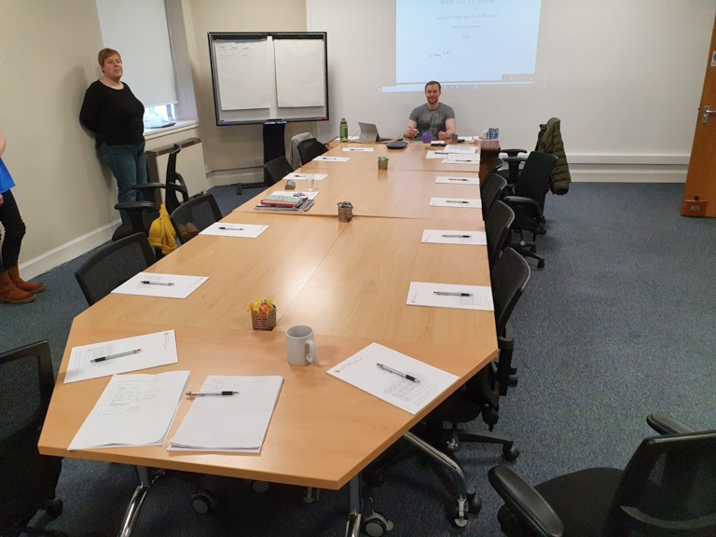

What did we do?
Our setup – F2F
Microsoft Surface connected to projector
Pre-prepared slides with blank space for handwritten annotations
Conferencing mic/speaker (kindly loaned by OU in Scotland)
Caption: A photo of the face-to-face student’s perspective

Slide 10
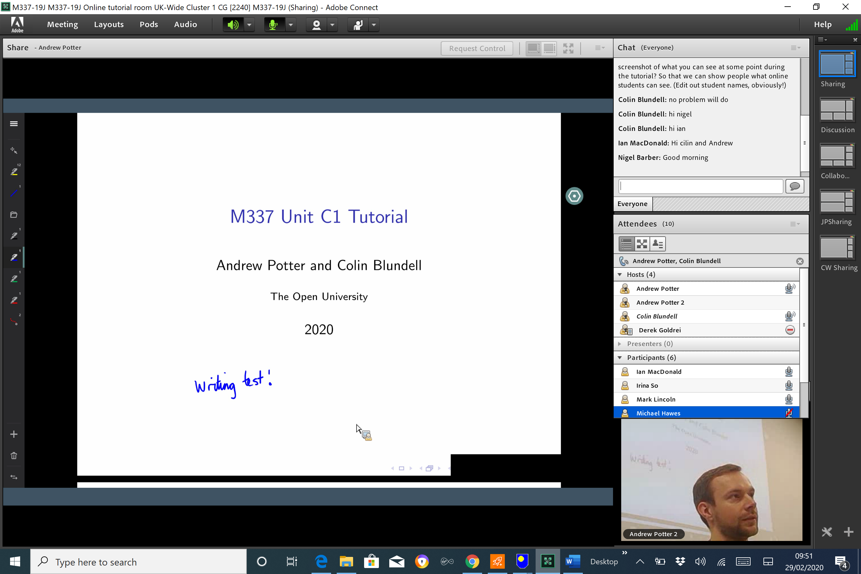
What did we do?
Our setup – online
Microsoft Surface logged into Adobe Connect
Screen-sharing to PDF annotation program
Second laptop set up to monitor chat (2nd tutorial)
Caption: A screenshot of the blended tutorial from an online student’s perspective.

Slide 11
How did we evaluate our project?
Methodology, results, and discussion

Slide 12
How did we evaluate this?
Methodology
Our own reflections
Planning, anticipation, testing…
Reflection, discussion, evaluation…
Tutorial observations
Each tutorial observed by a different experienced tutor
Student interviews
Semi-structured phone interviews
Variety of student experiences: online, face-to-face, recording

Slide 13
How did we evaluate this?
Thematic Analysis – findings
Two different worlds
Two very different experiences for students – but not much difference from what they expect from that medium.
Capture of informal chatter seen as a positive.
Pedagogy
Tutor-led approach – students reluctant to “derail” the flow.
Pacing slower than normal?
Audio communication
Talking over one another, audio lag, limited by scale.
Accessibility issues – can’t hear when facing away from mic.

Slide 14
How did we evaluate this?
Thematic Analysis – findings
Visual communication
Lack of visual cues; webcam didn’t add much.
Screen space at a premium; shared screen key for mathematics.
Can’t see face-to-face space; reluctance to be filmed.
Text chat
Can’t type question quickly enough.
Face-to-face attendees can’t see the text chat.
Organisational challenges
Quantity of tutorials; student awareness of resourcing issues.
Preserve as many face-to-face opportunities as possible.

Slide 15
Recommendations
What we’ve learned

Slide 16
Recommendations
What we’ve learned
Don’t expect experiences to be equivalent. Make this clear to students – let them know they can bring along a laptop if they wish to see text chat.
Plan around pedagogy, not around technology.
Have a backup plan for tech failures – but bear in mind that students are used to it!
Keep accessibility in mind – especially audio and visual.
Blended environments are a bit weird – let students have a chance to settle in. Chat informally, talk about the weather, allow breaks.

Slide 17
THANK YOU
Questions? Comments? Future directions?
Andrew.Potter@open.ac.uk
Reference
Bower, M., Dalgarno, B., Kennedy, G. E., Lee, M. J. W., Kenney, J. (2015) ‘Design and implementation factors in blended synchronous learning environments: Outcomes from a cross-case analysis’, Computers & Education, 86, pp.1—17.

