Slide 1
Confidence-building assessment for Level 1 Computing and IT students
Paul Piwek
School of Computing and Communications
STEM Faculty

Slide 2
The context
TM112: Introduction to computing and information technology 2
OU Level: 1
Credits: 30
Students: ~2500 per year
Presentations: 21 weeks D and J (18D, 18J, 19D)
Follows on from TM111
Part of Computing and IT qualifications, Degree apprenticeship, Data Science qualification, Optional: combined STEM, Design and Innovation, …

Slide 3
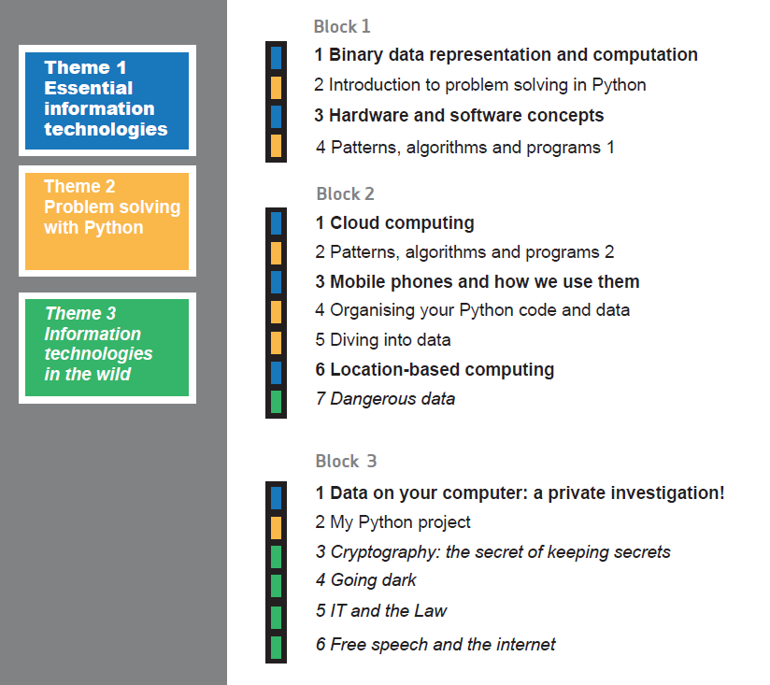
The context

Slide 4
The problem
Genuinely formative assessment that is taken seriously
Learning to program, especially in a text-based programming language, is often viewed as difficult by students and consequently students can easily lose motivation (Jenkins, 2002; Chetwynd & Dobbyn 2014).
Jenkins (2002) recommends avoiding summative (continuous) assessment in programming courses early on, in order to ease pressure on students.
One could try low-stakes summative assessment. But that may still generate pressure, since performance still determines pass or fail.
Assessment with thresholds and no limit on the number of attempts can address this. But (even good) students can still fail, if they don’t engage.
Grading or thresholds mean that students cannot discuss questions and solutions with each other: it forecloses opportunities for peer support.
But grades/thresholds do incentivise engagement.

Slide 5
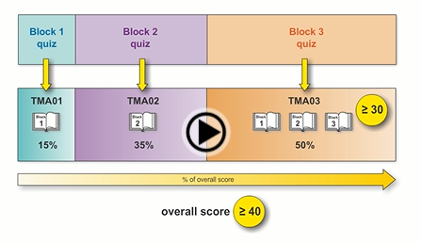
The approach
Notes:
About one hour per week for questions
Block 1: 18 questions
Block 2: 34 questions
Block 3: 19 questions

Slide 6
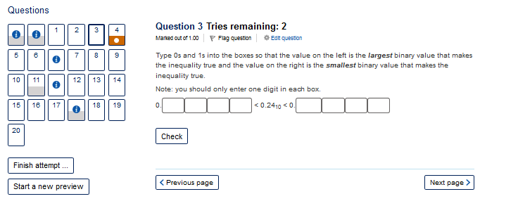

Slide 7
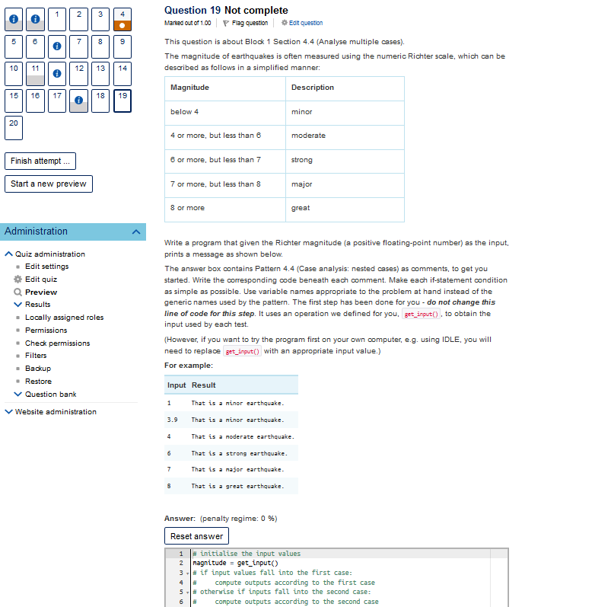

Slide 8
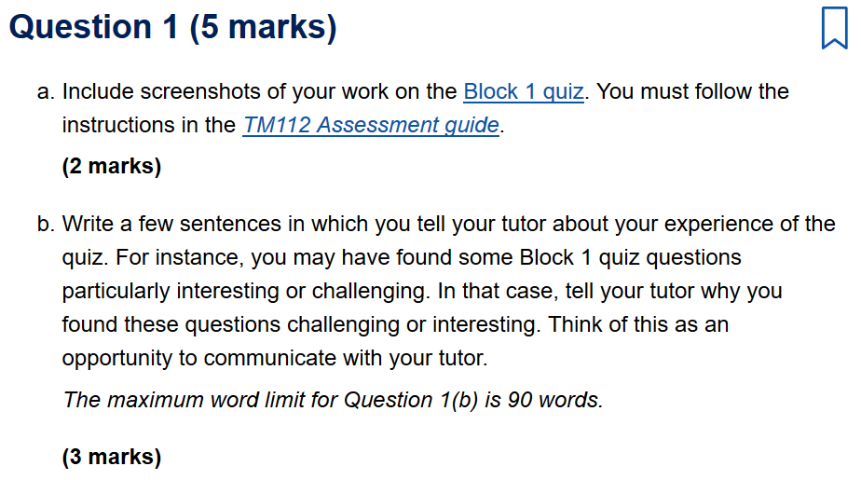
The approach
Rewarding quiz engagement and reflection via the TMAs

Slide 9
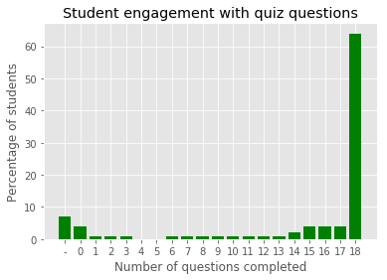
Results
Engagement with Block 1 quiz (18D)
Relative to
Reg 25
(fee liability)
for 18D at
~1500 students
TM112: 89%
TM111: 77%

Slide 10
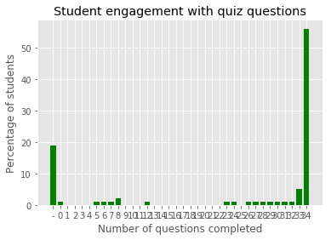
Results
Engagement with Block 2 quiz (18D)
TM112: 80%
TM111: 73%

Slide 11
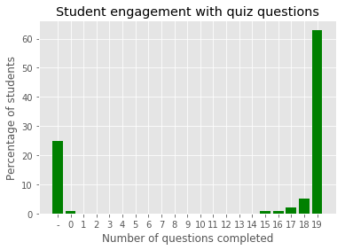
Results
Engagement with Block 3 quiz (18D)
TM112: 74%
TM111: 69%

Slide 12
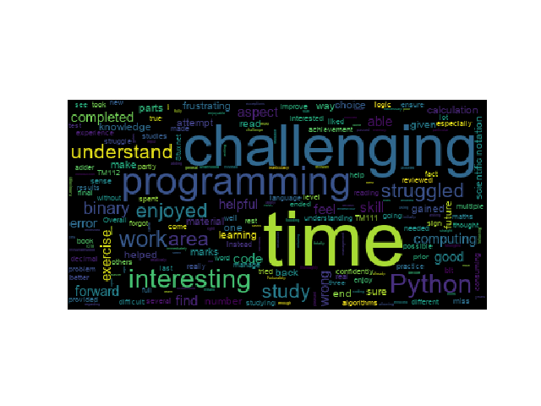
Results
Student to tutor reflection in the TMAs (18D)

Slide 13
Results
Student Experience on a Module (SEaM) survey
KPIS | Module reviewed TM112 18D % | Comparator module TM111 18D %
q21:I was satisfied with the quality of the module. | 90.2 (neither agree nor disagree: 5.4) | 88.2 (neither agree nor disagree: 7.9)
q23:My studies have helped me develop my self-confidence. | 79.7 (neither agree nor disagree: 16.8) | 78.1 (neither agree nor disagree: 19.2)

Slide 14
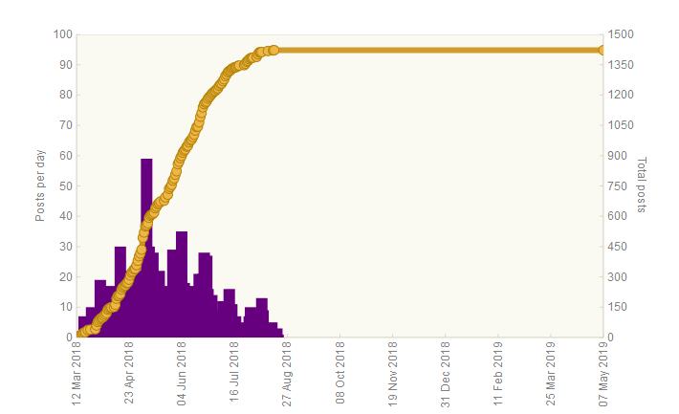

Results
Forum postings – Python (18D)
TM112 reg25: ~1500 students
TM111 reg25: ~1700 students
TM112 Python: 1422
Beyond TM112: 192
TM111 18D: 700
(Tech Help)
Notes:
10 May – TMA 01
12 July – TMA 02
13 Sept – TMA 03

Slide 15
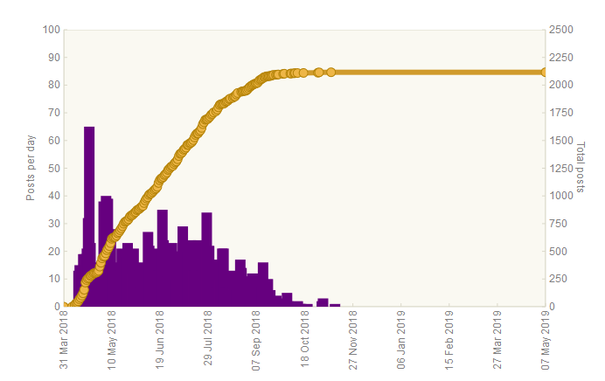
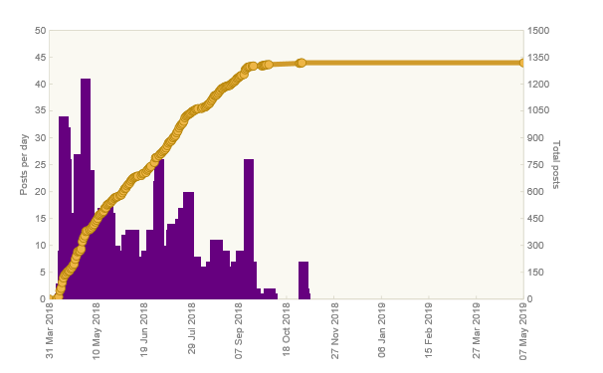
Results
Forum posting – Module discussion (18D)
TM112: 2116
TM111 18D: 1319

Slide 16
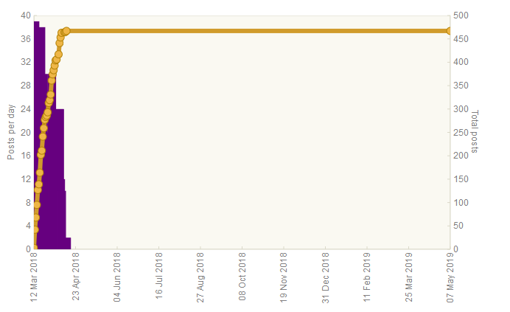
Results
Forum postings – Early bird (18D)
Total: 467
TM111 18D: 676

Slide 17
Conclusions
An approach to formative assessment without thresholds but with an incentive to engage and reflect via the TMA.
Engagement is good along several dimensions.
Follow-up projects: study of the forum discussions (Institute of Coding) and student co-design of quizzes (eSTEeM) with Simon Savage.
Acknowledgments: TM112 module team, staff tutors, tutors and students. In particular, discussions with: Karen Kear, Sharon Dawes, Andrew Smith, Paul Johnson, Marina Carter, Elaine Thomas and the TM112 module forum moderators: Kate Sim, Richard Walker, Sharon Dawes and Shaun Harley.
Thank you for your
Attention!

