Slide 1

Specialist Recruitment
Past, Present and Future
Phil Hackett, David McDade & Anthony Johnston
Computing & Communications
18th March 2025

Slide 2
This Session
Specialist recruitment activities – past, present and future
Recruiting to Cyber Security modules (TM256 & TM359) – 10 mins
Bespoke CPD – 5 mins
School of C&C CPD Dashboard – 5 mins
Questions – 5/10 mins
Notes:
Introductions
Briefly mention what is coming up in this talk
In the past - Cyber Security modules
Present – providing ask to tutor produced CPD
Future – Mix of vendor CPD alongside bespoke CPD
I’ll hand over to David and Anthony to chat about the work done to support recruitment to our Cyber Security, R60, modules…

Slide 3

To Evaluate the Effectiveness of Focused Staff Training
in Recruitment on Specialised Modules
Project team:
Phil Hackett: (phil.hackett@open.ac.uk)
Anthony Johnston: (anthony.johnston@open.ac.uk)
David McDade (Project lead)
(david.mcdade@open.ac.uk)
March 2024

Slide 4
Introduction
This presentation outlines the work of an eSTEeM project over the past two years (completed Sept 2024).
The project has been examining the impact of offering focused training to support the delivery of specialist (new) curriculum areas within Computing & Communications.
The R60 Cyber Security qualification contains two brand new modules that required tutors with specialist skills.

Slide 5
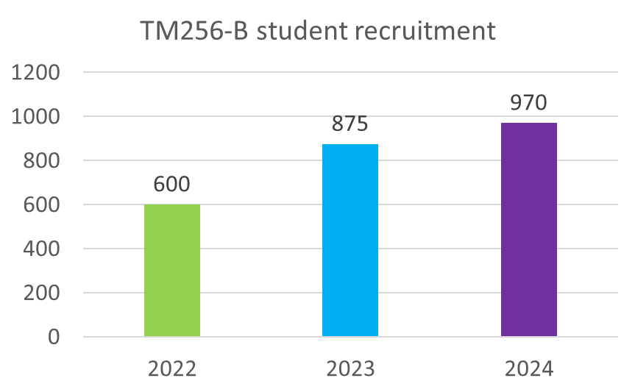
Background to the project
Over recent years, the ‘skills gap’ within the UK and global cyber security workforce has remained an area of concern
As of 2023, DSIT reports that around 50% of business still have a skills gap. Only 2% of cyber graduates go on to become HE teaching professionals
Updates to curriculum within C&C highlighted issues around skills gaps within the school and potential impact on tutor (and student) recruitment
The popularity of TM256

Slide 6
Questions:
To what extent is focused staff training effective in the recruitment of tutors for specialised modules at levels 2 and 3?
What approaches are required to upskill tutors to successfully tutor in specialist curriculum areas?
What resources are required to upskill tutors to successfully tutor in specialist curriculum areas?

Slide 7
Developing the workforce
Curriculum mapping activity and development of module specifications for R60 identified risks associated with the lack of cyber specialisms in the AL community
A good handful of ALs within the school have existing skillset as cyber elements are being delivered on other C&C modules - not enough to meet demand
Two computing vendor awards were offered to ALs interested in teaching on:
  TM256: Cyber Security (Cisco Cybersecurity Essentials)
  TM359: Systems Penetration Testing (Certified Ethical Hacker)

Slide 8
Existing literature
The OU offers staff fee waiver as well as recognition of the importance of staff development (through the Staff Development Policy):
  there does not seem to be any scheme in existence that provides a focused approach to address specific gaps in skills (within STEM/C&C)
Recent studies across Europe and the US identify that focused training to address cyber skills gaps for academics is now critical in HE in the face of global increase in cyber-attacks (more so across Europe)
Recommendations from recent literature mirror approaches taken in this study:
  Self-education and enhanced proficiency through participation in targeted programmes of study

Slide 9
Method
Using Jisc Online Surveys, we gathered quantitative and qualitative data related to the CPD offered
Targeted survey – 110 tutors
Very good participation – 40% responded
Different groups were identified
We used Likert scale questions to ascertain:
How helpful certain aspects of the CPD were? (e.g. Setting a deadline for completion)
How influential certain aspects of the CPD were? (e.g. Sponsorship payment)
Impact on tutor confidence in tutoring certain module topics
We also used free text responses to gather additional detail regarding responses
Notes:
We approached tutors who had participated in either Cyber Essentials CPD or Certified Ethical Hacker CPD.
We also included current TM256 & TM359 tutors who may not have participated in either CPD offer.
Participation was high possibly because the way the survey invitation was framed – it was a chance to have input on the potential future offers of CPD
Groups - We had responses from tutors who had participated in sponsored CPD and non-sponsored CPD. We also had responses from tutors who did not participate in the CPD, but they were current TM256 or TM359 tutors.
The question types gave us a rich set of data – we were able to gain tutor perceptions and confidence in the different blocks within each module (TM256 & TM359).

Slide 10
Results
These results are from the following groups:
Cybersecurity Essentials (TM256) sponsored tutors – 1 day ADC
Cybersecurity Essentials (TM256) non-sponsored tutors
Certified Ethical Hacker (TM359) sponsored tutors – 2 days ADC
Tutors participated in TM256 or TM359 sponsorship rounds or non-sponsored (TM256)
The following key points were identified from 35 responses:
Main influence for completing the CPD
Willing to do CPD in own time (without payment)
Would you have applied to tutor (TM256/TM359) without completing the CPD?
Notes:
Some tutors may have participated in both TM256 & TM359 sponsorship.

Slide 11
Results
Main influence for completing the CPD
Notes:
The single biggest influence is that the CPD provided was module specific and beneficial to tutoring on the respective modules.
The next biggest influence was the vendor – the fact that these are industry recognised CPD from well know vendors.
The fact that sponsorship of 1- or 2-days Additional Duties Contract (ADC) was provided was also influential…although, on the next slide…

Slide 12
Results
Willing to do CPD in own time (without payment)
Notes:
…we also asked tutors if they would be willing to participate in this type of CPD in their own time.
From the 35 respondents, just over half of them received sponsorship. The quality of the materials and potential of official certification, were some of the reasons indicated for completing the CPD.

Slide 13
Results
Would you have applied to tutor (TM256/TM359) without completing the CPD?
Notes:
One of the most important data that we identified is shown here.
We may have struggled to recruit enough tutors without the CPD offering.
We did note that some of the tutors indicating yes, already had some teaching and/or industry experience in the Cyber Security discipline.

Slide 14
Discussion
Why is it difficult to recruit for specialist modules?
  Specialist knowledge required
  External pool of potential candidate can earn more elsewhere
Is it possible to equip existing tutors to teach on specialist modules?
Is there a financial cost in training existing tutors?
Should tutors be paid for training that will help them gain more work?

Slide 15
Conclusion
It is difficult to recruit for specialist modules
Focused Staff Training can be effective in helping tutors:
  Developing in confidence to apply for specialist modules
  Feel equipped to teach on specialist modules
Training linked to industry-recognised qualifications
Tutors may be willing to undertake such training in their own time

Slide 16
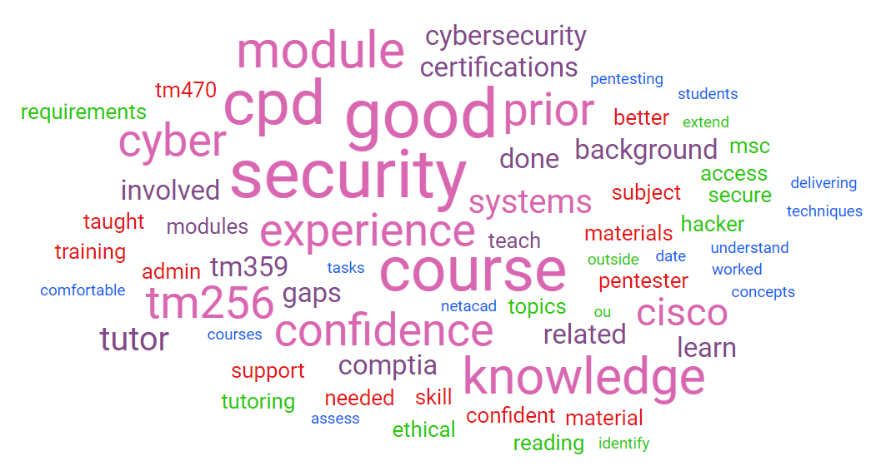
Survey comments
Survey comments word cloud

Slide 17
Intro Slide Title 3
Tutor recruitment & retention on M269

Slide 18
Slide Title 8
Background
M269 – Algorithms, Data Structures & Computability
M269 has seen student numbers increase steadily and significantly over the past few years…
Notes:
I’ll just give some background information on M269..
We have had a steady increase of student numbers requiring a lot of tutor recruitment – or at least attempts at recruitment.

Slide 19
Slide Title 8
Problem
Recruitment & Tutor Retention Issues
As well as recruiting additional tutors for the increase in student numbers, we also needed to replace tutors who had reduced workload, resigned or retired.
We were reaching saturation point with double and ‘large’ tutor groups.
Notes:
Historically, recruitment of new tutors is difficult since it requires significant amount programming skills, mathematical understanding (Big-O notation) and knowledge of computational theory (P vs NP) – tractable and intractable problems.
Historically, tutor numbers appeared to be quite stable – there didn’t seem to be an obvious issue although I do not have the figures prior to 2020.
There were a number of changes on the horizon…
AL Contract – so a round of ALVS
As previously mentioned, the number of students increased, however we also had a number of workload reductions, resignations and retirements.
Prior to start of 21J we lost 9 tutor groups
Prior to start of 22J we lost 16 tutor groups
Prior to start of 23J we lost 13 tutor groups
Some of these were tutors who had double or triple groups – we were told that we are not allowed triple groups under the new contract.
I proposed a project to address the retention (and recruitment) issue – develop a package of CPD to support M269 tutors.

Slide 20
Slide Title 8
Opportunity
Developing a package of CPD
In early 2023, an opportunity arose to address the tutor recruitment & retention issue – funding was provided to support recruitment.
Building on the work done with recruiting tutors to specialist Cyber modules
Opportunity to do something similar, however…there was no existing CPD material
This led to the production of a bespoke, tutor created package of CPD including…
11 hours of video covering each weekly topic
Bank of iCMA quiz questions
Production of materials involved 7 existing M269 tutors
Notes:
A previous C&C initiative provided vendor specific courseware to tutors prior to them applying to tutor on TM256 and TM359.
I was presented with an opportunity to develop the pool of potential M269 tutors as well as support existing tutors in a similar way, however there was no existing vendor specific materials other than the module itself.
The videos, created by 7 different M269 tutors, are 30-60 minute videos summarising each topic in enough detail to become reasonably familiar.
The iCMAs are practice questions to give real examples of the theory.
Thank you very much to those tutors who were involved in the production of these materials – I think some of them are here.

Slide 21
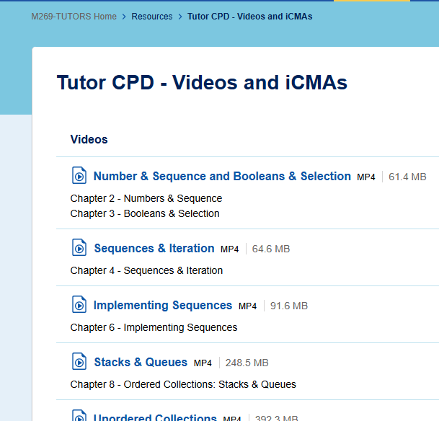
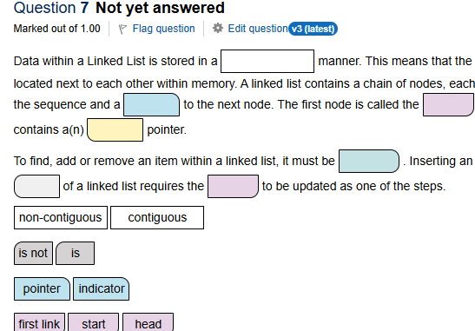
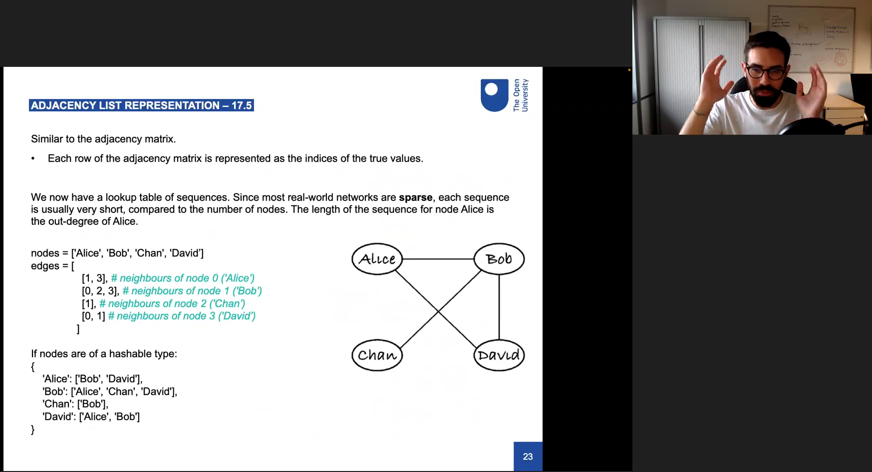
Slide Title 8
M269 CPD
Developing a package of CPD
Videos & Quizzes (iCMAs) located on M269 tutors website
Used by newly appointed 23J tutors
However, there were limitations
Notes:
Unfortunately, these resources were only accessible to existing tutors, so newly appointed tutors could access them, but not potential M269 tutors.
A tutor could not automatically keep track of where they were up to.
There was no recognition of watching the videos and completing the quizzes.

Slide 22
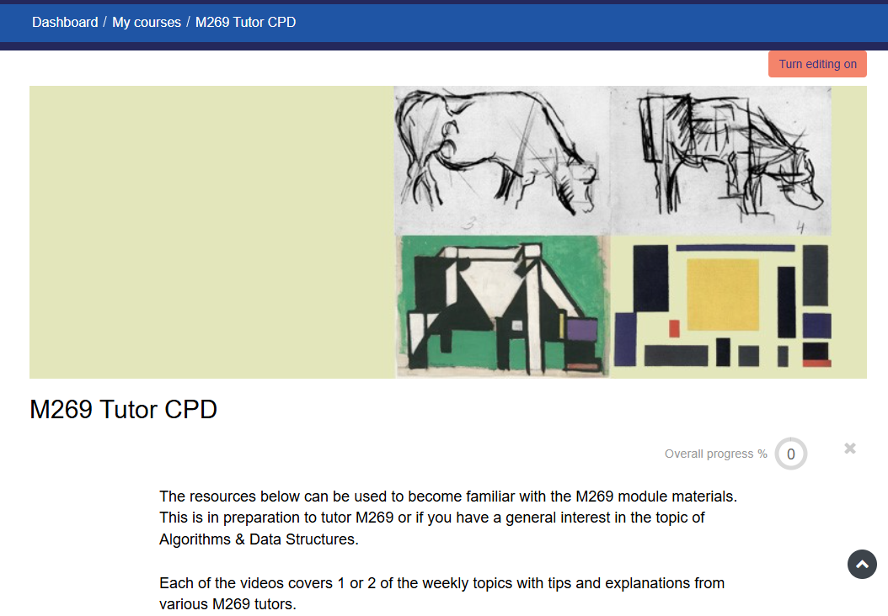
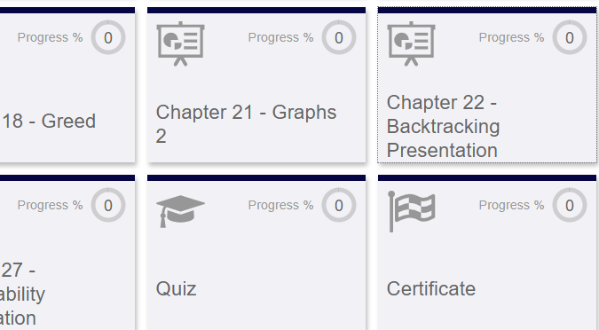
Slide Title 8
M269 CPD – The Learning Centre
Developing a package of CPD – available to all
Moved all resources to ‘The Learning Centre’
Allows auto tracking of watched videos
Produces a certification of completion
https://thelearningcentre.learningpool.com/course/view.php?id=6601
Notes:
https://thelearningcentre.learningpool.com/course/view.php?id=6601
This experience of offering vendor specific and bespoke CPD has led to the development of the following resources for tutors who are wanting to upskill for academic currency, professional development or personal development.

Slide 23
Intro Slide Title 3
C&C CPD Dashboard

Slide 24
Slide Title 8
C&C CPD Dashboard
Offering a range of CPD – available to all
In collaboration with numerous colleagues, we developed…
Self-paced industry recognised CPD (Networking, Cyber, Programming, AI)
Bespoke CPD
Current plans…
More bespoke CPD - module-specific & discipline areas
Signposting additional CPD (e.g. IBM SkillsBuild)
https://thelearningcentre.learningpool.com/totara/dashboard/index.php?id=189
Notes:
https://thelearningcentre.learningpool.com/totara/dashboard/index.php?id=189
The Cisco links will all self-enrolment at any time. The courses include certificates of completion. Thank you to Andrew Smith & the OU Cisco academy team for facilitating this.
The Amazon AWS courses will require manual enrolment currently – there will be a sign-up form to participate. Thank you to Amel Bannaceur for facilitating access to AWS.
As well as the existing M269 CPD, we are developing plans to produce CPD for specific modules (perhaps for the new AI curriculum) and discipline areas such as post-graduate tutoring or project supervision…

Slide 25

Slide Title 8
https://thelearningcentre.learningpool.com/totara/dashboard/index.php?id=189

Slide 26
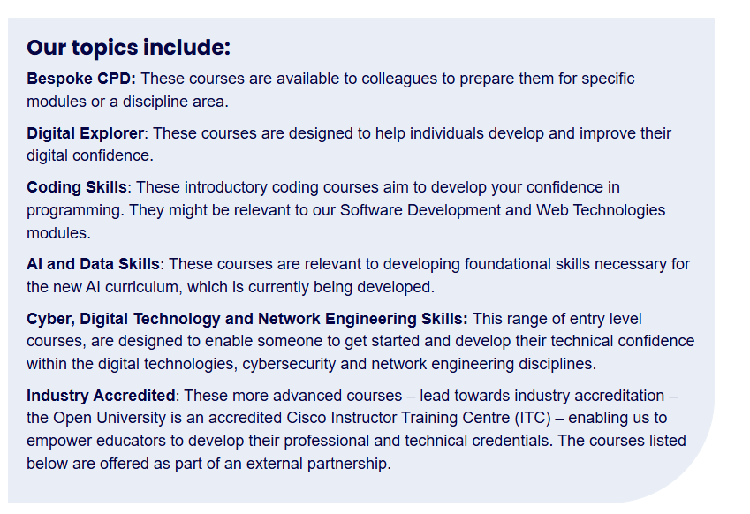
Slide Title 8
C&C CPD Dashboard

Slide 27
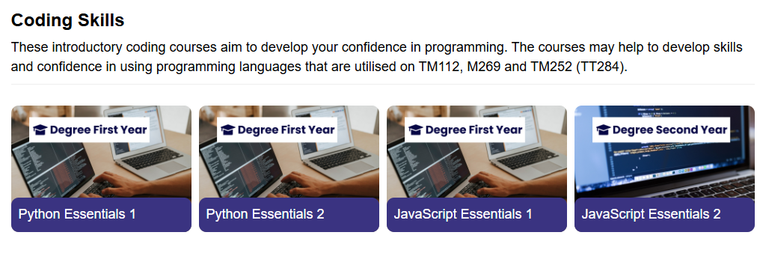
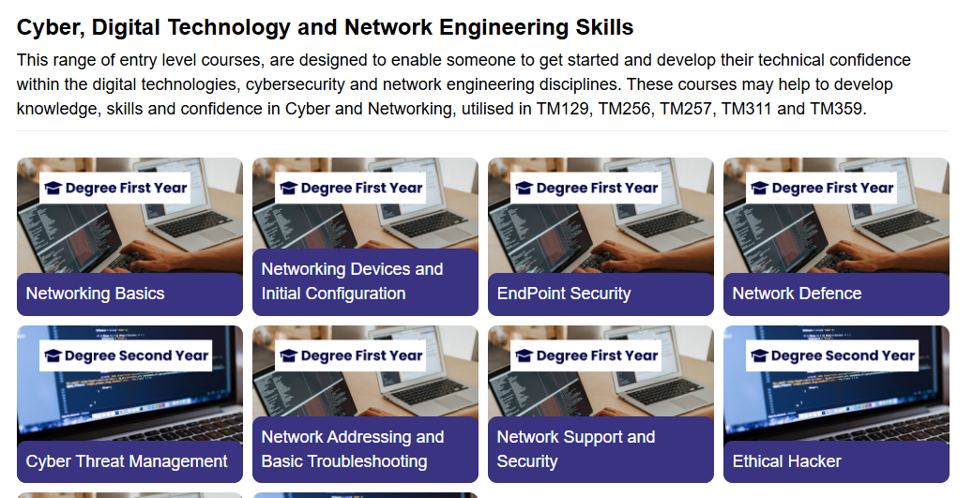
Slide Title 8
C&C CPD Dashboard
Notes:
The CPD dashboard is the result of the evaluation that we have done regarding our specialist recruitment activities over the past few years.

Slide 28
Intro Slide Title 3
Any Questions?

Slide 29
Slide Title 31

