Slide 1


To Evaluate the Effectiveness of Focused Staff Training in Recruitment on Specialised Modules: Past, Present and Future
Project team:
Phil Hackett: (phil.hackett@open.ac.uk)
Anthony Johnston: (anthony.johnston@open.ac.uk)
David McDade (Project lead)
(david.mcdade@open.ac.uk)
November 2025

Slide 2
Introduction
This presentation outlines the work of an eSTEeM project carried out between 2022 and 2024.
The project led to further work on recruitment.
The project examined the impact of offering focused training to support the delivery of specialist (new) curriculum areas within the School of Computing & Communications.
The R60 Cyber Security qualification contains two brand new modules that required tutors with specialist skills.

Slide 3
Background to the project (figures updated for 2025)
Over recent years, the ‘skills gap’ within the UK and global cyber security workforce has remained an area of concern
As of 2025, DSIT reports that around 49% of business struggle with basic cyber tasks (setting up firewalls).
In 2022 only 2% of cyber graduates went on to become HE teaching professionals
Updates to curriculum within C&C highlighted issues around skills gaps within the school and potential impact on tutor (and student) recruitment
The popularity of TM256 (Cybersecurity)
Notes:
DSIT: Department of Science, Innovation and Technology

Slide 4
Developing the workforce – focussed staff training
Although some tutors within the school have existing skillsets as cyber elements are being delivered on other C&C modules – there was not enough to meet demand
Two computing vendor awards were offered to ALs interested in teaching on:
TM256: Cyber Security (Cisco Cybersecurity Essentials)
TM359: Systems Penetration Testing (Certified Ethical Hacker)

Slide 5
eSTEeM project questions :
To what extent is focused staff training effective in the recruitment of tutors for specialised modules at levels 2 and 3?
What approaches are required to upskill tutors to successfully tutor in specialist curriculum areas?
What resources are required to upskill tutors to successfully tutor in specialist curriculum areas?

Slide 6
Existing literature and background
The OU offers staff fee waiver as well as recognition of the importance of staff development (through the Staff Development Policy):
Recent studies across Europe and the US identify that focused training to address cyber skills gaps for academics is now critical in HE in the face of global increase in cyber-attacks (more so across Europe)
Recommendations from recent literature mirror approaches taken in this study:
Self-education and enhanced proficiency through participation in targeted programmes of study

Slide 7
Method
Once the training (CPD) was completed:
Used Jisc Online Surveys, gathering quantitative and qualitative data related to the CPD offered
Targeted survey – 110 tutors
Very good participation – 40% responded
Different groups were identified
We used Likert scale questions to ascertain:
How helpful certain aspects of the CPD were? (e.g. Setting a deadline for completion)
How influential certain aspects of the CPD were? (e.g. Sponsorship payment)
Impact on tutor confidence in tutoring certain module topics
We also used free text responses to gather additional detail regarding responses
Notes:
We approached tutors who had participated in either Cyber Essentials CPD or Certified Ethical Hacker CPD.
We also included current TM256 & TM359 tutors who may not have participated in either CPD offer.
Participation was high possibly because the way the survey invitation was framed – it was a chance to have input on the potential future offers of CPD
Groups - We had responses from tutors who had participated in sponsored CPD and non-sponsored CPD. We also had responses from tutors who did not participate in the CPD, but they were current TM256 or TM359 tutors.
The question types gave us a rich set of data – we were able to gain tutor perceptions and confidence in the different blocks within each module (TM256 & TM359).

Slide 8
Results
The results are from the following groups:
Cybersecurity Essentials (TM256) sponsored tutors – 1 day ADC (additional duty contract)
Cybersecurity Essentials (TM256) non-sponsored tutors
Certified Ethical Hacker (TM359) sponsored tutors – 2 days ADC
Tutors participated in TM256 or TM359 sponsorship rounds or non-sponsored (TM256)
The following key points were identified from 35 responses:
Main influence for completing the CPD
Willing to do CPD in own time (without payment)
Would you have applied to tutor (TM256/TM359) without completing the CPD?
Notes:
Some tutors may have participated in both TM256 & TM359 sponsorship.

Slide 9
Results
Main influence for completing the CPD
Notes:
The single biggest influence is that the CPD provided was module specific and beneficial to tutoring on the respective modules.
The next biggest influence was the vendor – the fact that these are industry recognised CPD from well know vendors.
The fact that sponsorship of 1- or 2-days Additional Duties Contract (ADC) was provided was also influential…although, on the next slide…

Slide 10
Results
Willing to do CPD in own time (without payment)
Notes:
…we also asked tutors if they would be willing to participate in this type of CPD in their own time.
From the 35 respondents, just over half of them received sponsorship. The quality of the materials and potential of official certification, were some of the reasons indicated for completing the CPD.

Slide 11
Results
Would you have applied to tutor (TM256/TM359) without completing the CPD?
Notes:
One of the most important data that we identified is shown here.
We may have struggled to recruit enough tutors without the CPD offering.
We did note that some of the tutors indicating yes, already had some teaching and/or industry experience in the Cyber Security discipline.

Slide 12
Conclusions
It is difficult to recruit for specialist modules
Specialist knowledge required
External pool of potential candidate can earn more elsewhere
Focused Staff Training can be effective in helping tutors:
Developing in confidence to apply for specialist modules
Feel equipped to teach on specialist modules
Training linked to industry-recognised qualifications
Tutors may be willing to undertake such training in their own time
The financial cost in training existing tutors

Slide 13
Intro Slide Title 3
Tutor recruitment & retention in other specialist areas

Slide 14
Slide Title 8
Opportunity
Developing a package of CPD
In early 2023, an opportunity arose to address the tutor recruitment & retention issue for M269 (algorithms module) – funding was provided to support this.
Building on the work done with recruiting tutors to specialist Cyber modules
It was an opportunity to do something similar, however…there was no existing CPD material (like the Cisco or EC-Council materials)
This led to the production of a bespoke, tutor created package of CPD including…
11 hours of video covering each weekly topic
Bank of iCMA quiz questions
Production of materials involved 7 existing M269 tutors
Notes:
Building on the experience with the Cyber modules, we wanted to develop the confidence of tutors, so they would apply to tutor on the module.
I was presented with an opportunity to develop the pool of potential M269 tutors as well as support existing tutors in a similar way, however there was no existing vendor specific materials other than the module itself.
The videos, created by 7 different M269 tutors, are 30-60 minute videos summarising each topic in enough detail to become reasonably familiar.
The iCMAs are practice questions to give real examples of the theory.

Slide 15

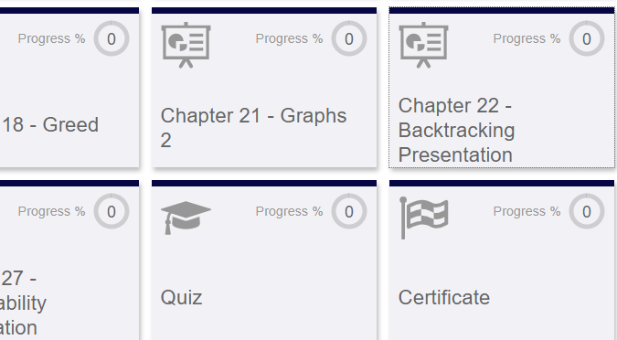
Slide Title 8
M269 CPD – The Learning Centre
Developing a package of CPD – available to all OU tutors
All resources located on ‘The Learning Centre’
Allows auto tracking of watched videos
Produces a certification of completion (Similar to Cisco CPD)
https://thelearningcentre.learningpool.com/course/view.php?id=6601
Notes:
https://thelearningcentre.learningpool.com/course/view.php?id=6601
The Learning Centre contains our mandatory and compliance training as well as other development courses
This experience of offering vendor specific and bespoke CPD has led to the development of the following resources for tutors who are wanting to upskill for academic currency, professional development or personal development.

Slide 16
Slide Title 8
C&C CPD Dashboard
Offering a range of CPD – available to all
In collaboration with numerous colleagues, and building on the work done since 2022, we developed:
A single platform to allow tutors to upskill in different subject areas, including…
Self-paced industry recognised CPD (Networking, Cyber, Programming, AI)
Bespoke CPD (module specific)
This is an ever-evolving resource that is needed to prepare for new curriculum areas (Artificial Intelligence and digital apprenticeships)
Signposting additional CPD (e.g. IBM SkillsBuild)
https://thelearningcentre.learningpool.com/totara/dashboard/index.php?id=189
Notes:
https://thelearningcentre.learningpool.com/totara/dashboard/index.php?id=189
The Cisco links will all self-enrolment at any time. The courses include certificates of completion. Thank you to Andrew Smith & the OU Cisco academy team for facilitating this.
The Amazon AWS courses will require manual enrolment currently – there will be a sign-up form to participate. Thank you to Amel Bannaceur for facilitating access to AWS.
As well as the existing M269 CPD, we are developing plans to produce CPD for specific modules (perhaps for the new AI curriculum) and discipline areas such as post-graduate tutoring or project supervision…

Slide 17

Slide Title 8
https://thelearningcentre.learningpool.com/totara/dashboard/index.php?id=189

Slide 18
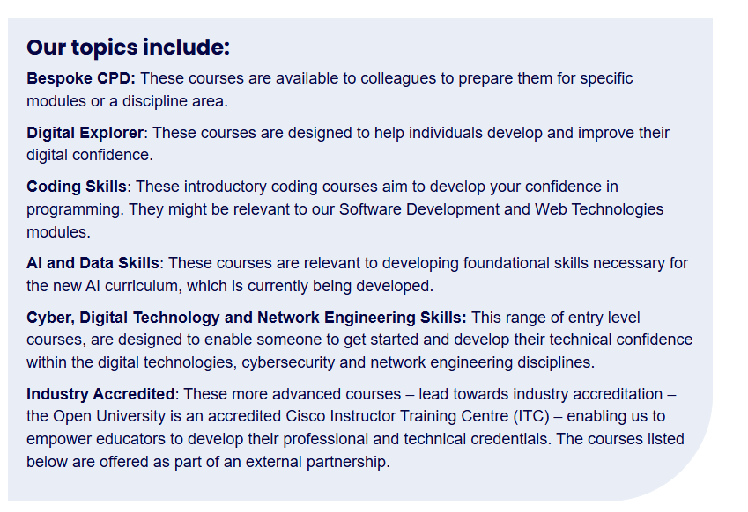
Slide Title 8
C&C CPD Dashboard

Slide 19
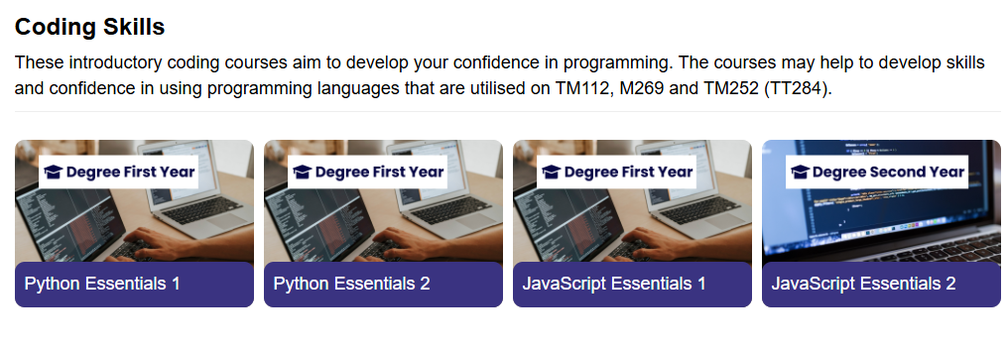
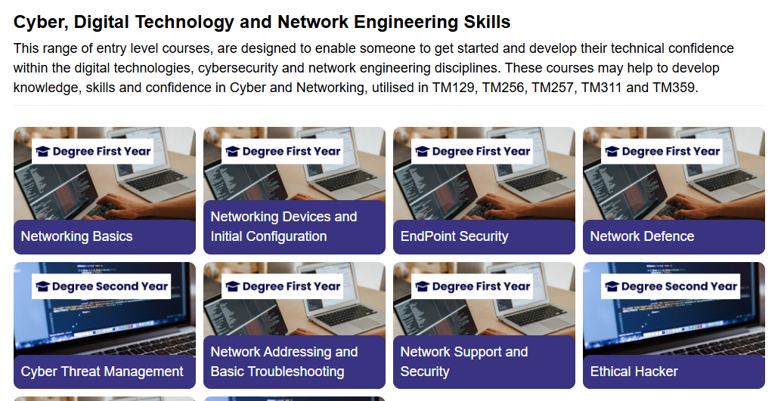
Slide Title 8
C&C CPD Dashboard
Notes:
The CPD dashboard is the result of the evaluation that we have done regarding our specialist recruitment activities over the past few years.

Slide 20
Intro Slide Title 3
Any Questions?

Slide 21
Slide Title 31

