Slide 1
Perceptions of Tuition: Implications for Module Tuition Strategies
Ann Walshe
School of Computing and Communications

Slide 2
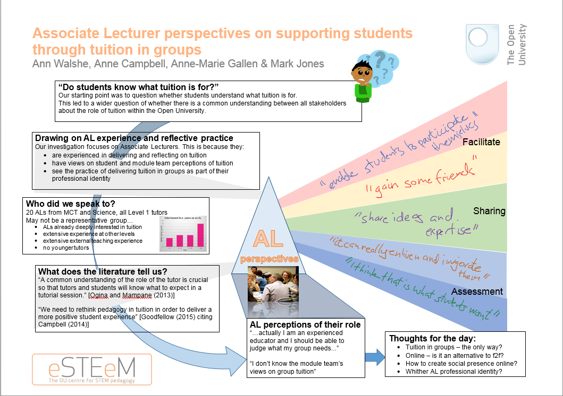
Notes:
The team carried out an eSTEeM project to examine perceptions of tuition in the OU. We started looking at tuition when the new Group Tuition Policy was being introduced, and eSTEeM put out a call for group tuition related projects. At the time we were unclear what group tuition meant. We decided it meant tuition of groups, that is provision of group tutorials, which is what the OU has been doing since its inception.
The first phase of the project examined tutor perspectives. This is our prize-winning poster summarising the findings. I will talk in greater detail about the various sections.
The literature tells us that a common understanding of the role of the tutor is crucial.
The thoughts for the day which we presented over a year ago are even more relevant in the context of the recently announced OU Redesign.

Slide 3
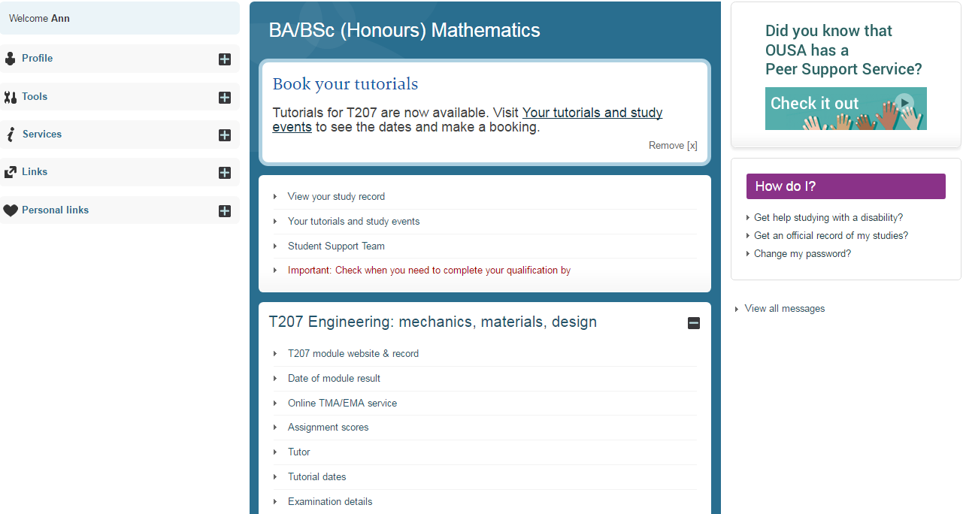
Do students know what tuition is for?
Notes:
How do students know what tuition is for? Do they know what it is for? Does the OU tell them what it is for?
This is a screenshot of my StudentHome page. At the top centre of the page I am invited to book my tutorials. If I view my tutorials and study events …..

Slide 4
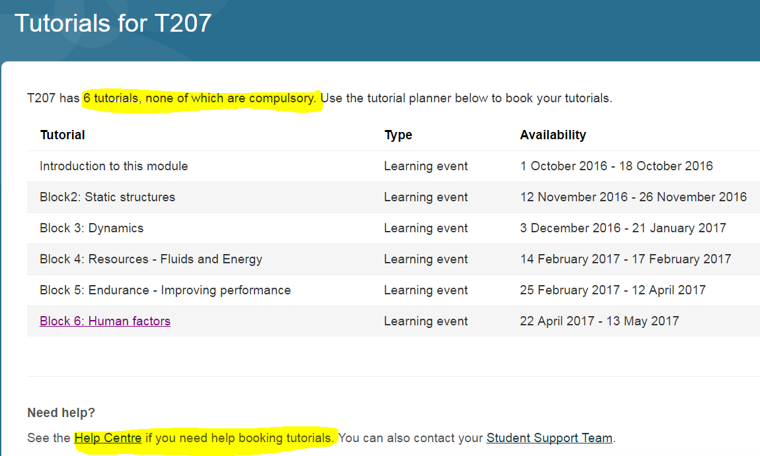
Do students know what tuition is for?
Notes:
I see a list. The first thing I notice is that tutorials are not compulsory. I also notice I can see the help centre …. I click on Help Centre ….

Slide 5
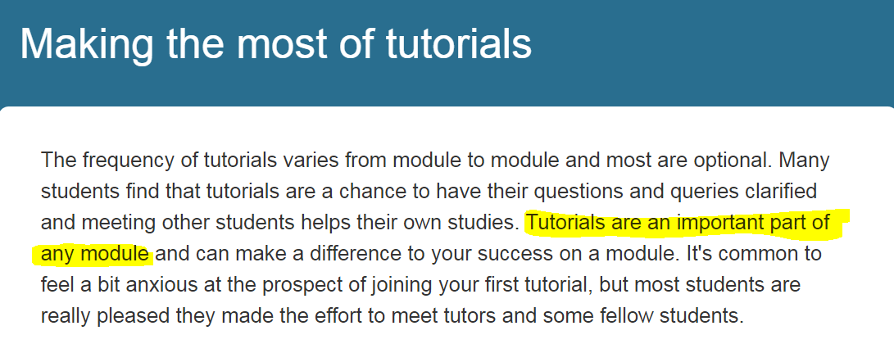
Do students know what tuition is for?
Notes:
I have searched the Help Centre to find out more about tutorials and I find this. Why are tutorials optional yet at the same time they are an important part of any module?
Why are they important? Does this description say enough to convince students that attending tutorials will benefit them?

Slide 6
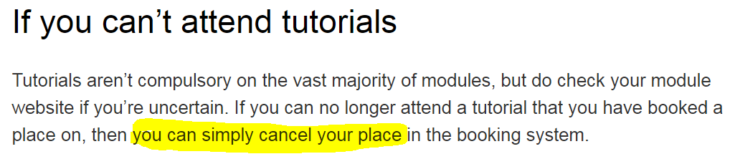
Do students know what tuition is for?
Notes:
Worse still … what if you can’t attend tutorials?
You can simply cancel your place.
What message is this giving to students?
Has the OU told students what tuition is for? Do we know ourselves what tuition is for?

Slide 7
What does OU Scholarship tell us?
MCT Tuition Review 2012 suggested:
  Module teams should communicate with each other and with staff tutors to ensure consistency in the development and implementation of tuition strategies.
  Module teams should create tuition resources.
  The tutor-student relationship should be retained while concentrating resource on national forums.
Notes:
In response to the changes in the HE environment following the Browne report (2010) the OU carried out a tuition review.
Workshops in our faculty (MCT Tuition Review 2012) elicited these suggestions about group tuition.
Browne (2010) `Securing a sustainable future for higher education: an independent review of higher education funding and student finance [Browne report]' Available at https://www.gov.uk/government/publications/the-browne-report-higher-education-funding-and-student-finance (Accessed February 2016)
MCT Tuition Review (2012) `Final MCT Tuition Review Report (March 2012)', Available at http://learn.open.ac.uk/course/view.php?id=7697\m=3 (Accessed 21 June 2017)

Slide 8
What does OU Scholarship tell us?
Pat Atkins (2013) summarised existing OU research into tuition:
  Positives and concerns around clustering and loosening the tutor-student relationship
  Low tutorial attendance is a concern
  Link between tutorial attendance and retention and attainment? - inconclusive
  Tutorials need a clear purpose
  What is that purpose? – not explored
Notes:
Atkins, Pat (2013) `Existing Research into Tuition in the OU – October 2013 updated version of July 2013 paper' Available at https://intranet9.open.ac.uk/collaboration/ScholarshipExchange/Wiki/Document.aspx?DocumentID=921 (Accessed January 2016)

Slide 9
What does OU Scholarship tell us?
Robin Goodfellow (2014) found:
  Students agreed that tutorials helped them to understand module concepts
  Students perceived benefits of tutorials to be
      interaction with tutor and other students
      motivation
Notes:
Goodfellow, Robin (2014) `Students' attitudes to Face-to-face and Online (Elluminate) Tutorials: 2012J Tutorials Survey – report on findings', Available on the OU Scholarship platform at https://intranet9.open.ac.uk/collaboration/Scholarship-Exchange/documents/Results\%20of\%20Tutorials\%20Survey\%202013.docx (Accessed 28 September 2015 – no longer at this link)
See scholarship exchange at https://intranet9.open.ac.uk/collaboration/Scholarship-Exchange/Wiki/Home.aspx accessed 21 June 2017

Slide 10
Drawing on AL experience and reflective practice
We interviewed ALs and conducted thematic analysis of the transcripts.
ALs have:
Professional identity
Experience
Direct student contact
Judgement
Views on student expectations
Notes:
ALs are professionals and have experience, they are the ones who have direct student contact, and they have perceptions of what students should get out of attending tutorials.
ALs see delivering tutorials as part of their professional identity
ALs are experienced in running and reflecting on their tutorials – there has been a move towards online tuition
ALs use their judgement to choose tutorial content and teaching style
ALs have developed views on student expectations of tutorials – now there is an increased emphasis on student satisfaction

Slide 11
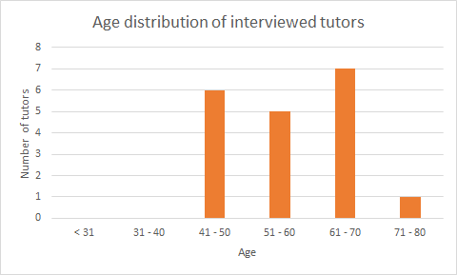
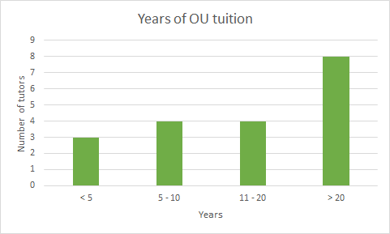
Who did we speak to?
19 OU STEM AL volunteers
Level 1 tutors
Most had experience at higher levels and across disciplines
Most had extensive teaching experience external to OU
Notes:
By asking for volunteers, our interviewees may have had a strong prior interest in tutorials and their purposes, which may have led to bias.
Graphs by Anne Campbell.

Slide 12
AL perceptions of their role
Emerging themes
ALs facilitating learning
… to guide a student through the material rather than to teach them,
Building student confidence and maintaining motivation
...where you are geeing up the whole group, preparing them for what is coming
and giving them some advice and guidance on how to tackle it.
Social interaction/sharing between students
… an opportunity to socialise with each other, gain some friends,
share ideas and expertise and mutually resolve issues.
Helping students to understand threshold concepts
... [students] benefit from the reinforcement of concepts through guided practice.
Notes:
Case study: The perceptions of STEM Tutors on the role of tutorials in distance learning
Authors Anne Campbell, Anne-Marie Gallen, Mark H. Jones, Ann Walshe
Submitted to Journal of Open Learning 2017

Slide 13
AL perceptions of their role
Emerging themes
Developing skills
… maths skills, professional skills
Collaboration/group work
… a huge opportunity for students to learn from one another
Preparation for assessment
… support for assignments because I think that is what the students want.
Challenging students intellectually
...it is about extending learning …, it is about adding another dimension.
Notes:
Case study: The perceptions of STEM Tutors on the role of tutorials in distance learning
Authors Anne Campbell, Anne-Marie Gallen, Mark H. Jones, Ann Walshe
Submitted to Journal of Open Learning 2017

Slide 14
Implications for Module Tuition Strategies
Students are not told the purpose of tutorials or why they are an important part of any module.
Scholarship tells us that tutorials should have a clear purpose.
AL perceptions of the purposes of tutorials are formed through their professional identity, experience and reflective practice
How can we address this at school or module level?
Notes:
Given that at University level, students are not being informed of the benefits of attending tutorials, what can we do at School or Module level? Pause for initial thoughts.
Should we be doing something? If so , then what?
School level – qualification website?
Module level – module tuition strategy, module guide, learning design

Slide 15
Implications for Module Tuition Strategies
Students are not told the purpose of tutorials or why they are an important part of any module.
Scholarship tells us that tutorials should have a clear purpose.
AL perceptions of the purposes of tutorials are formed through their professional identity, experience and reflective practice
How can we address this at school or module level?
Are tutorials an important part of your module?
Notes:
Given that at University level, students are not being informed of the benefits of attending tutorials, what can we do at School or Module level? Pause for initial thoughts.
Should we be doing something? If so , then what?
School level – qualification website?
Module level – module tuition strategy, module guide, learning design

Slide 16
Implications for Module Tuition Strategies
Students are not told the purpose of tutorials or why they are an important part of any module.
Scholarship tells us that tutorials should have a clear purpose.
AL perceptions of the purposes of tutorials are formed through their professional identity, experience and reflective practice
How can we address this at school or module level?
Are tutorials an important part of your module?
Why?
What is their purpose?
Notes:
Given that at University level, students are not being informed of the benefits of attending tutorials, what can we do at School or Module level? Pause for initial thoughts.
Should we be doing something? If so , then what?
School level – qualification website?
Module level – module tuition strategy, module guide, learning design

Slide 17
Implications for Module Tuition Strategies
Students are not told the purpose of tutorials or why they are an important part of any module.
Scholarship tells us that tutorials should have a clear purpose.
AL perceptions of the purposes of tutorials are formed through their professional identity, experience and reflective practice
How can we address this at school or module level?
Are tutorials an important part of your module?
Why?
What is their purpose?
What are the implications for the module tuition strategy?
Notes:
Given that at University level, students are not being informed of the benefits of attending tutorials, what can we do at School or Module level? Pause for initial thoughts.
Should we be doing something? If so , then what?
School level – qualification website?
Module level – module tuition strategy, module guide, learning design

Slide 18
Example module tuition strategy
M250
Element title | Student event description
Introduction to M250 | This is an introductory event, but you will also have the opportunity to overcome any software installation problems, understand the nature of the study you are about to undertake, and where you will need to devote your efforts; also how much effort is required to become a decent programmer. It is very important to note at this stage that programming is a skill. In the same way that you wouldn't expect to give a classical piano concert without hours of practice, you should not expect to be come a good (or even competent) programmer without practice. You should leave this tutorial with some idea of what it will take to pass the module (specifically what the assessment structure is). Please try to attend the tutorial given by your own tutor. You will get more out of this tutorial if you bring questions with you. The content of the tutorial will vary to some extent, depending on when it is run and which students attend the tutorial.
Notes:
Here is a tutorial description from the M250 tuition strategy. A lot of work has gone into writing the description following feedback from the last presentation.. What are the purposes of this tutorial?
Which of these purposes are addressed:
ALs facilitating learning
Building student confidence and maintaining motivation
Social interaction/sharing between students
Helping students to understand threshold concepts
Developing skills
Collaboration/group work
Preparation for assessment
Challenging students intellectually

Slide 19
Example module tuition strategy
M250
Threshold concepts
Collaboration / group work
Social interaction
Element title | Student event description
Introduction to M250 | This is an introductory event, but you will also have the opportunity to overcome any software installation problems, understand the nature of the study you are about to undertake, and where you will need to devote your efforts; also how much effort is required to become a decent programmer. It is very important to note at this stage that programming is a skill. In the same way that you wouldn't expect to give a classical piano concert without hours of practice, you should not expect to be come a good (or even competent) programmer without practice. You should leave this tutorial with some idea of what it will take to pass the module (specifically what the assessment structure is). Please try to attend the tutorial given by your own tutor. You will get more out of this tutorial if you bring questions with you. The content of the tutorial will vary to some extent, depending on when it is run and which students attend the tutorial.
Maintain motivation
Facilitate learning
Build confidence
Preparation for assessment
Develop skills
Challenge students intellectually
Notes:
Here is a tutorial description from the M250 tuition strategy. A lot of work has gone into writing the description following feedback from the last presentation.. What are the purposes of this tutorial?
Which of these purposes are addressed:
ALs facilitating learning
Building student confidence and maintaining motivation
Social interaction/sharing between students
Helping students to understand threshold concepts
Developing skills
Collaboration/group work
Preparation for assessment
Challenging students intellectually

Slide 20
Example module tuition strategy
M250
Element title | Student event description
Coding Lab: Programming with Java | This is an opportunity for you to bring your laptop along (or share with another student) and discuss anything to do with Java, from installation problems, understanding how to use the IDE, understanding what error messages mean right through to more complex coding examples. You will be able to discuss any problems you are having writing code with the tutor. You will get more out of this tutorial if you bring questions with you and have tried the practical exercises in the units. The content of the tutorial will vary to some extent, depending on when it is run and which students attend the tutorial.
Notes:
Here is a tutorial description from the M250 tuition strategy. A lot of work has gone into writing the description following feedback from the last presentation.. What are the purposes of this tutorial?
Which of these purposes are addressed:
ALs facilitating learning
Building student confidence and maintaining motivation
Social interaction/sharing between students
Helping students to understand threshold concepts
Developing skills
Collaboration/group work
Preparation for assessment
Challenging students intellectually

Slide 21
Example module tuition strategy
M250
Threshold concepts
Collaboration / group work
Social interaction
Element title | Student event description
Coding Lab: Programming with Java | This is an opportunity for you to bring your laptop along (or share with another student) and discuss anything to do with Java, from installation problems, understanding how to use the IDE, understanding what error messages mean right through to more complex coding examples. You will be able to discuss any problems you are having writing code with the tutor. You will get more out of this tutorial if you bring questions with you and have tried the practical exercises in the units. The content of the tutorial will vary to some extent, depending on when it is run and which students attend the tutorial.
Maintain motivation
Facilitate learning
Build confidence
Preparation for assessment
Develop skills
Challenge students intellectually
Notes:
Here is a tutorial description from the M250 tuition strategy. A lot of work has gone into writing the description following feedback from the last presentation.. What are the purposes of this tutorial?
Which of these purposes are addressed:
ALs facilitating learning
Building student confidence and maintaining motivation
Social interaction/sharing between students
Helping students to understand threshold concepts
Developing skills
Collaboration/group work
Preparation for assessment
Challenging students intellectually

Slide 22
Example module tuition strategy
TM351
Element title | Student event description
Introduction | Please sign up to the event run by your own tutor if possible. Introduction to the module, guidance and validation of module software installation. The actual content will vary depending on the needs of the students who attend. You will get more out of this session if you bring questions with you.
Notes:
Here is a tutorial description from the TM351 tuition strategy.
What are the purposes of this tutorial?
Which of these purposes are addressed:
ALs facilitating learning
Building student confidence and maintaining motivation
Social interaction/sharing between students
Helping students to understand threshold concepts
Developing skills
Collaboration/group work
Preparation for assessment
Challenging students intellectually

Slide 23
Example module tuition strategy
TM351
Threshold concepts
Collaboration / group work
Social interaction
Element title | Student event description
Introduction | Please sign up to the event run by your own tutor if possible. Introduction to the module, guidance and validation of module software installation. The actual content will vary depending on the needs of the students who attend. You will get more out of this session if you bring questions with you.
Maintain motivation
Facilitate learning
Build confidence
Preparation for assessment
Develop skills
Challenge students intellectually
Notes:
Here is a tutorial description from the TM351 tuition strategy. Does this adequately explain the purpose to the student? How could it be improved?
Do you think that improved description will make a difference to student understanding the benefits and wanting to attend?
What are the purposes of this tutorial?
Which of these purposes are addressed:
ALs facilitating learning
Building student confidence and maintaining motivation
Social interaction/sharing between students
Helping students to understand threshold concepts
Developing skills
Collaboration/group work
Preparation for assessment
Challenging students intellectually

Slide 24
Example module tuition strategy
TM351
Element title | Student event description
TMA01 preparation | To help you prepare for TMA 01. The actual content will vary depending on the needs of the students who attend. You will get more out of this session if you bring questions with you.
Notes:
Here is a tutorial description from the TM351 tuition strategy. How can this description be improved?
What are the purposes of this tutorial?
Which of these purposes are addressed:
ALs facilitating learning
Building student confidence and maintaining motivation
Social interaction/sharing between students
Helping students to understand threshold concepts
Developing skills
Collaboration/group work
Preparation for assessment
Challenging students intellectually

Slide 25
Questions
Who should write the tuition strategy?
When should it be written?
How best to write the tutorial descriptions?
How do we know the purposes will be met?
Can all the purposes be articulated in the description or do ALs address some purposes whatever the description?
How to avoid being too prescriptive and preventing ALs from using their professional judgement?
How to explain to students the benefits of attending tutorials?
Can we make the tutorials more prominent in the module materials or study calendar?
Ways forward?

