Slide 1
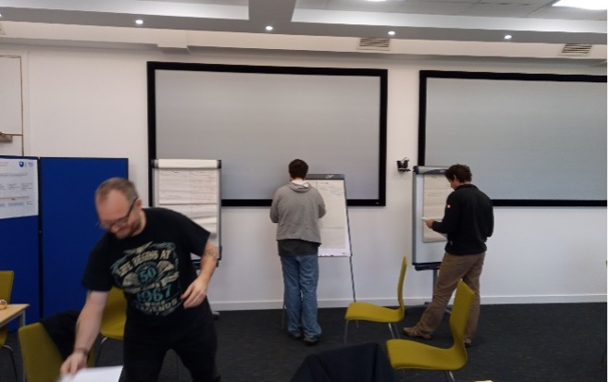
Intro Slide Title 1
Lessons and insights from student co-design of formative assessment
Paul Piwek & Simon Savage
Key students and staff associated with the project: Cameron Watkinson (student), Ian Stockbridge (student), Joel Peyton (student), Michel Wermelinger (staff) and Matthew Nelson (staff)
School of Computing and Communications
21 June, 2023

Slide 2
Context
TM112 – Introduction to Computing and IT 2

Slide 3
Context
TM112 – Introduction to Computing and IT 2
Challenges with Learning to Program and Problem Solve: An Analysis of Student Online Discussions
Institute of Coding project

Slide 4
Context
TM112 – Introduction to Computing and IT 2
Student co-design of confidence-building formative assessment for Level 1 Computing & IT students
eSTEeM project
Challenges with Learning to Program and Problem Solve: An Analysis of Student Online Discussions
Institute of Coding project

Slide 5
Context
TM112 – Introduction to Computing and IT 2
Understanding how students support each
other in a Python programming forum
EdD project Simon Savage
Student co-design of confidence-building formative assessment for Level 1 Computing & IT students
eSTEeM project
Challenges with Learning to Program and Problem Solve: An Analysis of Student Online Discussions
Institute of Coding project

Slide 6
Context
TM112 – Introduction to Computing and IT 2
Understanding how students support each
other in a Python programming forum
EdD project Simon Savage
Student co-design of confidence-building formative assessment for Level 1 Computing & IT students
eSTEeM project
Challenges with Learning to Program and Problem Solve: An Analysis of Student Online Discussions
Institute of Coding project

Slide 7
Confidence-building formative assessment
TM112 – Introduction to Computing and IT 2

Slide 8
Confidence-building formative assessment
TM112 – Introduction to Computing and IT 2
Confidence-building: challenging, but with no marks for scores and opportunity for discussion on the module forums.

Slide 9
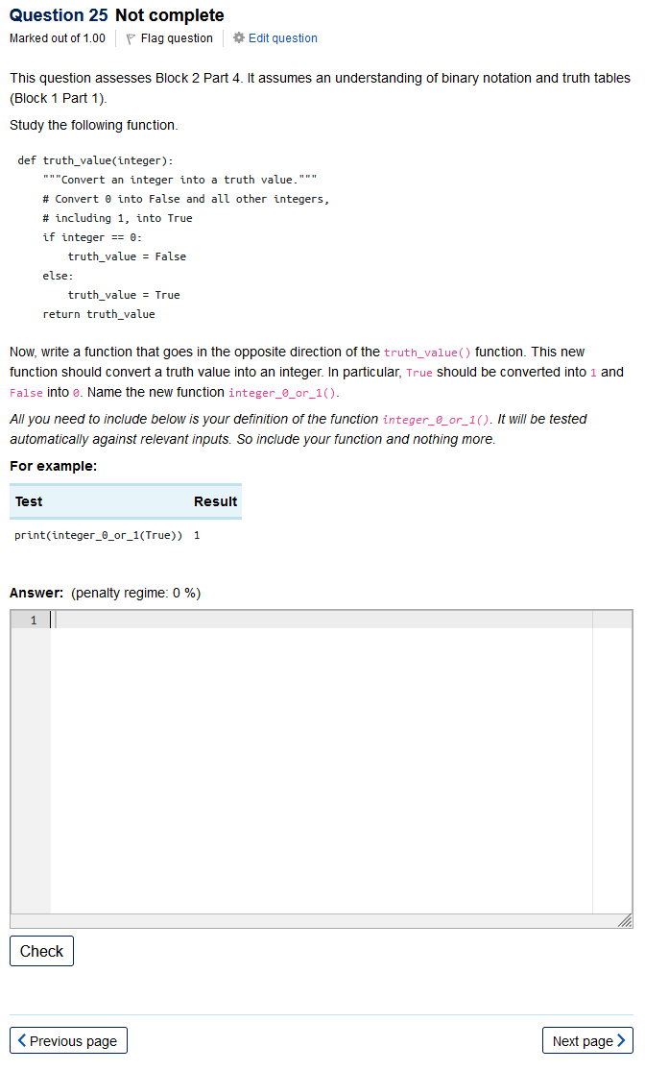
Confidence-building formative assessment
TM112 – Introduction to Computing and IT 2
Confidence-building: challenging, but with no marks for scores and opportunity for discussion on the module forums.

Slide 10
Confidence-building formative assessment
TM112 – Introduction to Computing and IT 2
Confidence-building: challenging, but with no marks for scores and opportunity for discussion on the module forums.
Formative: students can gain 5/100 marks on each of the TMA for evidence of engagement and reflection.

Slide 11
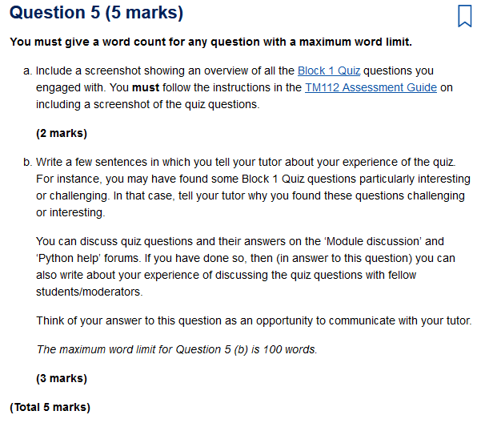
Confidence-building formative assessment
TM112 – Introduction to Computing and IT 2
Confidence-building: challenging, but with no marks for scores and opportunity for discussion on the module forums.
Formative: students can gain 5/100 marks on each of the TMA for evidence of engagement and reflection.

Slide 12
Confidence-building formative assessment
TM112 – Introduction to Computing and IT 2
Confidence-building: challenging, but with no marks for scores and opportunity for discussion on the module forums.
Formative: students can gain 5/100 marks on each of the TMA for evidence of engagement and reflection.
Follow-up: Based on the postings we identified wording issues with a small number of questions.

Slide 13
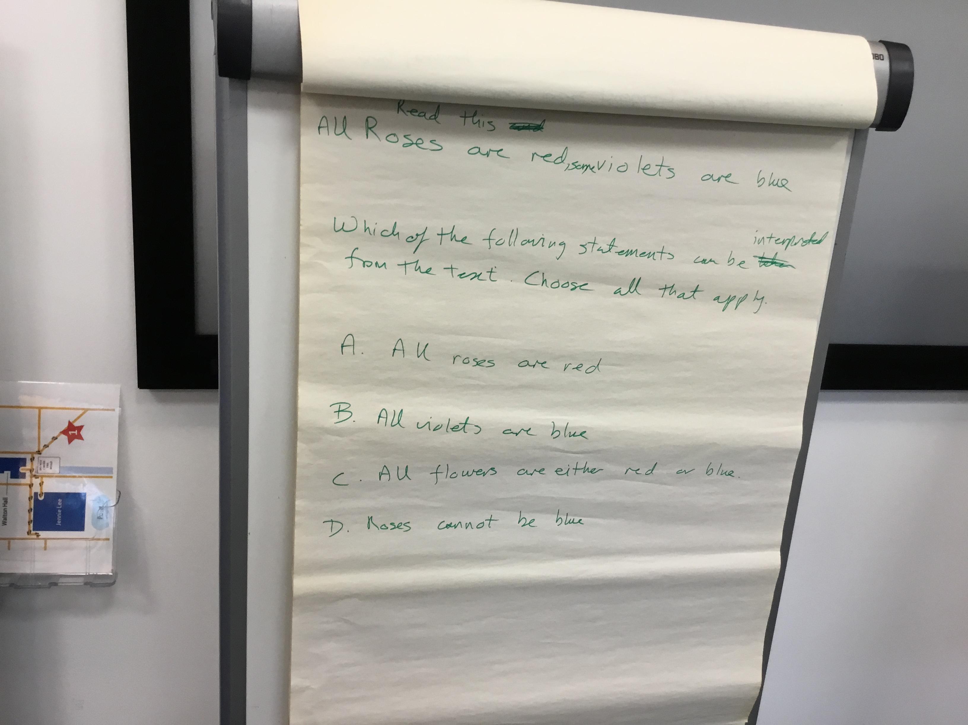
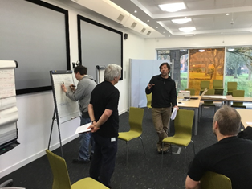
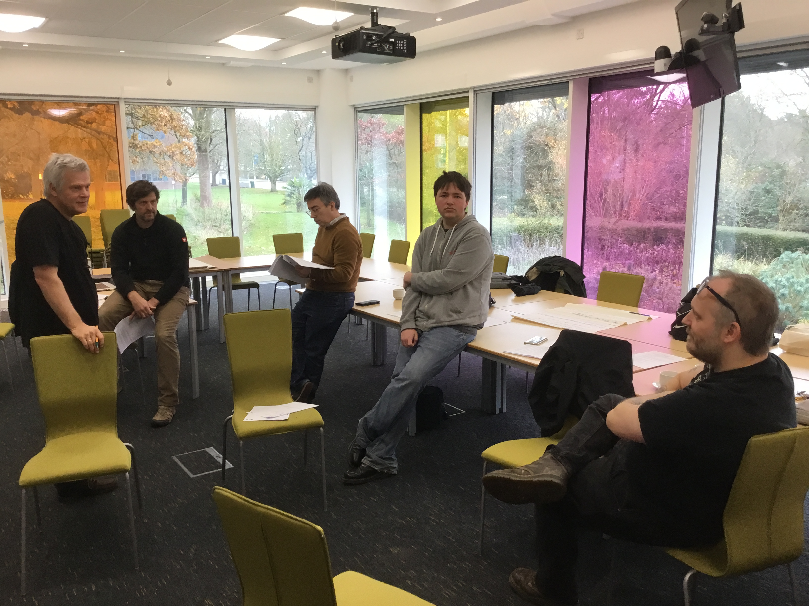

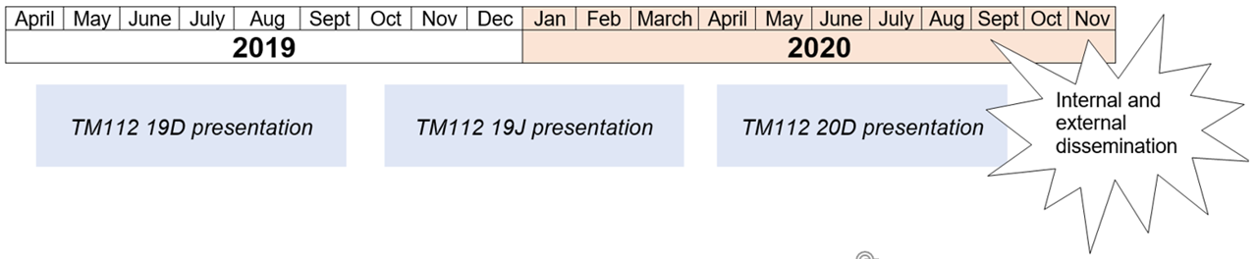
Students for co-design workshop identified and contacted
Redesign of 20D evaluated in comparison with 18D, 19D and 19J
Evaluation and debrief (in Teams) with student co-designers
Co-design workshop at the OU in Milton Keynes
Redesign of formative assessment implemented for TM112 20D, based on co-design workshop outputs

Slide 14
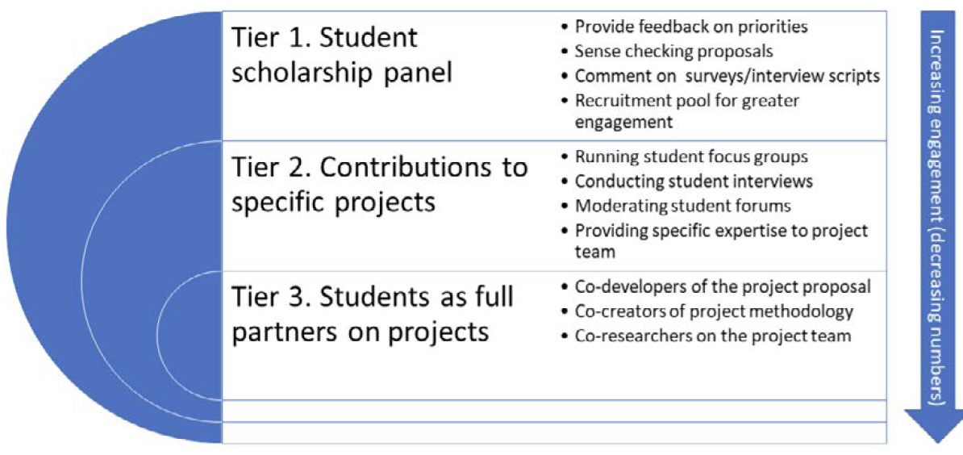
Students as partners
Butler and Brown’s activity model (2019)
Collins, T.D. (2022). Student Engagement Framework: Students as Partners in Scholarship. Scholarship Steering Group Report. The Open University, UK. October 2022.
Minocha, Shailey and Collins, Trevor (2023). Impact of Scholarship of Teaching and Learning: A compendium of case studies. The Open University, Milton Keynes, UK.

Slide 15
Students as partners
Butler and Brown’s activity model (2019)
Collins, T.D. (2022). Student Engagement Framework: Students as Partners in Scholarship. Scholarship Steering Group Report. The Open University, UK. October 2022.
Minocha, Shailey and Collins, Trevor (2023). Impact of Scholarship of Teaching and Learning: A compendium of case studies. The Open University, Milton Keynes, UK.

Slide 16
Students as partners
Butler and Brown’s activity model (2019)
Collins, T.D. (2022). Student Engagement Framework: Students as Partners in Scholarship. Scholarship Steering Group Report. The Open University, UK. October 2022.
Minocha, Shailey and Collins, Trevor (2023). Impact of Scholarship of Teaching and Learning: A compendium of case studies. The Open University, Milton Keynes, UK.
project proposal and scholarship

Slide 17
Students as partners
Butler and Brown’s activity model (2019)
Collins, T.D. (2022). Student Engagement Framework: Students as Partners in Scholarship. Scholarship Steering Group Report. The Open University, UK. October 2022.
Minocha, Shailey and Collins, Trevor (2023). Impact of Scholarship of Teaching and Learning: A compendium of case studies. The Open University, Milton Keynes, UK.
project proposal and scholarship
assessment authoring

Slide 18
Reflections
Students liked
The good stuff
😎Students with great ideas 😎Understand how students engage 😎Concrete examples inform design 😎Question improvement 💡More diversity in their group 💡Online alternative to workshop 💡Having a concrete goal rather than open activities | 😍Having their voice heard 😍The open format 😍Visiting Walton Hall 🤷Recruiting enough students 🤷‍Student selection process is lengthy 🤷Coordinating student logistics
Challenges
Students suggested

Slide 19
Debrief results
What were your expectations? | None/opportunity to help improve quiz questions.
Were those expectations met? | Yes. Happy with equality in discussions/partnership.
If you wanted to get students involved in codesigning formative assessment, what would you keep the same/do differently? | Try to involve a more representative sample, including those who struggled.
Was there anything you found challenging in taking part in this project? | Face to face in MK was great/good fun. “online would not have been the same”. Pre-workshop work was challenging, being uncertain about expectations.
Was there anything you found exciting/interesting/useful in taking part? | Interesting to see question design process and effort going into it.
Has the experience of taken part in the project impacted your studies in any way (positive or negative) | Learned about designing questions, but no academic value so far, but there may be for Year 3. Enjoyed helping OU and felt proud to be involved.
Now that you have been involved in designing some educational material, can you see other types of material that students could add value to? | There is value in more perspectives. “There will always be things which lecturers just don't see from their one perspective”

Slide 20

For more information, including the full final report see:
https://tinyurl.com/PPSSeSTEeM
Thank you for your attention!

Slide 21
Key findings
We got a better understanding of:
how the new co-designed questions seem to be an improvement on the original questions, especially in terms of elimination of negative forum feedback on the questions. However, there was no clear trend in terms of a quantitative measure such as Discrimination efficiency.

